Slide 1
Optimization Library: System VnV Plan
By: Fasil Cheema

Slide 2

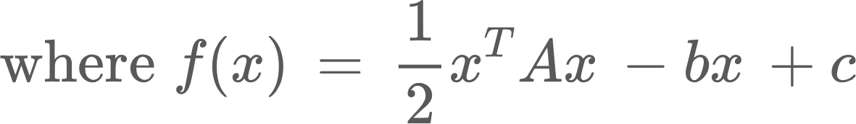
Optimization Library
2/12
Main problem of function optimization; specifically function minimization
We narrow down to the class of functions that can be expressed in the quadratic form
Notes:
Before we dive into the Verification and Validation plan let us recap the main topic of my project. In this project I will develop an optimization library; that is a family of function optimizers.
We will constrain this problem to function minimization instead of both maximization and minimization. We will also narrow it down to the class of functions that can be expressed in the quadratic form.

Slide 3
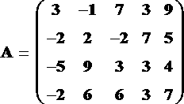
Optimization Library
3/12
Narrow down the dimensionality of the matrices/vectors to constrain them to 6 dimensions
Notes:
Further general constraints that narrow down the scope of our problem are constraints induced by computational limitations. For instance, matrix computations can be quite demanding and we definitely cannot minimize functions with numerical methods for matrices of infinite dimensions.
As discussed in the SRS presentation we will restrict to 6 dimensions, this constraint needs to be discussed for one of the nonfunctional test cases later.
Finally to summarize the current state of the project we will talk about the 2 families we will employ to solve the function minimization problem. These are the Quasi-Newton family (specifically David-Fletcher-Powell method and the Broyden–Fletcher–Goldfarb–Shanno algorithm ) and the Conjugate Gradient Descent (Specifically the Fletcher-Reeves method)

Slide 4
System Test Description
4/12
Functional System Test Cases
Input Test Cases
Run-Time Test Cases
Pseudo-Oracle (Scipy)
Notes:
We will discuss tests for the functional requirements. The functional system test cases will be divided into two types; input test cases and run-time test cases. INput cases will be the tests prior to the software running as we will see this will entail error handling etc, runtime testing is the tests when the software then runs the algorithms. As we will see later this entails mainly how long our program will run for etc.
Obviously there are numerous libraries that conduct convex optimization. IN scipy there is a function called minimize which allows you to call to BFGS, Fletcher Reeves, and DFP. This will the pseudo oracle to compare against in all these tests. In addition there are numerous other libraries we can compare to for instance in matlab there is a minimization

Slide 5
Implementation Verification Plan
5/12
Expert Reviews
Error Handling Testing
Rubber Duck Testing
Boundary Value Testing
Notes:
Rubber duck testing will be done in the verification plan. This process will ensure each component of the software is understood and explainable.
Expert Reviews will also be done to verify the software. The experts for this software would be anyone who has taken a convex optimization course and is familiar with the algorithms and methodology of convex optimization. This process can be done in unison with rubber duck testing as I should be able to explain these concepts to expert and peer reviewers.
Error handling testing will also be done. This is to ensure the softwares robustness to various inputs. We want to make sure no input can make the software run into significant issues (infinite loop etc).Error handling testing will outline the expected system behaviour when invalid data enters the system. This testing ensures that the system recognizes valid data from invalid data and provides appropriate feedback to the user. Successful error handling testing will also lead to better usability of the system as more feedback on how to correct the system is provided to users.
Boundary value testing will outline the expected behaviour of the system
at the boundaries of variable constraints. This testing ensures that all edge-
case behaviour has been considered and that system responses are designed
for those cases.

Slide 6
Nonfunctional testing
6/12
Installation testing
Performance testing
Notes:
For nonfunctional testing we will focus on testing the installation and performance testing these will be discussed further momentarily.

Slide 7
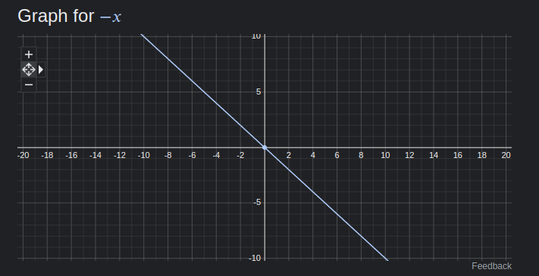
Error Handling Testing
7/12
Non-PSD matrices
Convergence guarantees
Step size/wolfe conditions
Notes:
For our problem we will focus on problems that will be specific to inducing errors in our software. The algorithms we are dealing with come with theoretical guarantees of convergence under certain assumptions. When these assumptions are violated the behaviour of the respective algorithms can be unpredictable.
For instance, non PSD matrices do not have convergence guarantees for the DFP, BFGS, and Fletcher Reeves algorithms to global minima. These methods may get stuck at a local minima and not return the optimal solution. Another issue is that certain functions may not converge, for instance in one dimension minimizing a line without setting a termination limit can allow the minimizer to run forever for the line y = -x.
Another issue for specific algorithms is when using inexact step sizes (some algorithms require an exact step size for convergence to the correct solution). Not using appropriate step sizes can lead to incorrect solutions.
To remedy Convergence guarantees we will enforce a termination limit on the number of steps. This number will be decided for our restricted class of functions, and to not allow excessive runon programs.
This also addresses other issues since it is not the developers responsibility for an incorrect solution if invalid inputs are provided.
Finally, an option will be made for full step sizes or exact step sizes of a minimizer. As we can see in this figure the choice of step size can greatly affect the performance and final result of an algorithm. Picking the right step size can allow for faster convergence, and obtaining the correct result whereas the full step size can make an algorithm go on forever and not even approach the right solution.
Obviously there are numerous libraries that conduct convex optimization. IN scipy there is a function called minimize which allows you to call to BFGS, Fletcher Reeves, and DFP. This will the pseudo oracle to compare against in all these tests. In addition there are numerous other libraries we can compare to for instance in matlab there is a minimization

Slide 8
Boundary Value Testing
8/12
Maximum number of steps
NonConvex functions
Highest value of ε
Notes:
Edge case behaviours will be 3 main cases. Maximum number of steps and testing if acceptable solutions can be found for this range.
We will also gauge the behaviour of nonconvex functions with our software. This will ensure results are as expected. Which may actually not be a global minimum. Our program should still run on these edge case problems despite not giving the ideal global minima.
Finally, we need to set a minimum value of epsilon so that the program does not run forever and we obtain an acceptable solution. The number of steps may be directly related to this step. This step also adds another safety to this problem so it is nice to have.

Slide 9
Software Validation Plan
9/12
For each algorithm test input cases and obtain results
Run the same input case in Scipy.minimize(method=...)
Compare results!

Slide 10




Installation testing
10/12
Notes:
We want to ensure our program works on a wide variety of machines and environments. For this reason we want to track the packages needed to execute the software. Successfully having a fresh virtual machine for each environment, installing the appropriate libraries from the ground up and running the library correctly. Conda can allow for a packaged environment to contain all necessary modules. For my project this will mainly be numpy and potentially scipy.
Due to the low number of dependent libraries can also package this up into a script and there definitely will be a text file highlighting the version of python and libraries.

Slide 11
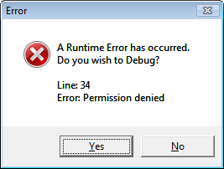
Runtime Testing
11/12
Notes:
Finally i want to check runtime tests. This is critical for my problem as discussed because despite the smaller class of functions we restricted our library to, optimizers can still run for a long time for even simple functions. So setting boundaries on how long the program can run for and testing for this is critical. This can be verified in a very simple manner, for instance minimizing a line and obtaining a report on how long this program runs for with relevant diagnostics.

Slide 12
Thank You!
12/12

