Slide 1

Analyzing Food Product Data
Presented by: Octave Antoni
Last Updated: September 19th, 2022

Slide 2
Table of contents
Introduction
Dataset
Key figures
Correlation analysis
Conclusion

Slide 3
Introduction
Project based on an the open food database (downloadable at https://world.openfoodfacts.org/)
Analyze the data ➔ Univariate and bivariate analysis
Main objective ➔ Present the analysis to a wide audience.
Analysis of product data, highlighting key figures
Multivariate analyses ➔ Measuring correlation
Proving hypotheses ➔ descriptive and exploratory analysis

Slide 4
Dataset

Slide 5
Dataset
Dataset = 1 csv table, initially 161 columns
Filtered down to 20 columns, including 5 categorical and 15numeric variables
Removed columns with more than 90% NA values
Removed tagged columns with duplicate information
Removed categorical variables with >100 unique values
Removed site specific and user specific variables
Removed the quantity column since all nutrients are for 100g
Calculated 2 columns : Nutrition score grades for UK and France

Slide 6
Data cleaning
Removed rows with incoherent values (ex. 150g / 100g)
Removed rows based on maximal possible energy value for 100g (3762kJ)
Removed row with no energy information, and no information on all of the 3 principal nutrients (fat, proteins and carbohydrates)
Deleted duplicate rows and product names
Analysis of categorical variables and replacement of mistypes based on calculation of Levenshtein distance
Data imputation (median) for NaN numeric values

Slide 7
Key figures

Slide 8
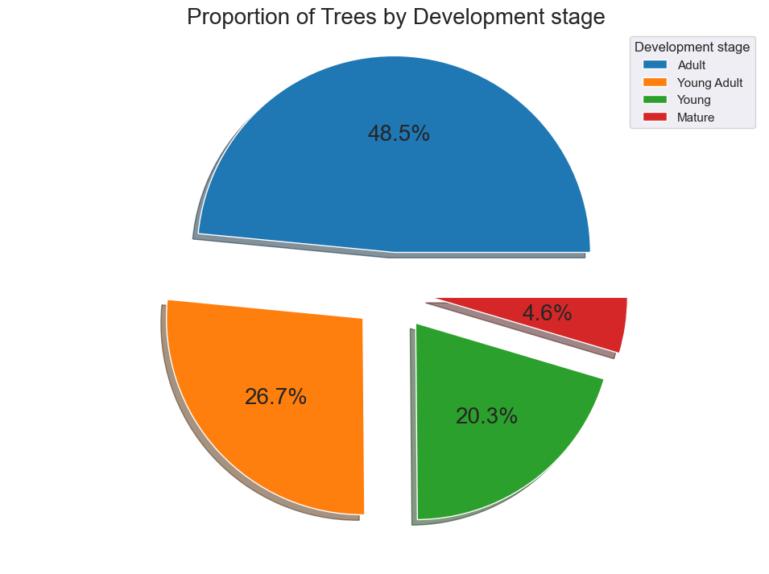
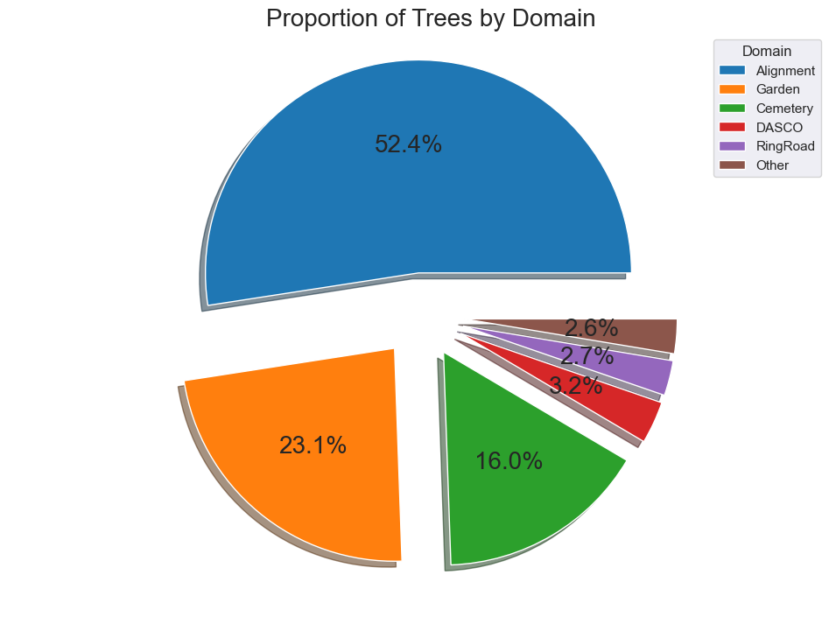
Repartition of trees
48.5% of trees are classified as Adult, with less than 5% Mature trees
The domain of most referenced trees is Alignment (52,4%)
Garden and Cemetary represent respectively 23% and 16% of the dataset
Only 0.1% of referenced trees have been categorized as Outstanding

Slide 9
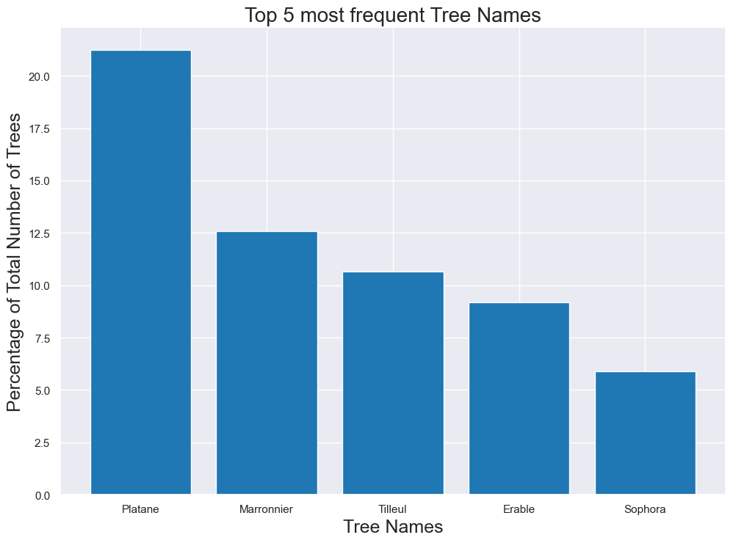
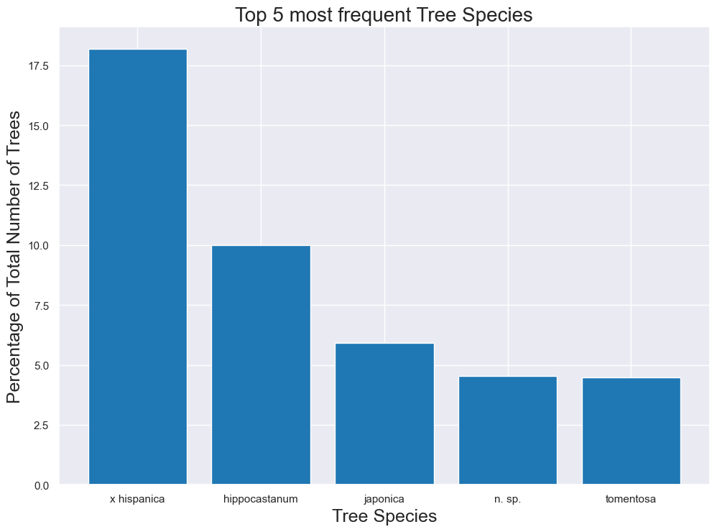
Most frequent tree names, species and variety
More than 20% of the studied trees are Plane trees
2 other types of trees are over 10% : Chestnut (Maronnier – 12.5%) and Lime tree (Tilleul -10.5%)
The 2 most prevalent species are X Hispanica at 18% and hippocastanum at 9.9%.
The varieties are much more spread with the top variety Baumannii at only 2.3%

Slide 10
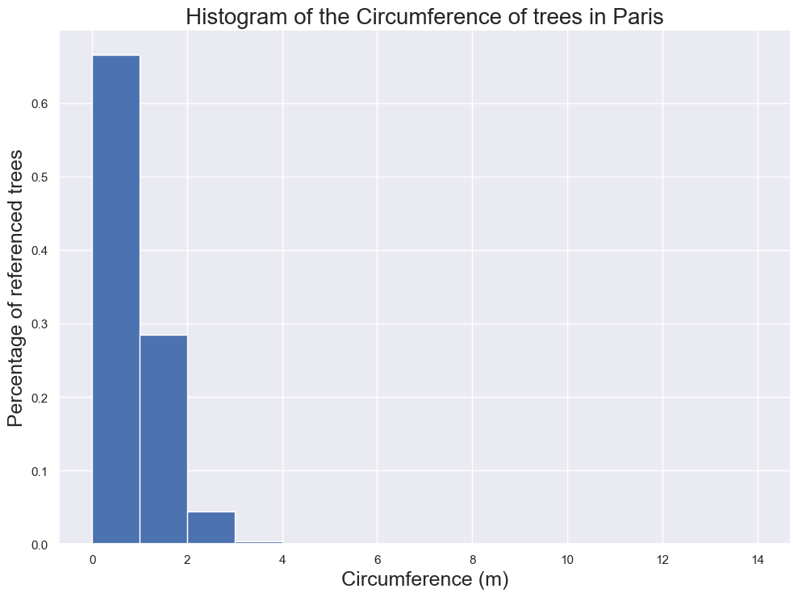
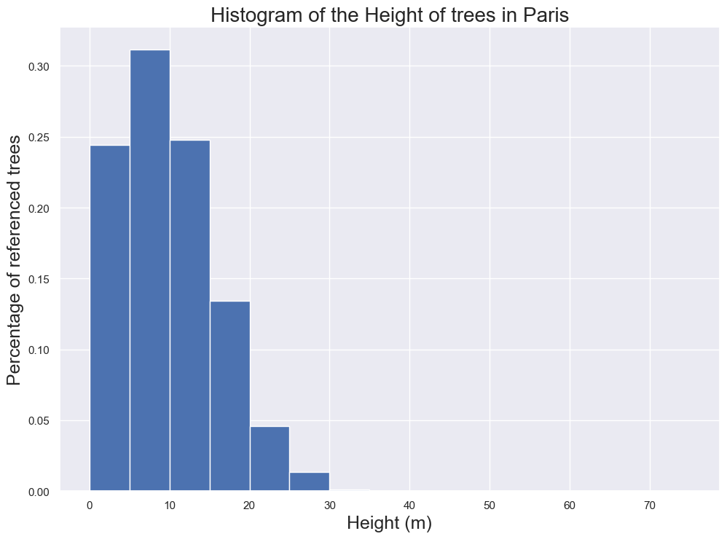
Distribution of Height and Circumference (1/2)
More than 65% of the trees have a circumference below 1m (100cm)
Several outliers in tree circumference: 0.10% of trees with a circumference over 4m (max = 13.6m)
Several outliers in tree height : only 0.11% of trees with a height over 30m (max = 66m)

Slide 11
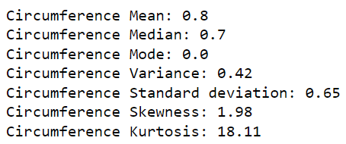
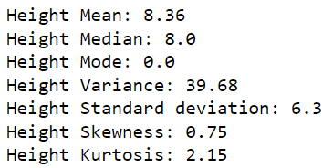
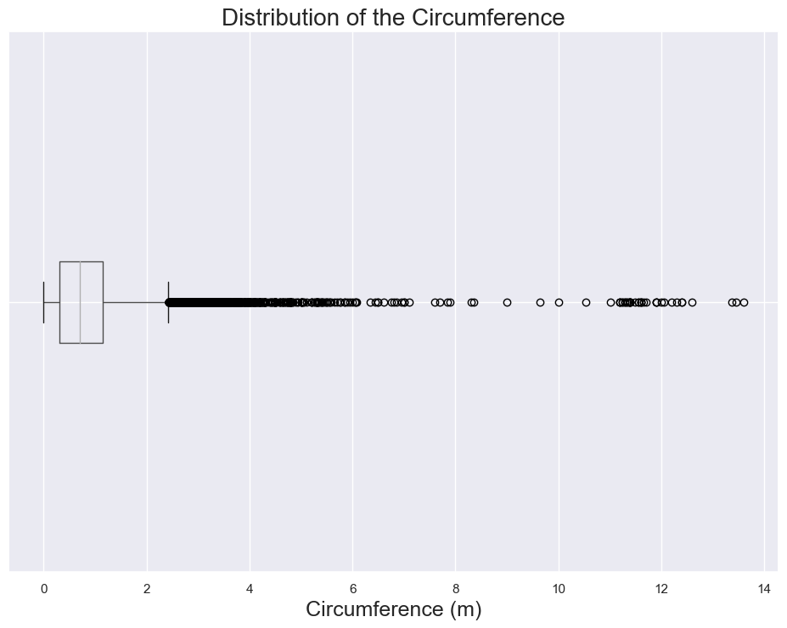
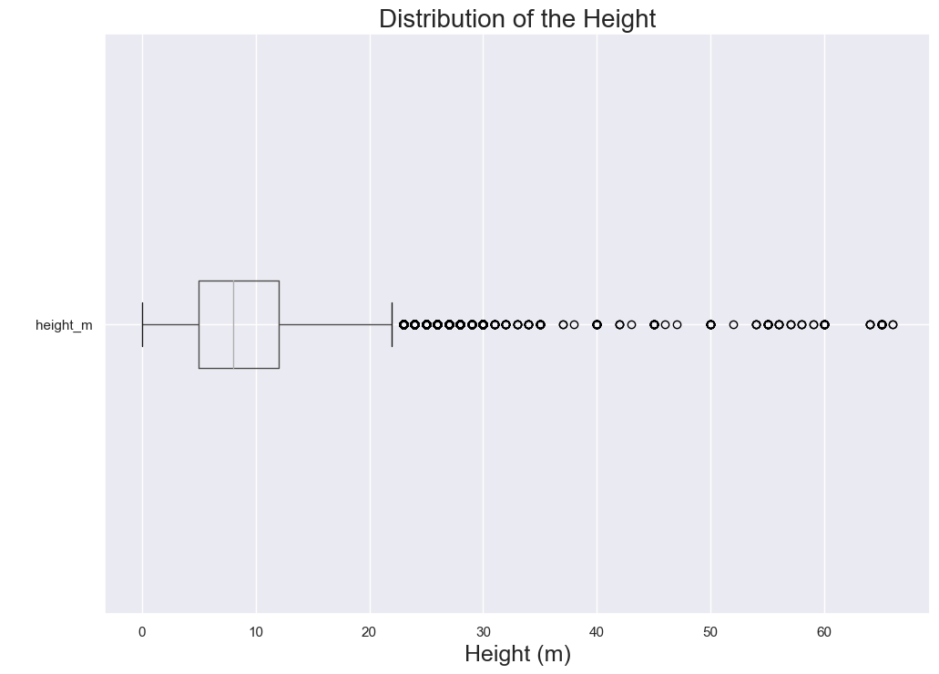
Distribution of Height and Circumference (2/2)
There’s ~ a tenfold difference in height and circumference mean/median values
Height has a very high variance (28.23)
The standard deviation remains relatively low for both variables (0.61 / 5.31)
Both variables are skewed right, with circumference having the higher skewness
Circumference has a very high kurtosis at 25, while height has only a kurtosis of 5.
Med = 0.7
Med = 8

Slide 12
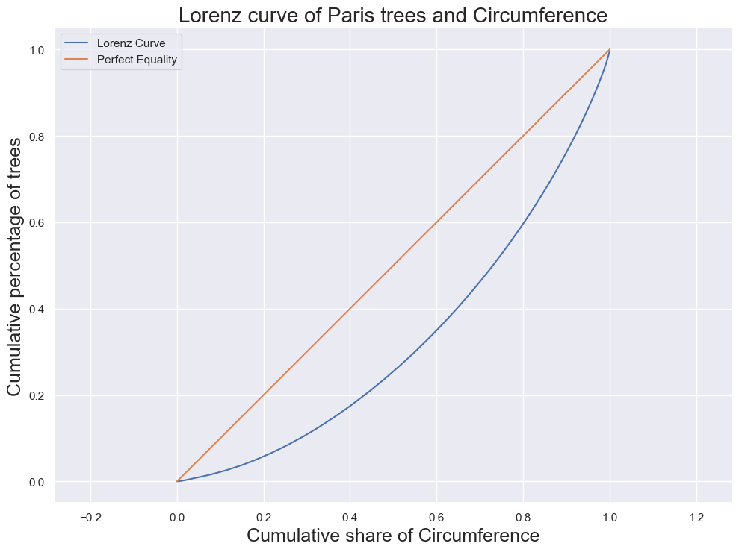
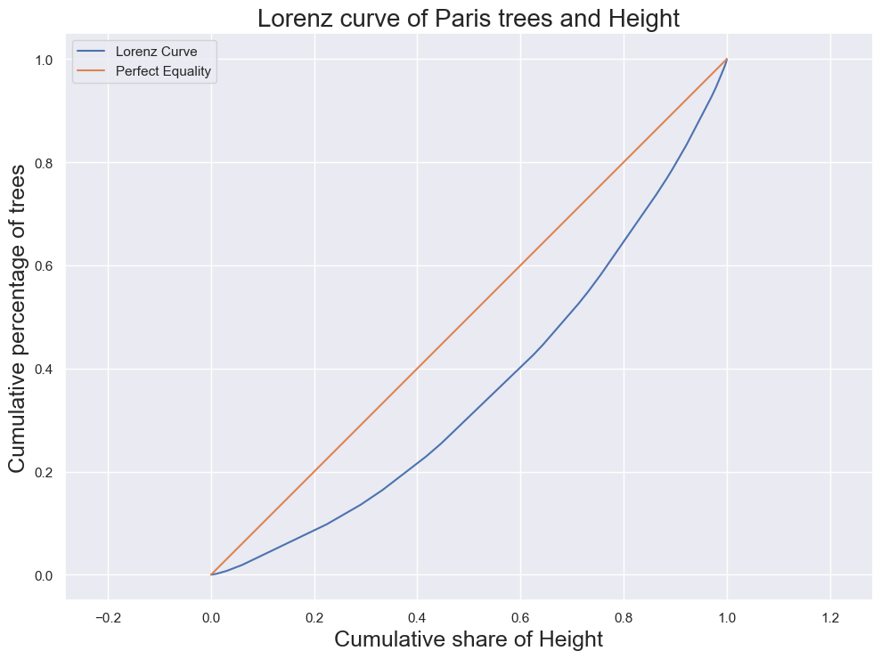
Concentration of height and circumference
The concentration of circumference is more inequal than that of height
Gini index : 0.35 for circumference / 0.28 for height
The Gini indexes are below 0.4 ➔ distribution is adequately distributed
Gini index = 0.35
Gini index = 0.28

Slide 13
Correlation Analysis

Slide 14
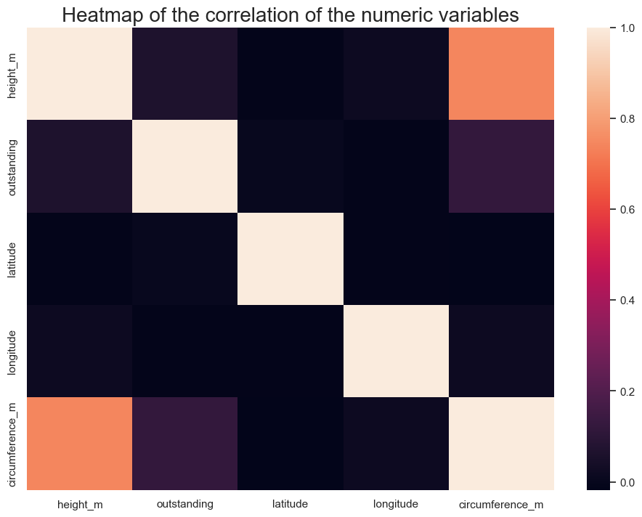
Correlation of numeric variables
Strong correlation between height and circumference (R = 0.73)
No significant correlation between the other numeric variables

Slide 15
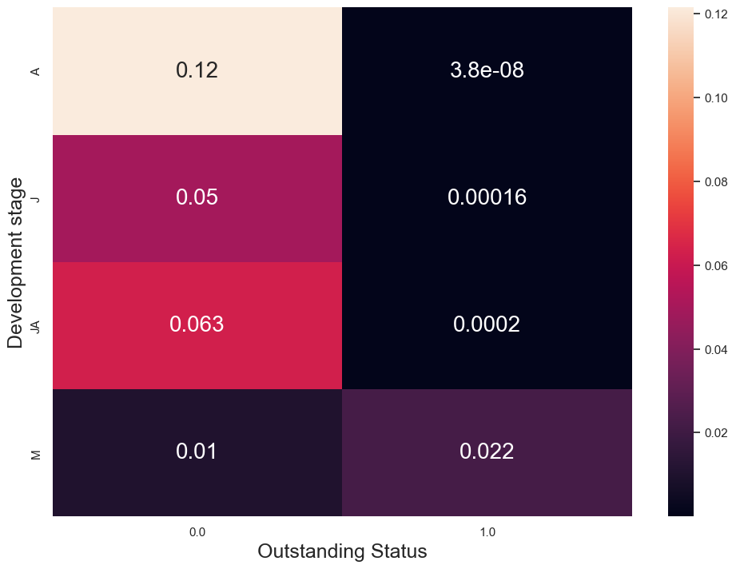
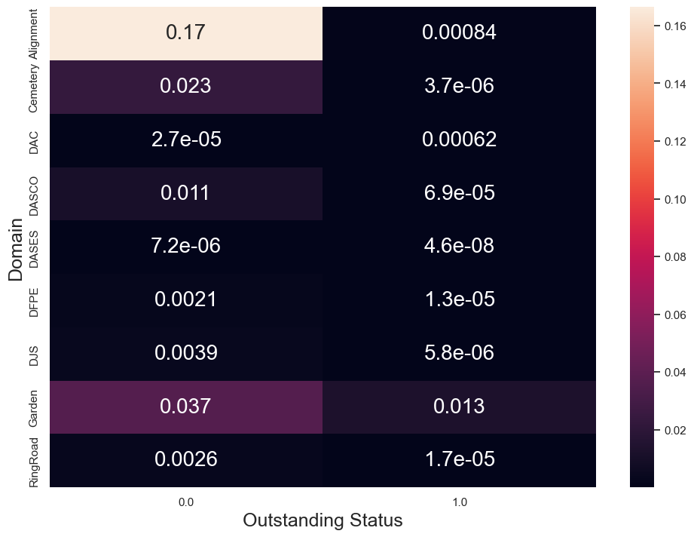
Association of categorical variables
Strong association between Outstanding status and Development stage (Cramer’s V = 0.57)
Moderate association between Outstanding status and Domain (Cramer’s V = 0.45)
Moderate association between Domain and Development Stage (Cramer’s V = 0.35)

Slide 16
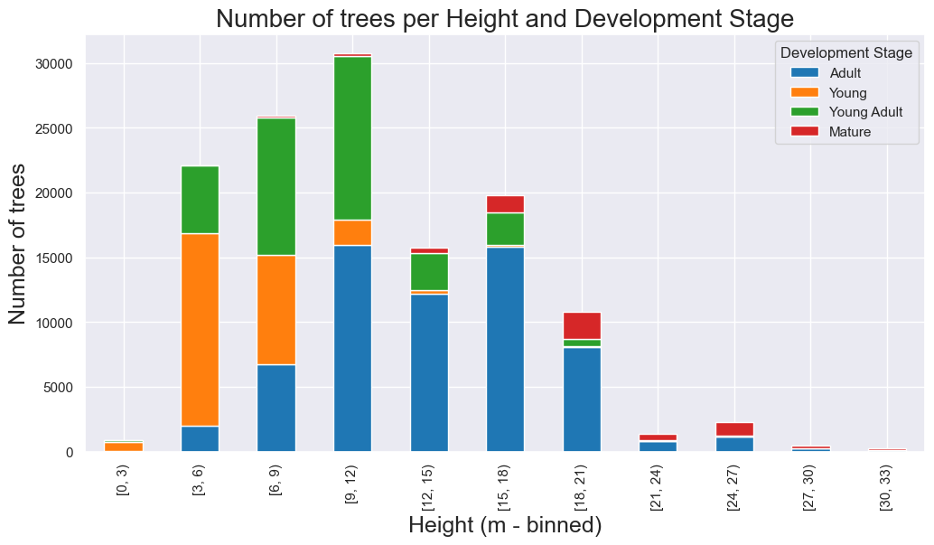
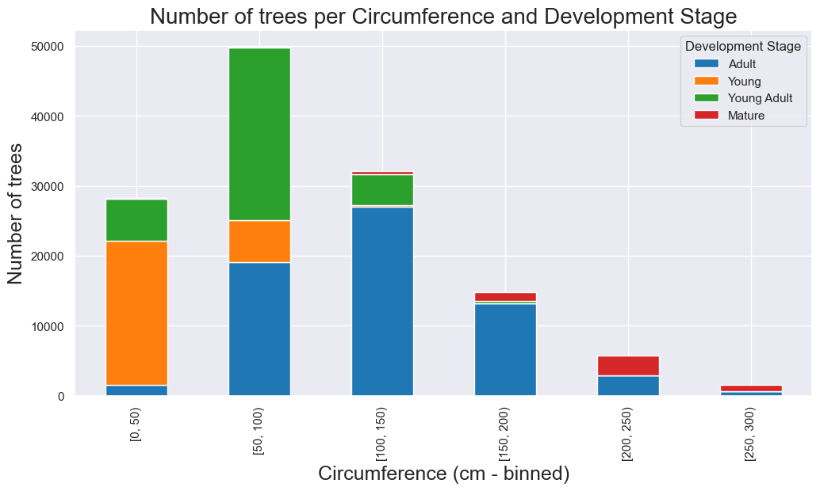
Item category and age
Strong correlation correlation between Circumference and Development stage (eta² = 0.51)
Moderate correlation correlation between Height and Development stage (eta² = 0.38)
Other variables are not correlated (eta² < 0.03)
Analysis of the distribution of height and circumference shows young / young adult trees smaller and less wide than Adult and Mature trees.

Slide 17
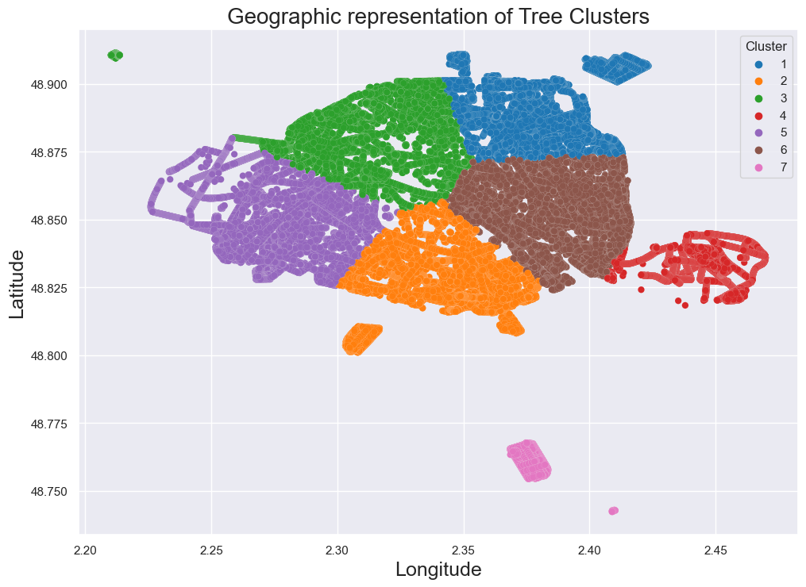
Creating coordinate clusters
Applied Kmeans clustering algorithm to divide the trees in coordinate clusters
Applied elbow method and calculated Calinski Harabasz scores to compute n_clusters = 7
Visualization shows that clusters are nicely separated
➔ Could be used to divide maintenance crew areas of responsibility

Slide 18
Conclusion

Slide 19
Conclusion
More than 40% of trees in Paris are either plane trees, chestnut trees or lime trees.
Half of the trees are categorized as adult
More than 50% of the trees are in an Alignment
55% of the trees have a height below 10m and 65% of the trees have a circumference below 1m
Height and Circumference are strongly correlated to each other and to Development Stage
7 clusters have been created to optimize the division of maintenance crew areas of responsibility

Slide 20
Questions?

