Slide 1

Scoring Potential Borrowers
Presented by: Octave Antoni
Last Updated: September 28th, 2022

Slide 2
Table of contents
Introduction
Building a Robust Dataset
Model Selection and Optimization
Model Interpretability
Conclusion

Slide 3
Introduction
Main goal ➔ Develop a scoring model used to screen borrower applications.
Users of the model : customer relations manager (non-technical).
Key points :
Interpretability of the algorithm
Identification of the most relevant features
Analysis of borrower loan histories, finances and behaviors
Identifying the best model to answer the business need

Slide 4
Building a Robust Dataset

Slide 5
Dataset
Main Dataset :
1 csv file with 122 columns and ~307k samples
Contains information about loan applications
Labeled samples : TARGET feature provided
Key : ID of current application (SK_ID_CURR)
Additional Data :
5 additional csv files
Information about previous applications including previous installments, credit bureau data, cash and credit card balance
Foreign key : ID of current application
Extracting statistical indicators about each feature (mean, standard deviation, min and max)
Merging this data with main dataset ➔ 508 columns

Slide 6
Data Cleaning
Removing XNA Gender (only 4 samples)
Replaced null values of categorical features by ‘UKN’ ( > 10k samples)
Mode imputation for remaining missing categorical features
Replacing values == 0 in categorical fields by null
Removing outlier DAYS EMPLOYED Data (> 100 years) and total income (>100million)
Absolute value of DAYS columns
Median imputation of remaining missing values
Removed columns with more than 80% null values

Slide 7
Feature Engineering
Created age label (1 if age < 30, 2 if 30<=age<40, 3 if 40<=age<50, 4 if 50<=age<60, 5 if age>=60)
Created income bins in quantiles
Calculated new features to increase predictive power (ex. Annuity income (pct) = Annuity / Income total)
Performed cleaning and feature creation for the 5 additional data files
Merged additional data files with main dataset
Transformed weekday into numbers for easier processing

Slide 8
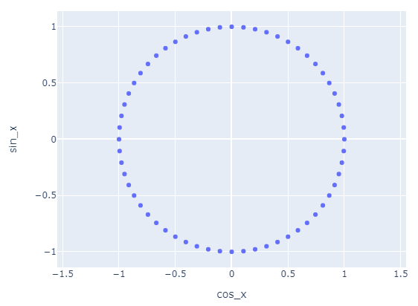
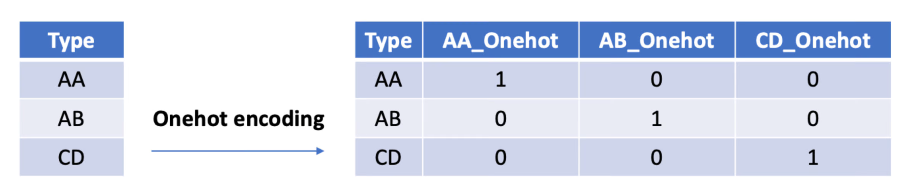
Feature Encoding
Why did we encode our features? Most models only take into account numeric data
Encoded day and hour of application process into
sin and cos to preserve cyclical nature
3 methods for encoding categories:
Label Encoding (0-1-2-3…)
One Hot Encoding
Weight of Evidence encoding:
Method developed for credit scoring algorithm
Measures the degree of the separation between good and bad borrowers for each encoded variable

Slide 9
Feature Selection
Main goal : Reducing the number of features to prevent overfitting and diminish calculation time
4 methods have been tested :
Variance-based Selection: Remove features with low variance (low predictive power)
Correlation-based Selection: Remove intercorrelated features
Kbest Selection: Keep only the K best features
Boruta algorithm: Algorithm based on a random forest that separates important and non important features

Slide 10
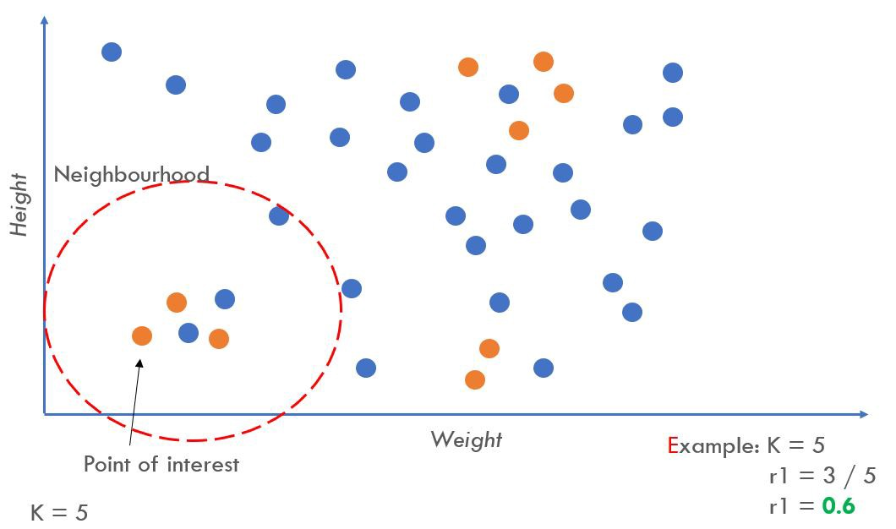
Resampling
Goal : Prevent bias by balancing the number of each category of borrowers
Main Dataset widely imbalanced : 92% / 8% split of good/bad borrowers
We use the Adaptive Synthetic algorithm that focuses on generating more data for harder to learn example, thus leading to a better model than just random oversampling.

Slide 11
Model Selection and Optimization

Slide 12
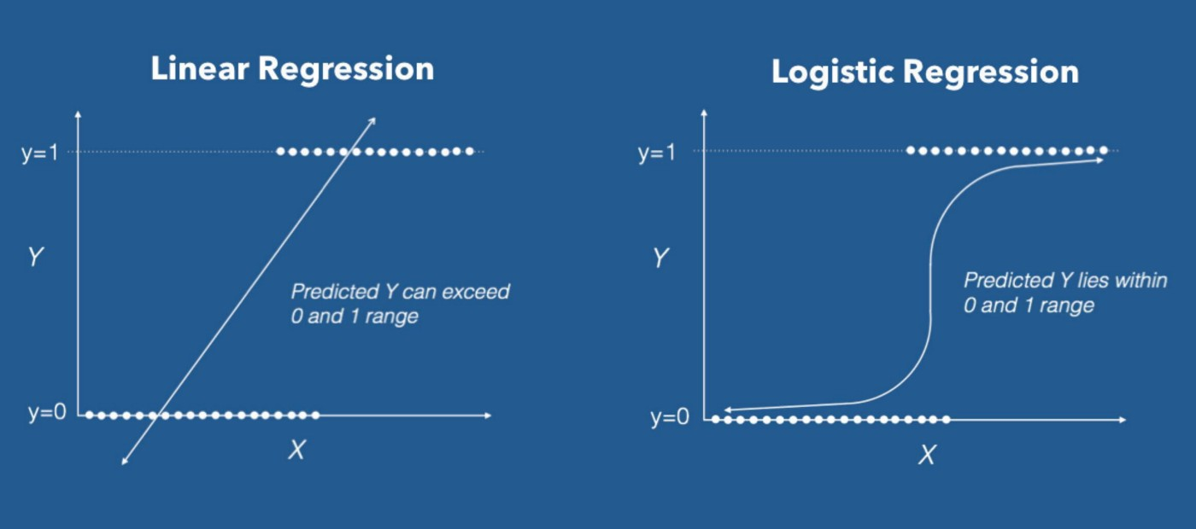
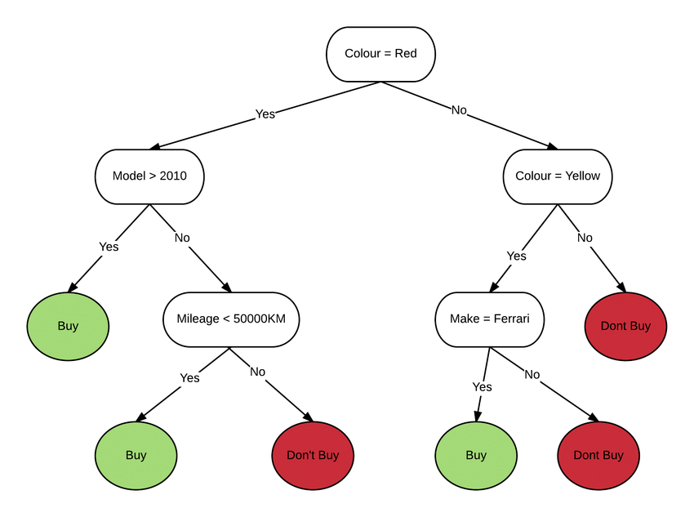
Candidate Models
Requirement : interpretable model ➔ 3 main options :
Logistic Regression
Ridge Regression Classifier
Decision Tree Classifier
Performance indicator : ROC AUC Score, balanced performance indicator

Slide 13
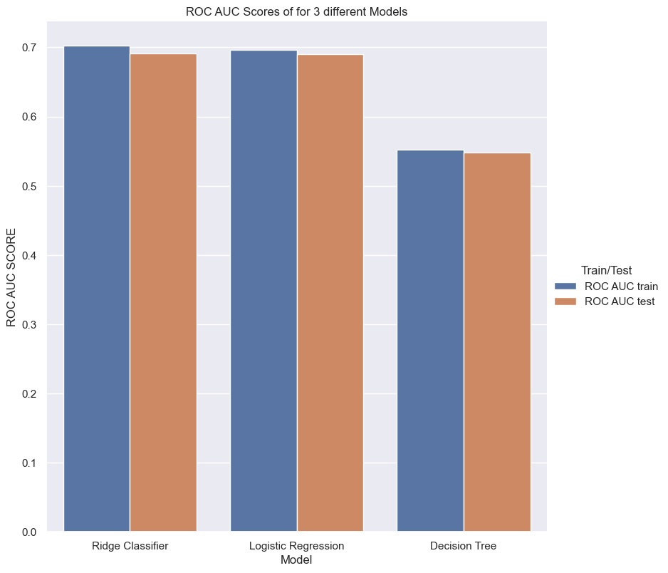
Model Selection
Optimization of the parameters of the 3 models using an optimized search algorithm (Bayesian Search)
Compute ROC AUC (test) score on the 3 models
➔ Ridge Classifier has the best performance and will be chosen for our model

Slide 14
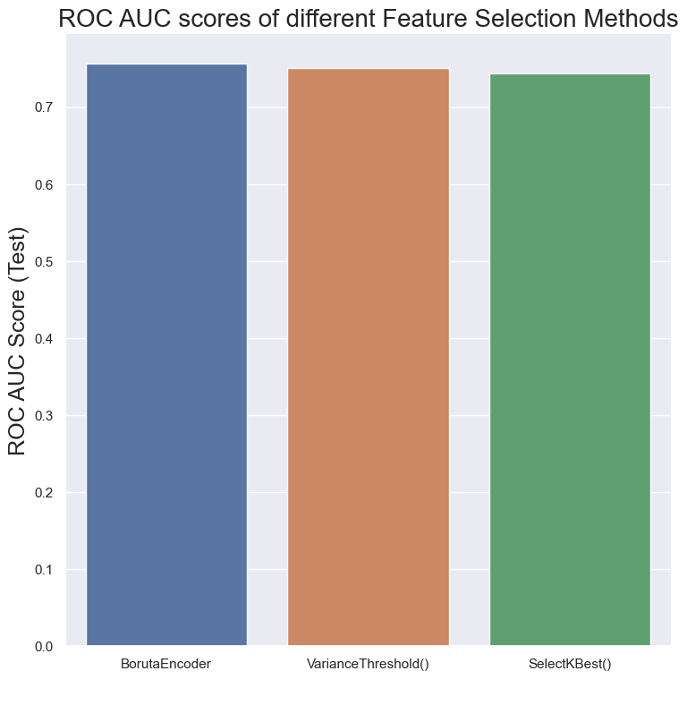
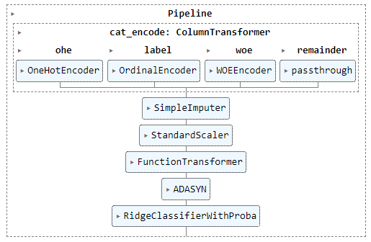
Optimization of the preprocessing pipeline
To improve our model further :
Selection of the most efficient scaler (Standard Scaler)
Identification of the best feature selection method (Boruta Algorithm)
Selection of the best categorical variable encoding methods (Mixed Encoding)
Applied the most performant oversampling algorithm and ratio (ADASYN ratio =1)
= Median Imputer
= Boruta Selector

Slide 15
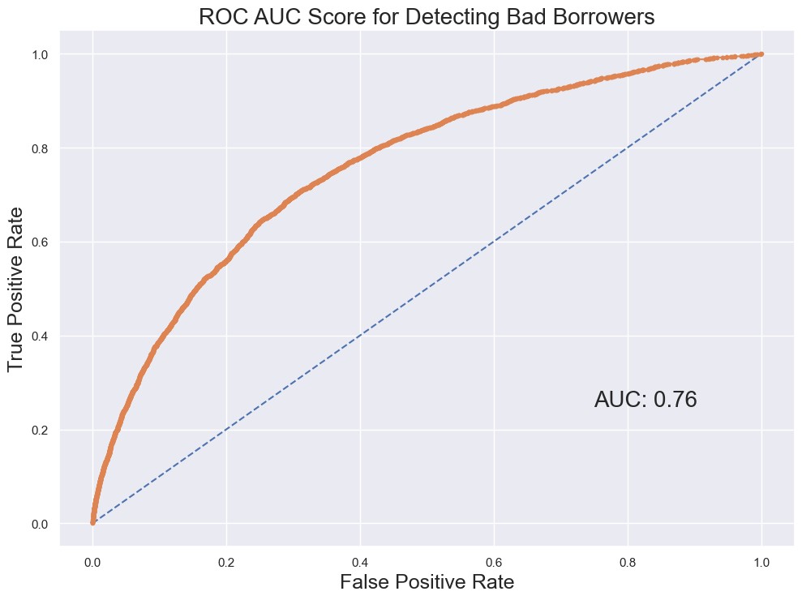
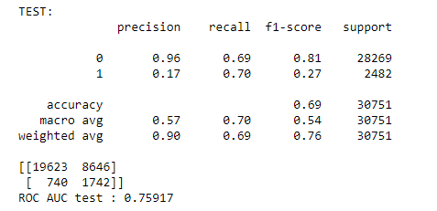
Selected Model
Our selected model and pipeline uses the Ridge Classifier linear algorithm.
Final ROC AUC Score : 0,76
Detects 70% of bad borrowers at the cost of a misdetection of 30% of good borrowers
Features with the highest coefficients : extracted from the Credit Card dataset

Slide 16
Model Interpretability

Slide 17
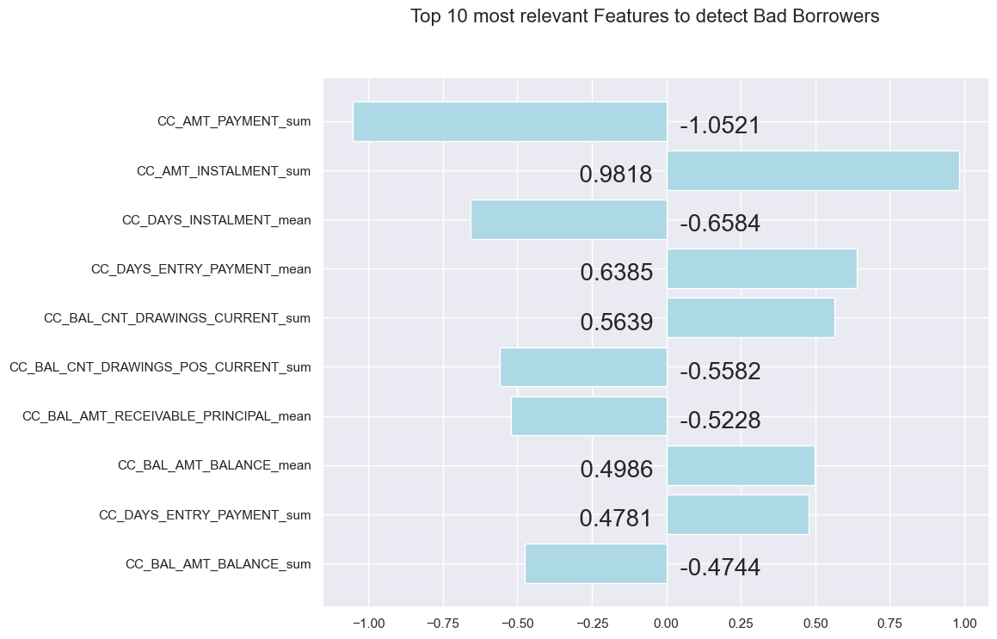
Model Interpretability
Goals:
Build trust in the model
Interpret the probabilities
Importance of different features
Avoid bias
Model based on Linear Regression ➔ Easy to explain
Coefficients are provided ➔ Easy to figure out which features are important

Slide 18
Conclusion

Slide 19
Conclusion
The dataset provided had a lot of missing values and a significant amount of features.
We have built a model using Ridge Regression with this dataset.
It is an interpretable model that can be used by non-technical employees.
The model is able to detect 70% of potential bad borrowers at the cost of 30% of misdetection of good customers.
The coefficients of each feature can be easily interpreted, the most useful dataset is the credit card balance data.
This model could be improved by changing the model with a less interpretable algorithm.

Slide 20
Questions?

