Slide 1
Cyclistic Data Analysis Report
Comparing user groups to prepare a marketing strategy
Presented by: Octave Antoni
Last Updated: May 27th, 2022

Slide 2
Table of contents
Main objective
The data
Main findings
Conclusion
Appendix

Slide 3
Main Objective

Slide 4
Objective
Identify key differences between casual riders and annual members and provide insights on how these differences could be used to increase the conversion rate of casual riders.

Slide 5
Introducing the dataset

Slide 6

Dataset - Presentation
Publicly available on the Divvy AWS page
Only the last 12 months are studied (May 21 – April 22)
More than 5 million rows of data

Slide 7
Dataset - Limitations
20% of the records have missing station information
No personal information included
Limited coordinate precision

Slide 8
Findings

Slide 9
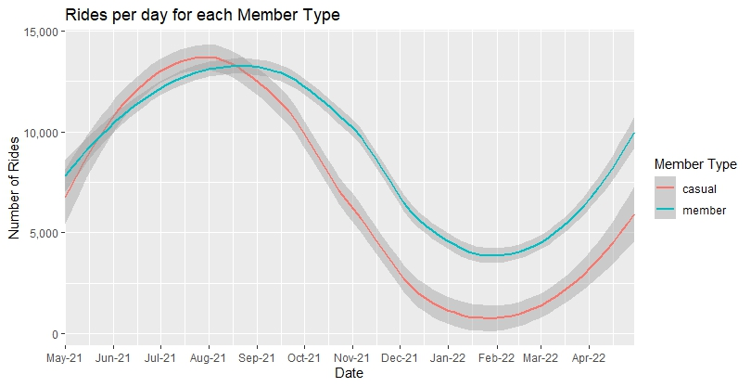
Volume
Peak in summer (June-September)
Higher peak for casual members
Very low casual member traffic in the winter months
Challenge ➔ Convincing casual members to ride during winter months

Slide 10
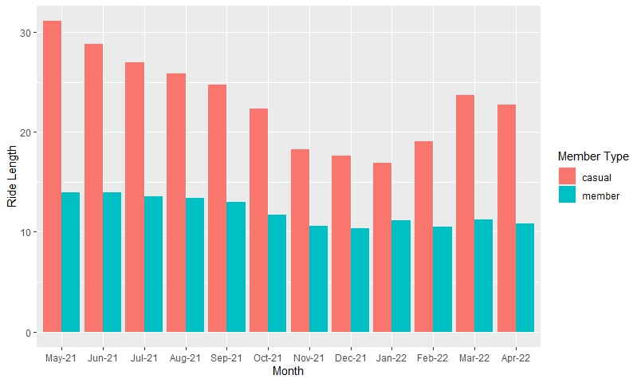
Ride length
Average ride length X2 for casual members compared to annual members
Casual members ride longer during the spring-summer months compared to winter
Length of annual member rides stable

Slide 11
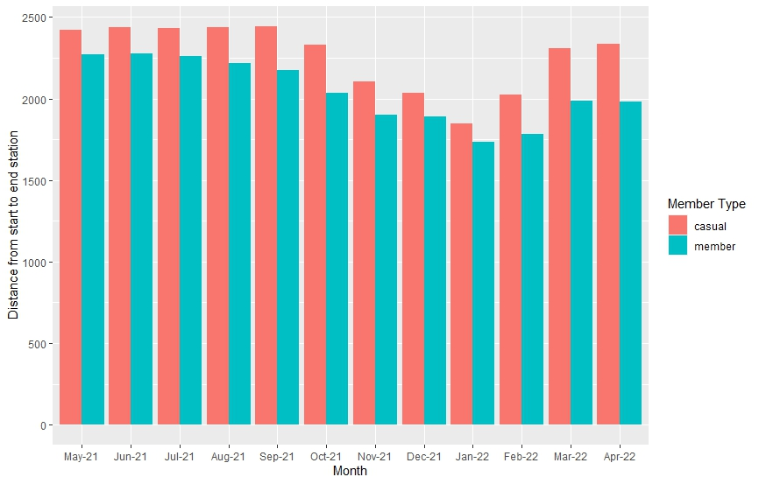
Start-end Distance
No significant differences between the 2 user groups
Distance represents only the interval between start and end stations, not actual ride distance
Distance slightly lower during the winter months

Slide 12
Bike type
Casual users predominantly (51%) use Electric Bikes
Annual members use more Regular Bikes (61%)
Electric Bike Regular Bike

Slide 13
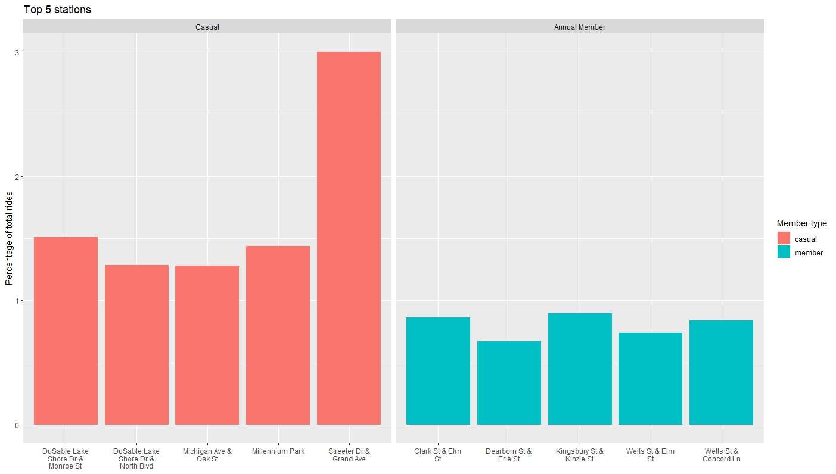
Top 5 stations
Casual users traffic concentrated within fewer stations
Annual members traffic more diluted
No station in the top 5 of both member types ➔ significant differences in station usage

Slide 14
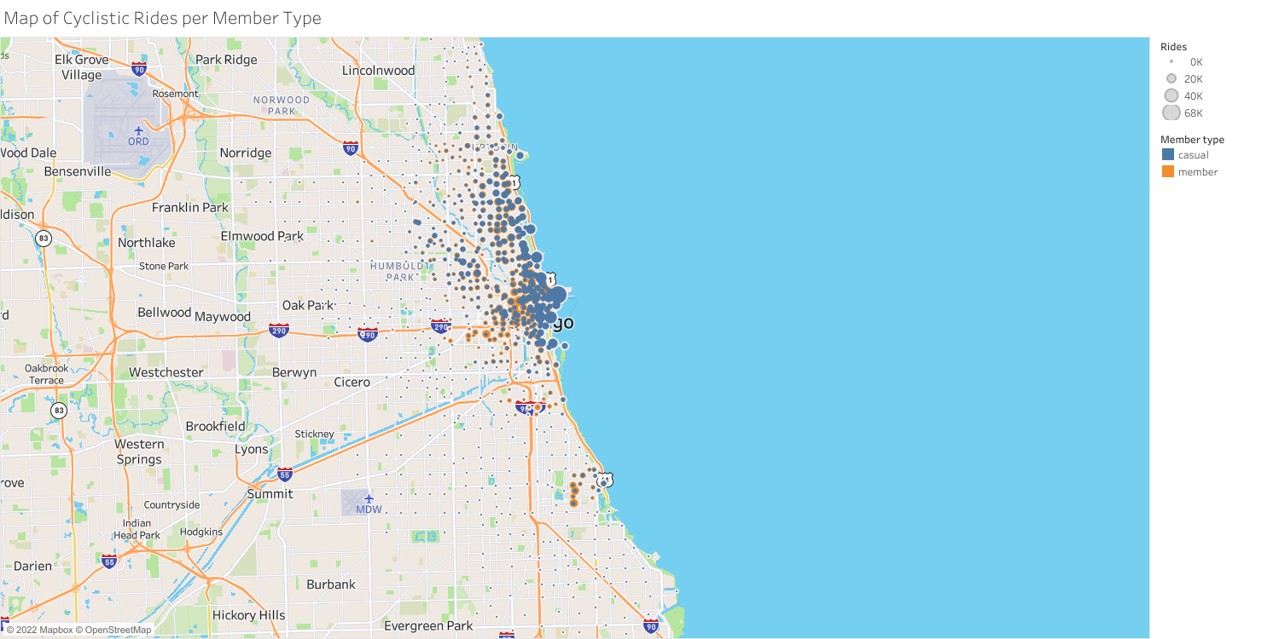
Station map
Downtown Chicago
Hyde Park

Slide 15
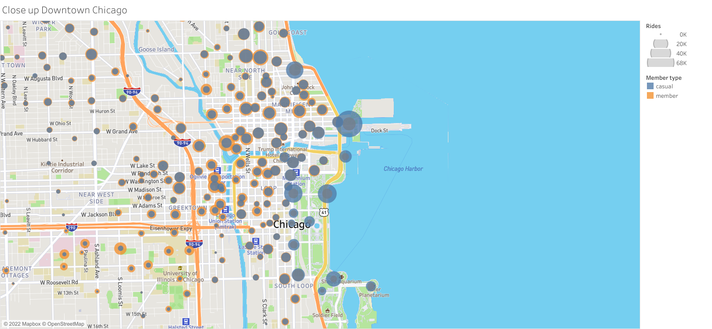
Downtown Chicago Closeup

Slide 16
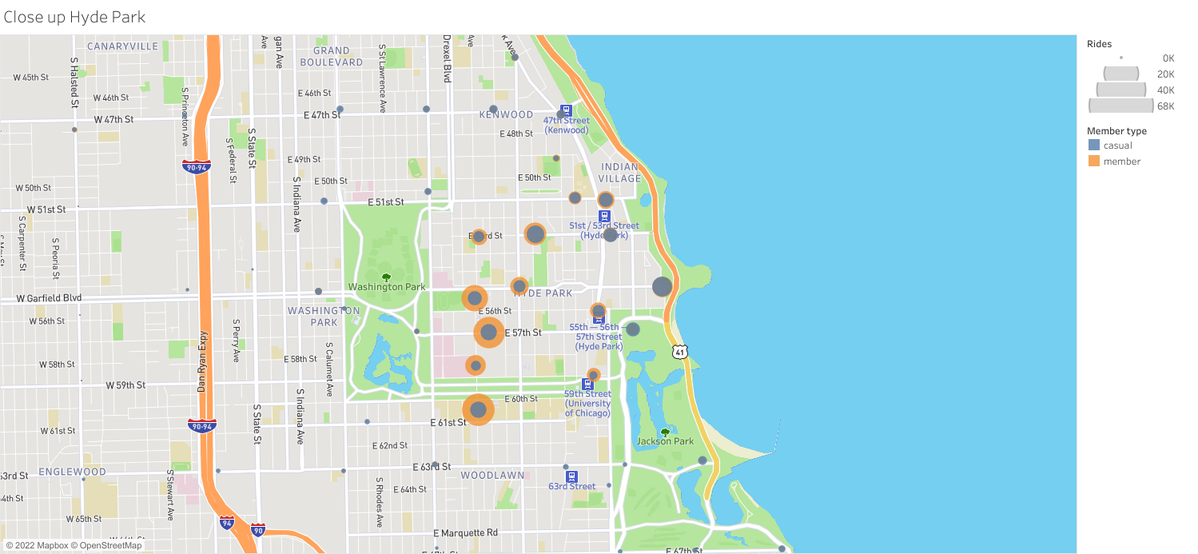
Hyde Park Closeup

Slide 17
Monthly Evolution

Slide 18
Station usage
2 hotspots : Downtown Chicago and Hyde Park
Casual users traffic concentrated IVO the lake side
Annual members traffic more present in the East of Chicago
Traffic very low during the winter months and high peak in the summer

Slide 19
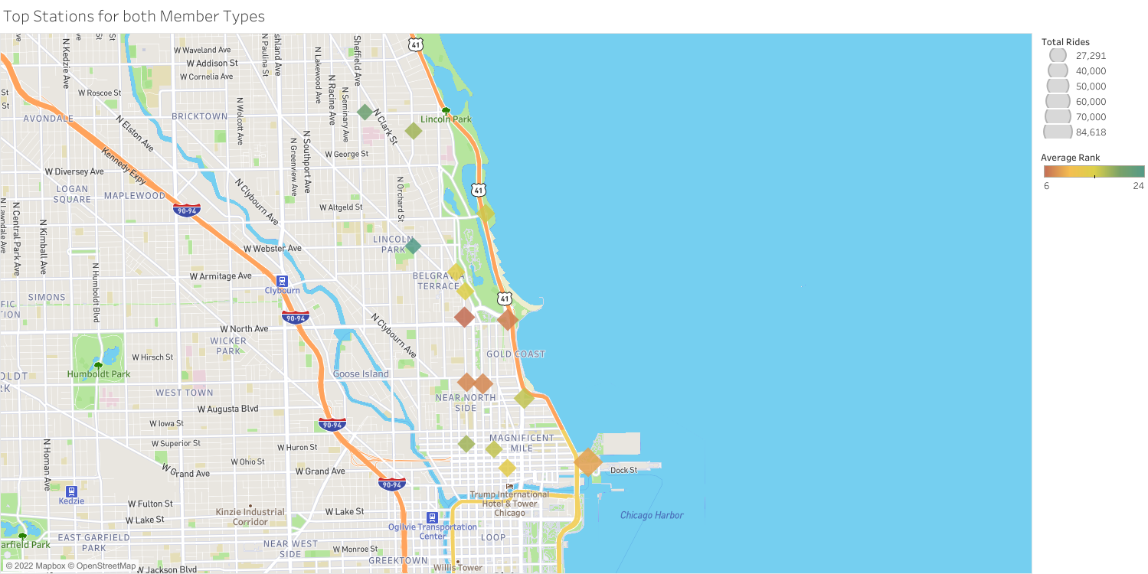
Top stations for both user groups

Slide 20
Conclusion

Slide 21
Conclusions
1
2
3
Casual user traffic is concentrated in the spring and summer months and in the lakeside areas.
Casual users are also more likely to use electric bikes.
Their rides are on average twice longer than the annual members.
Casual users traffic is concentrated within fewer stations.

Slide 22
Recommendations
1
2
3
Target top stations for both user groups in order to select casual members likely to be Chicagoans.
Avoid focusing too much marketing efforts on the summer months due to the presence of tourists.
Spring seem to be the best conversion period due to the high ride number to tourist ratio.
Outline the advantages of electric bikes and the possibility of doing long rides in the marketing strategy.

Slide 23
appendix
Here I would have included more detailed data such as the list of the top stations for both user groups

