Slide 1

Creating a Mobile Application for Recommending Content
Presented by: Octave Antoni
Last Updated: November 11th, 2022

Slide 2
Table of contents
Introduction
The Dataset
Developping a Recommendation Model
Deployment Architecture
Conclusion

Slide 3
Introduction
Main goal ➔ Create a draft mobile application to recommend articles from the My Content website.
Use of the Globo.com dataset (opensource)
Test different recommendation techniques
Key points :
Development of Content-Based and Collaborative Filtering based models
Final model is hybrid
Could not develop a deep learning model
Deployment of an API on Azure function, connected to mobile App
Limitation : Azure Credits not provided to student ➔ Only low performance computes could be used (trial account) ➔ Unable to develop a relevant deep learning model

Slide 4
The Dataset

Slide 5
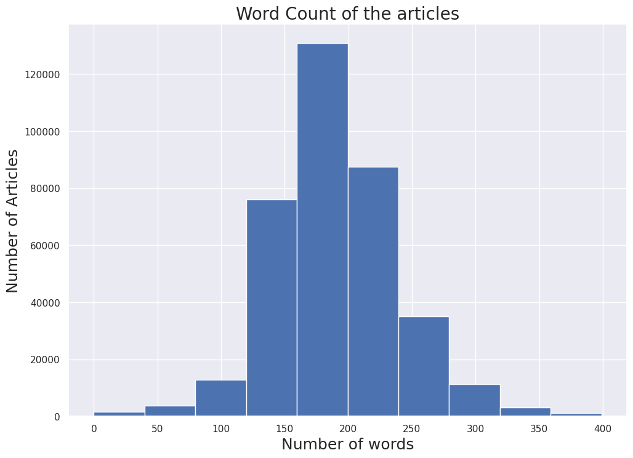
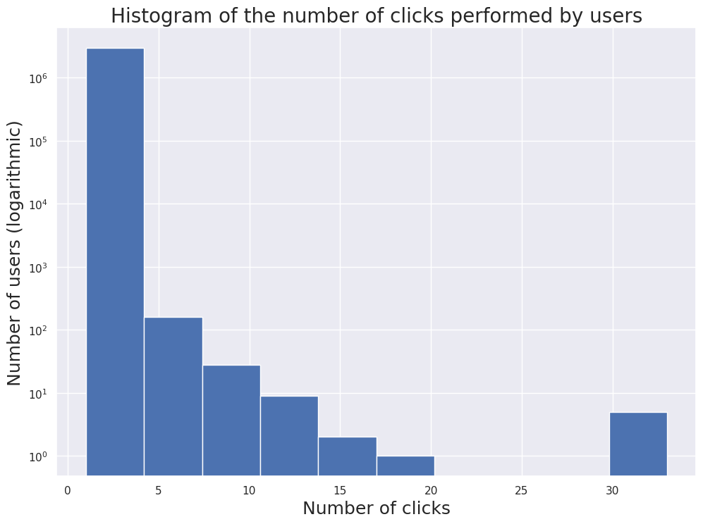
Dataset
Globo.com dataset
3 main sources of information:
Article metadata:
Category, creation date and word count of 364k articles
User click data:
Session id, start, size, ID of the article clicked, timestamp, environment, device group, os, country, region, referrer type
No column metadata provided
~3 million rows
Article embeddings:
Pickle file containing 250 embeddings for each article

Slide 6
Developing a Recommendation Model

Slide 7
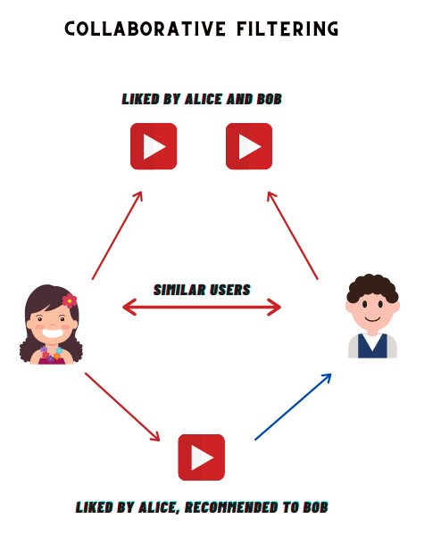
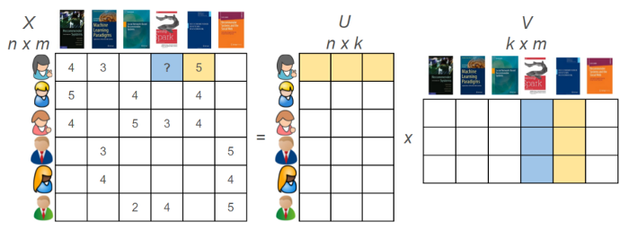
Collaborative Filtering (Category based)
Principle : Recommendations based on similar users.
Category based Implementation with Surprise
Testing of different algorithms :
Singular Value Decomposition (SVD)
SlopeOne
Non-negative Matrix Factorization (NMF)
Hyperparameter Optimization with Grid Search
Performance metrics : Root Mean Square Error, Fraction of Concordant Pairs (FCP)
Final results : RMSE = 4.27, FCP = 0.54
Non-negative Matrix Factorization

Slide 8
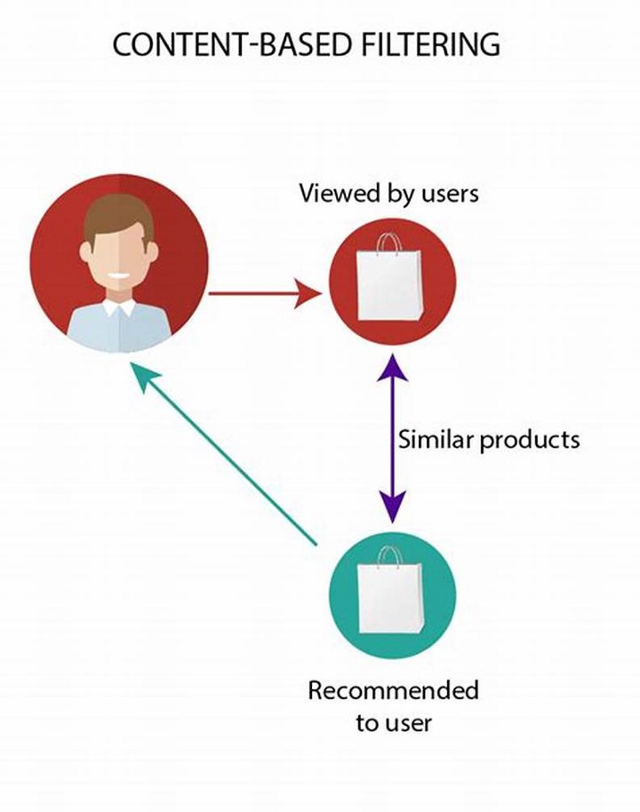
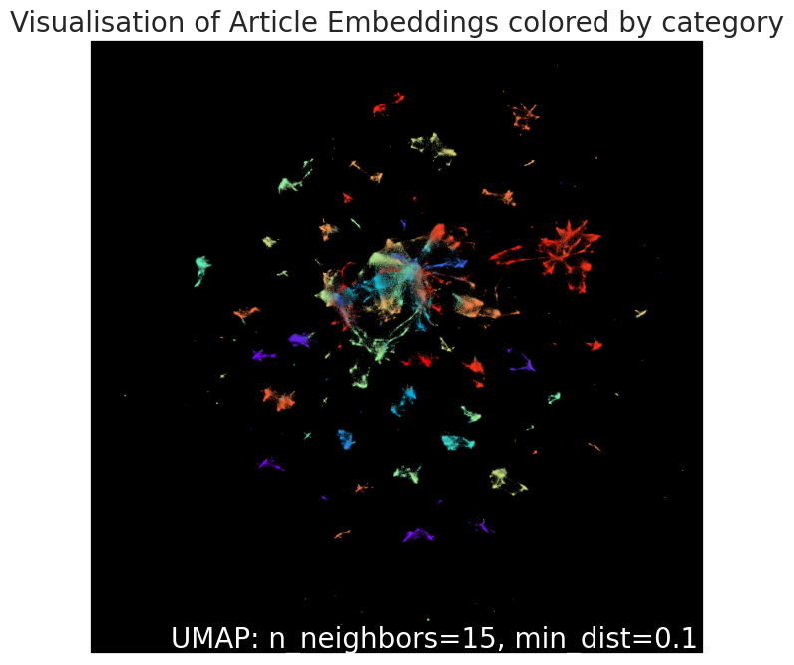
Content-based Filtering
Principle : Recommendations based on products similar to those liked/viewed by users
Implementation with Cosine Similarity
Limitation : size of cosine similarity matrix
➔ Necessary to keep only articles viewed by users (45k / 364k)
For each user :
Compute cosine similarity matrix of all read articles
Multiply score by number of clicks
Remove articles already seen by user

Slide 9
Hybrid Recommendation Algorithm
No
Is the user known?
AND Did he read any articles?
Yes
Retrieve a sample of top 10 articles within last 6 months
Multiply score by number of article clicks
Compute similarity score of read articles
Multiply score by 4/3.5/3/2.5/2 (depending on rank) if article within recommended categories
Retrieve CF category recommendations
Return top 5 articles

Slide 10
Deployment Architecture

Slide 11
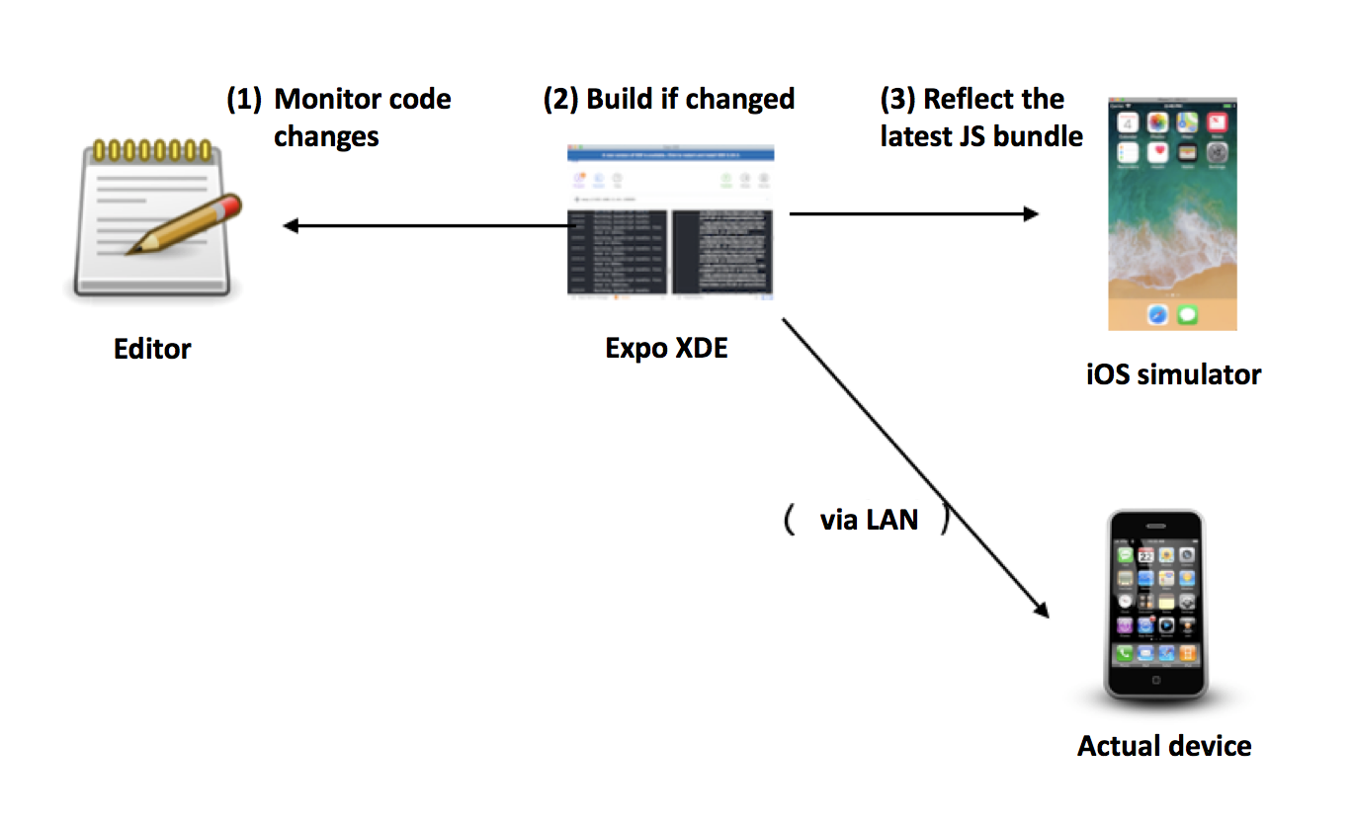
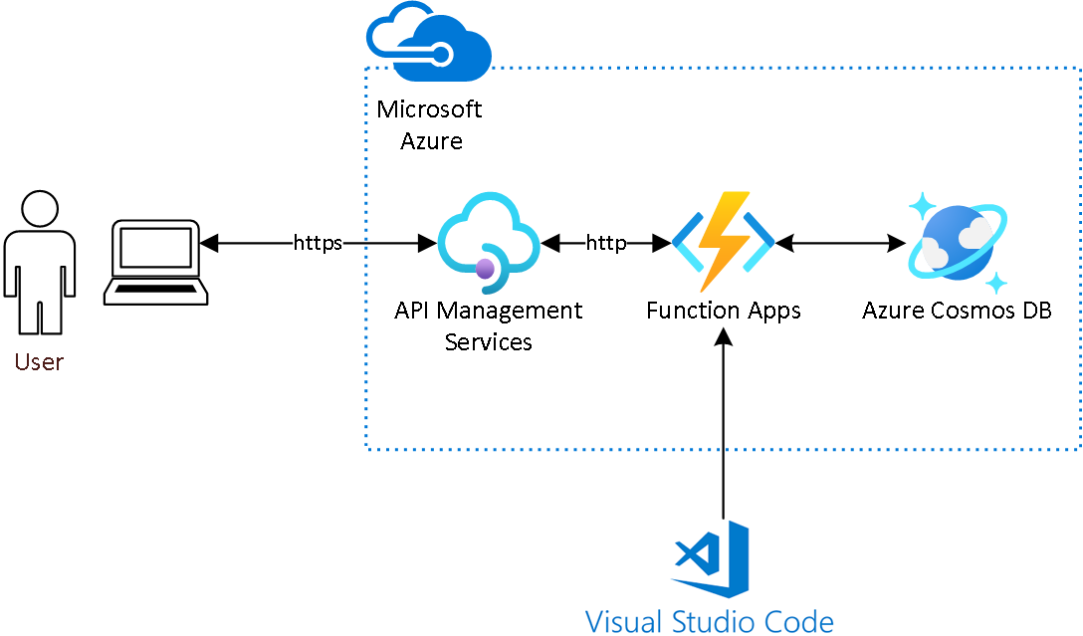
Model Deployment: Current Architecture
Implementation of the application on Expo by updating outdated Github repository
Javascript (React) file updated to work with current version of the modules used
Recommendation API deployed on Azure Function
No modelling libraries required
~8GB of disk and RAM space necessary to host pickled dataframes
Average recommendation time : 900ms

Slide 12
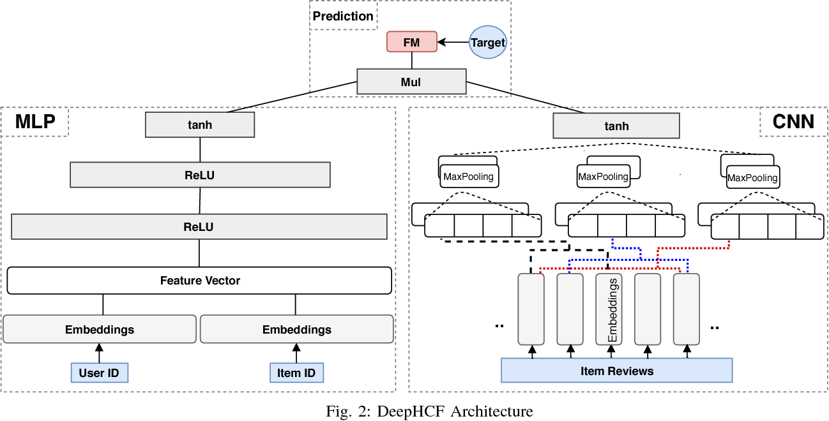
Model Deployment: Target Architecture
Implementation of a modern deep learning hybrid model if necessary
Lazy loading of recommendations
Use all of the user and article features
Deployment on high performance computes
New users receive a sample of top 10 articles
Database updated dynamically to include new articles and user clicks
➔ New users receive updated recommendations once they have browsed an article

Slide 13
Conclusion

Slide 14
Conclusion
During this project, a Recommendation Model has been developed in order to deploy a mobile article recommendation application.
The model developed so far can be refined before deployment in production
Recommendations :
Study the implementation of a deep learning Hybrid recommendation model
Perform lazy loading of recommendations to increase browsing speed
Integrate a dynamic update of the database for new users and articles
Set in place periodic retraining of model with new data

Slide 15
Questions?

