Slide 1

Creating a Mobile Application for Recommending Content
Presented by: Octave Antoni
Last Updated: November 11th, 2022

Slide 2
Table of contents
Introduction
The Dataset
Developping a Recommendation Model
Deploying the Model
Conclusion

Slide 3
Introduction
Main goal ➔ Create a draft mobile application to recommend articles from the My Content website.
Use of the Globo.com dataset (opensource)
Test different recommendation techniques
Key points :
Development of Content-Based and Collaborative Filtering based models
Final model is hybrid
Could not develop a deep learning model
Deployment of an API on Azure function, connected to mobile App
Limitation : Azure Credits not provided to student ➔ Only low performance computes could be used (trial account) ➔ Unable to develop a relevant deep learning model

Slide 4
The Dataset

Slide 5
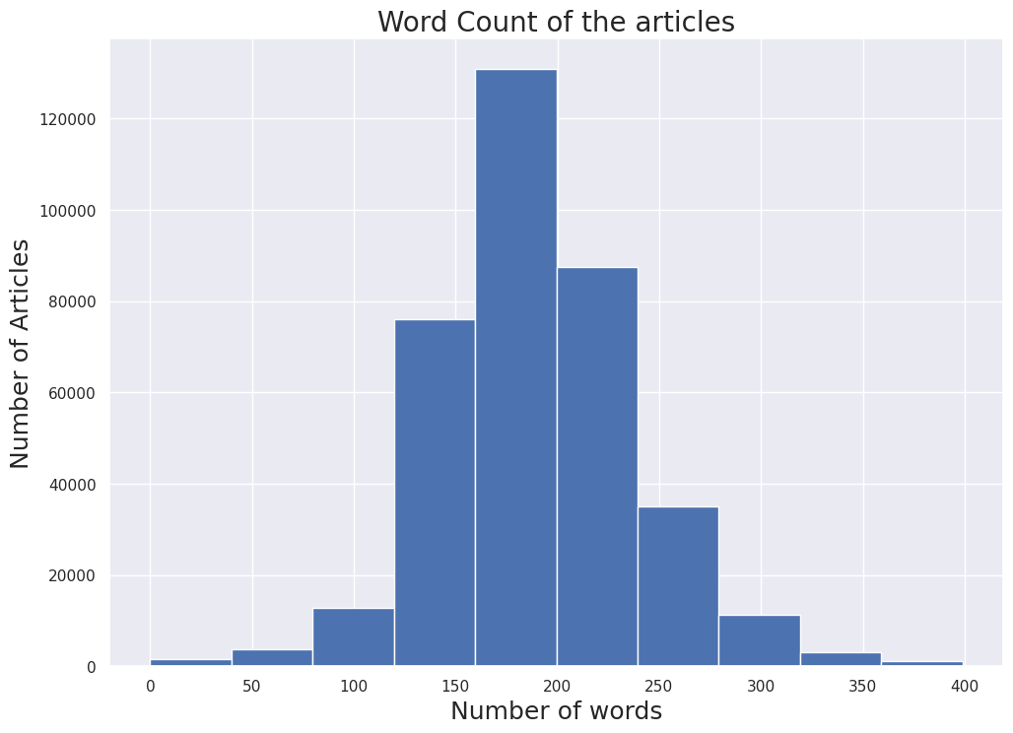
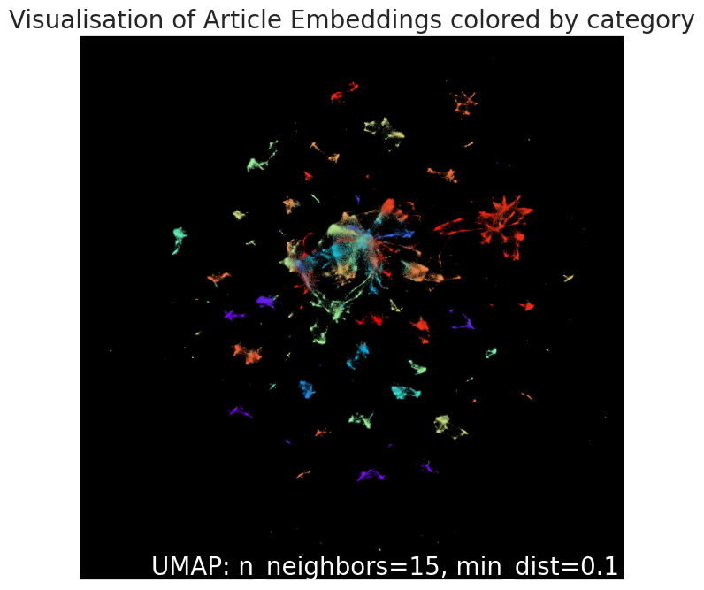
Dataset
Globo.com dataset
3 main sources of information:
Article metadata:
Category, creation date and word count of 364k articles
User click data:
Session id, start, size, ID of the article clicked, timestamp, environment, device group, os, country, region, referrer type
No column metadata provided
~3 million rows
Article embeddings:
Pickle file containing 250 embeddings for each article

Slide 6
Developing a Recommendation Model

Slide 7
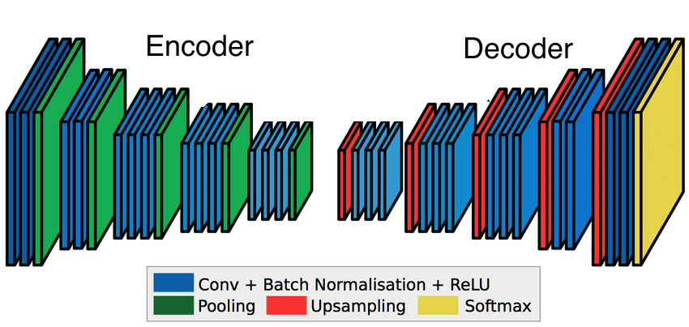
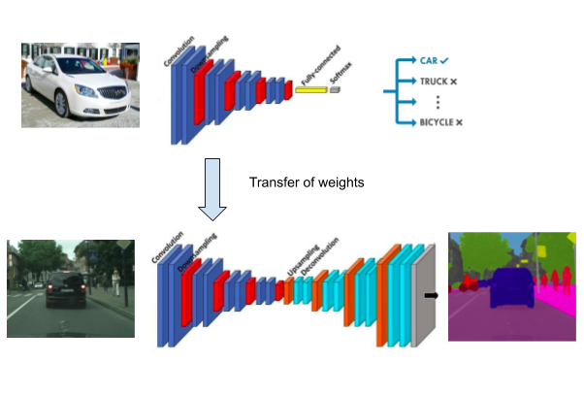
Image Segmentation principles
Semantic Image Segmentation
Use of Convolutional Neural Networks (CNN)
Performance Metrics : Dice Coefficient – Intersection over Union (IoU) – Mean One-Hot
Other metric : shape of the predicted masks
Optimizer : Adam – Adam Weighted (AdamW)
Loss : Categorical Cross-Entropy – Dice Loss
Use of skip connections to prevent the loss of low-level information
Transfer learning for encoder necessary ➔ reduce computation time

Slide 8
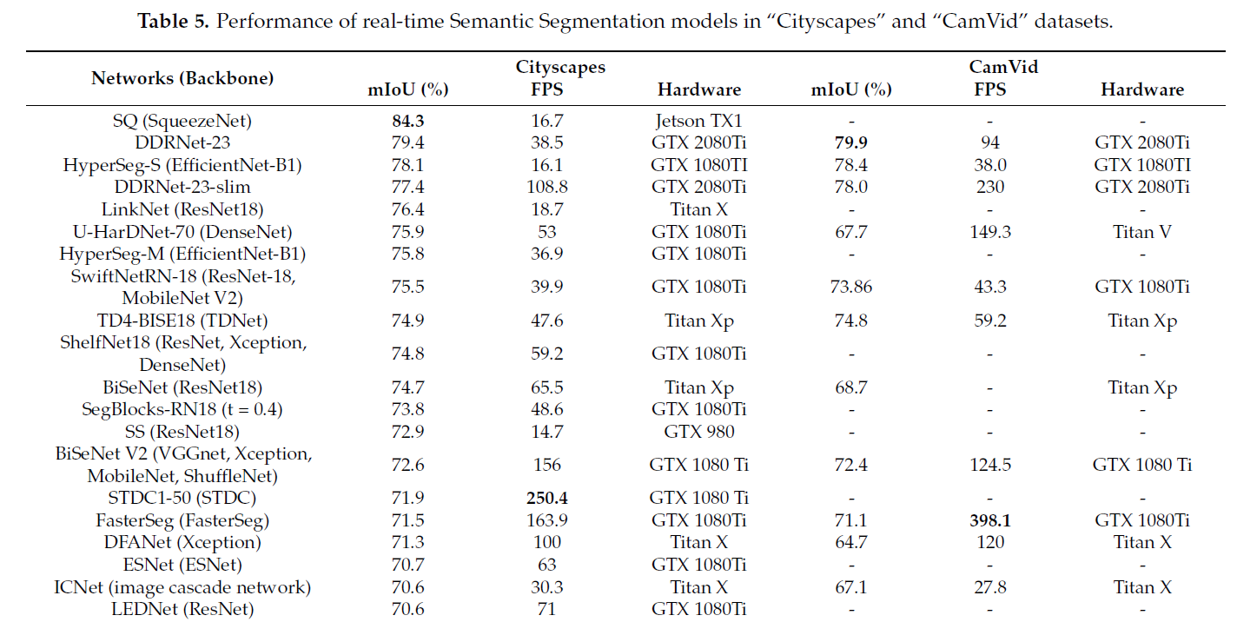
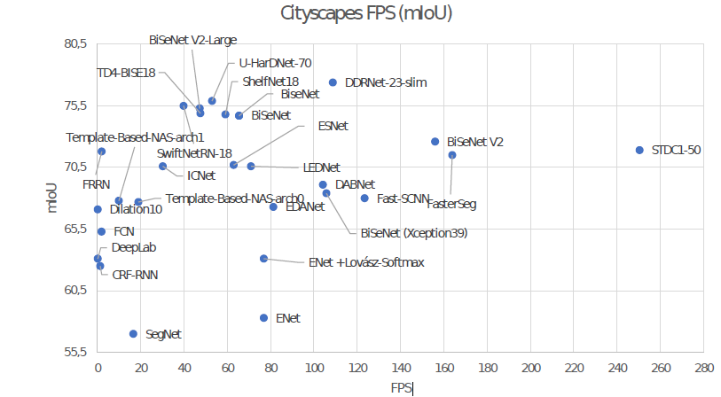
State of the Art Semantic Segmentation
Study of research paper : Real-Time Semantic Image Segmentation with Deep Learning for Autonomous Driving : A Survey
Best performance on Cityscrapes dataset : SQ (SqueezeNet encoder)
Fastest model : STDC1-50 (STDC backbone)
2 main problems with state of the art models:
Models not implemented in Keras / TF
Training requires high computational power
SQ
Performance reached by final model
73.5

Slide 9
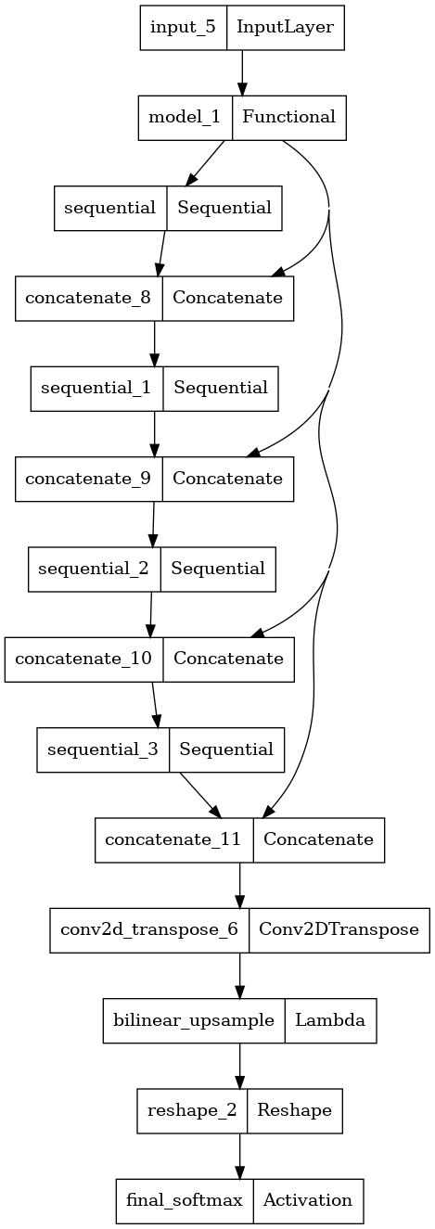
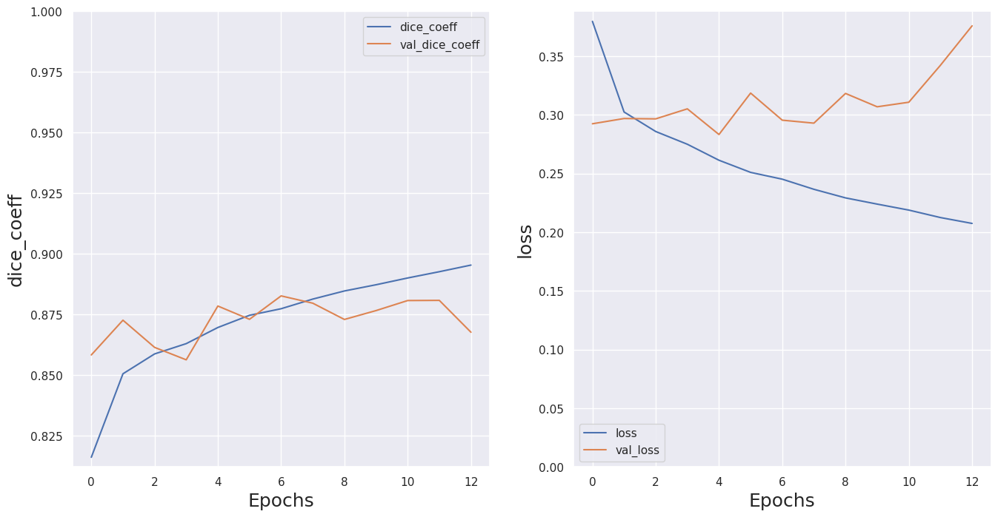
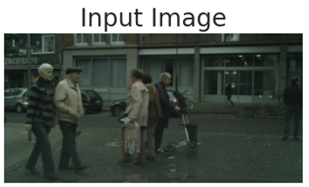
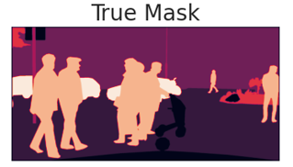
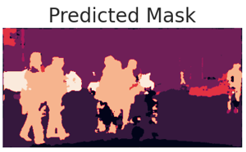
MobileNet - UNet
Encoder used : MobileNetV2 loaded with ImageNet weights
Decoder : Modified version of UNet
Use of skip connections between 4 MobileNetV2 layers and UNet upsamplers
Different versions tested:
256x256 and 256x512 image size
With or without data augmentation
JaccardLoss / Categ. CrossEntropy
Final Dice Coeff: 0.885 Mean IOU : 0.573
Accuracy : 0.911

Slide 10
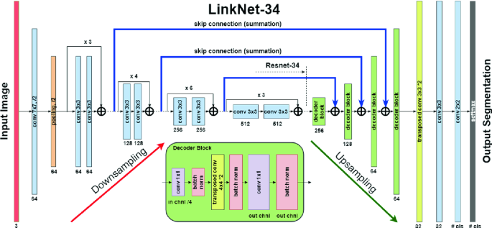
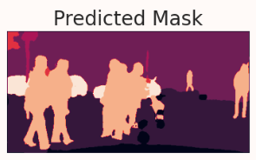
ResNet18 - LinkNet
Encoder used : ResNet18 loaded with ImageNet weights
Decoder : base version of LinkNet
Automatic generation of model architecture with segmentation-models module
Final Dice Coeff: 0.909 Mean IOU : 0.732
Accuracy : 0.927
Best performance on all metrics : Comparable to state of the art models, with only 70% of training samples

Slide 11
Cloud based Model Deployment

Slide 12
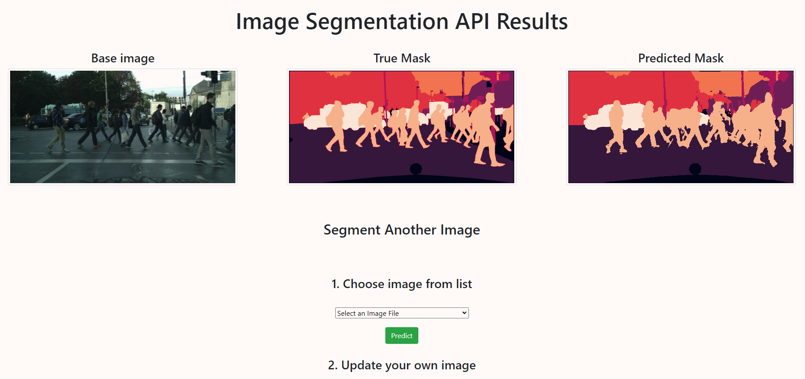
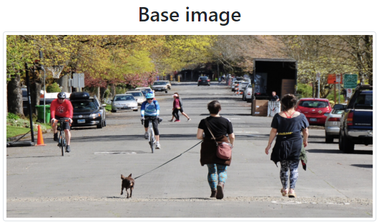
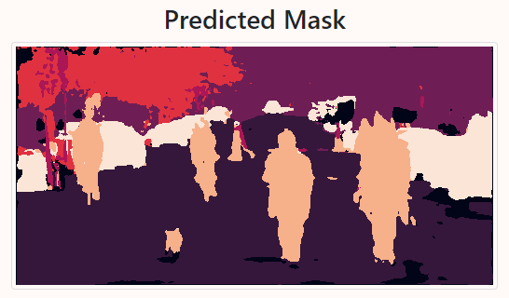
Model Deployment on the cloud
Implementation on Flask
Deployment on Heroku (premium dyno)
Limited by the size of the deployment slug, necessity to host model weights on Amazon S3
Model has to be recompiled at application launch to reduce host size
Tested on “real” pictures
2 possibilities :
Predict one of the uploaded test image
Predict a user-uploaded image

Slide 13
Conclusion

Slide 14
Conclusion
During this project, an Semantic Image Segmentation model has been developed based on images extracted from the Cityscrapes dataset.
The model developed so far can be refined before deployment in production
Recommendations :
Use developed ResNet18 – LinkNet model as base for further work
Use high performance computes ➔ increase the number of training epochs.
Increase image size used in training to native resolution (1024x2048)
Verify FPS of model to assert compatibility with Computer Vision System
Perform fine-tuning of ResNet18 encoder by unfreezing top layers

Slide 15
Questions?

