Slide 1
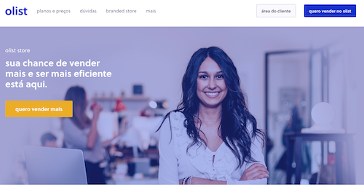
Olist Customer Segmentation
Presented by: Octave Antoni
Last Updated: October 6th, 2022

Slide 2
Table of contents
Introduction
Building a Robust Dataset
Model Selection and Optimization
Model Performance
Conclusion

Slide 3
Introduction
Main goal ➔ Using a clustering algorithm to segment the customers of an ecommerce website.
Key points :
Stability of the segmentation
Creating relevant features
Actionable description of the clusters
Analysis of order history, products purchased, customer reviews and location.
Identifying the best model to answer the business need

Slide 4
Building a Robust Dataset

Slide 5

Dataset
Dataset :
9 csv files
Orders, order items, order payments, order reviews, products, sellers, customers, locations, category translations
99441 orders, 96096 unique customers ➔ Few returning customers

Slide 6
Data Cleaning and Filtering
Cleaning duplicate product categories using Levenshtein distance algorithm
Removing product size data
Imputation of missing coordinates by aggregating by state and calculating the mean
Keeping only completed orders (delivered or cancelled)
Removing samples with NAs ➔ Only 4% of the dataset
Transforming timestamps into datetime fields
Merging all the data in a single dataframe

Slide 7
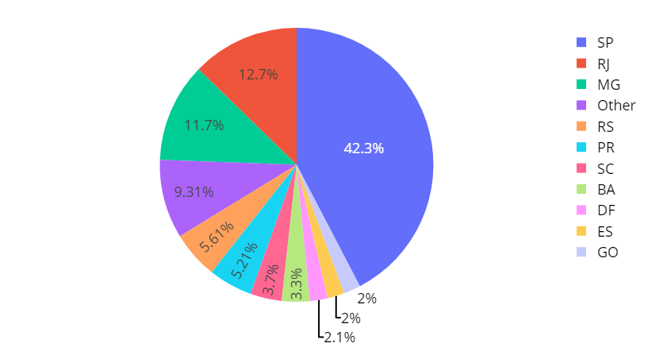
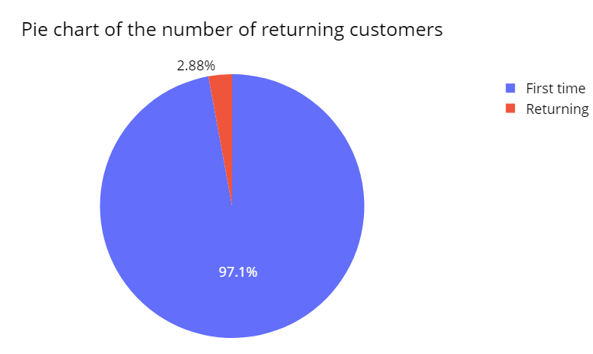
Exploratory Data Analysis
Pie chart of the region of customers
42% of customers from the Sao Paulo (SP) region, followed by Rio (RJ) at 12,7%
97% of customers in the dataset are first time customers
74% of payments by credit card
Numeric variables are not Gaussian
Correlation between payment value, price and freight value
Moderate correlation between use of credit card and number of installments

Slide 8
Feature Engineering
Calculated distance between seller and customer
Computed difference between payment value and price.
Calculated delays for order approval, shipping and order review
Encoded categorical variables with cross tabulation and One-Hot Encoding
Aggregated the dataset over customer unique id with several aggregation techniques (nunique, count, max, min, average, sum)
Performed train-test split for final test of stability

Slide 9
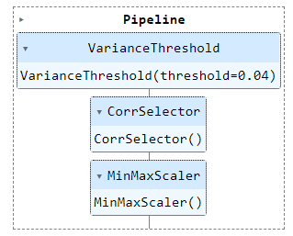
Preprocessing Pipeline
3 steps preprocessing pipeline :
Feature Selection using Variance Threshold (0,04)
Feature Selection using Correlation Selector (0,8)
Scaling using MinMaxScaler

Slide 10
Model Selection and Optimization

Slide 11
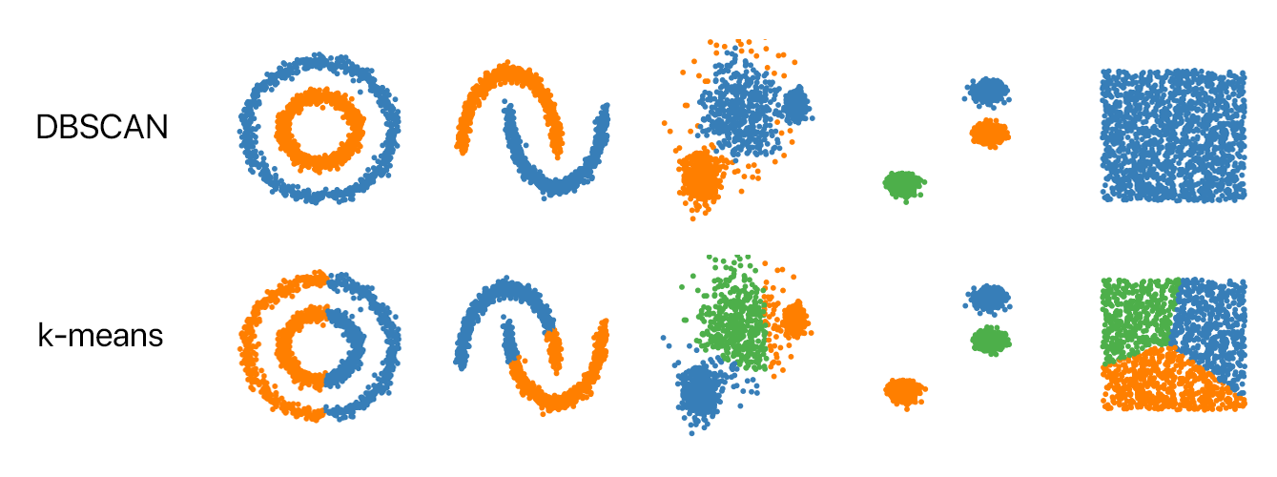
Candidate Models
2 studied options :
Inertia minimization algorithm ➔ Kmeans
Density based algorithm ➔ DBSCAN
Performance indicator : Silhouette score
Measures the similarity of objects within clusters and the separation of different clusters.
Ranges from -1 to 1.

Slide 12
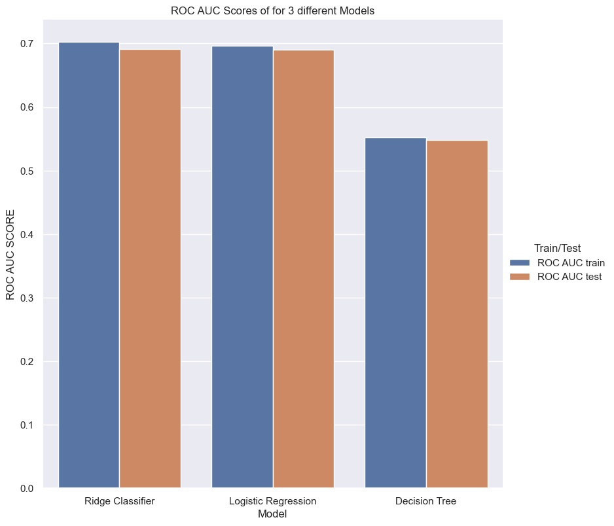
Model Selection
Optimization of the parameters of the 3 models using an optimized search algorithm (Bayesian Search)
Compute ROC AUC (test) score on the 3 models
➔ Ridge Classifier has the best performance and will be chosen for our model

Slide 13
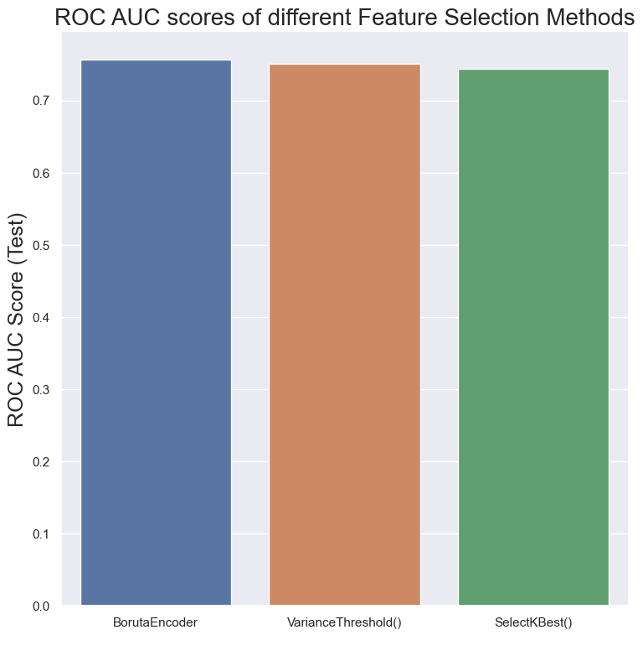
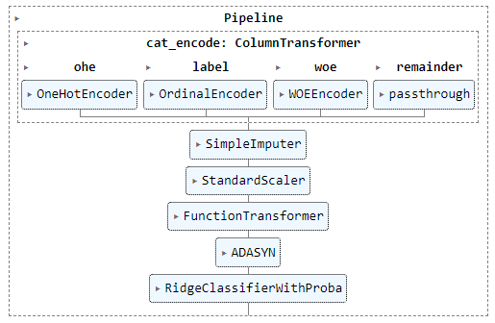
Optimization of the preprocessing pipeline
To improve our model further :
Selection of the most efficient scaler (Standard Scaler)
Identification of the best feature selection method (Boruta Algorithm)
Selection of the best categorical variable encoding methods (Mixed Encoding)
Applied the most performant oversampling algorithm and ratio (ADASYN ratio =1)
= Median Imputer
= Boruta Selector

Slide 14
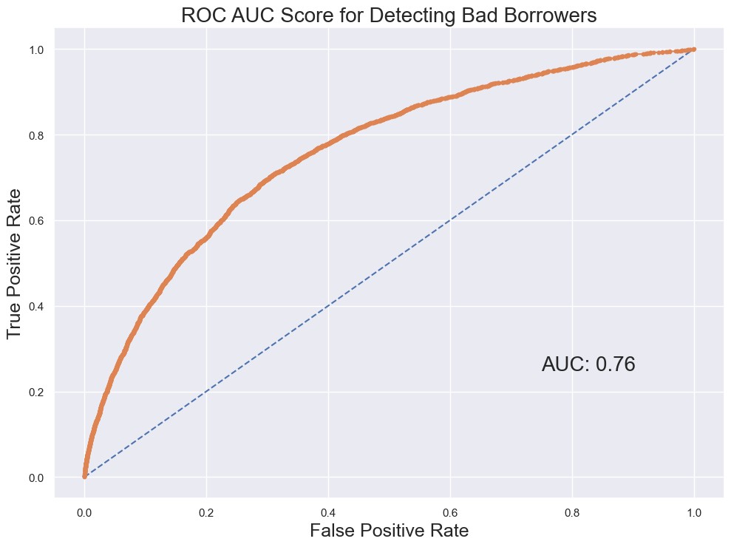
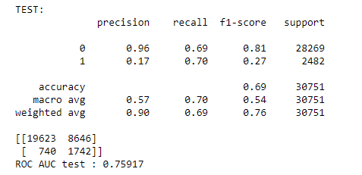
Selected Model
Our selected model and pipeline uses the Ridge Classifier linear algorithm.
Final ROC AUC Score : 0,76
Detects 70% of bad borrowers at the cost of a misdetection of 30% of good borrowers
Features with the highest coefficients : extracted from the Credit Card dataset

Slide 15
Model Interpretability

Slide 16
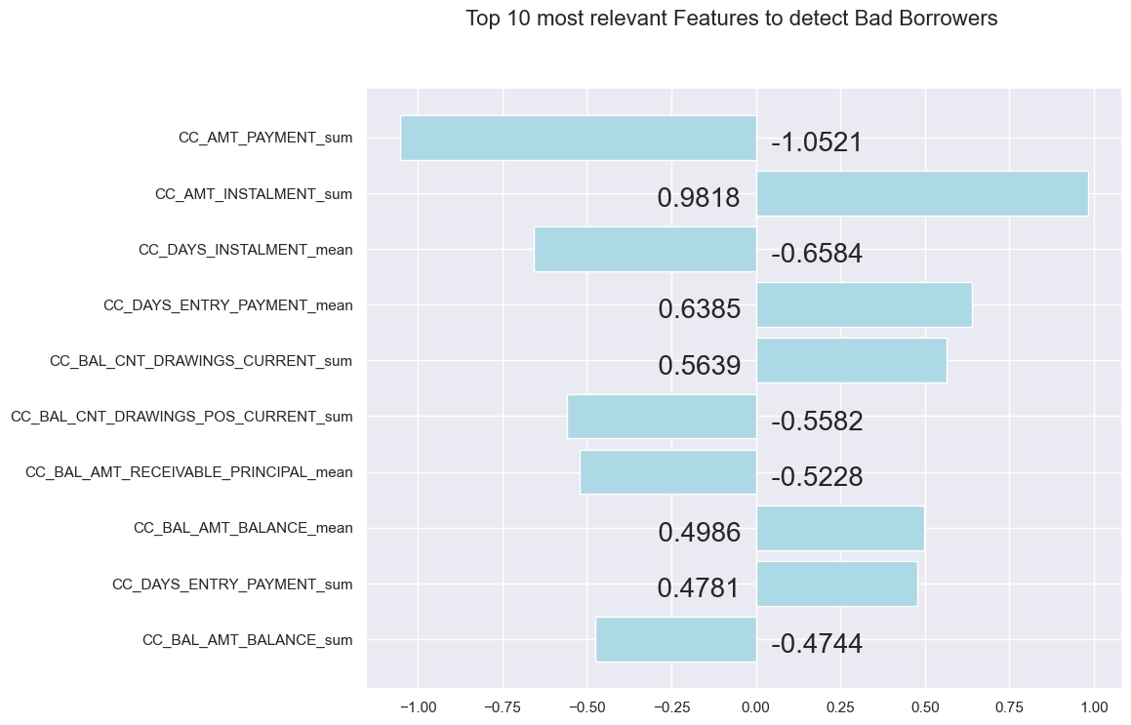
Model Interpretability
Goals:
Build trust in the model
Interpret the probabilities
Importance of different features
Avoid bias
Model based on Linear Regression ➔ Easy to explain
Coefficients are provided ➔ Easy to figure out which features are important

Slide 17
Conclusion

Slide 18
Conclusion
The dataset provided had a lot of missing values and a significant amount of features.
We have built a model using Ridge Regression with this dataset.
It is an interpretable model that can be used by non-technical employees.
The model is able to detect 70% of potential bad borrowers at the cost of 30% of misdetection of good customers.
The coefficients of each feature can be easily interpreted, the most useful dataset is the credit card balance data.
This model could be improved by using a better performing but less interpretable algorithm.

Slide 19
Questions?

