Slide 1
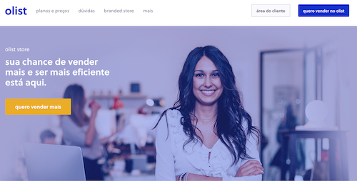
Olist Customer Segmentation
Presented by: Octave Antoni
Last Updated: October 6th, 2022

Slide 2
Table of contents
Introduction
Building a Robust Dataset
Model Selection and Optimization
Model Performance
Conclusion

Slide 3
Introduction
Main goal ➔ Using a clustering algorithm to segment the customers of an ecommerce website.
Key points :
Stability of the segmentation
Creating relevant features
Actionable description of the clusters
Analysis of order history, products purchased, customer reviews and location.
Identifying the best model to answer the business need

Slide 4
Building a Robust Dataset

Slide 5

Dataset
Dataset :
9 csv files
Orders, order items, order payments, order reviews, products, sellers, customers, locations, category translations
99441 orders, 96096 unique customers ➔ Few returning customers

Slide 6
Data Cleaning and Filtering
Cleaning duplicate product categories using Levenshtein distance algorithm
Removing product size data
Imputation of missing coordinates by aggregating by state and calculating the mean
Keeping only completed orders (delivered or cancelled)
Removing samples with NAs ➔ Only 4% of the dataset
Transforming timestamps into datetime fields
Merging all the data in a single dataframe

Slide 7
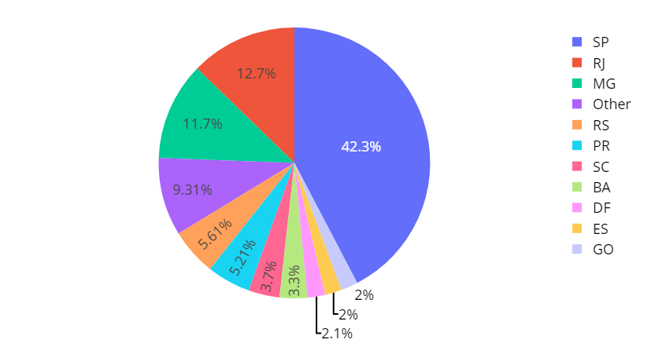
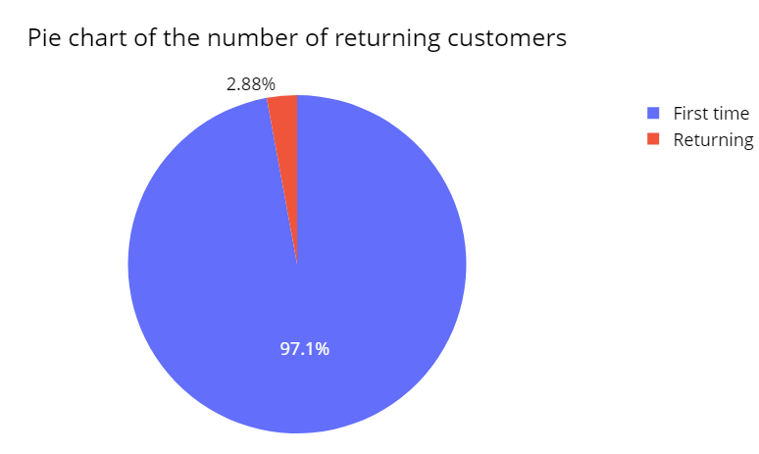
Exploratory Data Analysis
Pie chart of the region of customers
42% of customers from the Sao Paulo (SP) region, followed by Rio (RJ) at 12,7%
97% of customers in the dataset are first time customers
74% of payments by credit card
Numeric variables are not Gaussian
Correlation between payment value, price and freight value
Moderate correlation between use of credit card and number of installments

Slide 8
Feature Engineering
Calculated distance between seller and customer
Computed difference between payment value and price.
Calculated delays for order approval, shipping and order review
Encoded categorical variables with cross tabulation and One-Hot Encoding
Aggregated the dataset over customer unique id with several aggregation techniques (nunique, count, max, min, average, sum)
Performed train-test split for final test of stability

Slide 9
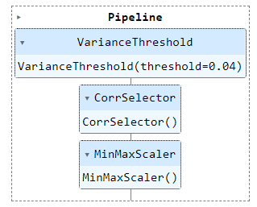
Preprocessing Pipeline
3 steps preprocessing pipeline :
Feature Selection using Variance Threshold (0,04)
Feature Selection using custom Correlation Selector (0,8) with feature names out
Scaling using MinMaxScaler

Slide 10
Model Selection and Optimization

Slide 11
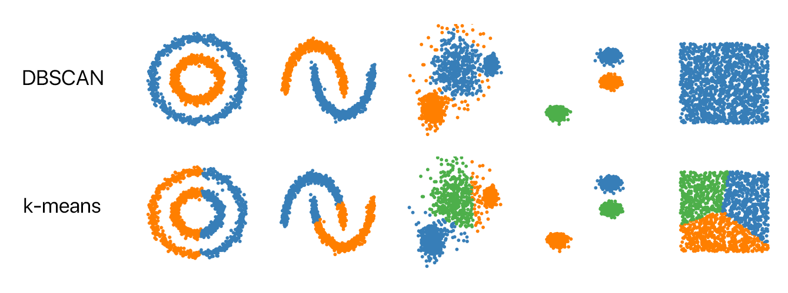
Candidate Models
2 studied options :
Inertia minimization algorithm ➔
K-means
Density based algorithm ➔ DBSCAN
Performance indicator : Silhouette score
Measures the similarity of objects within clusters and the separation of different clusters.
Ranges from -1 to 1.

Slide 12
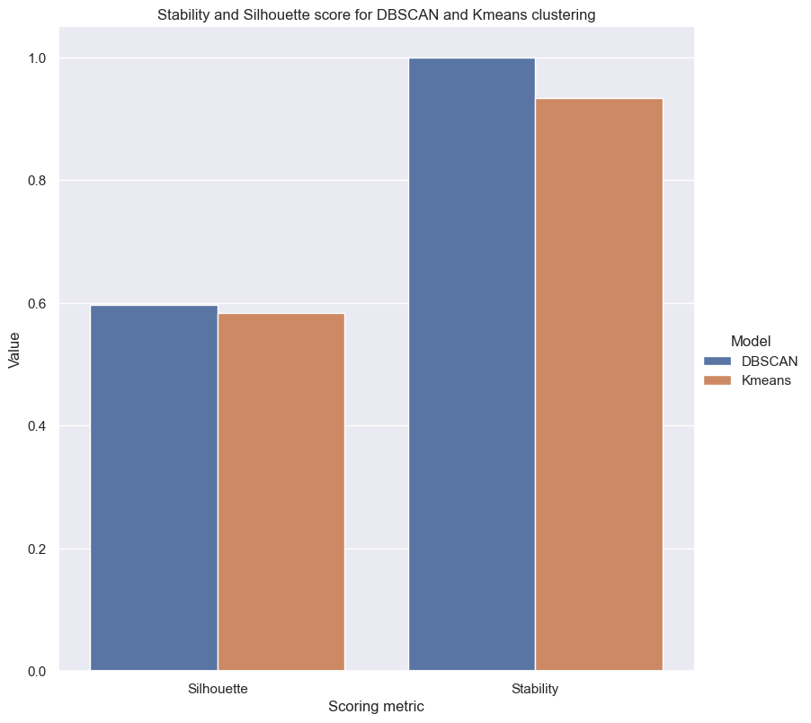
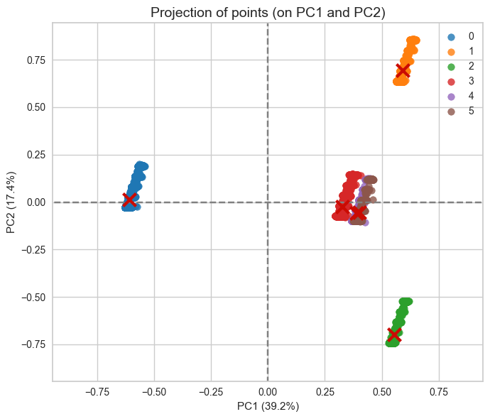
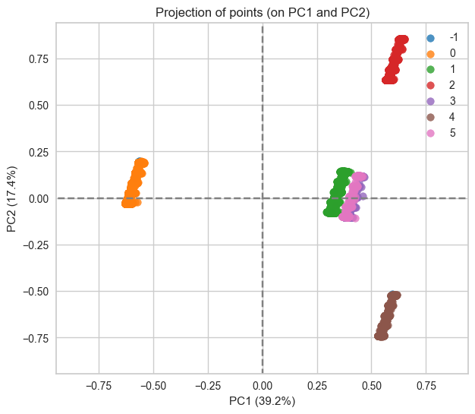
Model Selection
Optimization of the parameters of the 2 models using manual Grid search
Compute Silhouette score and Stability index on the 2 models with the best hyperparameters
Investigate the shape of both models using PCA visualization
➔ DBSCAN has the best performance and will be chosen as our model
K-means
DBSCAN

Slide 13
Final Model Performance

Slide 14
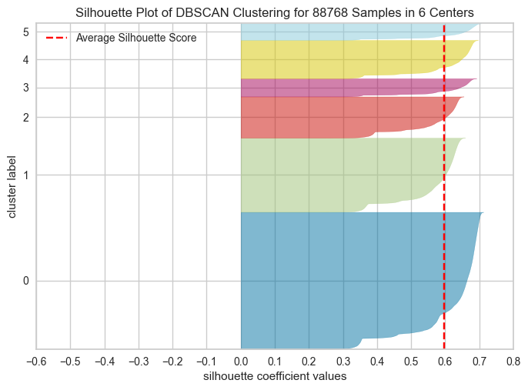
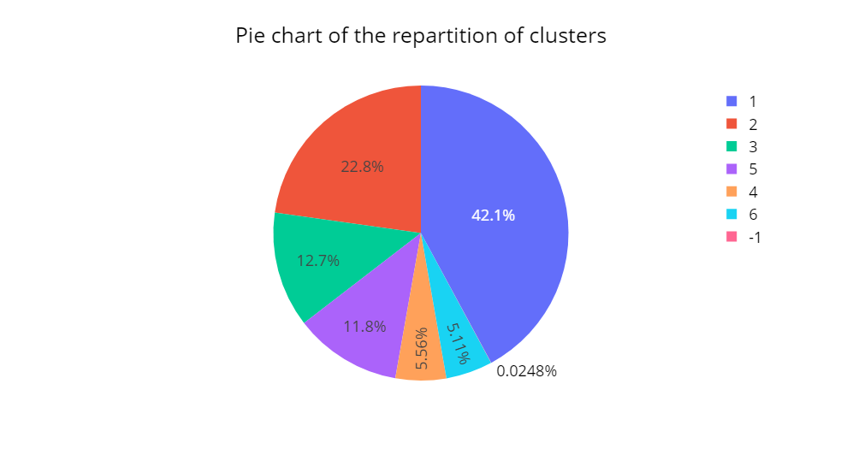
Performance Metrics
Our model has a good Silhouette score at 0,597 on the whole dataset.
Stability score = 1.
It separates the dataset in 6 clusters.
There is an unequal distribution of the samples in those clusters
Cluster 1 contains 42% of samples.
Cluster 2 : ~23% of samples
Disclaimer :
The clusters have been shifted from 0-5 to 1-6 for easier visualization

Slide 15
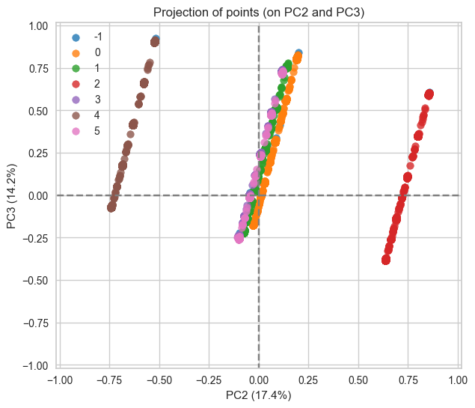
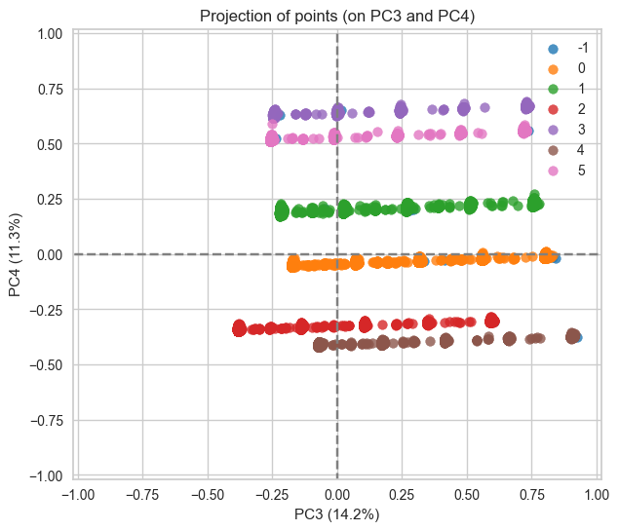
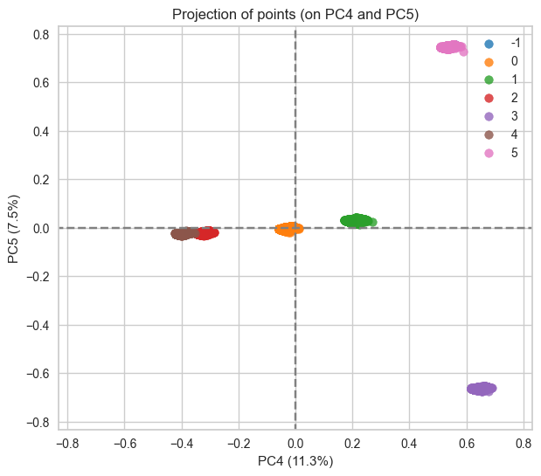
Model Shape
1st PCA plane : Good separation of 5 clusters
2nd PCA plane : 2 clusters clearly separated, slight separation of 3 additional clusters
3rd and 4th PCA plane : 6 clusters cleanly separated
Analysis of the shape of our clusters with PCA visualization (5 first components represent 90% of variance) ➔ proves the efficiency of our model

Slide 16
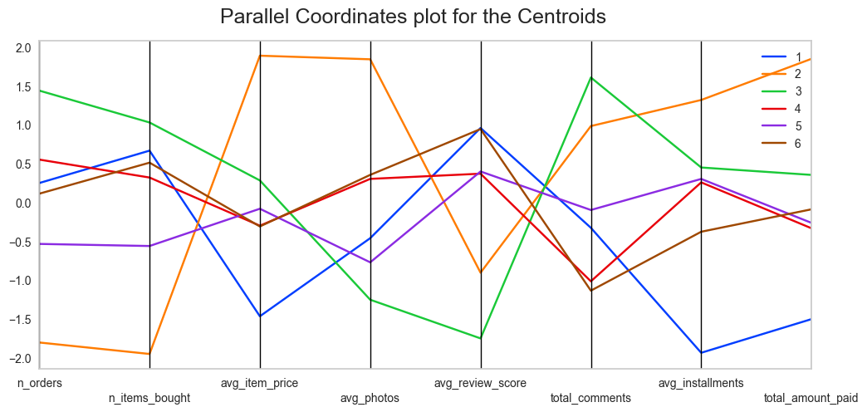
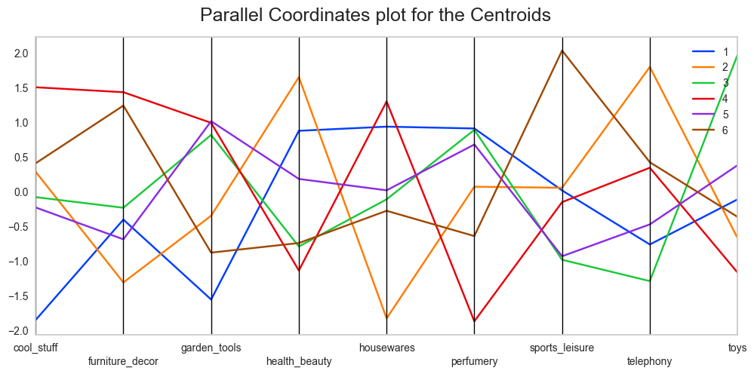
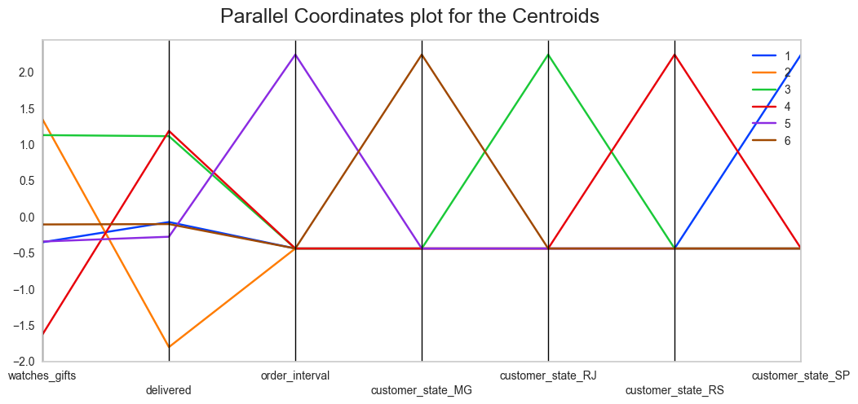
Segment characteristics
Segment 1: Sao Paulo area, mostly interested in health, beauty, housewares, bed, bath, tables and perfumery products, requests low shipping delay and buys low price products, gives good review scores
Segment 2: Likely to cancel order, mostly interested in telephony, health, beauty and auto products, orders from sellers far from its location, buys a low amount of items but with at a high price and with a high number of photos.
Segment 3: Rio de Janeiro area, mostly interested in toys, perfumery, garden tools, bed, bath and table products, mostly pays by credit card, high number of item bought and number of orders.
Segment 4: Rio Grande do Sul area, mostly interested in housewares, garden tools, furniture, decor, cool stuff and computer accessories, accepts higher shipping delay, less likely to use credit card and overpays items.
Segment 5: Likely to be a returning customer, mostly interested in perfumery, garden tools and computer accessories, high review delay.
Segment 6: Minas Gerais state, mostly interested in sports, leisure, furniture, decor and auto products, gives high rated reviews.

Slide 17
Conclusion

Slide 18
Recommendations
This project has outlined 6 stable customer segments ➔ fulfill business need
These segments can be used to optimize marketing efforts in different ways:
Reduce costs and improve marketing ROI by targeting ideal customers.
For local ad campaigns, focus on the products interesting the customers.
Write custom advertisements depending on customer needs (i.e. short shipping delay or possibility to buy without credit card).
More generally, target high paying customers with low cancellation rates.
The model could be improved by providing additional information like customer age and gender

Slide 19
Questions?

