Slide 1


Yelp Image and Text Data Preprocessing
Presented by: Octave Antoni
Last Updated: October 14th, 2022

Slide 2
Table of contents
Introduction
Text data Preprocessing
Image data Preprocessing
Multiclass Classification using Transfer Learning
Conclusion

Slide 3
Introduction
Main goal ➔ Detect the topics of dissatisfaction in Yelp reviews and automatically label posted photos.
Task ➔ Preprocess and Analyze Yelp image and reviews datasets.
Key points :
Use of dimensionality reduction techniques
Visualization of high-dimensional data
Collection of samples via Yelp API
Extra work ➔ Perform label identification and photo labelling using dedicated algorithms in order to fulfill business need

Slide 4
Text Data Preprocessing

Slide 5
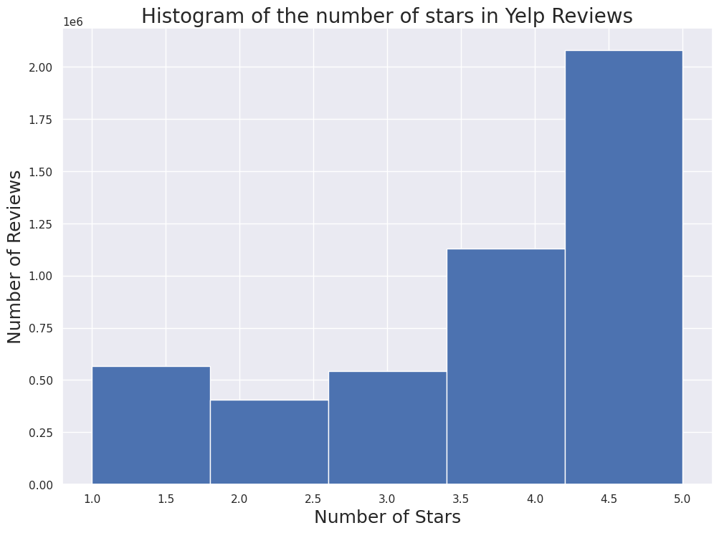
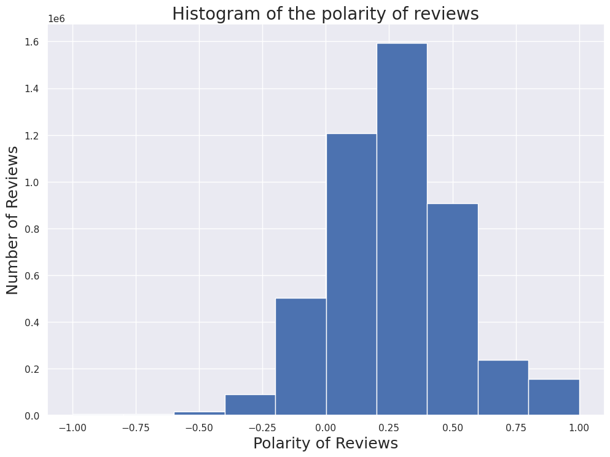
Dataset
Overview :
5 json files
Businesses, Check-ins, Reviews, Tips and Users
Only businesses and reviews are relevant to business need.
High number of positive reviews
Data cleaning and Filtering :
Selecting restaurants from business list
Filtering out reviews not belonging to restaurants
Calculation of review Sentiment
Keeping only reviews with 2 stars or less and with negative polarity

Slide 6
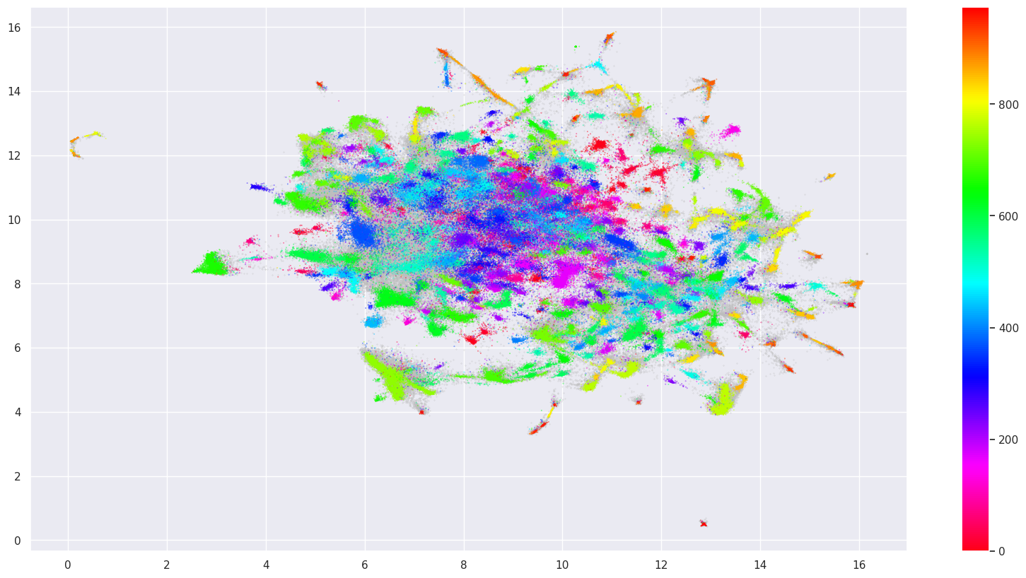
Text Data Preprocessing
Text Normalization using SpaCy to lemmatize dataset and remove stop words and punctuation.
Text Vectorization using TF-IDF Vectorizer
Dimensionality reduction with UMAP (10 features)
Clustering with HDBSCAN
2nd Dimensionality reduction with UMAP (2 features)
Visualization of created clusters
Visualization of Text data with UMAP

Slide 7
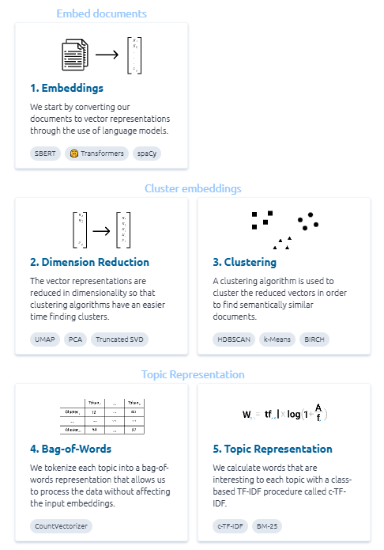
Topic Identification
Using BERTopic algorithm.
Embedding with SBERT
Dimensionality reduction with UMAP
Clustering with HDBSCAN
Tokenizing topics with Bag-of-Words
Topic Representation with c-TF-IDF

Slide 8
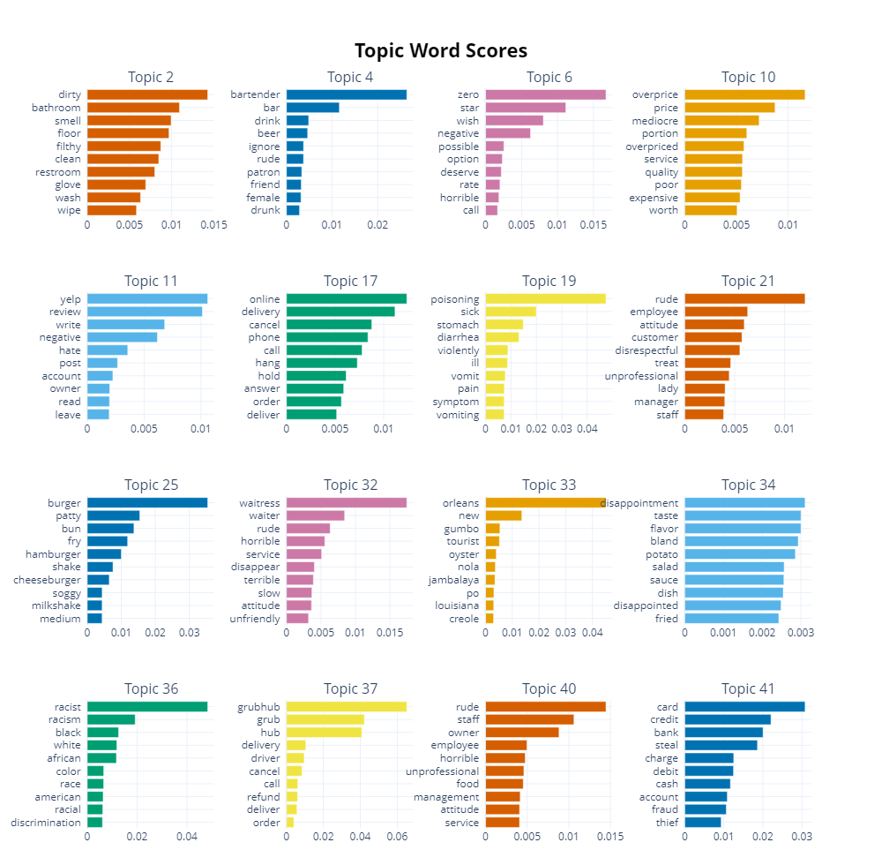
Identified topics of dissatisfaction
20 topics of dissatisfaction identified
Top 3 topics :
Dirtiness (bathroom / floor) and bad smell
Rudeness of the bartender, ignoring females and serving drunk people
Overpriced food with small portions and poor service

Slide 9
Updating the topics with new reviews
Verification of the possibility of retrieving new reviews with Yelp API
Performed sample collection by gathering information about 200 businesses and extracting 600 reviews.
Limitations :
Limited number of queries per day and month.
Location has to be included in business search
Only 3 reviews gathered by query
Low percentage of reviews are negative ➔ High number of queries needed to change our topic identification model.

Slide 10
Image Data Preprocessing

Slide 11
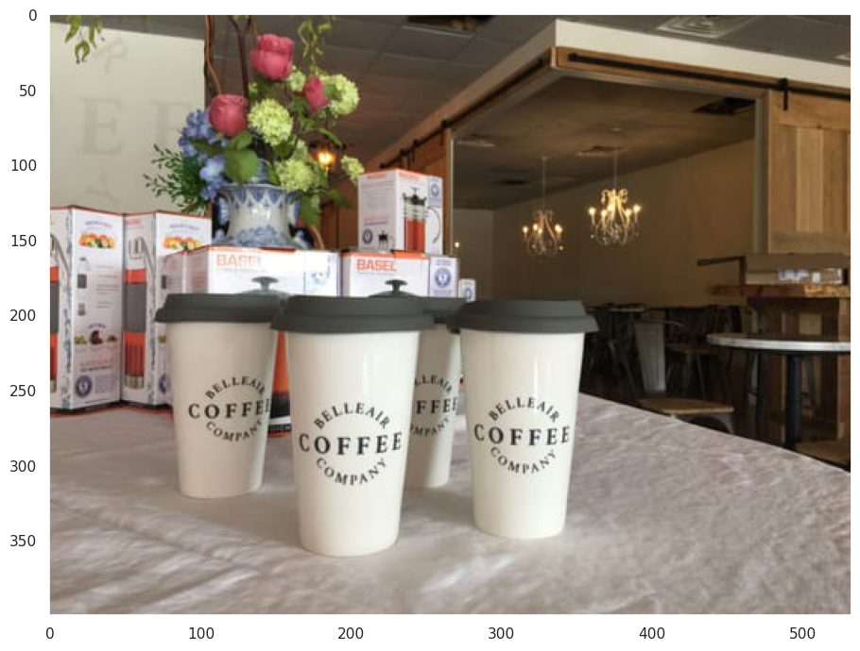
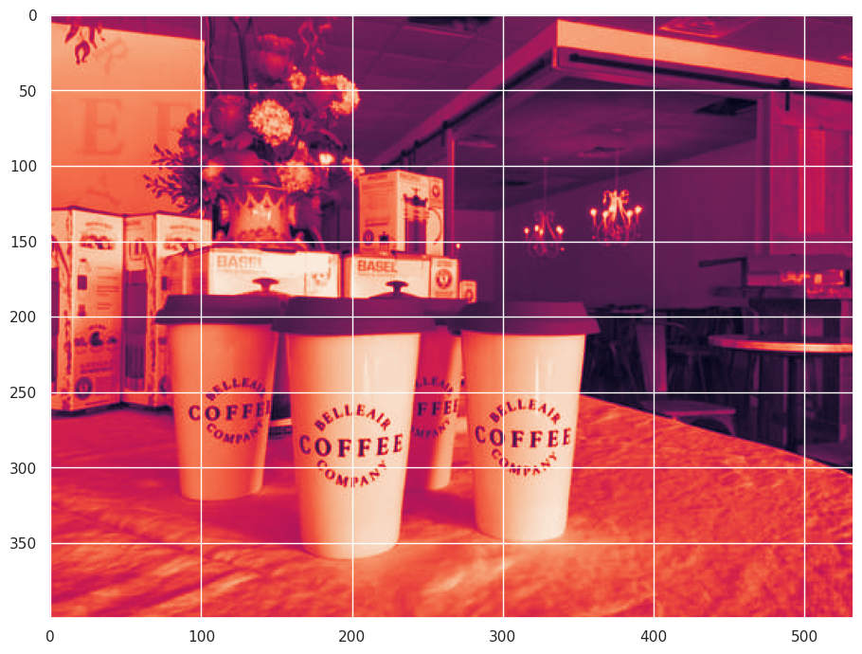
Image Preprocessing 1/2
Dataset overview :
1 JSON file with 200k rows
200k photos
Data cleaning and filtering
Kept only photos from restaurants
Removed corrupted files
Basic preprocessing :
Grayscaling
Image Normalization
Rescaling
Original
Image
Grayscale
+ Normalized

Slide 12
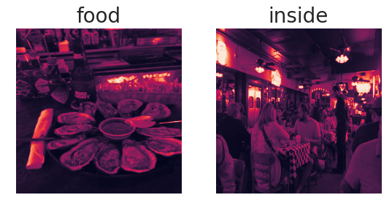
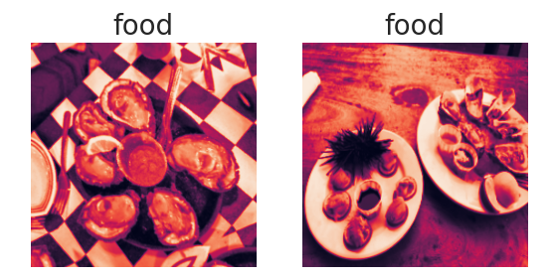
Image Preprocessing 2/2
Before equalization
Input image size defined as 160x160 px
Gaussian smoothing
Histogram equalization
Data augmentation :
Random flip (horizontal and vertical)
Random zoom
Random Rotation
One hot encoding labels
Goal ➔ Reducing overfitting, improving model performance
After equalization

Slide 13
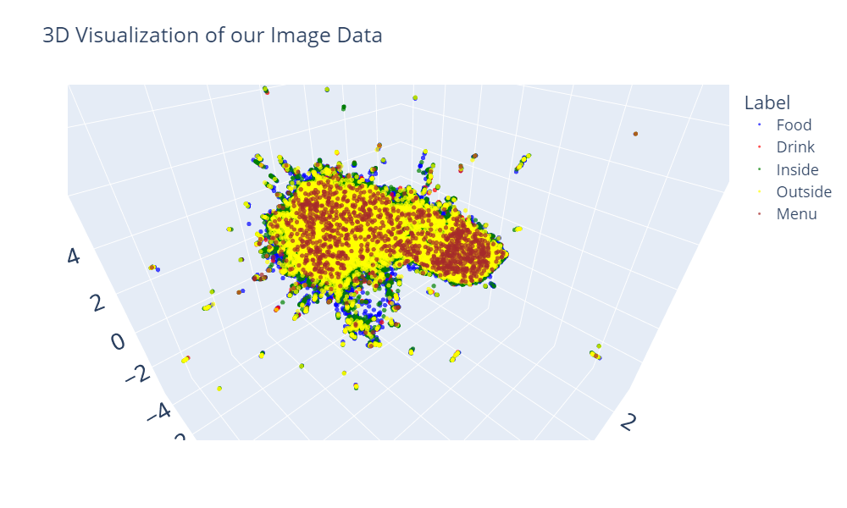
Feature extraction and dimensionality reduction
Feature extraction using MobileNetV2 model without top layers ➔ 5*5*1280 features
Reducing dimension by applying a Global Average Pooling 2D layer ➔ 1280 features
Dimensionality reduction with UMAP ➔ 3 components
3D Visualization
➔ No separation between the 5 clusters

Slide 14
Classification with Transfer Learning

Slide 15
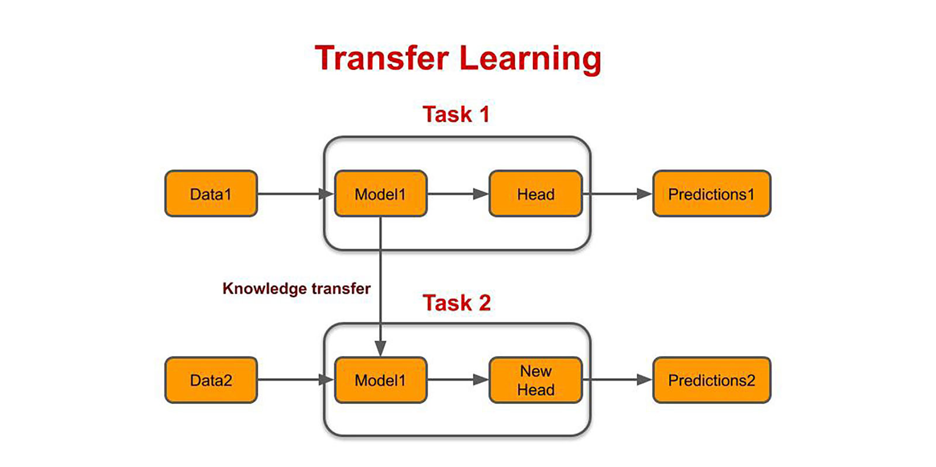
Implementation
Loaded the MobileNetV2 model without top layers.
Added Global Average Pooling 2D layer to reduce the dimensionality of features.
Added prediction layers, with final softmax layer with shape = number of labels
Integrated preprocessing and data augmentation steps within model.
Split our dataset in test, training and validation set and trained model on train set.

Slide 16
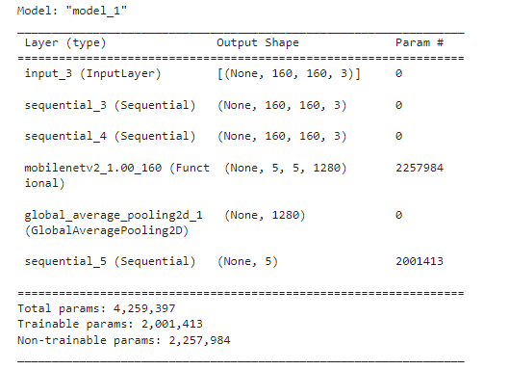
Classification results
Loss function : Categorical Cross-Entropy
Performance metric : Accuracy.
Trained the model with only 5 epochs due to high RAM usage.
Final accuracy on the test set ➔ 0.94
Model Summary

Slide 17
Conclusion

Slide 18
Conclusion
During this project, image and text data from the Yelp dataset has been analyzed and preprocessed.
We have outlined a topic identification algorithm and identified the 3 main topics of dissatisfaction among Yelp Reviews :
Restaurant cleanliness
Bad attitude from the bartender
Overpriced food and poor service
We have defined a draft image classification model ➔ proof that Good Dinner’s AI will be able to label images with collected images.
Recommendations :
Improve restaurant cleanliness, serving staff attitude and value for money
Improve classification model with fine tuning to identify labels with high accuracy
These segments can be used to optimize marketing efforts in different ways:
Reduce costs and improve marketing ROI by targeting ideal customers.
For local ad campaigns, focus on the products interesting the customers.
Write custom advertisements depending on customer needs (i.e. short shipping delay or possibility to buy without credit card).
More generally, target high paying customers with low cancellation rates.
The model could be improved by providing additional information like customer age and gender

Slide 19
Questions?

