Slide 1


Yelp Image and Text Data Preprocessing
Presented by: Octave Antoni
Last Updated: October 14th, 2022

Slide 2
Table of contents
Introduction
Text data Preprocessing
Image data Preprocessing
Multi-class Classification
Conclusion

Slide 3
Introduction
Main goal ➔ Detect the topics of dissatisfaction in Yelp reviews and automatically label posted photos.
Task ➔ Preprocess and Analyze Yelp image and reviews datasets.
Key points :
Use of dimensionality reduction techniques
Visualization of high-dimensional data
Collection of samples via Yelp API
Extra work ➔ Perform label identification and photo labelling using dedicated algorithms in order to fullfil business need

Slide 4
Text Data Preprocessing

Slide 5
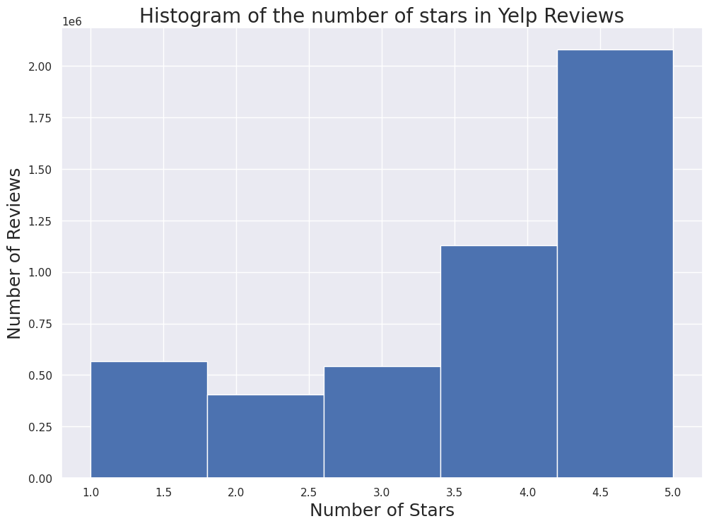
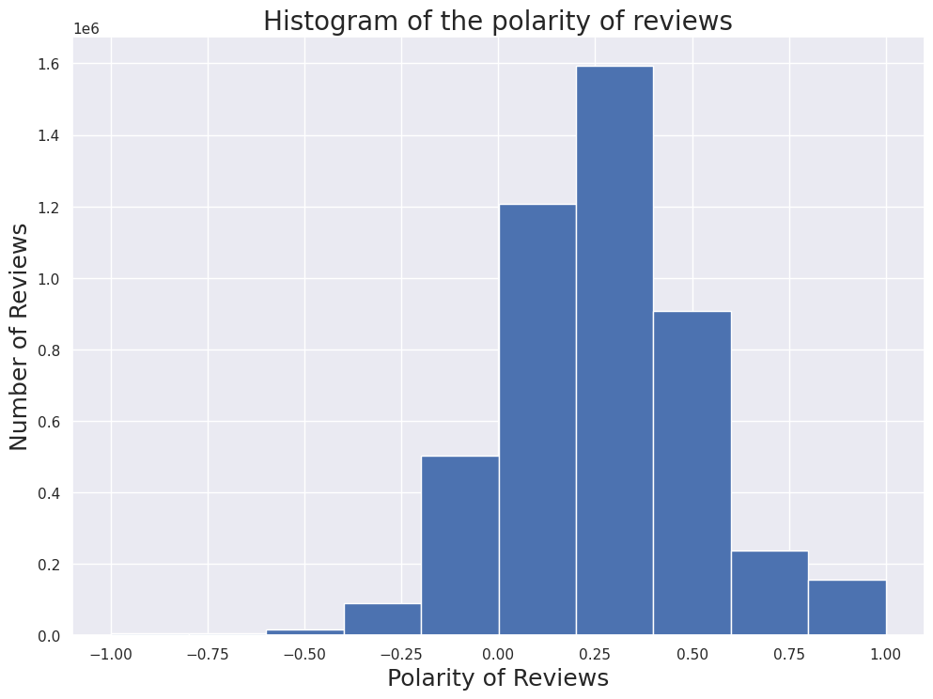
Dataset
Overview :
5 csv files
Businesses, Check-ins, Reviews, Tips and Users
Only businesses and reviews are relevant to business need.
High number of positive reviews
Data cleaning and Filtering :
Selecting restaurants from business list
Filtering out reviews not belonging to restaurants
Calculation of review Sentiment
Keeping only reviews with 2 stars or less and with negative polarity

Slide 6
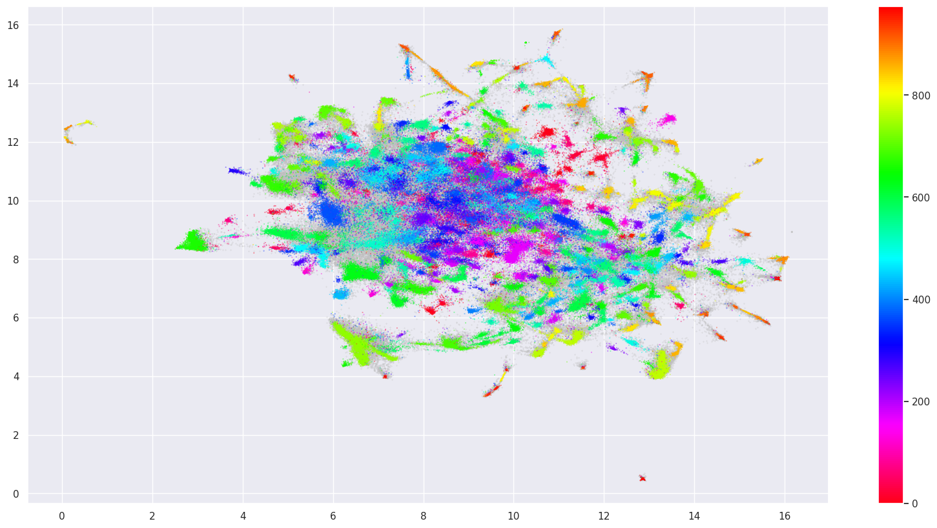
Text Data Preprocessing
Text Normalization using SpaCy to lemmatize dataset and remove stop words and punctuation.
Text Vectorization using TF-IDF Vectorizer
Dimensionality reduction with UMAP (10 features)
Clustering with HDBSCAN
2nd Dimensionality reduction with UMAP (2 features)
Visualization of created clusters
Visualization of Text data with UMAP

Slide 7
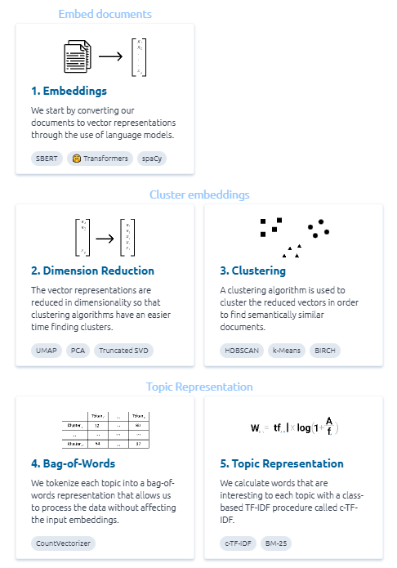
Topic Identification
Using BERTopic algorithm.
Embedding with SBERT
Dimensionality reduction with UMAP
Clustering with HDBSCAN
Tokenizing topics with Bag-of-Words
Topic Representation with c-TF-IDF

Slide 8
Identified topics of dissatisfaction
20 topics of dissatisfaction identified
Top 3 topics :
Dirtiness (bathroom / floor) and bad smell
Rudeness of the bartender, ignoring females and serving drunk people
Overpriced food with small portions and poor service

Slide 9
Updating the topics with new reviews
Verification of the possibility of retrieving new reviews with Yelp API
Performed sample collection by gathering information about 200 businesses and extracting 600 reviews.
Limitations :
Limited number of queries per day and month.
Location has to be included in business search
Only 3 reviews gathered by query
Low percentage of reviews are negative ➔ High number of queries needed to change our topic identification model.

Slide 10
Model Selection and Optimization

Slide 11
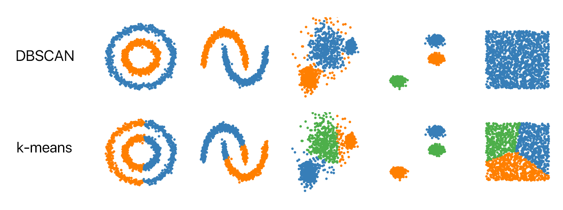
Candidate Models
2 studied options :
Inertia minimization algorithm ➔
K-means
Density based algorithm ➔ DBSCAN
Performance indicator : Silhouette score
Measures the similarity of objects within clusters and the separation of different clusters.
Ranges from -1 to 1.

Slide 12
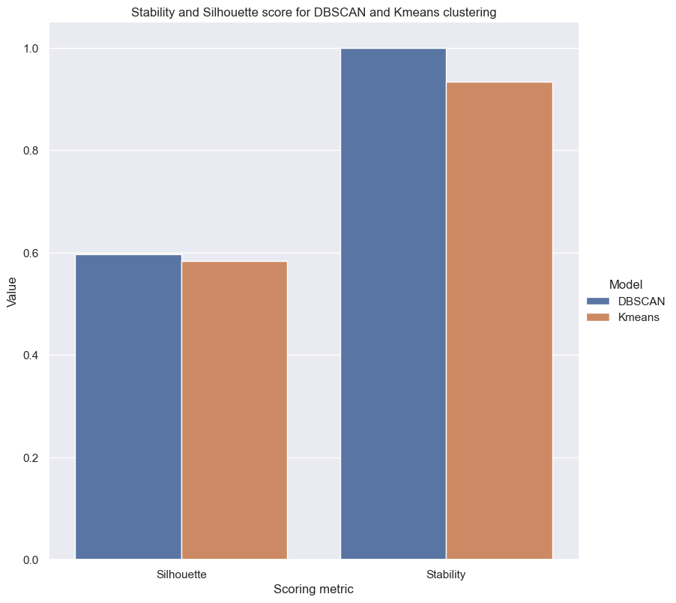
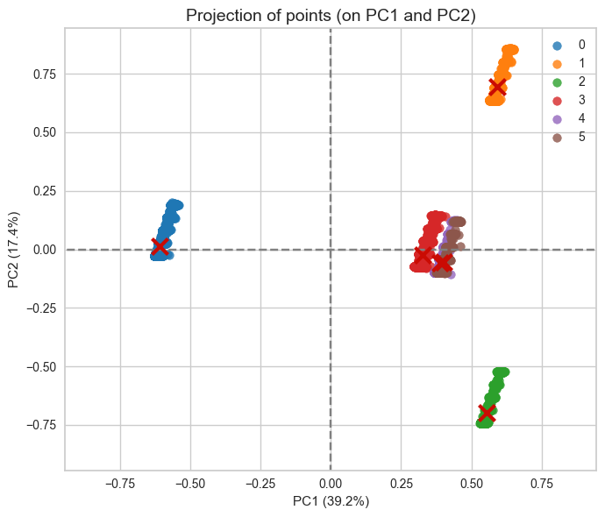
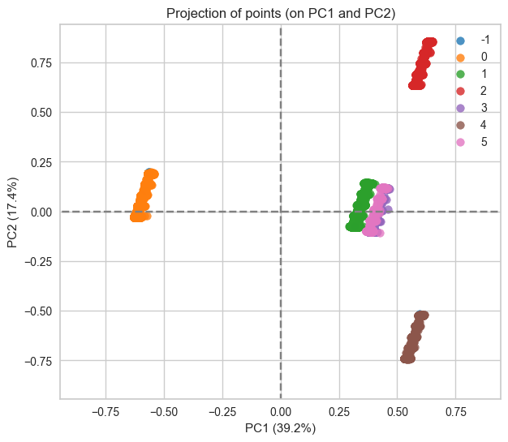
Model Selection
Optimization of the parameters of the 2 models using manual Grid search
Compute Silhouette score and Stability index on the 2 models with the best hyperparameters
Investigate the shape of both models using PCA visualization
➔ DBSCAN has the best performance and will be chosen as our model
K-means
DBSCAN

Slide 13
Final Model Performance

Slide 14
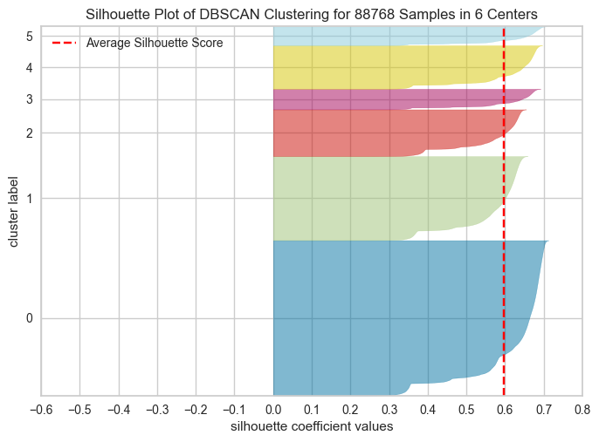
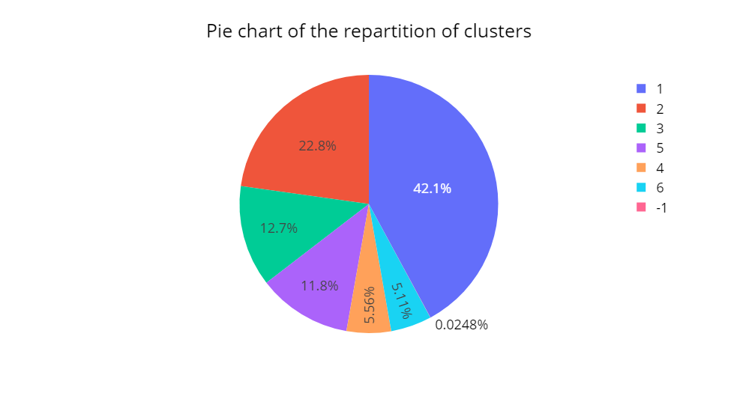
Performance Metrics
Our model has a good Silhouette score at 0,597 on the whole dataset.
Stability score = 1.
It separates the dataset in 6 clusters.
There is an unequal distribution of the samples in those clusters
Cluster 1 contains 42% of samples.
Cluster 2 : ~23% of samples
Disclaimer :
The clusters have been shifted from 0-5 to 1-6 for easier visualization

Slide 15
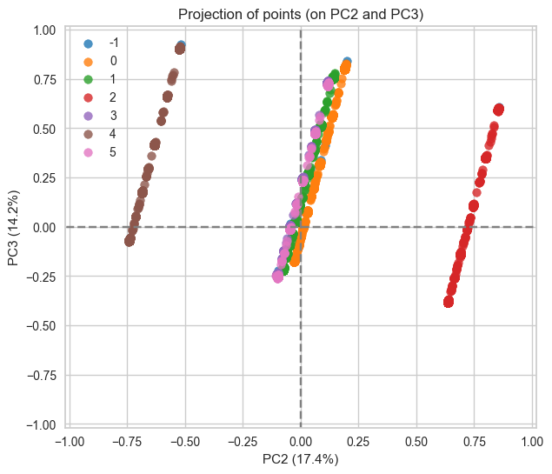
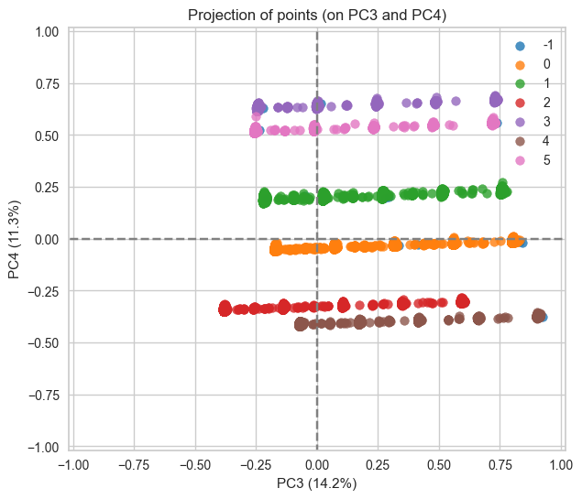
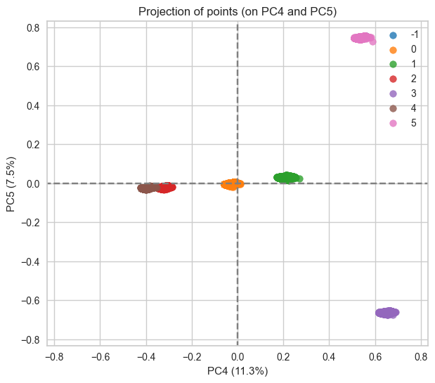
Model Shape
1st PCA plane : Good separation of 5 clusters
2nd PCA plane : 2 clusters clearly separated, slight separation of 3 additional clusters
3rd and 4th PCA plane : 6 clusters cleanly separated
Analysis of the shape of our clusters with PCA visualization (5 first components represent 90% of variance) ➔ proves the efficiency of our model

Slide 16
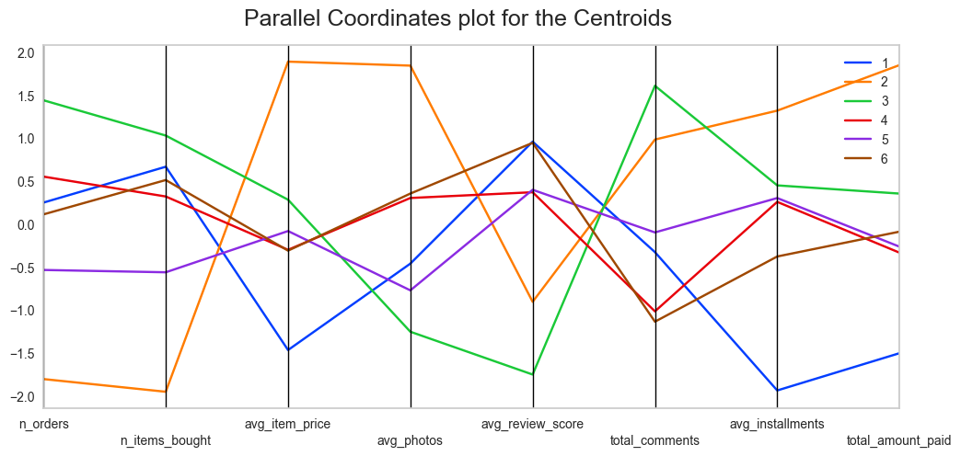
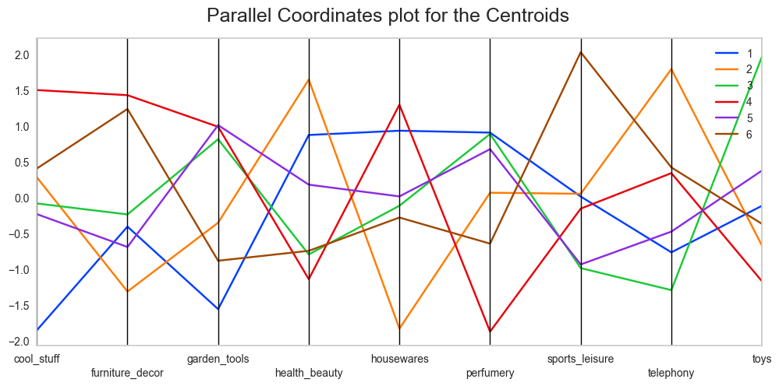
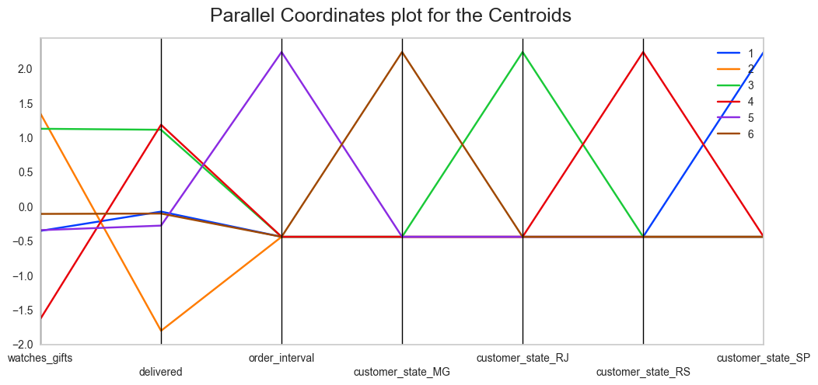
Segment characteristics
Segment 1: Sao Paulo area, mostly interested in health, beauty, housewares, bed, bath, tables and perfumery products, requests low shipping delay and buys low price products, gives good review scores
Segment 2: Likely to cancel order, mostly interested in telephony, health, beauty and auto products, orders from sellers far from its location, buys a low amount of items but with at a high price and with a high number of photos.
Segment 3: Rio de Janeiro area, mostly interested in toys, perfumery, garden tools, bed, bath and table products, mostly pays by credit card, high number of item bought and number of orders.
Segment 4: Rio Grande do Sul area, mostly interested in housewares, garden tools, furniture, decor, cool stuff and computer accessories, accepts higher shipping delay, less likely to use credit card and overpays items.
Segment 5: Likely to be a returning customer, mostly interested in perfumery, garden tools and computer accessories, high review delay.
Segment 6: Minas Gerais state, mostly interested in sports, leisure, furniture, decor and auto products, gives high rated reviews.

Slide 17
Conclusion

Slide 18
Recommendations
This project has outlined 6 stable customer segments ➔ fulfill business need
These segments can be used to optimize marketing efforts in different ways:
Reduce costs and improve marketing ROI by targeting ideal customers.
For local ad campaigns, focus on the products interesting the customers.
Write custom advertisements depending on customer needs (i.e. short shipping delay or possibility to buy without credit card).
More generally, target high paying customers with low cancellation rates.
The model could be improved by providing additional information like customer age and gender

Slide 19
Questions?

