Slide 1

Sentiment Analysis of Twitter reviews
Presented by: Octave Antoni
Last Updated: October 21th, 2022

Slide 2
Table of contents
Introduction
Text data Preprocessing
Text Classification with Deep Learning
Basic model and Commercial API
Conclusion

Slide 3
Introduction
Main goal ➔ Create 3 tiers of Sentiment Analysis models which will be used to predict the polarity of a tweet.
Basic Customized Model : Azure ML Designer service
Commercial off-the-shelf API : Azure Cognitive Service API
Advanced Customized Model : Deep Learning Model
Key points :
Use of Azure Machine Learning Studio platform
Comparison of different kinds of word embeddings
High accuracy sentiment prediction
Limitation : Azure Credits not provided to student ➔ Only low performance computes could be used (trial account) ➔ Low number of training epochs and high training time

Slide 4
Text Data Preprocessing

Slide 5
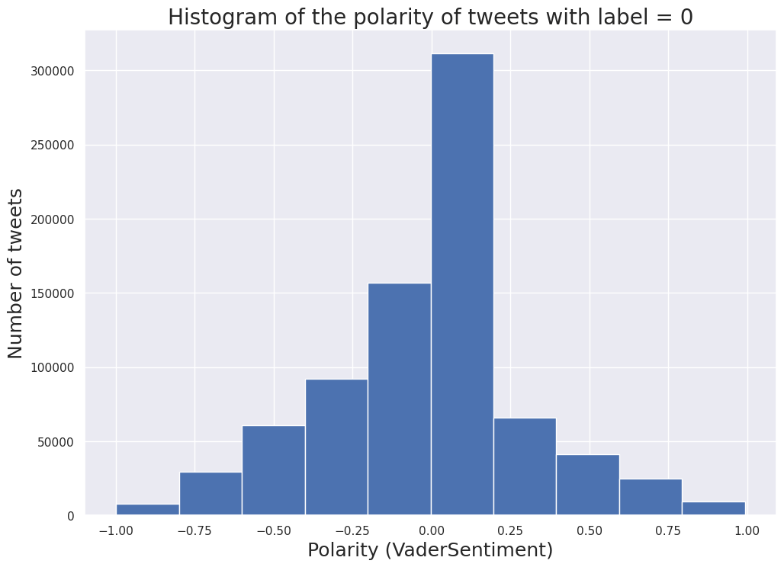
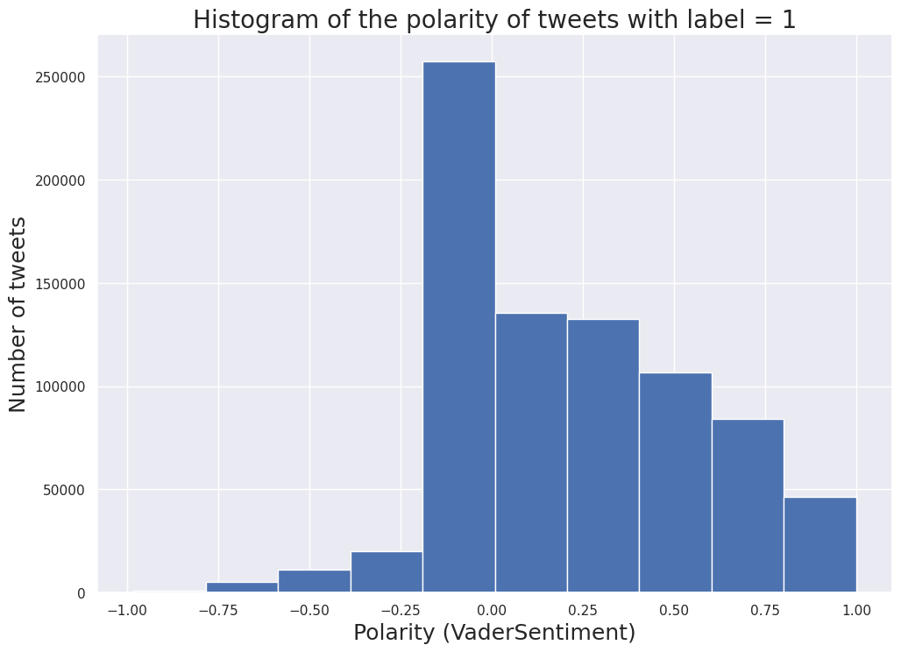
Dataset
Open source twitter dataset :
1 csv with 1.6 million rows
Label, date, user name and text
Labels are either 0 (negative) or 1 (positive)
Balanced class distribution (50/50)
Data cleaning and Filtering :
Removing date and user name fields
Calculation of tweet polarity with VaderSentiment
No empty tweets to clean

Slide 6
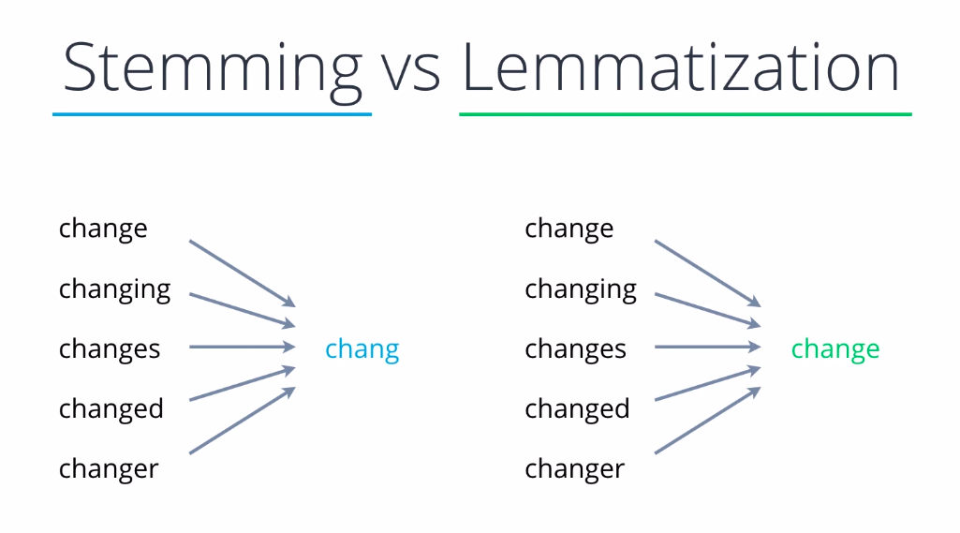
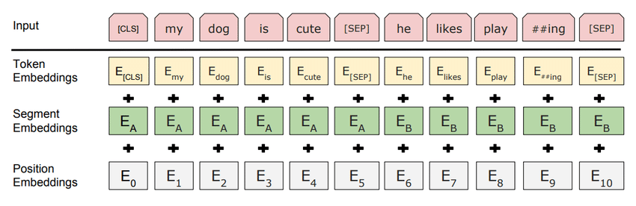
Text Data Preprocessing
Text Normalization using SpaCy to lemmatize dataset
Removal of stop words
Removal of punctuation
Testing of different text embeddings :
Keras TextVectorization (integer)
BERT Embedding (raw text)
Word2vec
Bigram Feature Hashing (Basic Model)
Most performant embedding technique : BERT

Slide 7
Deep Learning Text Classification

Slide 8
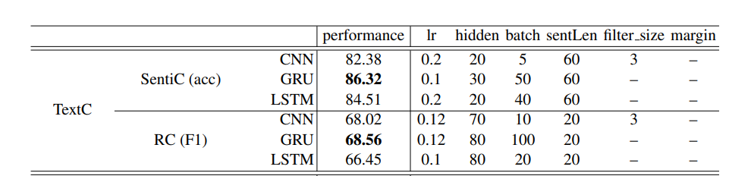
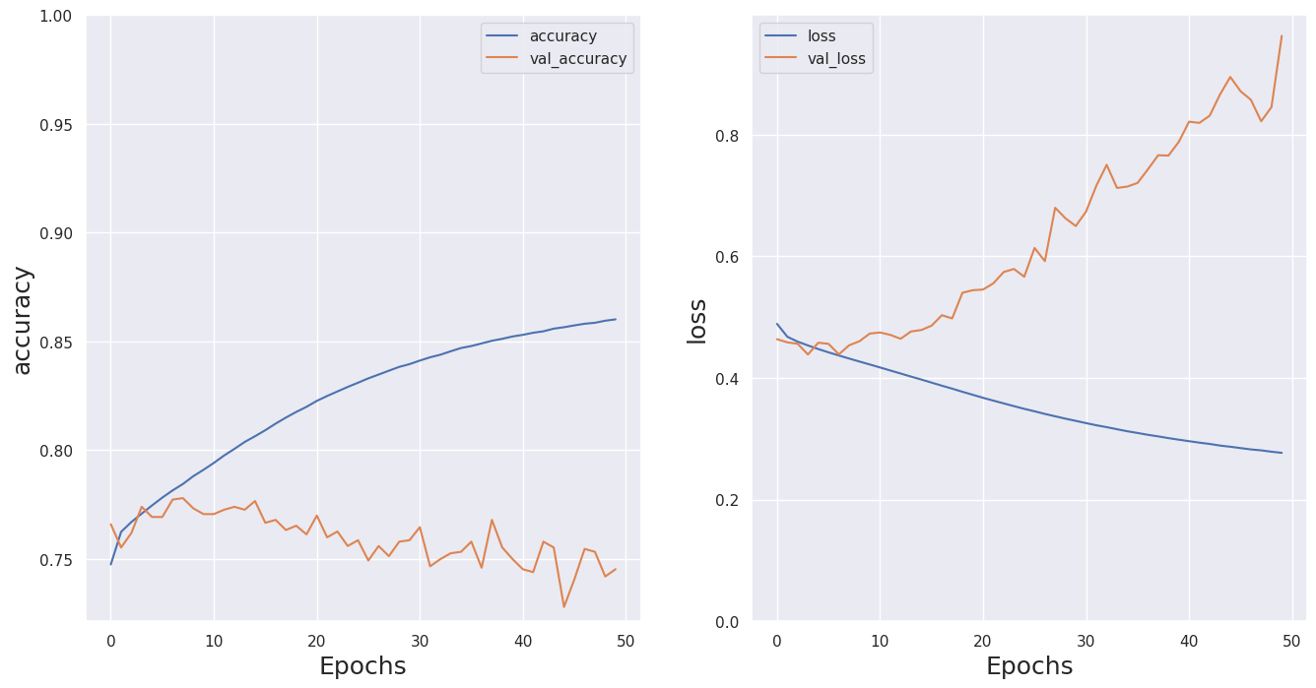
Simple Vectorization + RNN
Embedding used : Keras TextVectorization layer on lemmatized text
Use of Recurrent Neural Network (RNN) after reading Comparative study of CNN and RNN for NLP (research paper)
Metric : Accuracy, Optimizer : Adam
2 kinds of model tested :
Single Long Term Short Memory layer
2* LSTM layers + Dropout
Final Accuracy : 0.77
ROC : 0.86, F1 Score = 0.78
RNN

Slide 9
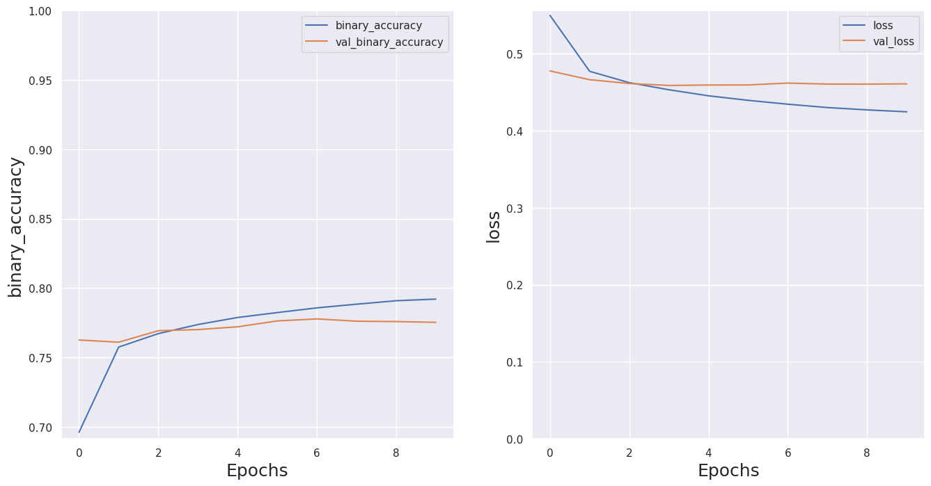
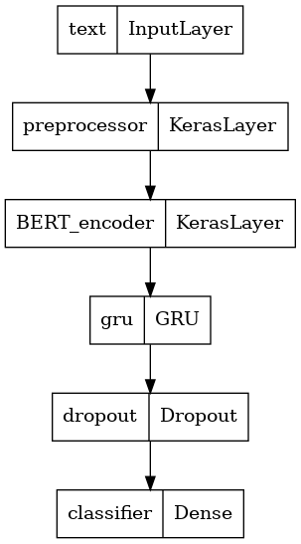
BERT (CNN and RNN)
Encoder used : SmallBERT L-2 H-128 (smallest BERT encoder)
Outputs a vector with 128 dimensions
Metric : Accuracy, Optimizer : AdamW
2 kinds of neural networks tested :
CNN with Dropout layer (high Recall)
RNN with GRU and Dropout
Final Accuracy : 0.80
ROC : 0.89, F1 Score : 0.81

Slide 10
Basic Model and Commercial API

Slide 11
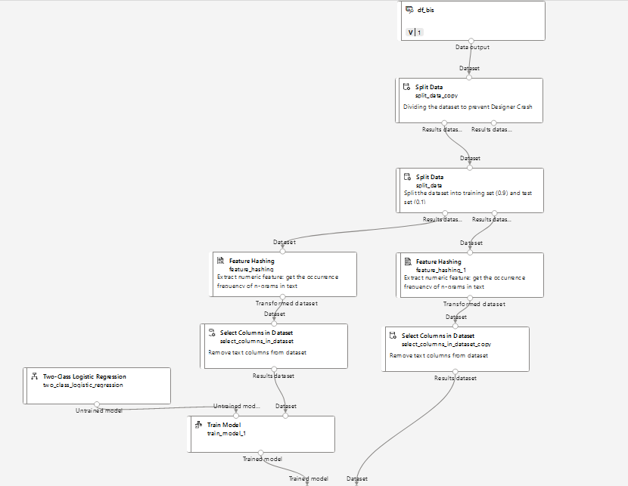
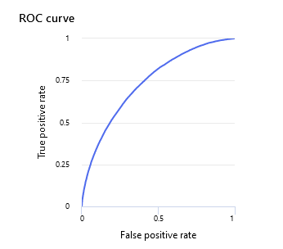
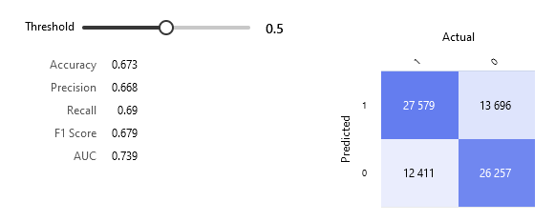
Basic Model Implementaiton
Reducing Dataset
to Prevent Crashes
Using Azure ML Designer
Loaded lemmatized Dataset to reduce computation time
Necessity to reduce the number of rows of the dataset to prevent crashes (50% used).
Performed Bigram Feature Hashing of text
Used Logistic Regression Model
Final Accuracy = 0.67
ROC : 0.74, F1 Score : 0.68
Test/Train Split
Bigram Feature
Hashing
Logistic Regress.
Training and Scoring
Accuracy 0.673

Slide 12
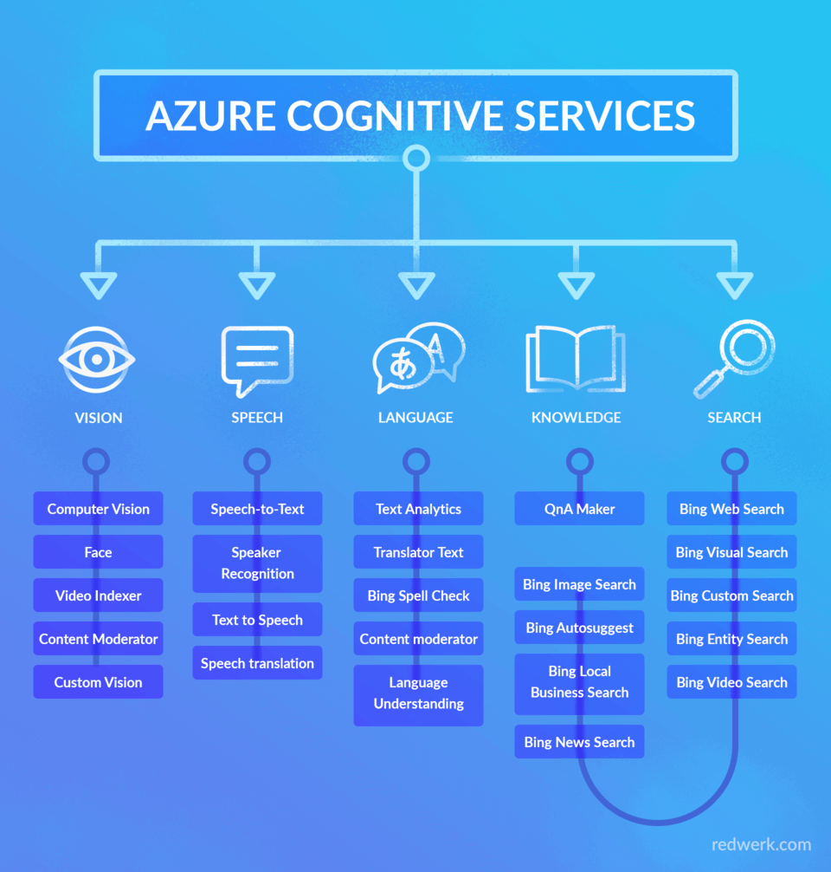
Commercial off-the-shelf API
Creation necessary of Azure Cognitive Service account
Maximal request size : 10 documents / request
Free up until 5000 requests / months, paying tier above
Big advantage : Very fast classification
Good Accuracy ➔ 0.76
ROC : 0.76, F1 Score = 0.78

Slide 13
Conclusion

Slide 14
Conclusion
During this project, Sentiment Analysis has been performed on Twitter posts.
Recommendations :
Reconsider using commercial API ➔ moderate accuracy (0.76) for high price.
Basic Model with Designer ➔ low accuracy (0.67), consider using a simple Deep Learning Model instead
Use BERT model + RNN for Advanced Customizable Model
Improve current model with more training epochs and better compute instances
Implement BERT model to create a Dashboard of the polarity of current tweets about Air Paradis

Slide 15
Questions?

