Slide 1
Anti-derivatives

Slide 2

Recall!
Function $f\left(x\right)$
Slope function $f^{′}(x)$
Anti-Differentiation
or
Integration
Differentiation

Slide 3
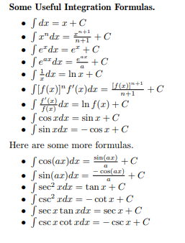
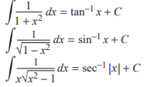

Slide 4
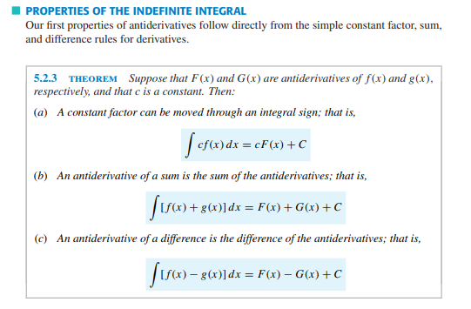

Slide 5
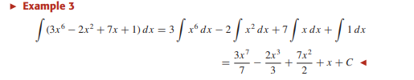
Example

Slide 6

Examples

Slide 7
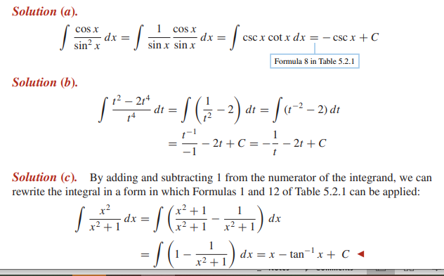
Examples

Slide 8
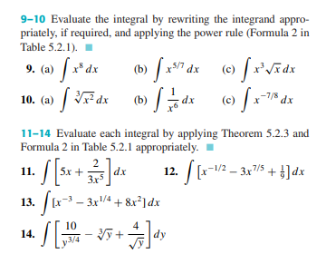
Exercise

