Slide 1
hexapod_spiderbot_tutorials/tutorial_forward_kinematics/media/top_view.png at main · robs-tech-workbench/hexapod_spiderbot_tutorials · GitHub

Slide 2
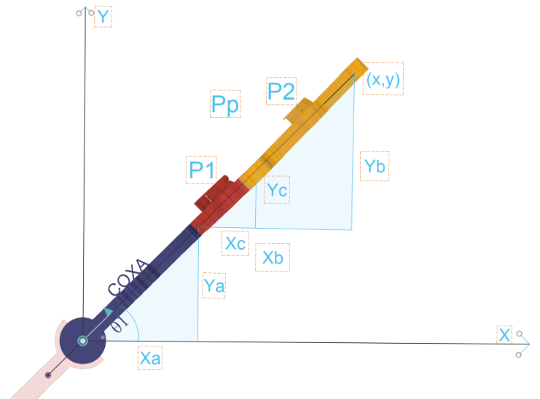
Top

Slide 3
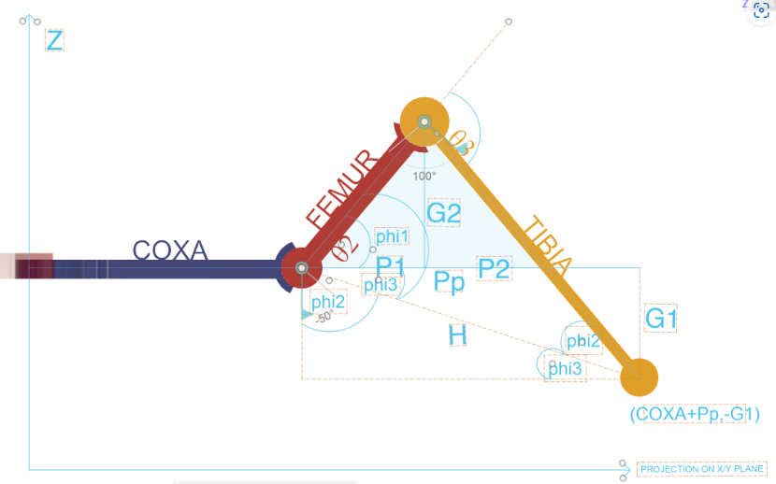
Side

Slide 4
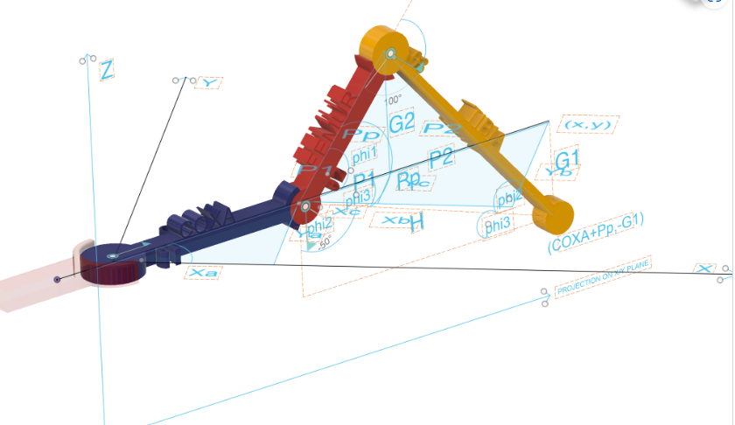
3D

Slide 5
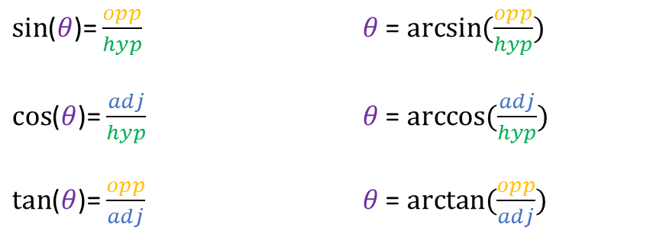





$sin$($θ$)= $\frac{opp}{hyp}$ $θ$ = $arcsin(\frac{opp}{hyp})$
$cos$($θ$)= $\frac{adj}{hyp}$ $θ$ = $arccos(\frac{adj}{hyp})$
$tan$($θ$)= $\frac{opp}{adj}$ $θ$ = $arctan(\frac{opp}{adj})$
hyp
opp
$$θ$$
adj
$cos$($C$)= $\frac{a^{2}+b^{2}−c^{2}}{2 ∗a ∗b}$
$cos$($A$)=$\frac{b^{2}+c^{2}−a^{2}}{2 ∗b ∗ c}$
$cos$($B$)=$\frac{c^{2}+a^{2}− b^{2}}{2 ∗c ∗a}$
$$A$$
C=?
a
$$B$$
$$C$$
b

Slide 6
Angle Conversion: The method begins by converting the joint angles from degrees to radians. This conversion is essential as trigonometric functions in Python's math library require angles in radians.
theta1, theta2, theta3 = map(math.radians, self.get_angles())
Coxa-Femur Joint Calculation:
Xa and Ya determine the x and y coordinates of the coxa-femur joint (the hip joint). They are calculated using the cosine and sine of theta1, respectively, multiplied by the length of the coxa (self.COXA). Cosine gives the horizontal component, and sine provides the vertical component.
Xa = self.COXA * math.cos(theta1)
Ya = self.COXA * math.sin(theta1)
Femur Segment Calculations:
The vertical component G2 of the femur length is calculated by the femur length (self.FEMUR) multiplied by the sine of theta2. This gives the vertical displacement.
The horizontal component P1 is found by multiplying the femur length by the cosine of theta2. This gives the horizontal displacement.
G2 = math.sin(theta2) * self.FEMUR
P1 = math.cos(theta2) * self.FEMUR
Femur-Tibia Joint Calculation:
Xc and Yc are the x and y coordinates of the femur-tibia joint (knee joint), computed by multiplying P1 with the cosine and sine of theta1.
Xc = math.cos(theta1) * P1
Yc = math.sin(theta1) * P1

Slide 7
5.Tibia-Tip Joint Calculation:
This step involves calculating the position of the tibia-tip joint (foot of the leg) using a series of trigonometric calculations.
H is the straight-line distance from the femur-tibia joint to the tibia-tip joint, calculated using the Law of Cosines.
H = math.sqrt(self.TIBIA**2 + self.FEMUR**2 - 2*self.TIBIA*self.FEMUR*math.cos(math.radians(180) - theta3))
phi1 is calculated using the Law of Cosines again, to find the angle at the femur-tibia joint.
phi1 = math.acos((self.FEMUR**2 + H**2 - self.TIBIA**2) / (2*self.FEMUR*H))
phi2 is the angle at the tibia-tip joint. It's calculated by subtracting phi1 and the external angle ( 180^\circ - \theta3 ) from 180 degrees.
phi3 is an auxiliary angle, used to find the horizontal and vertical projections. It's calculated by subtracting theta2 from phi1.
phi2 = math.radians(180) - (math.radians(180) - theta3) - phi1
phi3 = phi1 - theta2
Pp is the horizontal projection of the tibia-tip joint on the plane of the femur. It is calculated using the cosine of phi3 multiplied by H.
Pp = math.cos(phi3) * H
P2 is the horizontal distance between the femur-tibia joint and the tibia-tip joint. It is calculated as the difference between Pp and P1.
P2 = Pp - P1
Yb and Xb are the x and y coordinates of the tibia-tip joint, calculated by multiplying the sine and cosine of theta1 by Pp, respectively.
Yb = math.sin(theta1) * Pp
Xb = math.cos(theta1) * Pp
G1 is the vertical component (z-coordinate) of the tibia-tip joint. It is calculated using the sine of phi3 multiplied by H. The result is negated as the z-axis might be defined downwards in the robot's coordinate system.
G1 = math.sin(phi3) * H
G1 = -G1
6.Joint Locations List:
The method concludes by creating a list of joint locations. Each joint location is represented by a set of x, y, and z coordinates. This list includes the positions of the base joint, coxa-femur joint, femur-tibia joint, and the tip of the leg.
joint_locations = [
[0, 0, 0], # Base joint
[Xa, Ya, 0], # Coxa-femur joint
[Xa + Xc, Ya + Yc, G2], # Femur-tibia joint
[Xa + Xb, Ya + Yb, G1] # Tip of the leg
]

Slide 8
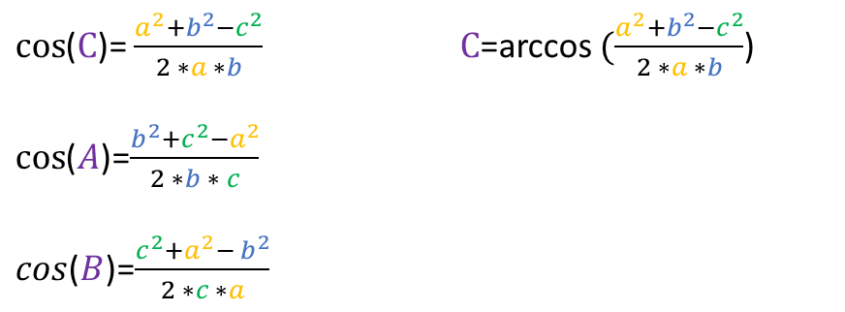
$sin$($θ$)= $\frac{opp}{hyp}$ $θ$ = $arcsin(\frac{opp}{hyp})$
$cos$($θ$)= $\frac{adj}{hyp}$ $θ$ = $arccos(\frac{adj}{hyp})$
$tan$($θ$)= $\frac{opp}{adj}$ $θ$ = $arctan(\frac{opp}{adj})$
hyp
opp
$$θ$$
adj
$cos$($C$)= $\frac{a^{2}+b^{2}−c^{2}}{2 ∗a ∗b}$ $C$=arccos $(\frac{a^{2}+b^{2}−c^{2}}{2 ∗a ∗b}$)
$cos$($A$)=$\frac{b^{2}+c^{2}−a^{2}}{2 ∗b ∗ c}$
$cos$($B$)=$\frac{c^{2}+a^{2}− b^{2}}{2 ∗c ∗a}$
$$A$$
C=?
a
$$B$$
$$C$$
b

