Slide 1
Привет!
Hi! Aloha! Mirëdita! Dobrý den! Bonjour! HEI! Guten Tag! Aloha! 嗨！こんにちは！Tere!
Привіт! Chào! ¡Hola! Merhaba! 안녕! Ciao! γεια! прывітанне! Здравейте! नमस्ते! talofa! ಹೈ! ola! салам! salute! Ողջու՜յն! Haigh! mholweni! Sveiki! Здраво!

Slide 2

Fastcart.ml
Efficient Checkout for Retail

Slide 3
Checkout Sucks.

Slide 4
Not anymore.

Slide 5
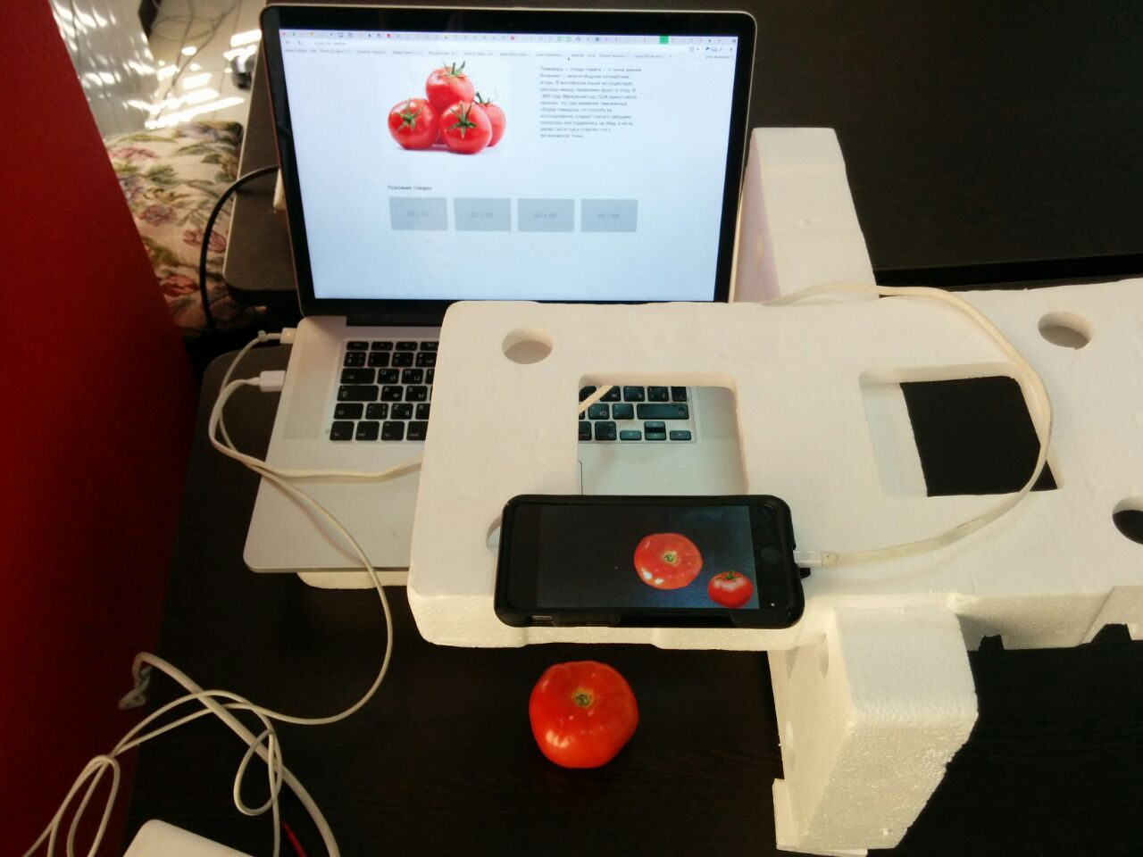
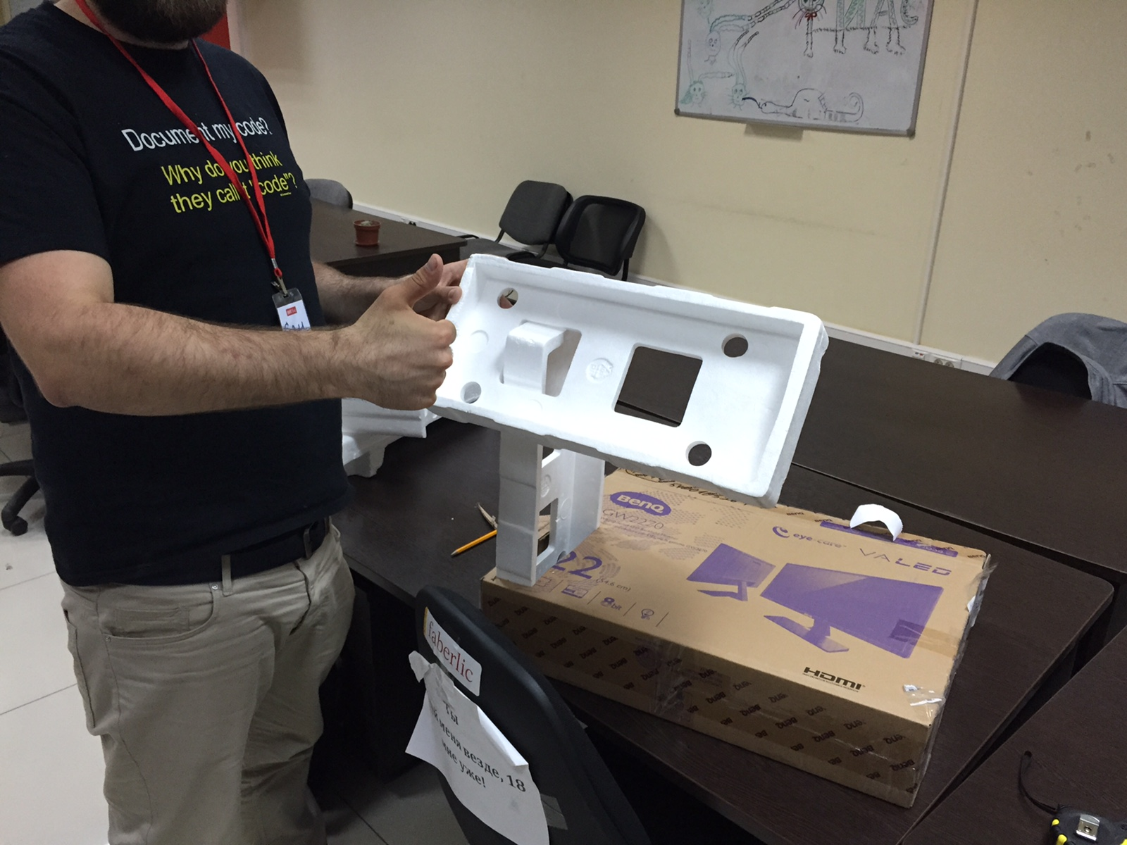

Slide 6
Prototype

Slide 7



Efficient
Faster scanning
Barcode free
Intuitive UI
Familiar Process
Constantly Improving
Accurate Machine Learning
Learns Varieties of products
Cross-market
Analytics
Built in
Predict Demand
Price Accurately
Buy Smarter
Big-Data Ready

Slide 8
Demo:
Fastcart.ml

Slide 9

Спасибо!

