Slide 1

Lonely Lobster
a multi-process flow simulation
Release 1 - Beta
Gerold Lindorfer, 2023-10-11

Slide 2
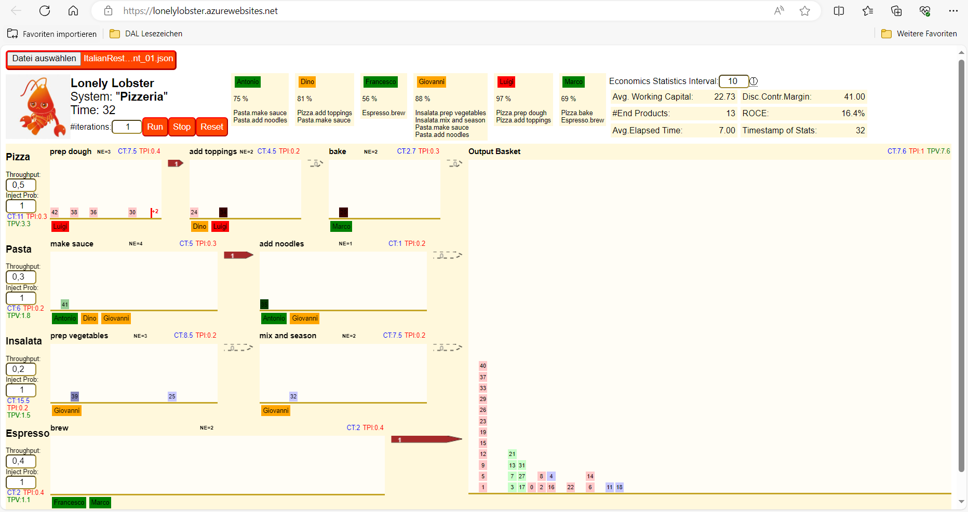
url
worker with utilization and process step assignments; workers can work on 1 work item per time unit
select system configuration json-file
advanced stats (beta)
configuration
#iterations to run
run, stop, reset iterations
value chain
process step
norm effort: effort it takes to complete work item in this process step
The kitchen‘s output, i.e. what is served to guests. The farther right the longer it took from start producing the dish to it completion.
assigned worker
CT=cycle time
TPI=ThroughPut [Items]
TBV: ThroughPut [Value]
overflow counter: 2 more aged workitems not visible any more
A workitem, i.e. a customer order. The darker the closer it is to its completion in the process step.
Process step stats, see explanation at Output Basket
inventory of workitems, some of which have been worked on. The farther right the longer has been in the process step‘s inventory
Throughput of incoming workorders
Irregularity of incoming work orders. Value btw. 0 and 1: low=rough, high=smoother
workitem flows to next step
Value chain stats, see explanation at Output Basket

