Slide 1
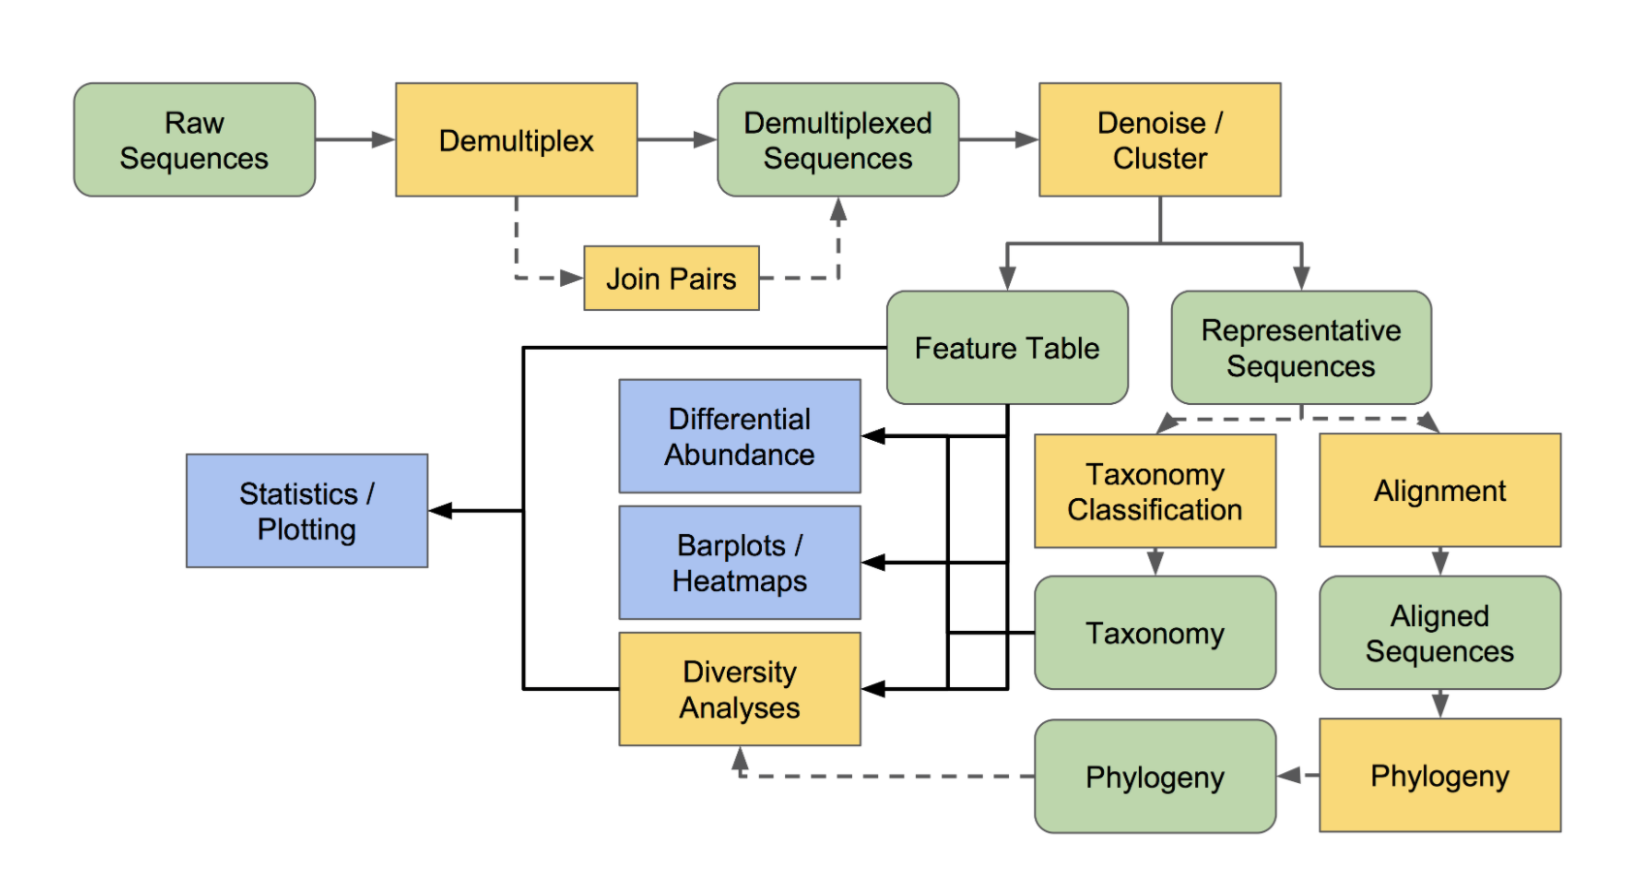
Input: Directory of .fastq files and metadata
Output: Interactive Dashboard with two primary modules
Module 0:
Data Pre-Processing
Automated process:
QIIME2 ACCEPTS .fastq file directory
then
DEMULTIPLEXES the data
then
QUALITY CONTROL of data
then
CREATES TABLES for
1. Sequence quality by position
2. Abundance by taxonomy
Module 1:
Sequencing Quality
Module 2:
Sequencing Results
Statistics and Plotting
INSERT GRAPH
INSERT GRAPH
INSERT GRAPH
Input
Outputs to Modules

