Slide 1
FastQCS³ Analytical App Interface for Microbiome Sequencing Quality and Results Nick Bohmann, Cassandra Maranas, Ben Nguyen, Evan Pepper, Kaylyn Torkelson

Slide 2
Background
Microbiome Sequencing
Identification of taxa present in the microbiome
Critical step in microbiome research
16S amplicon sequencing
Sequencing of unique region of bacterial DNA
Determine presence and relative abundance of taxa

Slide 3
Background
Interested in sequencing quality, classification of sequencing results
Sequence Quality: FastQC
Per base sequence quality, reads per sample
Taxonomic Classification: Qiime2
Relative abundance, alpha/beta diversity

Slide 4
Our Application: FastQCS³
Motivation:
Why is software so inaccessible to the inexperienced bioinformatician?
Goal: create easy to use, user-controlled, streamlined interface for preliminary 16S amplicon sequence data -- what did you get?
Performs summary statistics, generates ASVs, phylogenetics, classification, dash visualization
Leverages pre-existing software without all the fluff
Notes:
Evan

Slide 5
Use cases
The lab tech just generated new 16S sequencing data! I (a grad student) want to know generally what the data looks like.
Modules:
Validation and summary of sequencing data
ASV table, taxonomy, alpha/beta diversity
Notes:
Evan

Slide 6



Package Dependencies
QIIME2
input: raw sequencing data
output: taxonomic classification, alpha diversity metric vectors, beta diversity distance matrices
Biopython
tied in with QIIME2
used independently for determining sequencing quality
Dash
final interactive dashboard
Notes:
Kaylyn

Slide 7
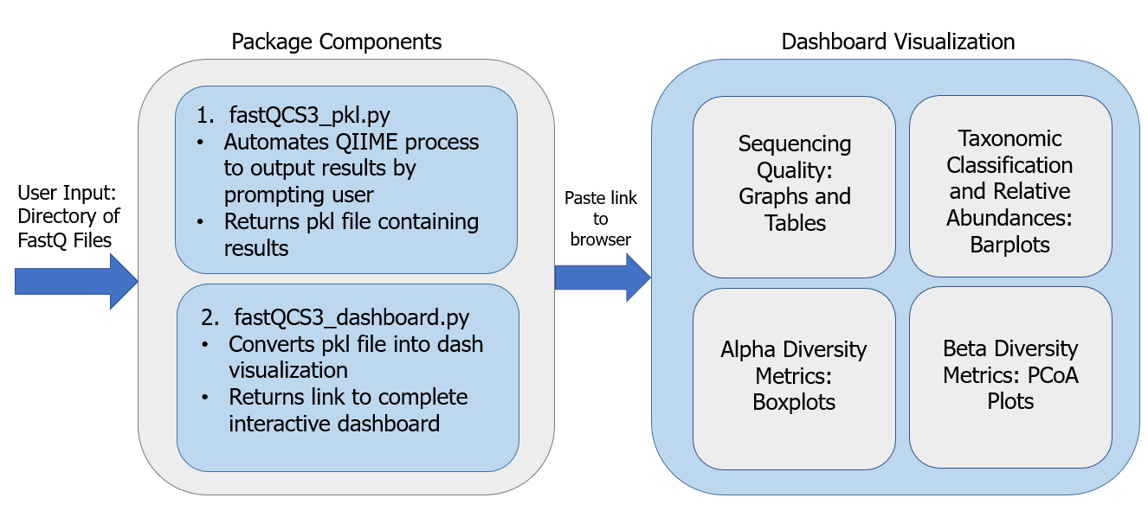
FastQCS³ Pipeline
Notes:
Kaylyn

Slide 8

Demo Video

Slide 9
Possible Future Steps
Ability to input multiple directories of .fastq files at once
More plots and enhanced user customization of their display
option to display some summary stats before dada2 filtering step
Include pipeline for training a user-specific classifier
Expand to include paired end sequencing
Cut out QIIME2 completely
Make pip installable

