Slide 1
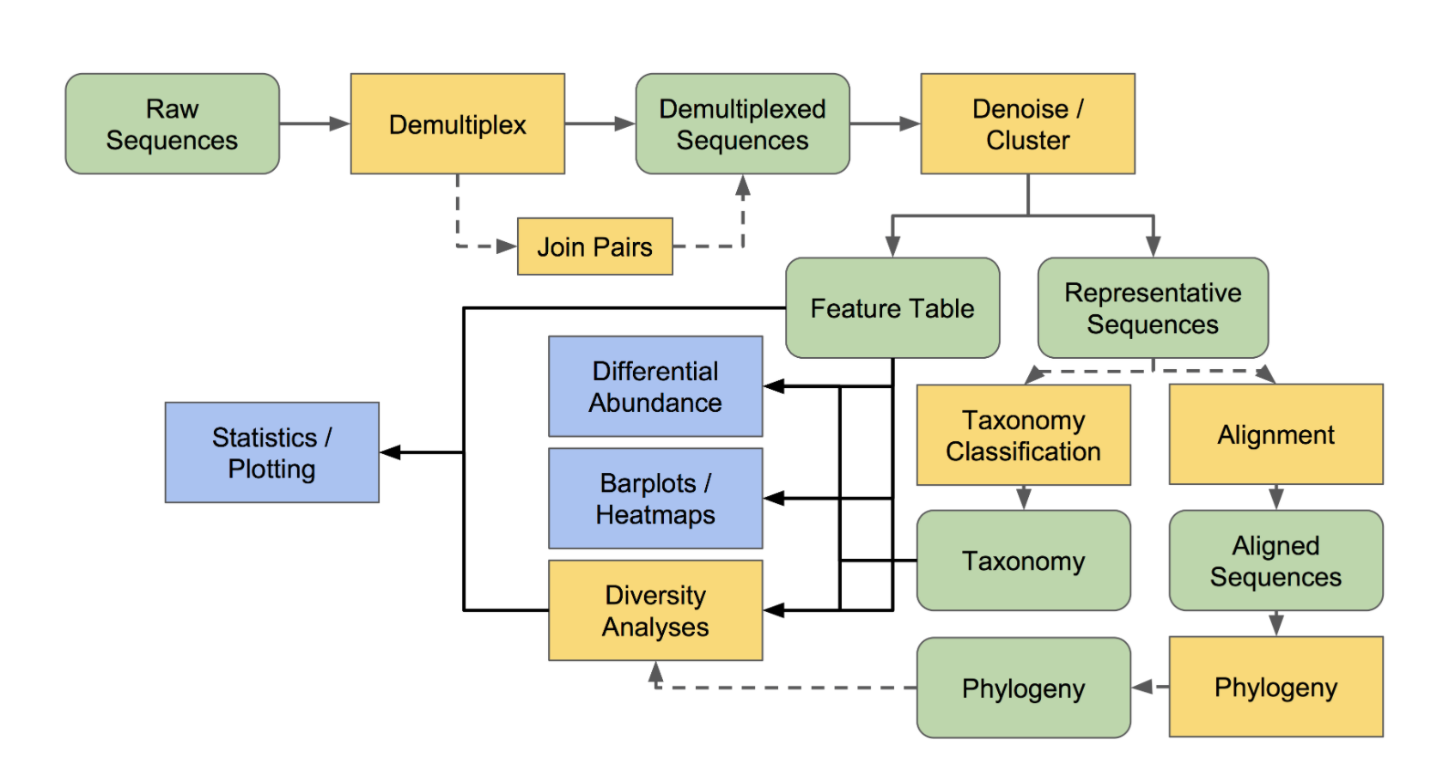
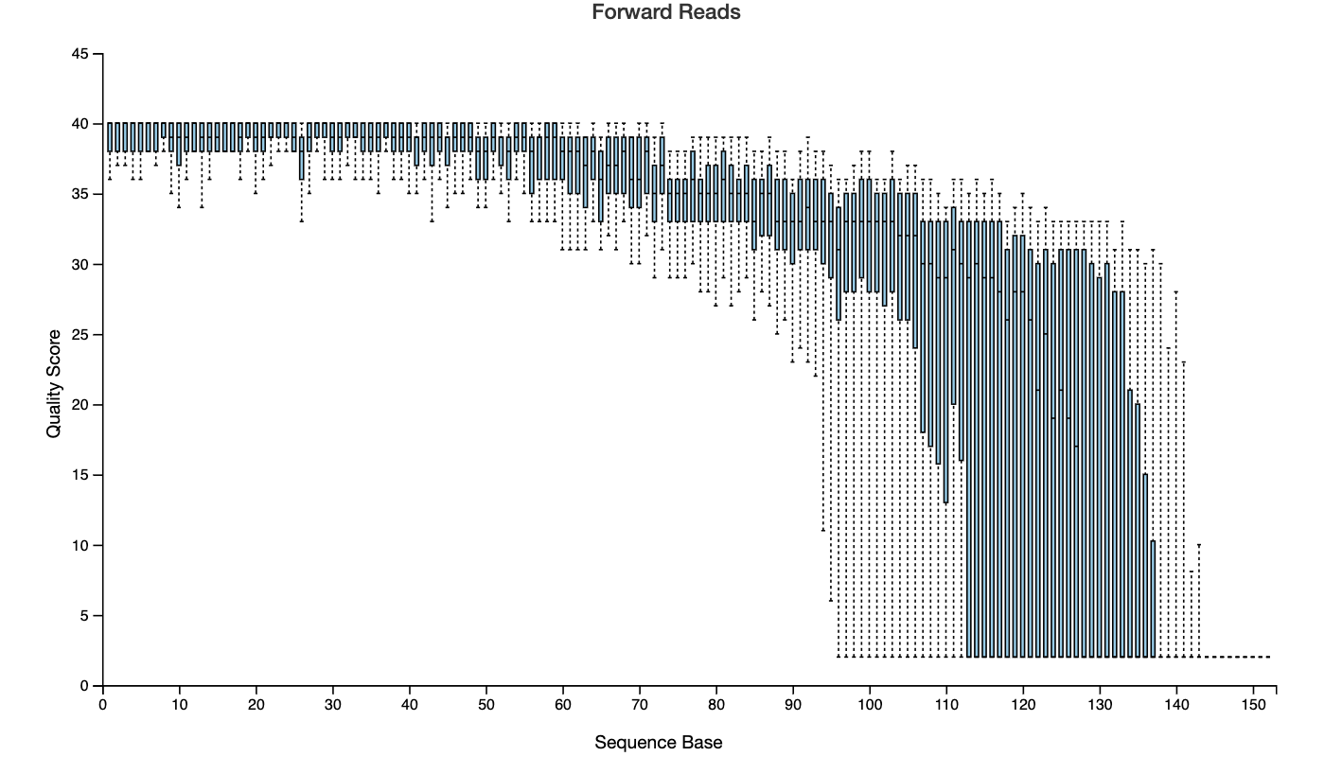
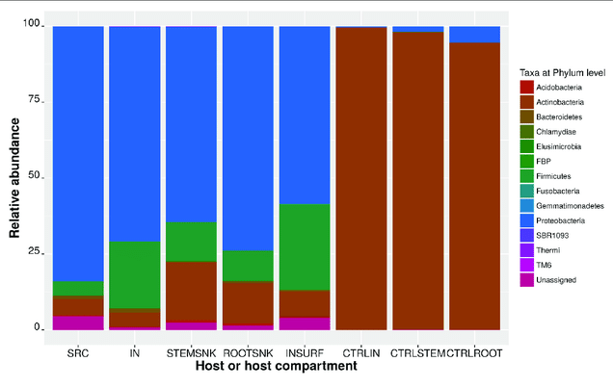
Input: Directory of .fastq files and metadata
Output: Interactive Dashboard with two primary modules
Module 0:
Data Pre-Processing
Automated process:
QIIME2 ACCEPTS .fastq file directory
then
DEMULTIPLEXES the data
then
QUALITY CONTROL of data
then
CREATES TABLES for
1. Sequence quality by position
2. Abundance by taxonomy
Module 1:
Sequencing Quality
Dashboard output:
Summary statistic table for sequencing quality
Number of reads per sample
Average length per read
Graph of sequence quality by sequence base position
Module 2:
Sequencing Results
Statistics and Plotting
Dashboard output:
Visualization of taxonomic classification by taxonomic level
Summary statistics on diversity (alpha and beta) by various metrics (Unifrac, Bray-Curtis), microbiome uniqueness score between samples*
* Based on paper: Gut Microbiome Pattern Reflects Healthy Aging and Predicts Extended Survival in Humans, Wilmanski et al.
Input
Outputs to Modules

