Slide 1
FastQCS³ Analytical App Interface for Microbiome Sequencing Quality and Results Nick Bohmann, Cassandra Maranas, Ben Nguyen, Evan Pepper, Kaylyn Torkelson

Slide 2
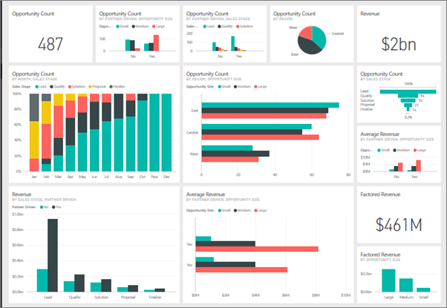
Our Application: FastQCS³
Easy to use, streamlined interface to determine and visualize sequencing quality and results in an interactive online dashboard
Dash: https://plotly.com/dash/
Required: platform for reading sequencing data, determining sequencing quality, and mapping to existing databases
Notes:
Kaylyn

Slide 3
Technology Considered
Options for Sequence Quality:
FastQC: Sequencing quality, not available in Python
MultiQC: Generates interactive report on quality
Qiime2: Generates output dataframe on sequencing quality
Options for Taxonomic Classification:
Biopython: Several options for using BLAST to classify sequencing data
Qiime2: Generates dataframe detailing
taxonomic classification of sequencing data
Notes:
Nick

Slide 4

Choice: QIIME2
>User input:
sample metadata
fastq files: sequence reads and barcodes
some read parameters
> QIIME2 outputs:
demultiplexed sequences
sequence quality data
phylogenetic diversity tree
alpha and beta diversity analysis
taxonomic analysis
Notes:
Cassandra

Slide 5
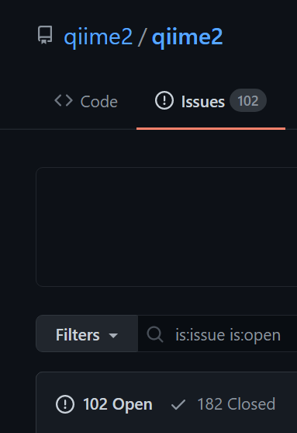
Appeal
Robust platform for taxonomic classification of sequencing results
Consolidates sequencing quality and database mapping (e.g. Biopython & FastQC all-in-one)
GitHub issues indicate regular use (182 closed issues, 102 open)
Developed tutorials for use and maintain forum for questions
More importantly, we CAN follow those tutorials
Notes:
Ben

Slide 6
Drawbacks
File formats are .qza or .qzv
Not easily editable in python
User needs to run a conda environment with QIIME 2 installed
QIIME2 is a big file
.fastq / .fastq.gz files need to be held locally
Notes:
Evan

