Slide 1


Fast Salt System
and EI assisted engineering
An open project for multidisciplinary design and education
Michigan State University
November 6, 2026
Thomas Wielenga, Ph.D., P.E.
Wielenga Innovation Foundation, Inc.
Notes:
0–1 min elapsed (1 min)
I’m here to talk about how a nuclear reactor can fit into energy needs and nuclear waste disposal needs. And how the design work can give students and faculty in different disciplines real projects to work on while using Electronic Intelligence.

Slide 2
EI (Electronic Intelligence) power demand
Efficiency improves
Energy needed per task reduced by a factor of 10 per year in recent years
Use also expands
Google reports more than 4× annual growth in API token throughput
Complexity increases
41 additional WISTRs
Longer reasoning, video, agents
Demand depends on usage, task complexity and efficiency.
One 600 MWe WISTR × 8,760 h/year × 95% capacity factor ≈ 5 TWh/year
2
Notes:
1–3 min elapsed (2 min)
The bars show annual electricity use by all US data centers. At 600 MWe and a 95% capacity factor, one WISTR would produce just under 5 TWh in a year. That additional need could be met by 41 additional WISTR reactors.
Why might actual demand depart from that projection? Less energy per task pulls it down. More users and longer, more complex tasks pull it up. The tenfold improvement refers to a recent trend for comparable tasks.
References
https://www.iea.org/reports/key-questions-on-energy-and-ai/executive-summary
https://abc.xyz/investor/events/event-details/2026/2026-Q3-Earnings-Call-2026-Ujou16CTw9/default.aspx
https://iea.blob.core.windows.net/assets/3179f7f8-01f6-4dd6-bffa-c9f7b73f1dc9/KeyQuestionsonEnergyandAI.pdf#page=110

Slide 3
Solar nearly does it
Annual additions
But power variable and not where needed
Annual data-center use grows ≈ 40 TWh/year
Energy storage needed and transmission from source to user.
Solar panels added: 46.6 GWdc/year. At 18.2% capacity factor:
≈ 74 TWh/year of new generation
Huge swings in energy production can produce negative wholesale prices.
Load following nuclear can improve earnings.
Solar additions could supply about
1.8× the annual demand growth.
Fast Salt System also addresses existing waste disposal.
3
Notes:
3–5 min elapsed (2 min)
Annual US data-center consumption grows by about 40 TWh each year on average. At the recent installation rate, one year’s 46.6 GW of new solar panels, rated in DC, could deliver about 74 TWh in a full year at the assumed 18.2% capacity factor.
That leaves two practical questions. Where is the power needed, and at what hour? Storage and transmission each address part of that problem. An operator facing negative wholesale prices could benefit from reducing reactor output during a surplus. The other reason I’m pursuing this system is what it could do with spent fuel.
References
https://iea.blob.core.windows.net/assets/3179f7f8-01f6-4dd6-bffa-c9f7b73f1dc9/KeyQuestionsonEnergyandAI.pdf#page=110
https://seia.org/news/report-solar-adds-more-new-capacity-to-the-grid-in-2024-than-any-energy-technology-in-the-past-two-decades/
https://seia.org/research-resources/solar-market-insight-report-2025-year-in-review/
https://www.eia.gov/electricity/Annual/table.php?t=epa_04_08_b.html
https://atb.nlr.gov/electricity/2025/utility-scale_pv
https://www.iea.org/reports/electricity-2026/prices
https://www.oecd-nea.org/upload/docs/application/pdf/2019-12/7056-system-effects.pdf

Slide 4
Spent Nuclear Fuel and the Plutonium problem
Commercial spent fuel
Surplus plutonium inventory
Over 90,000 metric tons
Nearly 20 metric tons
Stored at reactor sites in pools
and dry casks in fields.
plutonium under DOE fuel-use consideration
Growing by about 2,000 metric tons per year
Fast reactors can burn plutonium and long-lived actinides in spent fuel.
Inventory context: GAO and DOE, 2026
4
Notes:
5–7 min elapsed (2 min)
The figure on the left is the US inventory of commercial spent fuel. About 2,000 metric tons is added each year. Fuel is stored in pools and dry casks at reactor sites.
The nearly 20 metric tons on the right refers to a separate government surplus-plutonium inventory under consideration for fuel use. To see why either is of interest as fuel, we need one piece of reactor physics.
References
https://www.gao.gov/nuclear-waste-disposal
https://www.energy.gov/ne/articles/department-energy-seeks-transform-surplus-plutonium-nuclear-fuel
https://www.nrc.gov/facilities-safety/storage-of-spent-nuclear-fuel

Slide 5
Thermal and fast neutron reactors
Thermal reactors
Fast reactors
▪
A moderator slows most neutrons before further fission.
▪
The design preserves a fast neutron spectrum.
▪
Light-water reactors are the familiar example.
▪
Uses heavy fuels and coolants to keep speeds high.
▪
“Thermal” means slow neutrons.
▪
Can create actinides and burn them.
▪
Creates plutonium and higher actinides
5
Notes:
7–9 min elapsed (2 min)
Think of “thermal” and “fast” as descriptions of the neutrons that sustain fission. In a familiar light-water reactor, collisions with the water slow neutrons down. The choice of coolant and other core materials in a fast reactor allows much more of the neutron population to retain high energy.
Neutron capture can form heavier nuclei. Fission consumes them and releases energy. The competition between those reactions helps explain why both the neutron spectrum and the choice of fuel matter for our waste-management goal.
References
https://www.energy.gov/ne/articles/nuclear-101-what-fast-reactor

Slide 6
What remains in spent fuel
Material group | Why it matters
Uranium | Most of the remaining heavy metal is U-238 (depleted)
Plutonium and other actinides | Potential fuel and a long-term waste concern
Fission products | Products of fission with varied half-lives and heat output
Cladding and other materials | Also require handling and disposition
6
Notes:
9–10.5 min elapsed (1.5 min)
Uranium accounts for most of the remaining heavy metal, and most of that uranium is U-238. The plutonium and higher actinides are particularly interesting to us because they can serve as fuel. Fission products contribute decay heat, and the cladding is another material to handle.
References
https://www.energy.gov/ne/articles/5-fast-facts-about-spent-nuclear-fuel
https://www.nrc.gov/reading-rm/basic-ref/glossary/depleted-uranium

Slide 7
Recycling and net actinide consumption
▪
Recycling can return actinides to the fuel cycle and burn them.
▪
Fast-spectrum systems can support net actinide consumption.
▪
A fast reactor can operate as a burner or breeder, depending on its design. The WISTR is a burner.
▪
Separating high-heat cesium and strontium can ease management of the remaining waste.
The goal is useful energy with a smaller long-lived waste burden.
7
Notes:
10.5–12 min elapsed (1.5 min)
Recycling returns actinides to the fuel cycle. Subsequent fission is what consumes them. A fast reactor can be designed to produce more fissile material than it consumes or to consume it on net. The latter is the purpose of WISTR.
There is a second waste-management question. Separating heat-producing cesium and strontium could ease the thermal demands on disposal of the remaining material. Disposal requirements still depend on the composition of each resulting stream.
References
https://pub.iaea.org/MTCD/Publications/PDF/Pub1419_web.pdf

Slide 8
The Fast Salt System fuel cycle
Convert spent fuel → refine salt → generate power → recycle fuel
8
Notes:
12–14 min elapsed (2 min)
Spent Nuclear Fuel is produced by the Light Water Reactor. We have a process that can convert this oxide fuel (a ceramic) to a chloride salt. This is then processed in a Refiner that removes many of the fission products. This is then suitable as fuel for the WISTR reactor. Depleted uranium metal is produced by the converter and intermediate level waste and hot waste by the refiner. This separation of waste types allows convenient disposal.
References
Illustration — Thomas Wielenga, Fast Salt System 5 (26 June 2026), slides 3–4, 6–7.
/Users/thomaswielenga/Documents/dev/fastSalt/presentations/Fast-Salt-System-Progress-2026-Molten-Salt-Workshop-with-Michigan .pptx
/Users/thomaswielenga/Documents/dev/fastSalt/design/conversion-refining-review.md

Slide 9
Converting spent fuel into crude fuel salt
Purpose
Convert spent oxide fuel into crude chloride fuel salt.
Method
Oxide reduction with carbon, chlorination with chlorine ions in molten chloride salt, electrolytic reduction of uranium.
Chemical engineering matters
Design variations, sizing, thermodynamics, economics, process variables, kinetics, compatible materials, off-gas, remote handling.
9
Notes:
14–16 min elapsed (2 min)
The proposed converter receives solid spent oxide fuel, salt and carbon and produces a crude chloride salt for the refiner. The method shown combines oxide reduction, chlorination and removal of uranium from the salt.
References
Illustration — Thomas Wielenga, Fast Salt System 5 (26 June 2026), slides 21–23.
/Users/thomaswielenga/Documents/Ideas/Nuclear Reactor/FS Converter/Fast Salt Converter3.docx
/Users/thomaswielenga/Documents/dev/fastSalt/design/conversion-refining-review.md

Slide 10
Refining and recycling fuel salt
Treats:
Crude converter salt
Fuel returned from WISTR
Method
Preferential reduction of U and TRU into liquid metal cathode and then re-chlorinate.
Chemical engineering needs
Design variations, sizing, thermodynamics, economics, process variables, kinetics, compatible materials, off-gas, remote handling.
10
Notes:
16–18 min elapsed (2 min)
The Refiner takes molten salt with fission products and returns a cleaner fuel for the WISTR.
Actinides such as uranium, plutonium are preferentially reduced and dissolved in the liquid-metal cathode. This liquid metal is then pumped to the chlorinator where it recombines with the chlorine.
References
Illustration — Thomas Wielenga, Fast Salt System 5 (26 June 2026), slides 19.
/Users/thomaswielenga/Documents/Ideas/Nuclear Reactor/FS Recycler/Liquid Metal Fast Salt Refiner_4.docx
/Users/thomaswielenga/Documents/dev/fastSalt/design/conversion-refining-review.md

Slide 11
Separate fuel salt and coolant salt
Fuel salt
Coolant salt
55% NaCl, 25% UCl₃, 20%TRUCl₃
NaCl – KCl – MgCl₂ eutectic
Held in the core tanks during power operation.
Circulates through tubes in the fuel tanks.
Transferred for fueling, recycling and maintenance.
Carries heat to the steam generators.
11
Notes:
18–20 min elapsed (2 min)
The fuel salt is nominally 55% salt, 25% depleted uranium chloride, and 20% transuranium chlorides. The coolant salt circulates through tubes in the tanks, picks up heat and carries it to the steam generators. References
Illustration — Thomas Wielenga, Fast Salt System 5 (26 June 2026), slides 5–6.
/Users/thomaswielenga/Documents/dev/fastSalt/presentations/molten-salt-workshop-2026/asset-manifest.json
Michigan design-evolution report, UM/NRDSL-25/02, fuel-salt composition and regional heavy-metal fractions.

Slide 12
Chloride coolant versus sodium
Engineering issue | Sodium | Chloride salt
Heat transfer | High thermal conductivity | Lower thermal conductivity
Operating pressure | Low-pressure cooling possible | Low-pressure cooling possible
Chemical behavior | Reacts strongly with air and water | Avoids sodium-metal fire chemistry
Materials and purity | Established fast-reactor experience | Corrosion and impurity control central
Temperature range | Freezing and boiling constrain design | Freezing and materials constrain design
Salt avoids some sodium challenges and introduces others.
12
Notes:
20–22 min elapsed (2 min)
The choice of coolant is very important. Sodium conducts heat well, allows smaller cores and has some fast-reactor operating experience. But sodium reacts strongly with air and water and requires extensive precautions. Chloride salt brings its own questions about purity, corrosion and freezing temperature, but allows simpler designs.
References
https://www-pub.iaea.org/MTCD/Publications/PDF/TE_1696_web.pdf

Slide 13

The six-sector core
Current 3D core
Fuel regions within one sector
Six sectors • six fuel regions per sector • 3.8 m diameter × 3.4 m active height
13
Notes:
22–23.5 min elapsed (1.5 min)
The active core is 3.8 m in diameter and 3.4 m high. The cylindrical core is divided into six pie-shaped sectors. Within each sector there are six fuel regions. Dividing the core into sectors allows convenient transportation and maintenance. Dividing each sector into regions allows moving fuel from outer regions toward the center over time to reduce the power peak and higher power operation.
Illustration — Thomas Wielenga, Fast Salt System 5 (26 June 2026), slides 8–9, 11.
/Users/thomaswielenga/Documents/dev/fastSalt/presentations/molten-salt-workshop-2026/asset-manifest.json

Slide 14
Michigan research: fuel cycle and fueling strategy
Fuel regions and fuel evolution
Six regions within each sector provide the spatial basis for the fueling concept.
Michigan studies connect fueling and recycling choices to fuel-cycle performance and reactor behavior.
Research question → fuel evolution → design implications
14
Notes:
23.5–25 min elapsed (1.5 min)
Michigan studied how the fuel composition evolves and how changing the fueling strategy affects core behavior over time.
References
Illustration — Thomas Wielenga, Fast Salt System 5 (26 June 2026), slides 11.
/Users/thomaswielenga/Documents/dev/fastSalt/publications/index.md#w03
/Users/thomaswielenga/Documents/dev/fastSalt/publications/index.md#w11

Slide 15
Coolant circulation and heat removal
Follow the coolant
Cold salt descends around the core.
Flow turns inward below the core, then rises through the tubes.
Hot salt leaves for three steam-generator loops.
15
Notes:
25–27 min elapsed (2 min)
Cooler salt enters from the side and descends through the downcomer around the core. It turns inward at the bottom, rises through the reflector and core passages, and collects in the hot plenum. From there it flows to the steam generator. The plant has three such loops. The steam generators also serve as emergency air coolers as well. Because steam is a vapor, it takes a lot of surface area to transfer heat to steam and steam generators consequently are very large. They easily dwarf everything else, including the reactor.
References
Illustration — Thomas Wielenga, Fast Salt System 5 (26 June 2026), slides 6, 15.
/Users/thomaswielenga/Documents/dev/fastSalt/presentations/team-review-2026-10-13/asset-manifest.json

Slide 16
The dual-tube steam-generator concept
Hot air out
Side-by-side counterflow
Hot salt in
Steam out
Coolant salt: low pressure; avoid freezing and reactor pressurization.
Steam: high pressure and a large temperature change.
Separate tubes exchange heat through contact; air passages provide an additional heat-removal path.
Cooler salt out
Water in
Cool air in
16
Notes:
27–29 min elapsed (2 min)
The water and steam are at very high pressures (supercritical at 24 Mpa). The coolant salt is at very low pressures and passes through the reactor. To provide separation without the complication of an intermediate loop, tubes are provided for both salt and steam, so that steam leaks can pass to the air without pressurizing the reactor. Air passages through the steam generator also serve as emergency air cooler.
The steam generator design is the subject of a MSU capstone design project.
References
/Users/thomaswielenga/Documents/Ideas/Nuclear Reactor/Steam Generator/graphics/SideBySideCounterFlow.svg

Slide 17
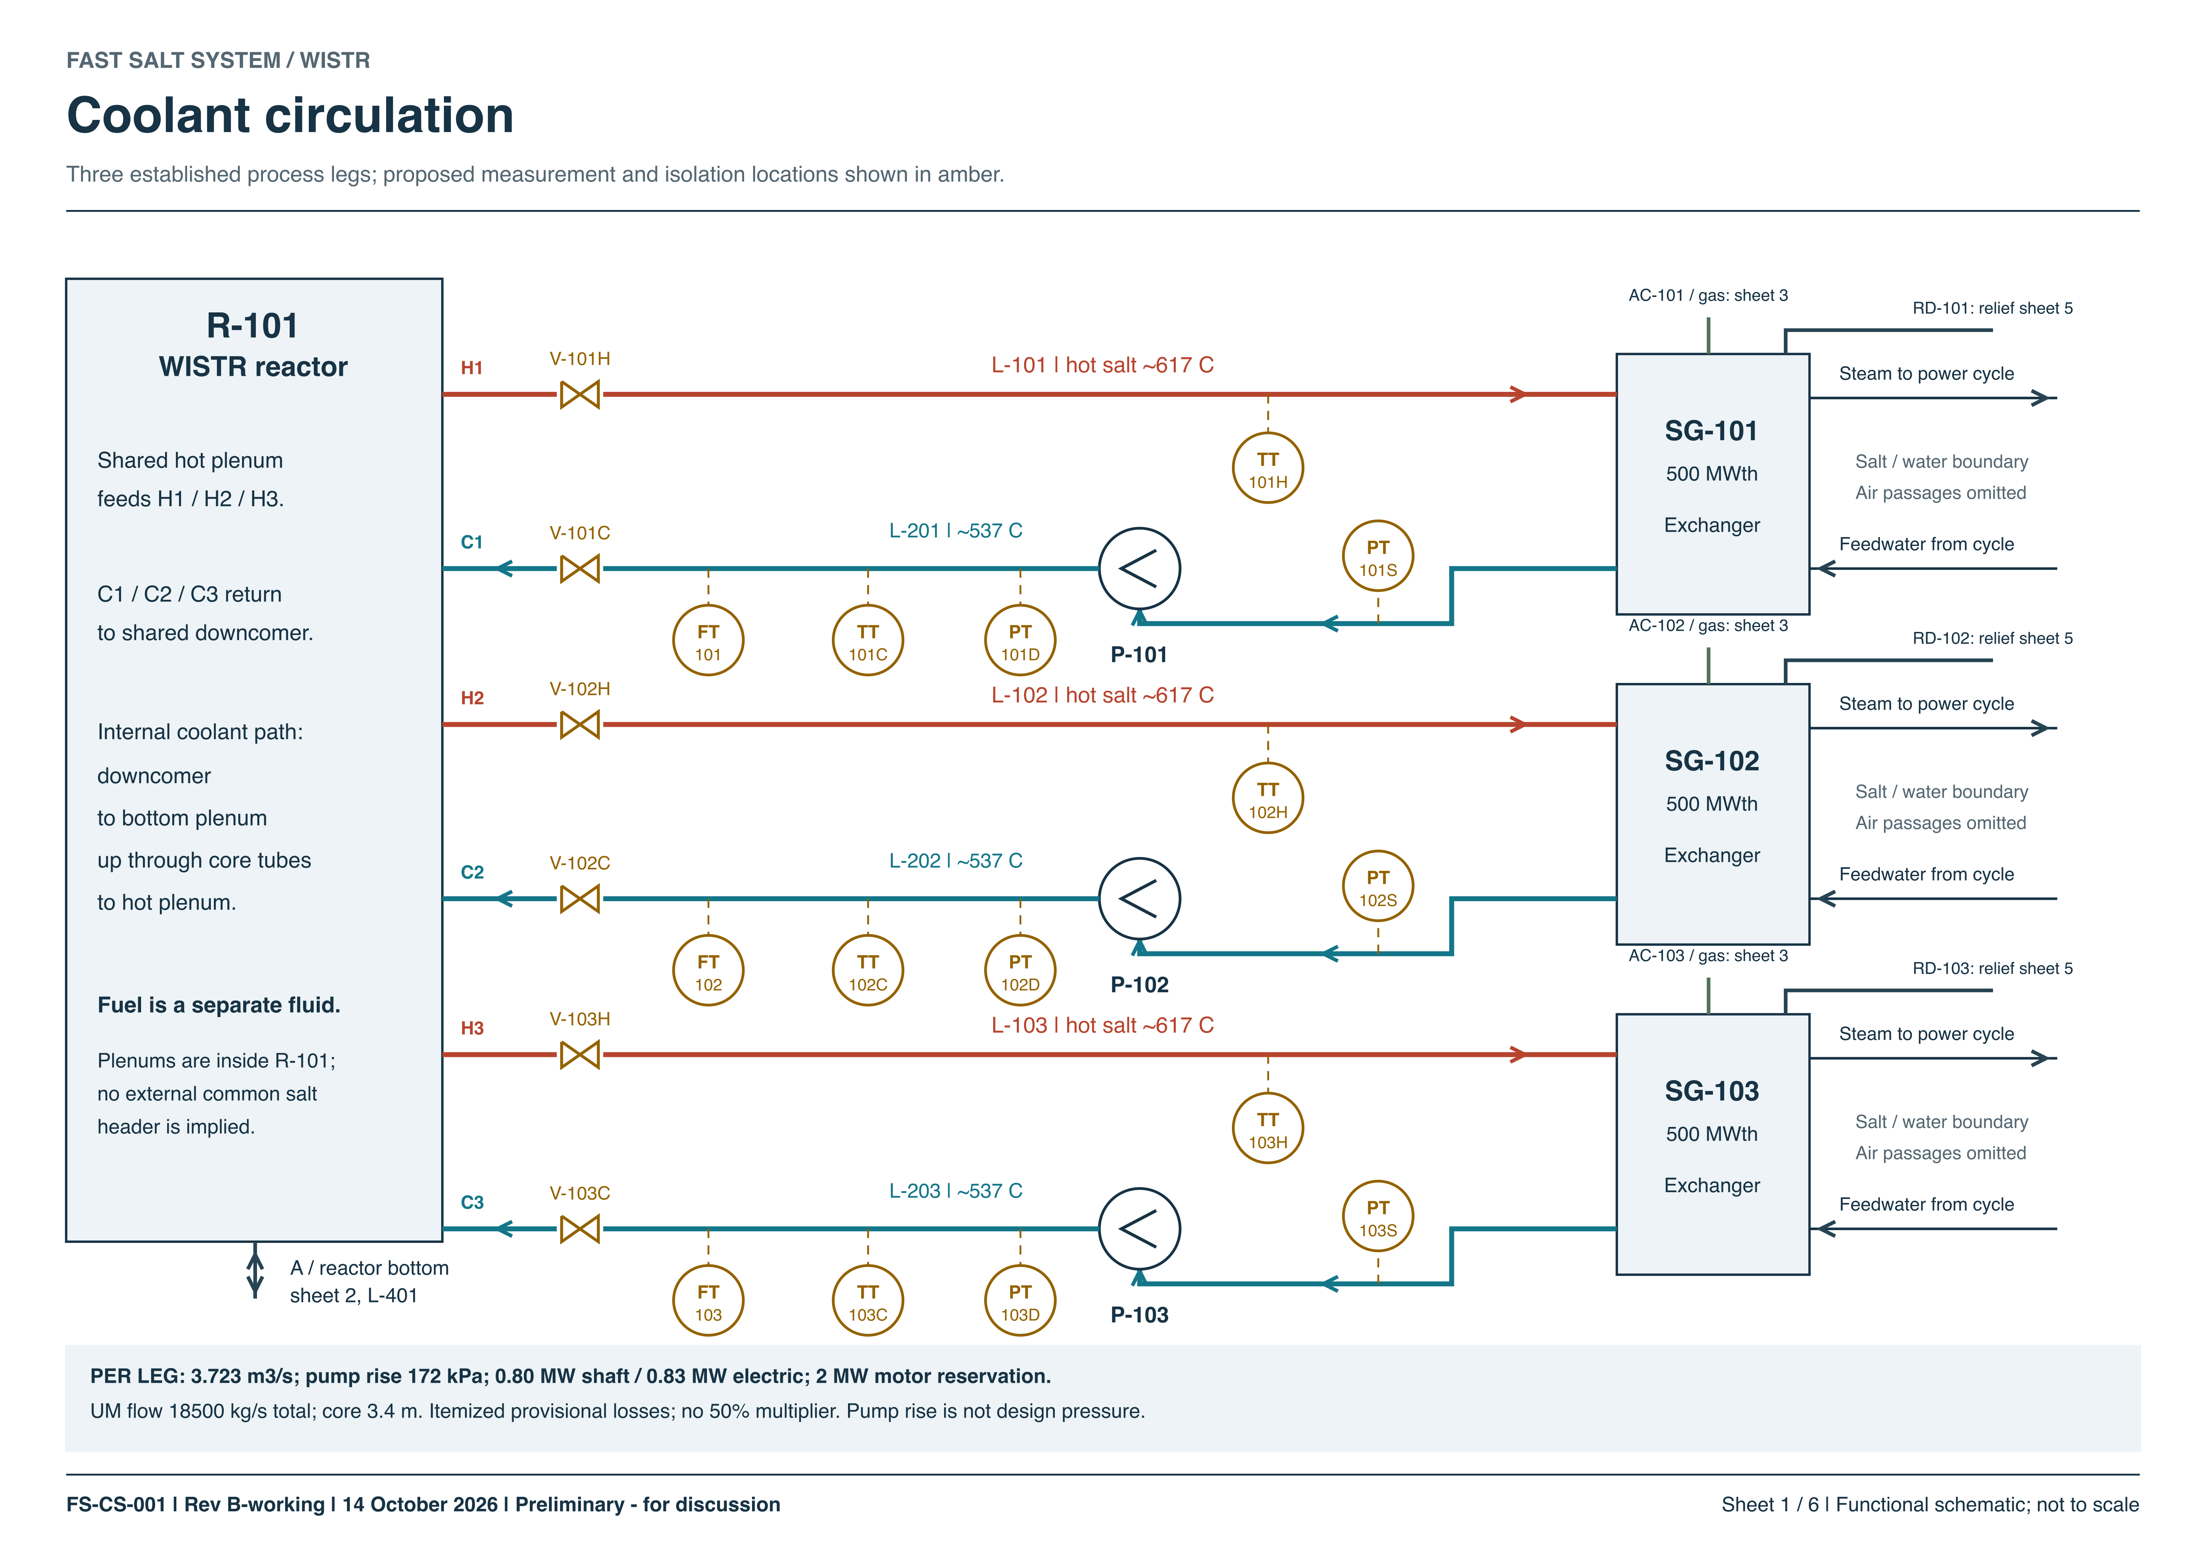
Coolant P&ID
17
Notes:
29–31 min elapsed (2 min)
This is a piping and instrumentation diagram. This shows the process, pumps, and instruments in the cooling design. The pump is on the cold leg. The next two rows repeat that arrangement.
The drawing records what connects to what. Later we’ll use the 3D model to see the length and bends of the physical pipe route.
References
Fast Salt System coolant P&ID, FS-CS-001, sheet 1 of 6, 14 October 2026.

Slide 18
Liquid absorber
18
Notes:
31–32.5 min elapsed (1.5 min)
Moving neutron-absorbing salt into the tank gives the reactor a means of shutdown. Each radial assembly has primary and secondary chambers, each served by its own module.
The different colors and vessel shapes help identify what is being moved.
References
Thomas Wielenga, liquid absorber system schematic. Project P&ID — design/pids/absorber-system/README.md.

Slide 19
Fuel storage during maintenance
19
Notes:
32.5–34 min elapsed (1.5 min)
Six regions in one sector are paired into three storage groups. Differential gas pressure moves the liquid between core and storage.
The next views show the mechanical part of the job.
References
Illustration — Thomas Wielenga, Fast Salt System 5 (26 June 2026), slides 9–10, 13.
/Users/thomaswielenga/Documents/dev/fastSalt/presentations/molten-salt-workshop-2026/asset-manifest.json

Slide 20
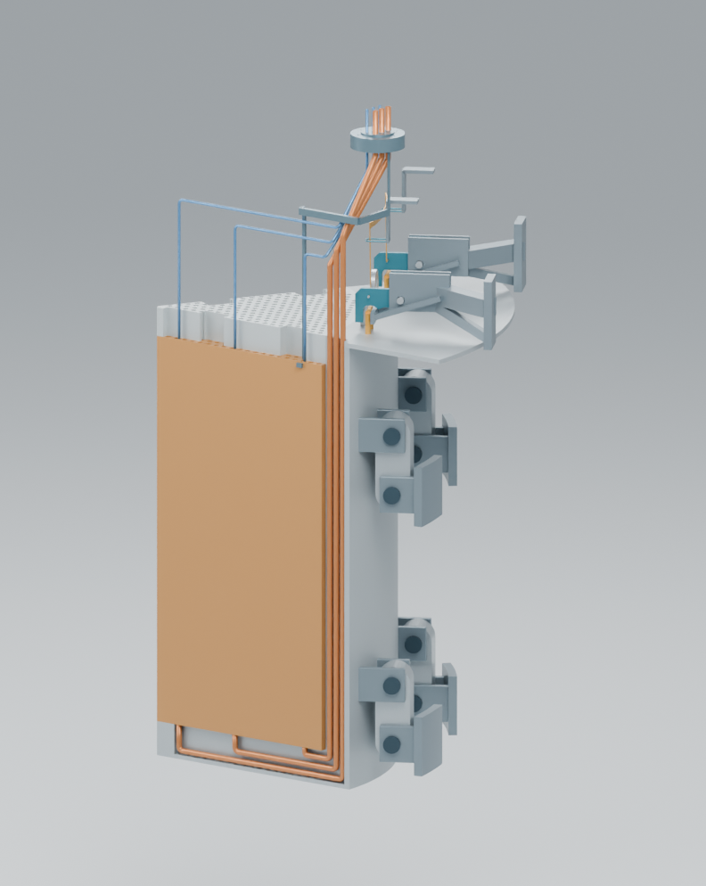
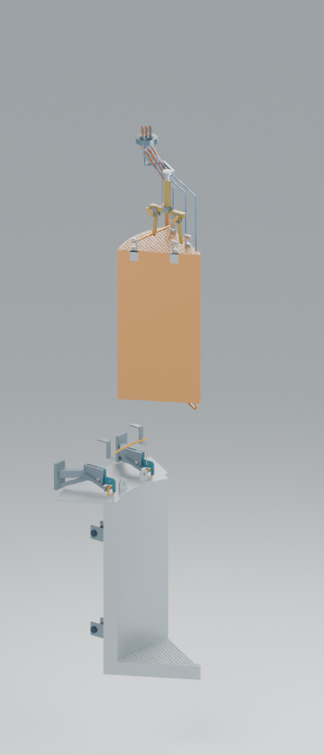
Remote sector maintenance
▪
Remove insulation and cap
▪
Raise and latch the sector
▪
Remove reflector and core
Maintenance position
Core removal
20
Notes:
34–35.5 min elapsed (1.5 min)
Once the insulation and cap have been removed, the linkage moves the sector up and outward into the maintenance position, where it is latched. The right image shows the opening used to lift out the reflector and core. This is where inspection of a model earns its keep. The crane needs a clear path for the load, and the removed pieces need somewhere to land. Both requirements affect the building layout.
References
/Users/thomaswielenga/Documents/dev/fastSalt/presentations/molten-salt-workshop-2026/asset-manifest.json

Slide 21
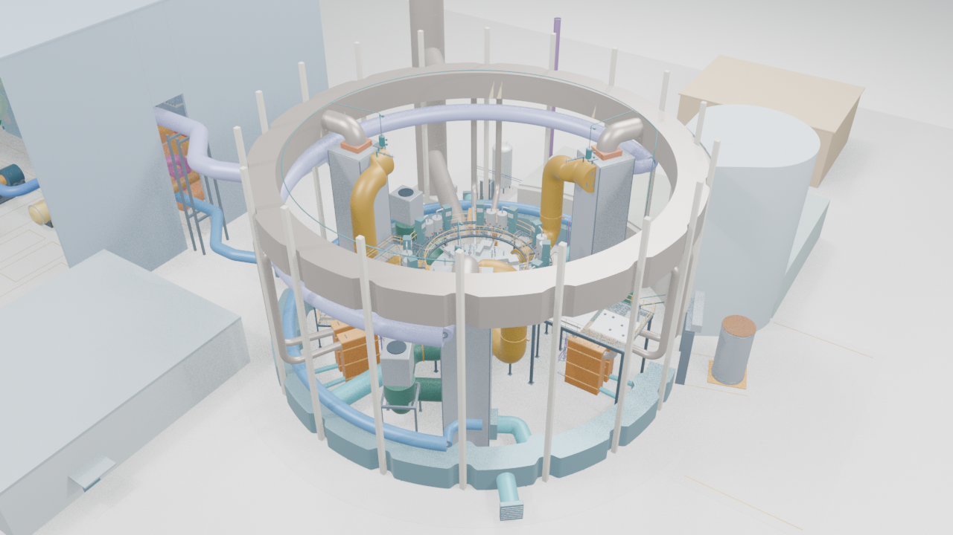
Reactor building
21
Notes:
35.5–37.5 min elapsed (2 min)
References
/Users/thomaswielenga/Documents/dev/fastSalt/presentations/molten-salt-workshop-2026/movie-slide-record.json

Slide 22
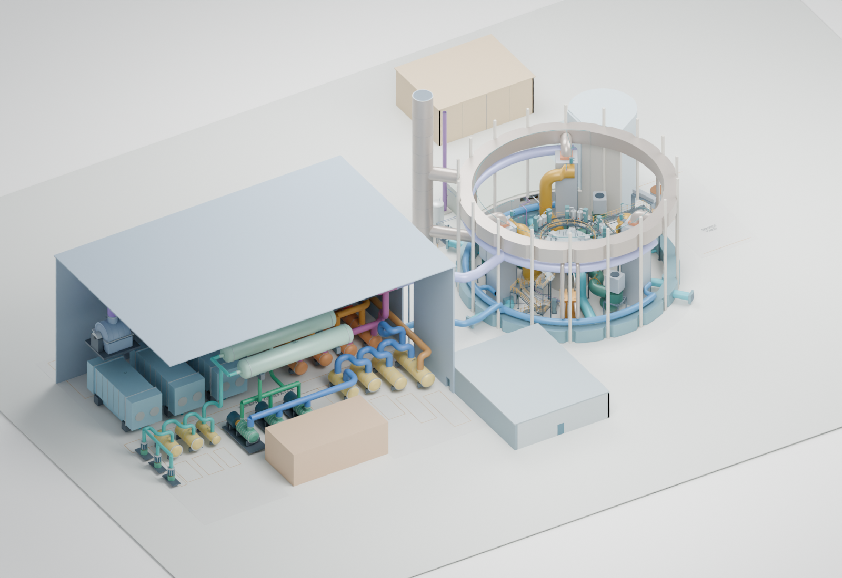
The overall plant
Reactor, turbine hall and service buildings
22
Notes:
37.5–39 min elapsed (1.5 min)
References
/Users/thomaswielenga/Documents/dev/fastSalt/presentations/molten-salt-workshop-2026/asset-manifest.json

Slide 23
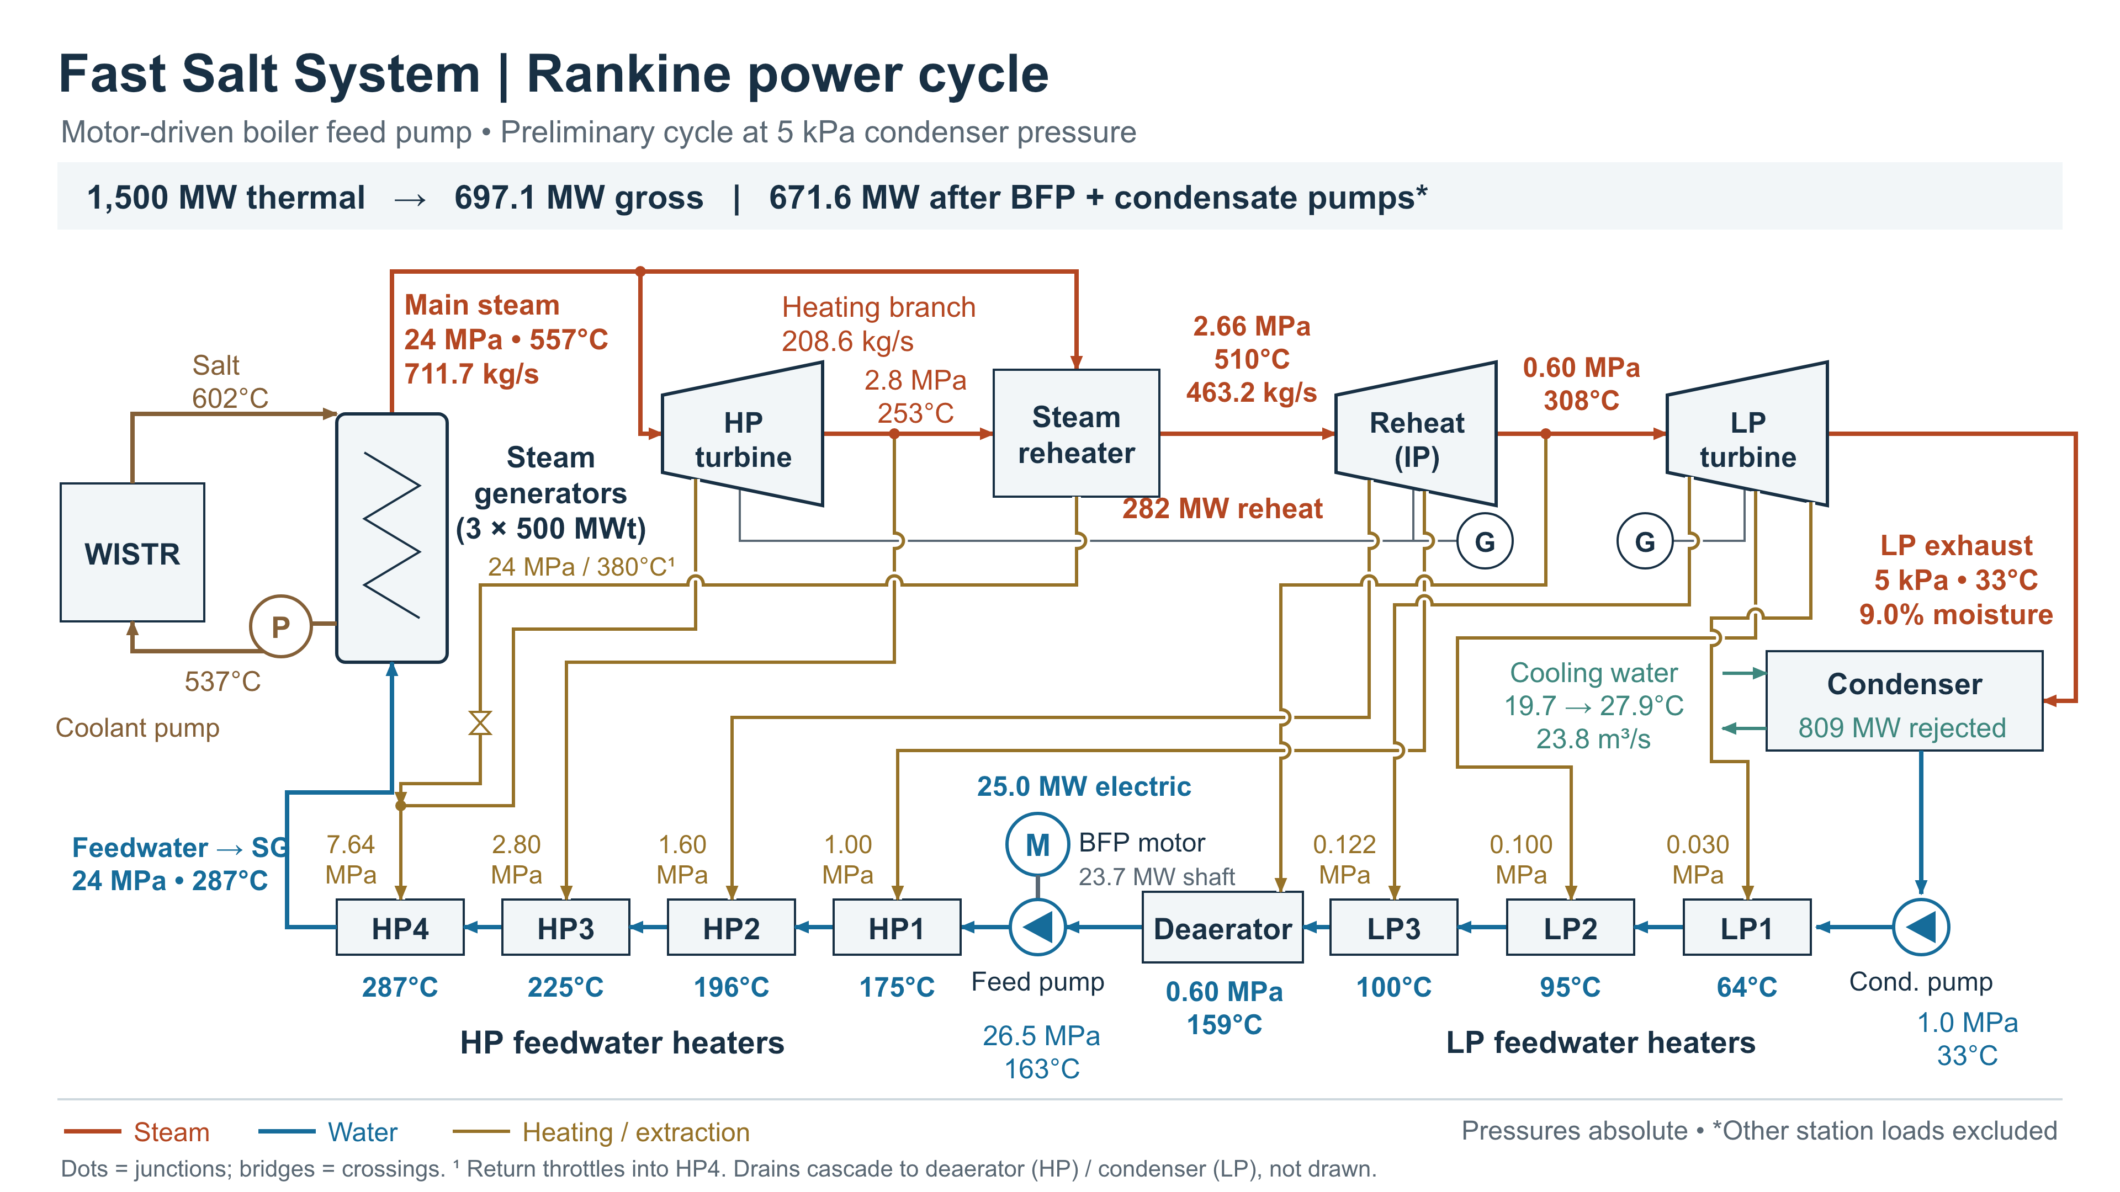
Power generation
23
Notes:
39–40.5 min elapsed (1.5 min)
References
Fast Salt System Rankine power cycle, motor-driven boiler feed pump diagram. See results/README.md.

Slide 24
Design choices and engineering consequences
Salt chemistry
Material selection, coatings and inspection
Coolant flow
Pipe sizes, pumping and heat exchangers
Removable sectors
Lifting interfaces, clearances and access
Integrated fuel cycle
Remote handling, buildings and service connections
Each choice creates work for several engineering disciplines.
24
Notes:
40.5–41.5 min elapsed (1 min)
I see this as an engineering education project. Several disciplines can contribute to the same design while working on different, well-defined questions.
References
/Users/thomaswielenga/Documents/dev/fastSalt/design/system-overview.md

Slide 25
Michigan team contributions
Core geometry
Evolved from annular WISSR fuel chambers to WISTR tank sectors
Neutronics and CFD
Core neutronics and fuel-convection CFD informed design development
Fuel regions
Six regions within each sector as the spatial basis for fueling
Fuel-cycle studies
Linked fueling and recycling choices to fuel-cycle performance
Absorber selection
Developed the liquid-absorber shutdown concept
Safety analysis
Protected station blackout and selected unprotected event studies
Michigan NERS team: from reactor geometry to fuel cycle and safety analysis.
25
Notes:
41.5–43.5 min elapsed (2 min)
Michigan’s work spans the move from annular WISSR fuel chambers to WISTR tank sectors, studies of core neutronics and fuel convection, and the evolution of fuel over time. The team also examined the absorber concept and how the plant responds to selected events.
The next slide gives one result from Hangyu Lee and Won Sik Yang’s safety analysis.
References
University of Michigan NERS and collaborating authors, project publications W01–W04, W06, W08, W10, W11 and W13. See publications/index.md.

Slide 26
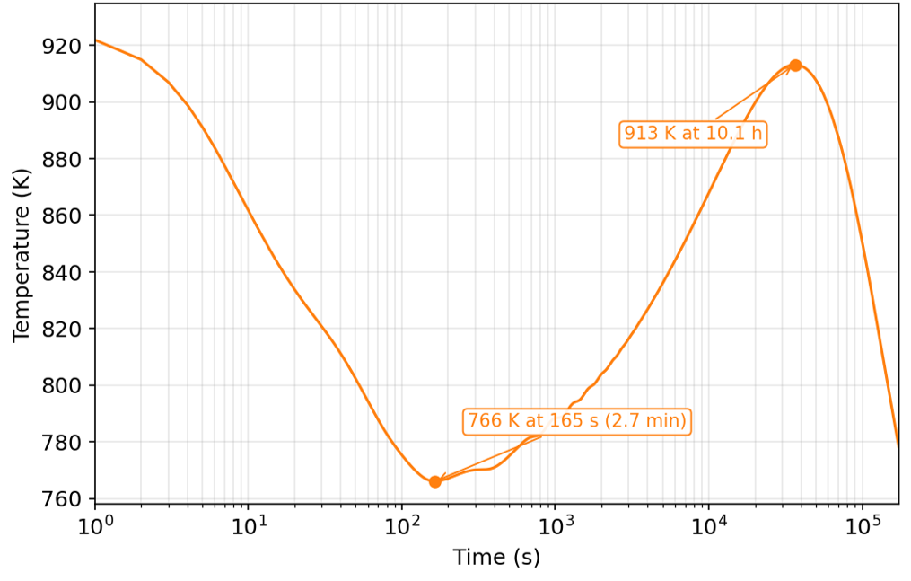
Wall Temperature Evolution in Station Black-Out
Initial decrease due to the reactor shutdown and pump coast down
Then increase due to decay heat until the decay heat removal capacity matches the decay heat
Notes:
43.5–46 min elapsed (2.5 min)
In the case Michigan analyzed, a station blackout triggers shutdown and the pumps coast down. The modeled wall temperature drops to a minimum after about 2.7 minutes. It then rises as decay heat continues. The later peak occurs after about 10.1 hours. After that, heat removal exceeds the declining decay heat and the temperature falls. Michigan’s analysis reported no freezing of fuel or coolant in this case. Heat removal is through the Steam Generator Auxiliary Coolers (SGACS) and the Reactor Vessel Auxiliary Cooler (RVAC). Both remove heat via air cooling.
Credit Hangyu Lee and Won Sik Yang for the calculation and figure.
References
Hangyu Lee and Won Sik Yang, WISTR Safety Analysis, 28 October 2026, slide 7.

Slide 27
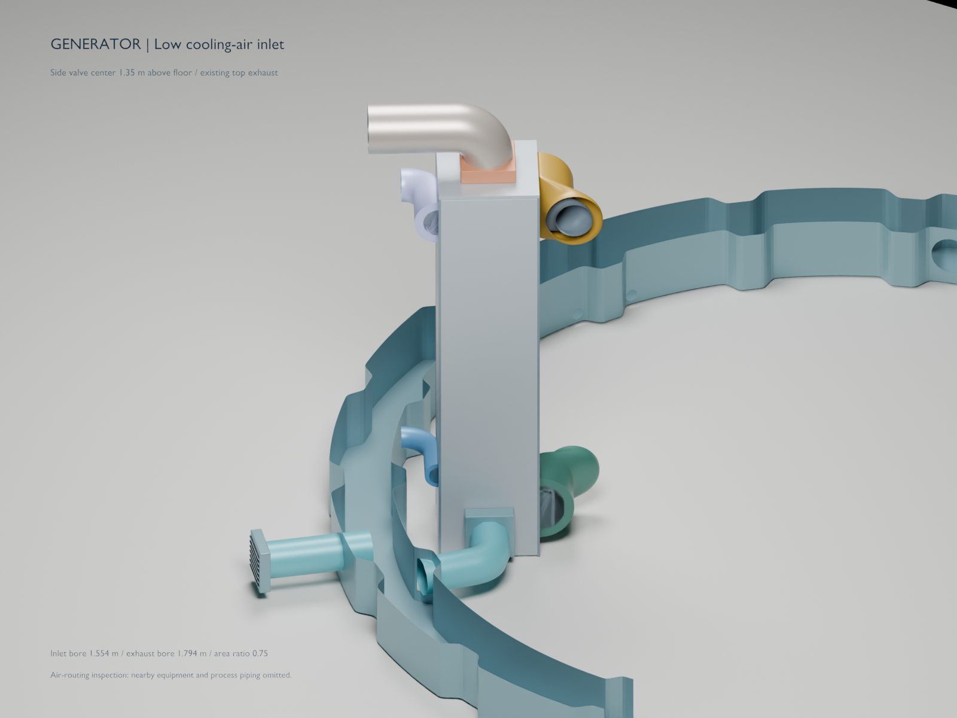
The MSU steam-generator capstone
▪
A real component with a defined place in the plant.
▪
Students start from preliminary calculations and system requirements.
▪
Calculations, geometry and interface checks become shared deliverables.
27
Notes:
46–48 min elapsed (2 min)
MSU students are already working on the steam generator you saw earlier. I supplied preliminary sizing calculations. The image is my project model and locates the component within the larger plant.
The students can ask how tube contact affects heat transfer, what flow resistance the arrangement produces, and what the air passages can remove. Their work can change a plant-level assumption and give the team a concrete result to defend.
References
/Users/thomaswielenga/Documents/dev/fastSalt/collaboration/steam-generator-project.md
/Users/thomaswielenga/Documents/dev/fastSalt/presentations/team-review-2026-10-13/asset-manifest.json

Slide 28
Electronic Intelligence help is essential now
A larger capacity to do work
A different learning task
▪
Machines let small teams undertake larger physical projects.
▪
Learn to operate the tool effectively.
▪
Electronic intelligence can extend the work an engineering team can attempt.
▪
Understand its limits and check the result.
▪
Develop engineering judgment.
Real projects give students reasons to learn the fundamentals.
28
Notes:
48–49 min elapsed (1 min)
A bulldozer changes how much a small team can do. The operator still needs to know what grade to cut, how to run the machine, and how to recognize when the work is going wrong.
That’s what interests me about EI in engineering. Students can take on a substantial problem and learn the fundamentals they need to judge what the tool gives them.

Slide 29
Tools for EI collaboration
Tool | Role in the project
Markdown | Assumptions and design reasoning
Hurmet | Calculations with explicit units
Python and Blender | Geometry and inspectable 3D models
Visual Studio Code | Workspace for editing the files
GitHub | Shared files and reviewed change history
Example: check a steam-generator estimate, then inspect its geometry.
29
Notes:
49–50.5 min elapsed (1.5 min)
These are the tools that allow effectively working with an EI. EIs are excellent at developing programs. So turn your project into a programming problem. These are the free tools that make an effective work environment. Visual Studio Code for code editing, documentation and viewing changes. Markdown is text based allowing versions of documentation. Hurmet combines documentation and calculations while allowing versioning. Python is used for more complicated calculations and builds the geometry that can be inspected by rendering it in Blender. GitHub records revisions and gives collaborators a common place to review them.
EI helps me move from a question or directions to a calculation or drawing; it can find references and do calculations.. The files give us something specific to check and revise together.
References
/Users/thomaswielenga/Documents/dev/fastSalt/collaboration/steam-generator-project.md
/Users/thomaswielenga/Documents/dev/fastSalt/calculations/README.md
/Users/thomaswielenga/Documents/dev/fastSalt/calculations/steam-generator/Itemized coolant pump estimate - Hurmet.md
/Users/thomaswielenga/Documents/dev/fastSalt/decisions/index.md#d-063--adopt-countersg-geometry-and-revised-coolant-calculations

Slide 30
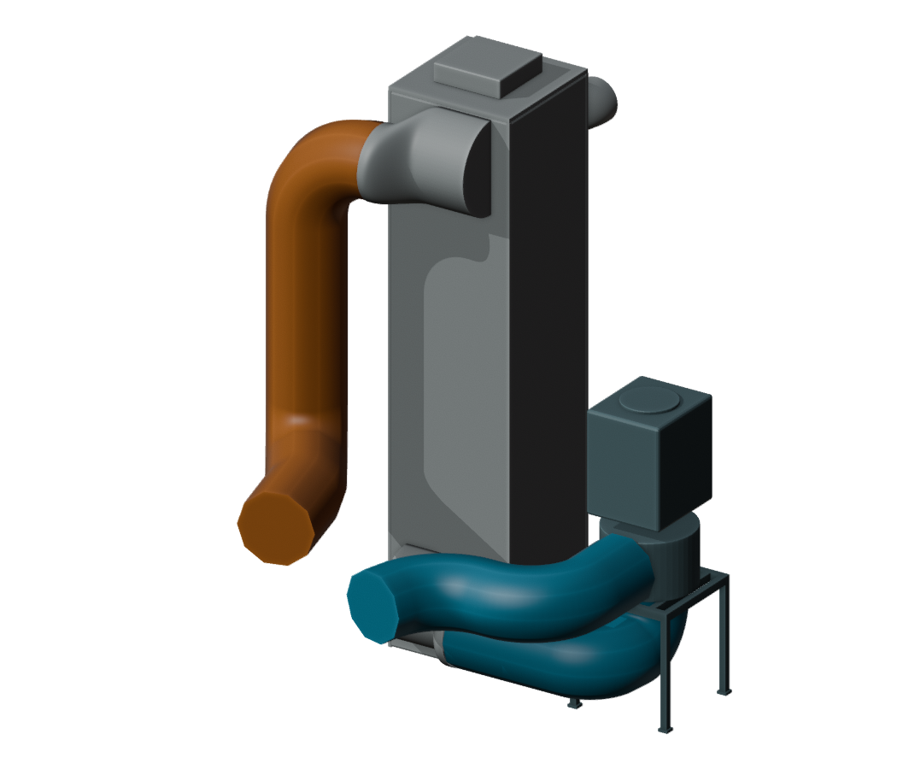
EI collaboration on coolant pump sizing
Steam generator
Direction
Replace the 50% pipe loss estimate with the losses in each part of the circuit.
What EI did
Used pipe lengths and bends from the model and friction flow model to itemize losses in Hurmet calculation.
Pump
Iterations
Supplied the newer steam generator design workbook.
Hot run 15.75 m
Cold runs 16.18 m
With the revised coolant flow, updated generator geometry, and itemized losses, estimated electrical input for all three pumps fell from 5.17 MW to 2.50 MW.
30
Notes:
50.5–53.5 min elapsed (3 min)
I first allowed 50% above the steam-generator friction loss for everything else in the loop. The 3D modeled lengths and bends went into the Hurmet worksheet along with the core and generator losses.
I supplied the newer generator workbook. At the same flow and geometry, the two methods give 1.54 MW and 2.50 MW of electrical input for all three pumps. For an oral check, 3.72 m³/s × 172 kPa is about 640 kW of hydraulic power per pump. Allowing for the pump and motor efficiencies gives about 835 kW electrical per pump. Itemized coolant pump estimate — calculations/steam-generator/Itemized coolant pump estimate - Hurmet.md
D-063 — decisions/index.md
Figure: FastSaltSystem/fastSaltModels, outputs/coolant-assembly/coolant-equipment.blend, loop 1. Pipes colored by service for this view.

Slide 31
Learning to question and judge results
Before calculating
Predict the scale and the direction of change
While working
Check units, balances and assumptions
After calculating
Compare independent evidence and limiting cases
Before sharing
Explain the result and preserve the reasoning
Students learn formulas through the questions they need to answer.
31
Notes:
53.5–55 min elapsed (1.5 min)
References
/Users/thomaswielenga/Documents/dev/fastSalt/calculations/hurmet-display-check.md

Slide 32
Projects across engineering disciplines
Discipline | Example contribution
Mechanical | Steam generator, maintenance tools and heat transfer
Chemical | Fuel-cycle chemistry and materials compatibility
Materials | Corrosion, coatings and irradiation damage
Civil / structural | Equipment supports, seismic requirements and installation
Electrical / controls | Measurements, controls and fault detection
Industrial / computing | Maintenance, cost, shared models and digital twins
FRIB may offer a connection for irradiation-effects research.
32
Notes:
55–57 min elapsed (2 min)
Choose two possibilities that fit the faculty in the room. A civil team could study how large equipment enters the building. A materials team could examine coating durability or irradiation damage. A controls group could build a measurement demonstration or simulation.
FRIB suggests a conversation about irradiation-effects research. The first research question is which damage mechanisms an available experiment could represent. The steam-generator capstone is already underway and gives us a model for organizing other projects.
References
Fast Salt System, collaboration/steam-generator-project.md.

Slide 33


Participation and discussion
fastSalt
fastSaltModels
github.com/FastSaltSystem/fastSalt
github.com/FastSaltSystem/fastSaltModels
What part of this system could become a worthwhile student or research project?
33
Notes:
57–58 min elapsed (1 min)
The first QR code leads to fastSalt, with design records, calculations and diagrams. The second leads to fastSaltModels, with the Python and Blender work.
Which part of this system could become a student or research project in your area, and what result would make it worthwhile?
References
https://github.com/FastSaltSystem/fastSalt
https://github.com/FastSaltSystem/fastSaltModels

