Slide 1
WISTR Safety Analysis
Hangyu Lee and Won Sik Yang
October 28, 2026

Slide 2
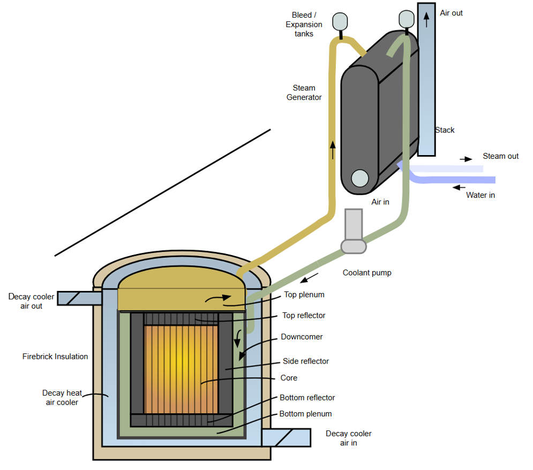
WISTR Reactor Coolant System Design
Reactor coolant system
  1,500 MWt, with static chloride fuel salt in six tanks and coolant salt flowing through 24,576 tubes in the fuel
  Three primary loops with a total coolant flow rate of 18,500 kg/s and core inlet / outlet temperatures of 810 / 890 K
  Supercritical SGs at 24 MPa
  Passive air cooling for decay heat removal: SGACS (Steam Generator Auxiliary Cooling System) and RVACS (Reactor Vessel Auxiliary Cooling System)
Safety design features
  Strong negative feedback from liquid fuel expansion (-7.8 pcm/K)
  Two independent gas pressure-driven absorber salt injection systems and fuel salt drain
  Passive decay heat removal systems

Slide 3
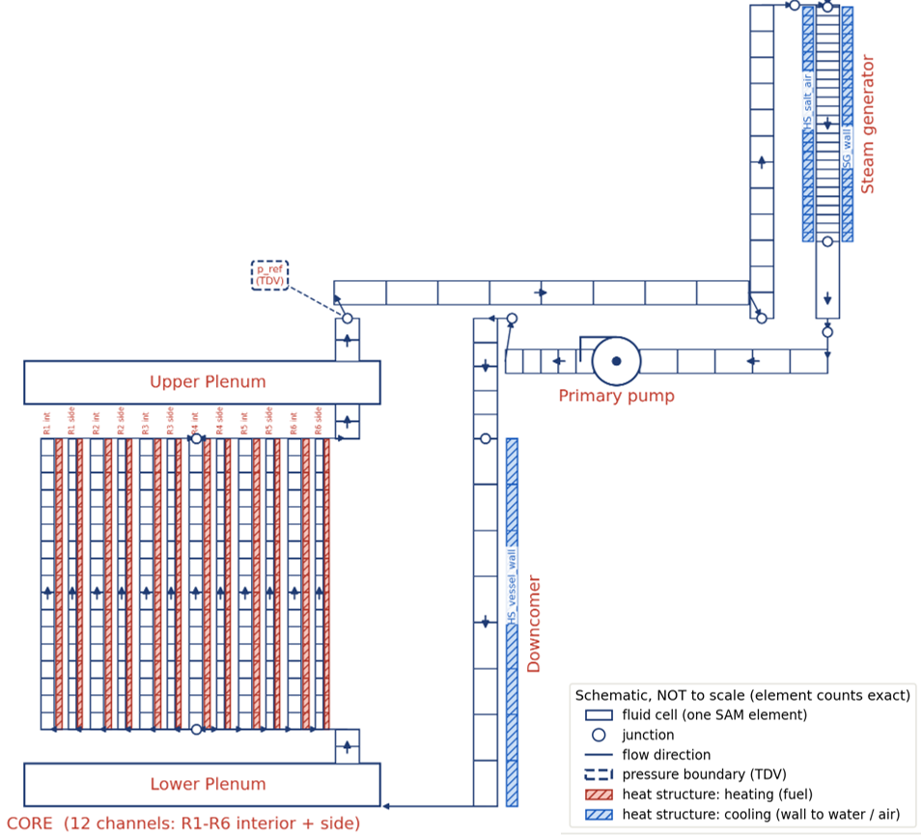
SAM Nodalization Diagram for WISTR Reactor Coolant System
One-dimensional SAM model of the primary circuit
  Six radial regions, each with an interior and a near-wall channel, and fuel salt as the heat structure
  Dual-loop configuration for single-loop failure scenarios
  U-tube supercritical steam generator
  SGACS and RVACS as 30 m natural-draught air paths
Point kinetics with spatially dependent reactivity feedback (evaluated with PERSENT) and ANS-5.1 decay heat
Shutdown worth of absorber salt injection systems evaluated from OpenMC and the absorber salt injection kinetics

Slide 4
WISTR Safety Strategy and Accidents Scenarios
Safety Design of WISTR
  Inherent power self-regulation by fuel expansion feedback
  Highly reliable shutdown by two independent absorber salt injection systems and fuel salt drain
  Passive decay heat removal by SGACS and RVACS
Investigation of Inherent Safety Characteristics
  Examined limiting scenarios beyond design basis events
  Evaluate inherent power self-regulation for selected unprotected reactivity- and flow-induced accident scenarios.
Currently Analyzed Accident Scenarios
  Protected station blackout (SBO) to access passive decay heat removal capability
    Loss of off-site power and emergency DGs but reactor shutdown by absorber salt injection
  Reactivity and flow induced accidents with assumed failure of reactor shutdown
    Unprotected transient overpower (UTOP) accident: step reactivity insertion of 50 pcm (1-week refueling worth)
    Unprotected pump overspeed (UPOS) and unprotected loss of flow (ULOF) accidents: malfunction of single or all primary pump(s)

Slide 5
Summary of Analyzed Accident Scenarios
Accident class |  | Station Blackout (SBO) | Reactivity induced | Flow rate induced
Accident |  | Protected SBO | UTOP | UPOS | ULOF | UPOS, single | ULOF, single
Initiating events |  | Loss of all on-site power w. scram | Fresh fuel charge | Pump power doubled, all loops | Pump power lost, all loops | Pump power doubled, single loop | Pump power lost, single loop
Transient variable |  | Pump head to zero, feedwater to zero, -6,700 pcm in 20 s | Step reactivity of 50 pcm | Pump head +56% (5 s) | Pump head to zero (5 s) | Single pump head +56% (5 s) | Single pump head to zero (5 s)
Peak Temperature (K) | Fuel * | 915 | 1,151 | 1,148 | 1,163 | 1,145 | 1,160
 | Coolant** | 914 | 897 | 894 | 1,005 | 892 | 950
 | Wall*** | 913 | 936 | 930 | 1,042 | 928 | 988
Peak power (%) |  | – | 118.4 | 104.4 | – (no rise) | 101.6 | – (no rise)
Asymptotic power (%) |  | – | 101.3 | 102.2 | 68.3 | 100.7 | 86.6
*Fuel boiling point: 1,837 K; design limit of fuel temperature: 1600 K
**Coolant boiling point: 1,383 K; design limit of coolant temperature: 1200 K
***SS316 service limit (ASME Sec. III, Div. 5): 1,089K; design limit of structure temperature: 1050 K

Slide 6
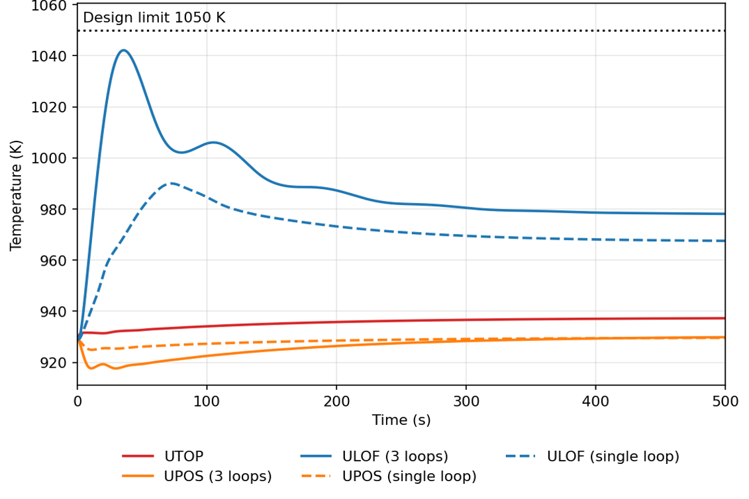
Wall Temperature Evolution in Unprotected Accidents

Slide 7
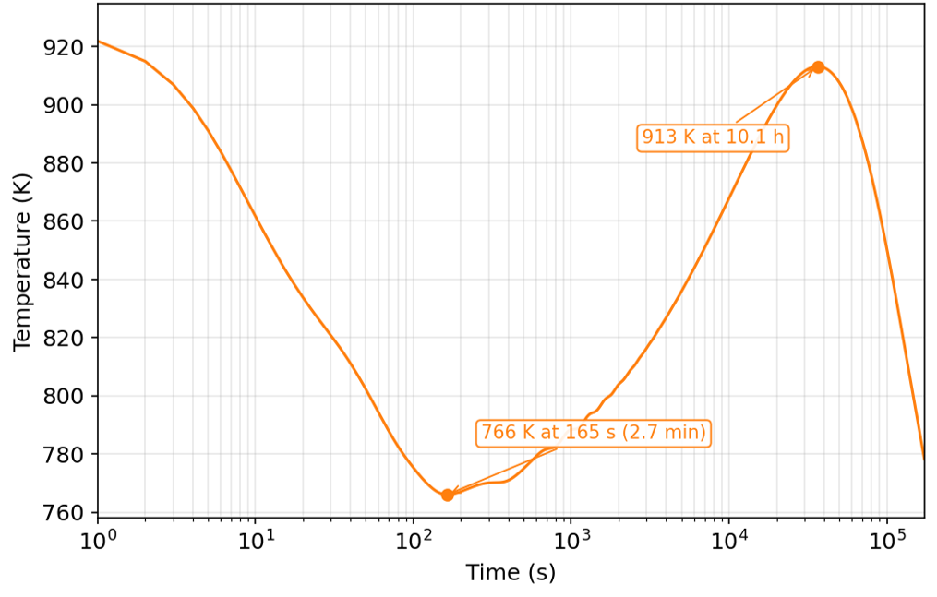
Wall Temperature Evolution in Protected SBO Scenario
Initial decrease due to the reactor shutdown and pump coast down
Then increase due to decay heat until the decay heat removal capacity matches the decay heat

Slide 8
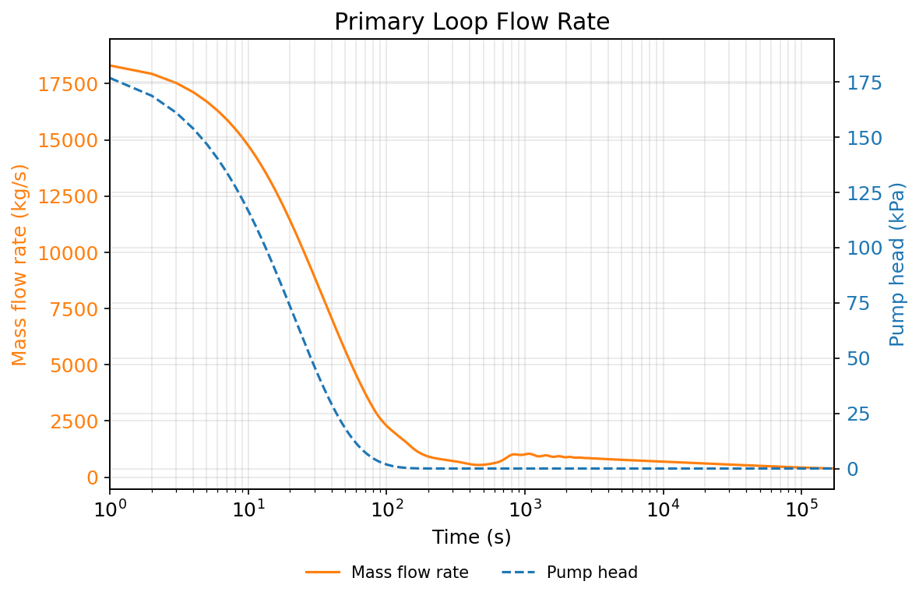
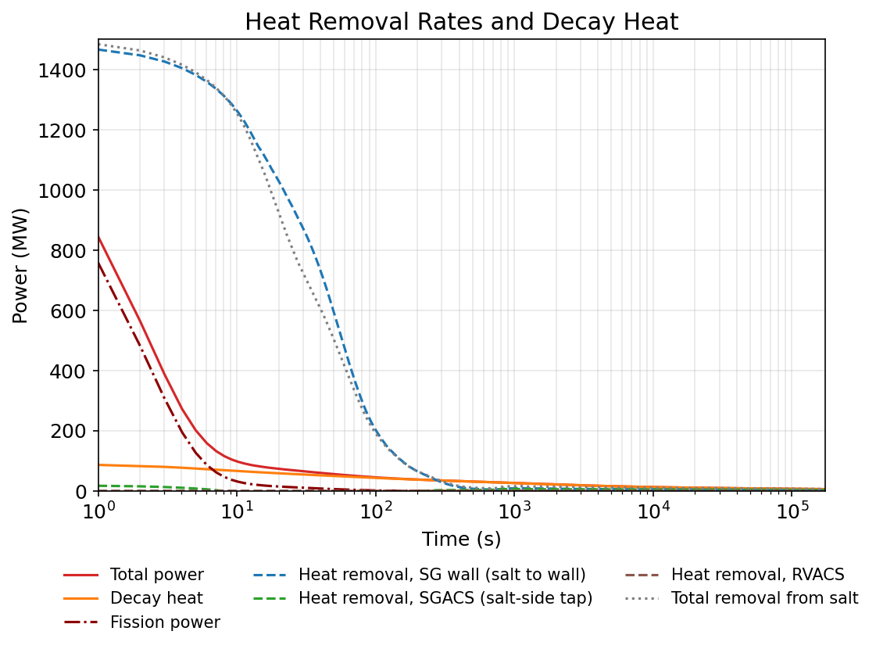
Natural Circulation and Heat Balance in Protected SBO Scenario
200–1,000 s: Net heat accumulation begins at ~200 s and triggers delayed flow recovery after ~400 s.
After 1,000 s: Declining decay heat gradually reduces natural circulation flow.

Slide 9
Conclusions
WISTR safety features
  Static liquid fuel gives a strong, prompt negative feedback.
  Shutdown and decay heat removal need no electric power (absorber injection systems, SGACS, and RVACS).
Safety analysis study
  SAM safety analysis models of the WISTR primary circuit with spatially dependent thermal feedback and passive heat removal systems were developed.
  Margins to the fuel and structural design limits were quantified.
Demonstrated inherent power self-regulation under various unprotected scenarios
  Strong negative fuel expansion feedback effectively shuts down the reactor.
  Reactor power and temperatures approach stable conditions without SCRAM in the selected UTOP, UPOS, and ULOF scenarios.
Confirmed passive decay heat removal capability
  SGACS and RVACS provide long-term decay heat removal through natural air circulation.
  In the protected SBO scenario, decay heat is removed passively through SGACS.

