Slide 1
AI ENGINEERING: FAST TRACK — COURSE PROJECT
VilniusPark Parking
Reservation Chatbot
A RAG chatbot that answers questions, collects reservations, routes each one through a human administrator, and records approvals through an MCP server — orchestrated end to end with LangGraph.
Stage 1 RAG · Stage 2 Human-in-the-loop · Stage 3 MCP server · Stage 4 LangGraph

Slide 2
THE ASSIGNMENT
Four stages, one pipeline
Each stage is gradable on its own, but they hand off to each other: a reservation only reaches the MCP server after a human has approved it, and the whole chain is wired together with LangGraph.
1
2
3
4
RAG Chatbot
Human-in-the-loop
MCP Server
LangGraph
Hybrid retrieval over Milvus + Postgres, with guardrails
A HITL agent pauses each booking for the admin
Records approved reservations to a file
One checkpointed graph ties stages 1–3 together
docs/SPECIFICATION.md — EPAM AI Engineering: Fast Track
VilniusPark Chatbot

Slide 3
ARCHITECTURE
One pipeline, four stages
Customer
FastAPI /chat
Milvus +
Postgres
prepare_
reservation
admin node
Administrator
Chat UI
user_agent node
RAG + dynamic data
status = pending
HITL pause · checkpointed
/admin/* API
File
MCP server
approved_reservations.txt
record_reservation()
record node sets approved / rejected — notification node pops the outcome up in the chat
app/main.py · app/ai/graph.py · app/api/routers/*.py
VilniusPark Chatbot

Slide 4
STAGE 1
A tool-calling agent over a split store
Static docs (general info, rules, booking process, per-car-park pages) are embedded into Milvus
Dynamic data (hours, prices, capacity, reservations) stays in Postgres — it changes, so it's queried live, never embedded
check_availability counts free spaces per period; a row lock stops two bookings taking the last one
A review (prepare_reservation) is a separate, explicit step from a save (confirm) — the model never authorizes a database write
list_parkings
IDs, names, districts
get_parking_info
date-specific prices, hours, capacity
search_public_rules
Milvus search, PII-guarded
prepare_reservation
validates + returns a review
app/ai/tools.py · app/ai/graph.py · app/db/repositories/*.py
VilniusPark Chatbot

Slide 5
STAGE 1 — GUARDRAILS
Guardrails that held up under real use
PIIGuard (Presidio + spaCy) keeps PII out of search queries and Milvus; PIIMiddleware redacts the agent's traffic
An opt-in transformer classifier screens for prompt injection before anything else runs
settings.public_contacts allow-lists the operator's own published phone/email so it's never redacted
Found by actually running the stack
0
2
Live testing caught a real bug the test suite missed: spaCy’s small NER model tagged "Vilnius" as a PERSON, corrupting answers mid-sentence. PERSON carries no real leak risk here (Milvus holds no customer data), so it was dropped from the redaction list.
PERSON false
positives after the fix
entity types kept:
EMAIL, PHONE, etc.
app/ai/guardrails.py
VilniusPark Chatbot

Slide 6
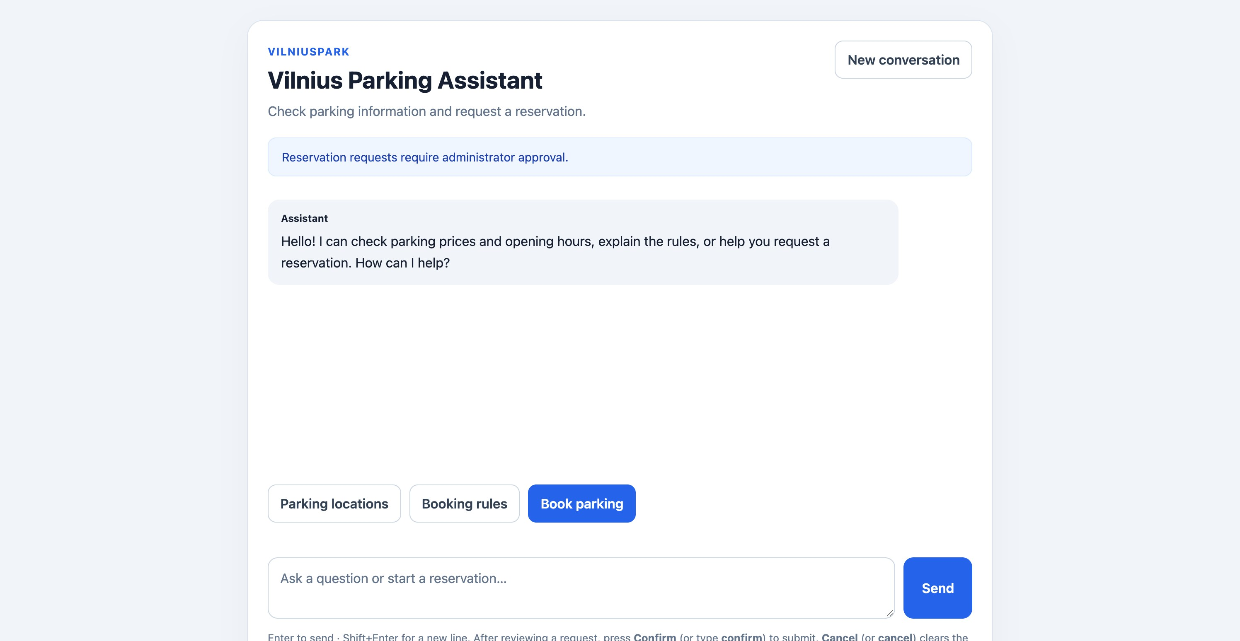
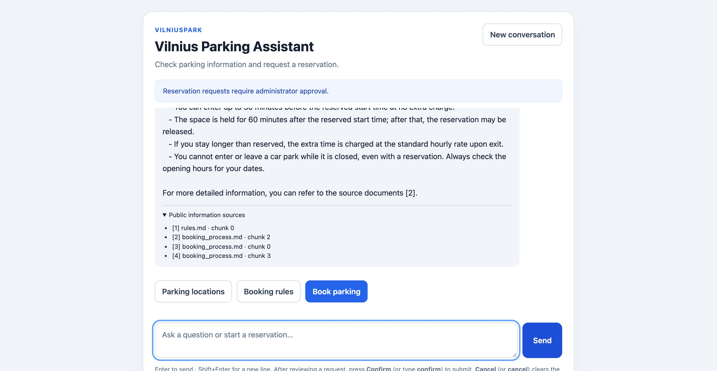
IN ACTION
The chat UI, live
Landing screen
Answer with cited sources
app/templates/chat.html · app/static/chat.js
VilniusPark Chatbot

Slide 7
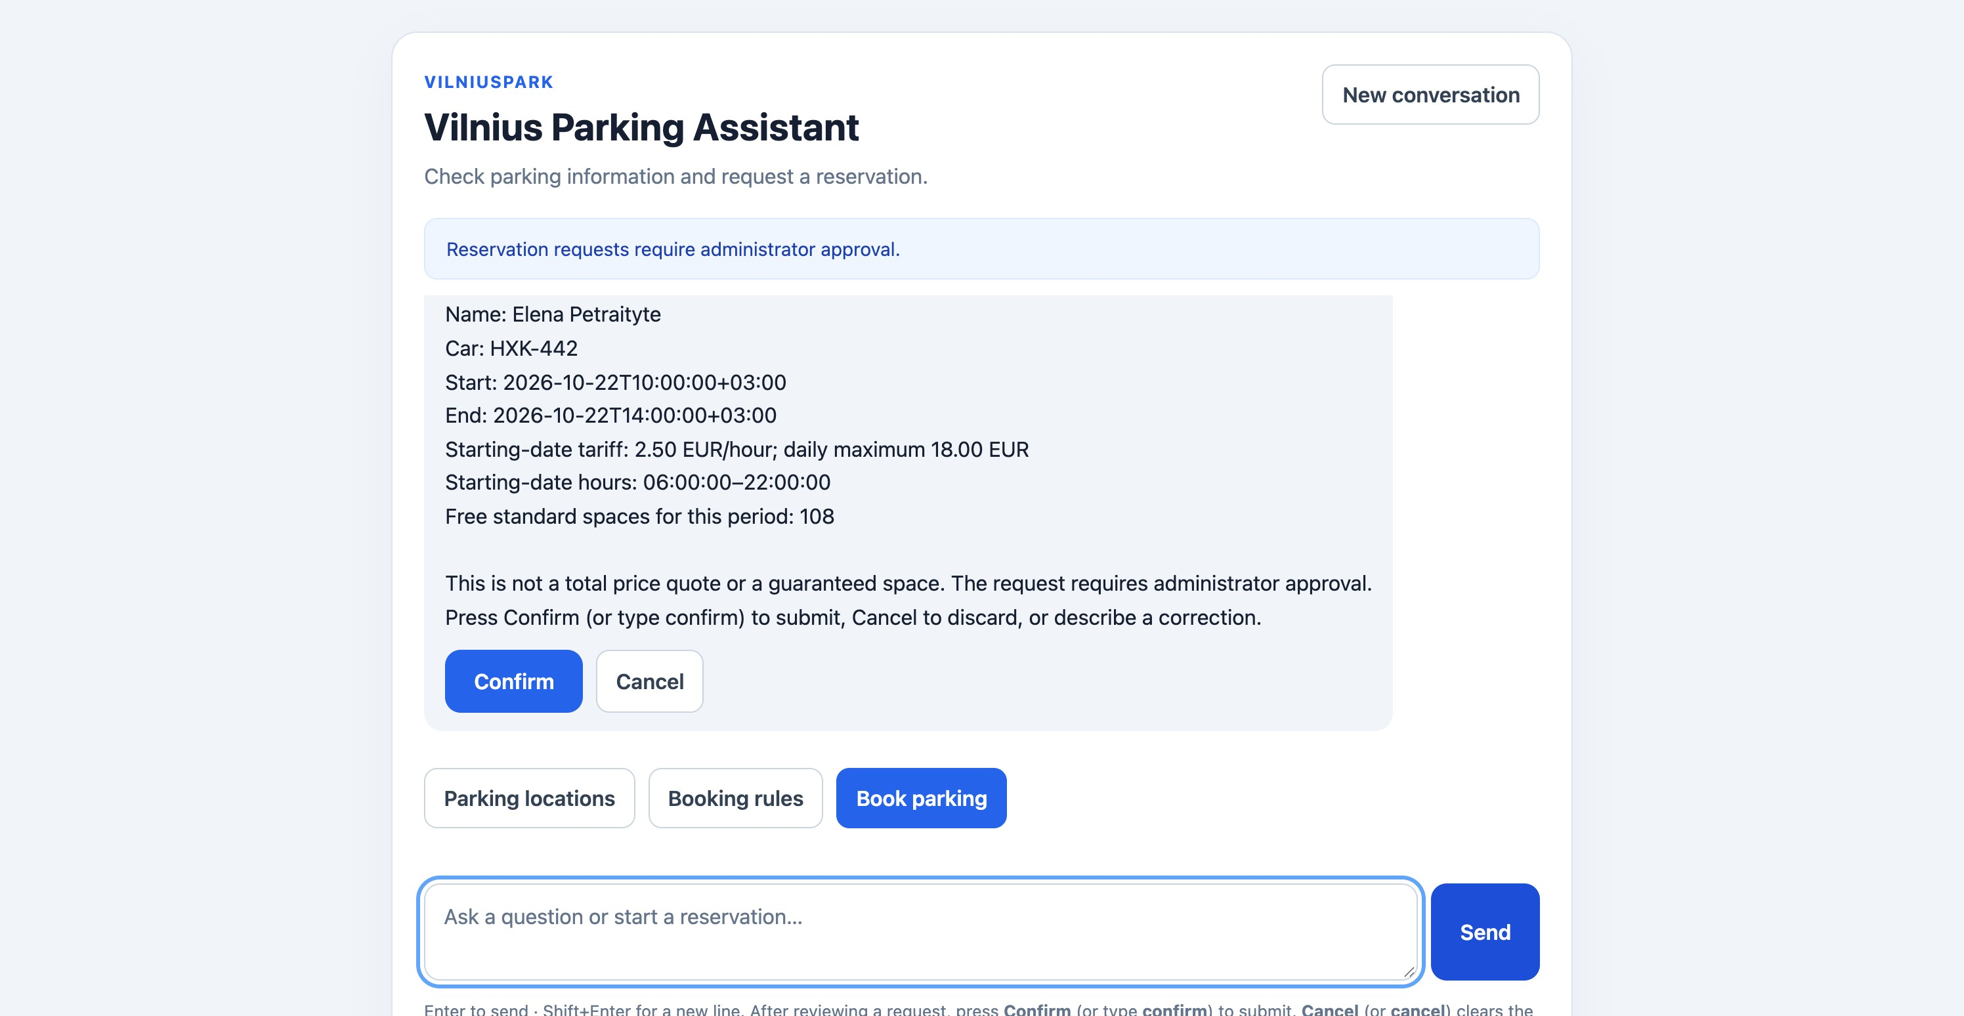
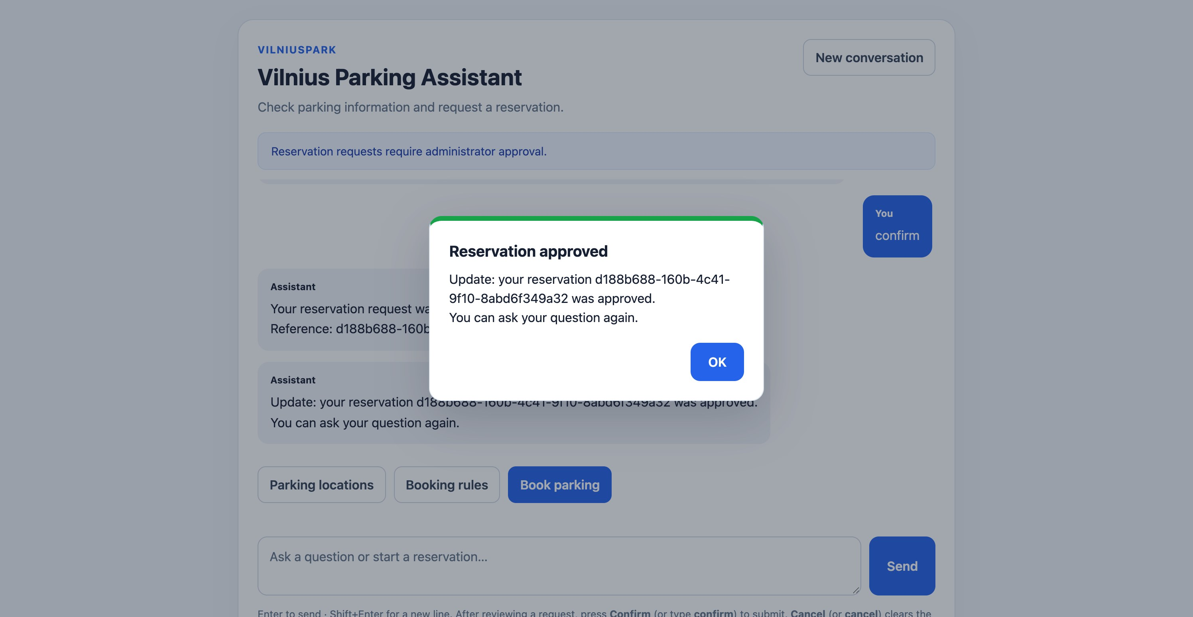
IN ACTION
From review to an approved reservation
prepare_reservation's review, with Confirm / Cancel
Confirm → admin approves → pop-up in the chat
app/ai/tools.py · app/ai/graph.py
VilniusPark Chatbot

Slide 8
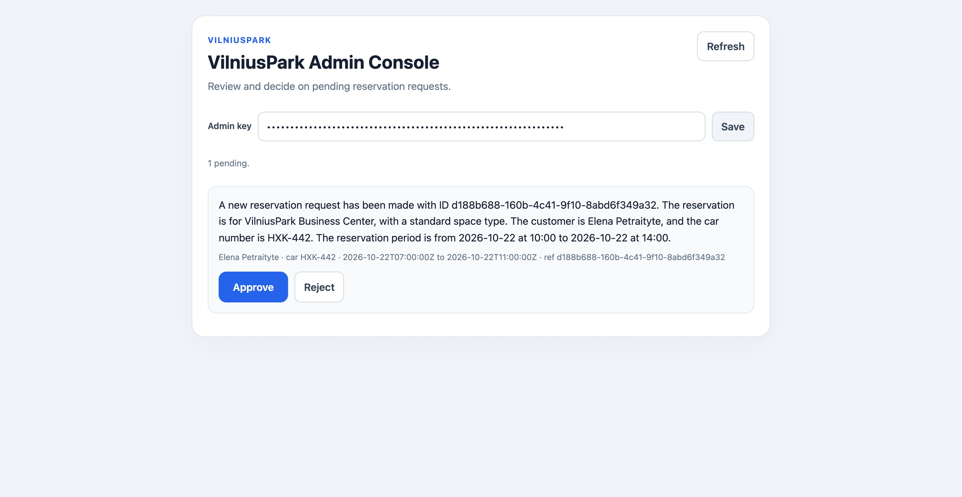
STAGE 2
A human-in-the-loop admin agent
The second agent proposes request_admin_approval(summary); LangChain's HumanInTheLoopMiddleware pauses that call until the administrator decides
The administrator decides over a REST API (GET /admin/reservations, POST .../decision), guarded by X-Admin-Key with lockout
Two interchangeable clients: a Streamlit console and a web page at /admin — same API underneath
The customer finds out too: the chat page polls and pops up “Reservation approved” or “rejected”
Admin console (web)
app/ai/agents.py · app/api/routers/admin.py · ui/admin_app.py
VilniusPark Chatbot

Slide 9
STAGE 3
A standalone server records the decision
Its own docker-compose service, not an in-process subprocess — a real, independently testable server
Streamable-HTTP transport, one tool: record_reservation, behind a bearer-token check (MCP_API_KEY)
The LangGraph recording node calls it as a real MCP client (langchain-mcp-adapters), just like any other tool
approved_reservations.txt — written live during this walkthrough
Test User | TRY-002 | 2026-10-10T10:00:00+03:00 - 2026-10-10T14:00:00+03:00 | 2026-10-05T22:26:44+03:00
mcp_server/server.py
VilniusPark Chatbot

Slide 10
STAGE 4
Durable orchestration with LangGraph
One graph per chat session: user_agent → admin → record → notification. The admin's decision can take hours, so the admin node pauses the whole conversation (Postgres-checkpointed) and the admin API resumes it.
user_agent
admin
record → notification
commands first, then
the RAG user agent
HITL middleware pause,
Postgres-checkpointed
MCP on approval,
then the chat pop-up
ParkingGraph.chat() returns as soon as the graph pauses; ParkingGraph.resume() is called from POST /admin/reservations/{id}/decision, and retries a step that failed.
app/ai/graph.py
VilniusPark Chatbot

Slide 11
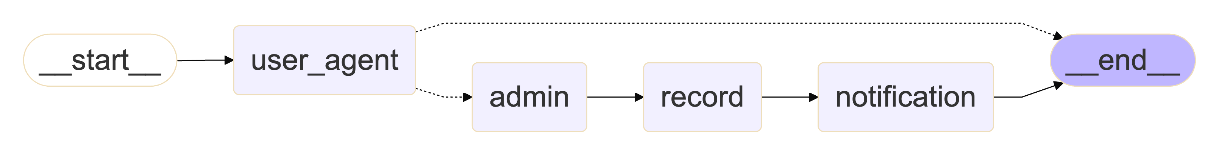
STAGE 4
The graph, as LangGraph draws it
Rendered from the compiled graph itself, not drawn by hand. Solid arrows are fixed edges; dotted ones are conditional: after confirm, user_agent routes to admin - any other turn ends.
docs/graph.md also has the user and admin agents' own graphs, where middleware - history summarization, the human-in-the-loop pause - shows up as steps. Regenerate with python -m scripts.export_graph.
scripts/export_graph.py · docs/graph.md
VilniusPark Chatbot

Slide 12
TESTING & EVALUATION
Tested for real, not just in theory
105
1
0.93
CI
automated tests:
unit, integration, e2e
real ephemeral Postgres
per test run (testcontainers)
Recall@4 on the
15-question golden set
ruff + pytest
on every push
e2e tests spin up the real MCP server as a subprocess and check the exact line it writes — not a mock
evals/report.md: Precision@4 0.58, Recall@4 0.93; retrieval about 0.6 s, a full chat turn about 3.7 s
load_tests/report.md: chatbot, admin and MCP load-tested with 0 failures; 1,112 MCP writes, none lost
Load testing caught a real bug: summarizing long chats sent parallel_tool_calls without tools (HTTP 500) - fixed and covered by a test
tests/ · evals/ · load_tests/ · .github/workflows/ci.yml
VilniusPark Chatbot

Slide 13
TRY IT YOURSELF
Try it yourself
docker compose --env-file .env.development up --build -d
alembic upgrade head, then python -m scripts.ingest_static / ingest_dynamic
Chat: http://localhost:8000/ · Admin: http://localhost:8000/admin
make test · make eval · make load-test
docs/SPECIFICATION.md has the full assignment · README.md has the full setup guide

