Slide 1
PRASUNETHON 2.0 • FINAL PROJECT SUBMISSION
LeadGenAI
AI-Powered Lead Generation &
Sales Automation Platform
A completed working MVP that connects lead discovery, research, scoring, personalized outreach, AI calling, knowledge retrieval and human-approved follow-up in one workflow.
WORKING MVP
VERCEL DEPLOYED
AI + AUTOMATION
LIVE DEMO
Team Avengers
ai-lead-generation-mvp.vercel.app
Raj Gautam • Team Leader
Priyanshu Kumar • Member
Sampath Kumar Midde • Member
github.com/FasterThanAi/ai-lead-generation-mvp

Slide 2
01 • PROBLEM
Lead generation is fragmented long before the first conversation.
Teams spend time switching between discovery, enrichment, spreadsheets, AI tools, email, calling and follow-up. The result is slow qualification and inconsistent outreach.
1
Finding the right lead
2
Deciding who matters
3
Following up safely
Search is scattered across public websites, CSVs and manual research. Contact data may be incomplete or inconsistent.
Sales teams need a repeatable way to prioritize fit, explain the score, identify pain points and choose an outreach angle.
Email replies, AI drafts, calls and follow-ups require review, context and clear next actions — not uncontrolled automation.
CORE CHALLENGE
How might we turn prospecting into one traceable workflow that saves time without removing human control?

Slide 3
02 • SOLUTION
One AI workspace from campaign idea to approved outreach.
LeadGenAI brings the high-friction steps of B2B prospecting into a single operator flow with explainable AI and approval checkpoints.
01
02
03
04
05
06
Define campaign
→
Discover leads
→
Research + score
→
Draft outreach
→
Call + learn
→
Human approve
Audience • location • offer
CSV • URLs • Lead Agent
Fit • pain • CTA • reason
Email • reply • follow-up
Vapi • outcomes • next action
Review before every send
DISCOVERY
INTELLIGENCE
OUTREACH
CALLING
CONTROL
•
01
✓
05
Design principle: automate preparation; keep consequential external actions reviewable.
unified workspace
approval points

Slide 4
03 • COMPLETED BUILD
The project is beyond the idea stage: the main operating loop is implemented.
The public repository documents the implemented MVP surface, integrations and the week-wise build progression.
01
Campaigns + leads
02
Discovery + enrichment
03
AI research + scoring
Create campaigns, upload CSVs, maintain campaign-wise lead tables, validate inputs.
Public-source discovery, website email extraction with pattern verification, and n8n Lead Agent automation.
Research summary, business fit, pain points, outreach angle, score and explainability.
04
Email + Gmail
05
AI replies + follow-up
06
RAG + calling
Gemini drafts, approval/rejection, Gmail OAuth, approved sending and reply checks.
Intent, sentiment, priority, next action, response drafts and safe follow-up flow.
Company knowledge, semantic/hybrid retrieval, Vapi AI calling, logs and outcomes.
Deployed on Vercel • public repository • 20 API modules • 17 services • 17 tables

Slide 5
04 • END-TO-END WORKFLOW
From target definition to measurable next action.
A single lead can move through discovery, enrichment, research, scoring, outreach, calling, reply handling and follow-up while preserving status and context.
1
Campaign context
Offer + industry + location + role
✓
Status stays visible
↓
2
Lead sourcing
CSV / public URLs / Lead Agent
↓
Lead status, score, draft state, sent state, reply analytics and call outcome remain accessible to the operator.
3
Email extraction
Visible public emails + pattern fallback
↓
4
AI enrichment
Business type + pain points + fit
↓
✓
Actions stay reviewable
5
Scoring
Priority + reason + outreach angle + CTA
↓
The product separates AI preparation from external sending and calling actions.
6
Outreach
Gemini draft → human approval → Gmail
↓
7
Conversation
Reply classification / AI call / outcome
↓
↺
Outcome loop
8
Follow-up
Response or follow-up draft → approval → send
Every interaction can produce a next action.

Slide 6
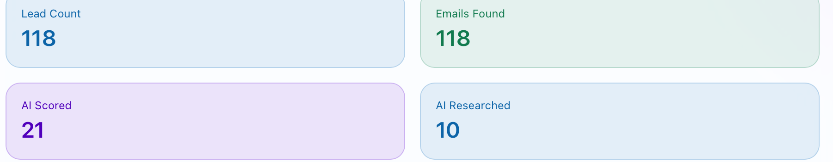
05 • LEAD DISCOVERY
Multiple lead-entry paths feed the same Leads table.
The MVP supports manual and automated sourcing while keeping discovered contacts pending review before import.
CSV
CSV upload
URL
Public-source discovery
AI
Lead Agent automation
Bulk lead intake with campaign linkage and invalid CSV validation.
User-provided URLs are reviewed first; readable public emails/phones are structured for approval.
Gemini generates search queries; n8n triggers Google Maps/Apify discovery and returns normalized leads.
ONE LIVE CAMPAIGN • KANPUR INDUSTRIAL OUTREACH
!
Safety boundary
LinkedIn scraping is not automated in the documented workflow. Discovery uses user-reviewed public source URLs or the configured Google Maps/Apify path.
Sourced by the Lead Agent; every lead resolved to a public email address through website extraction and pattern verification.

Slide 7
06 • AI RESEARCH + SCORING
Explainability is part of the lead decision.
Gemini combines campaign context, lead fields and lightweight public-site research to produce a concise enrichment profile and actionable scoring rationale.
R
Research profile
S
Score + qualify
C
Use the same context
Business type, products/services, likely pain points, use-case fit, outreach angle, risk flags, sources and confidence.
Priority labels with an explainable reason, recommended outreach angle, likely pain point and CTA.
The researched profile can feed scoring and cold-email generation instead of repeating research manually.
LIVE EXAMPLE • KANPUR CAMPAIGN
✓
Why it matters
Fit score
95
Contact score
25
Final = 0.75 × fit + 0.25 × contact confidence. Splitting the two separates “wrong company” from “right company, unusable email” — one means drop the lead, the other means find a better address.
Final score
78
Verdict
Right company, wrong contact

Slide 8
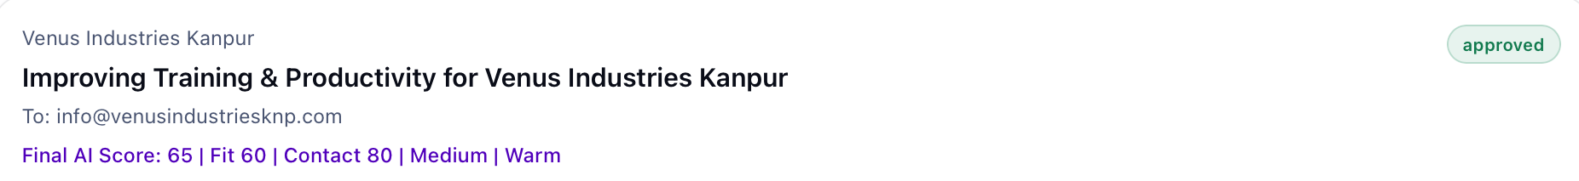
07 • EMAIL + REPLY INTELLIGENCE
Personalized outreach with human approval at the boundary.
The outreach layer covers draft generation, approval, Gmail sending, reply checking, AI classification and response drafting.
01
02
03
04
05
06
Draft
→
Review
→
Send
→
Check
→
Classify
→
Respond
Gemini + context
Approve / reject
Gmail OAuth
Reply tracking
Intent + sentiment
Draft + approve
✉
Cold email
AI
Reply intelligence
✓
Follow-up safety
Generated using campaign context and relevant company knowledge when available.
Classifies intent, sentiment, priority, summary and suggested next action.
Follow-up and response messages become drafts; sending remains approval-gated.
Live draft: generated subject, recipient and score breakdown — held in an approved state until the operator sends it.

Slide 9
08 • AI CALLING
Calling is a native step in the same lead workflow.
Selected leads can move into a Vapi-powered AI call, with call scripts, logs, outcomes, transcripts and next actions stored back in the system.
01
02
03
04
05
Select lead
→
Generate script
→
Start Vapi call
→
Capture result
→
Create next step
Eligible + not Do-Not-Call
Campaign + lead context
Backend-only API call
Transcript • sentiment
Follow-up draft only
!
Call control
◎
Call evidence
✓
No auto-send
The backend validates calling conditions; Do-Not-Call leads are blocked before any Vapi request.
Provider call id, status, outcome, sentiment, transcript, summary, recording URL and next action can be stored.
Interested or details-requested calls can create follow-up email drafts, but the project does not silently send them.
Outbound calls on the current provider plan are placed to a registered test number — a billing limit, not a missing integration.

Slide 10
09 • KNOWLEDGE BASE + RAG
Ground outreach in company-specific facts.
The knowledge layer stores product, pricing, FAQ, demo and objection-handling context and retrieves relevant chunks for AI-generated responses.
1. Upload
2. Chunk + store
3. Retrieve
4. Ground
→
→
→
PDF • DOCX • TXT • Markdown
Chunked company knowledge
Hybrid retrieval
Cold email • reply • follow-up
V
Semantic path
R
Grounding rule
✓
Trust outcome
When embeddings are available, Supabase/PostgreSQL pgvector supports semantic retrieval with hybrid and keyword fallback.
Relevant facts are brought into the prompt; the system is not “training” the LLM on company documents.
Pricing and demo replies prefer exact retrieved company facts and keep manual approval before sending.

Slide 11
10 • SYSTEM ARCHITECTURE
A modular full-stack build with clear service boundaries.
The deployed frontend runs on Vercel, the FastAPI backend on Render, and application data in Supabase PostgreSQL. External AI, Gmail, Vapi and n8n services plug in behind the backend.
USER
React + Vite
Tailwind CSS
Axios
Vercel
API
FastAPI
SQLAlchemy
20 route modules
Render
DATA
Supabase PostgreSQL
pgvector / knowledge
Lead + campaign records
Supabase
INTEGRATIONS
Gemini • Gmail • Vapi
n8n • Apify / Maps
Hunter (optional)
AI
MAIL
CALLS
Architecture principle
AUTOMATION
Secrets stay server-side; integrations are isolated behind backend calls.

Slide 12
11 • SAFETY + CONTROL
Human-in-the-loop is a feature, not a limitation.
The project deliberately separates AI preparation from consequential external actions.
✓
Approval-gated sending
!
Do-Not-Call guard
K
Credential isolation
Drafts are generated first. Email and response messages are sent only after explicit approval.
Calling requests are blocked for leads marked Do-Not-Call before reaching Vapi.
Gemini and Gmail credentials are kept on the backend and loaded from environment variables.
R
Reviewed discovery
G
Grounded responses
A
Auditable outcomes
User-provided public source URLs are fetched; discovered contacts remain pending until reviewed/imported.
Relevant knowledge is retrieved to reduce unsupported pricing/product claims.
Call logs, statuses, transcripts, response states and message ids provide a traceable record.

Slide 13
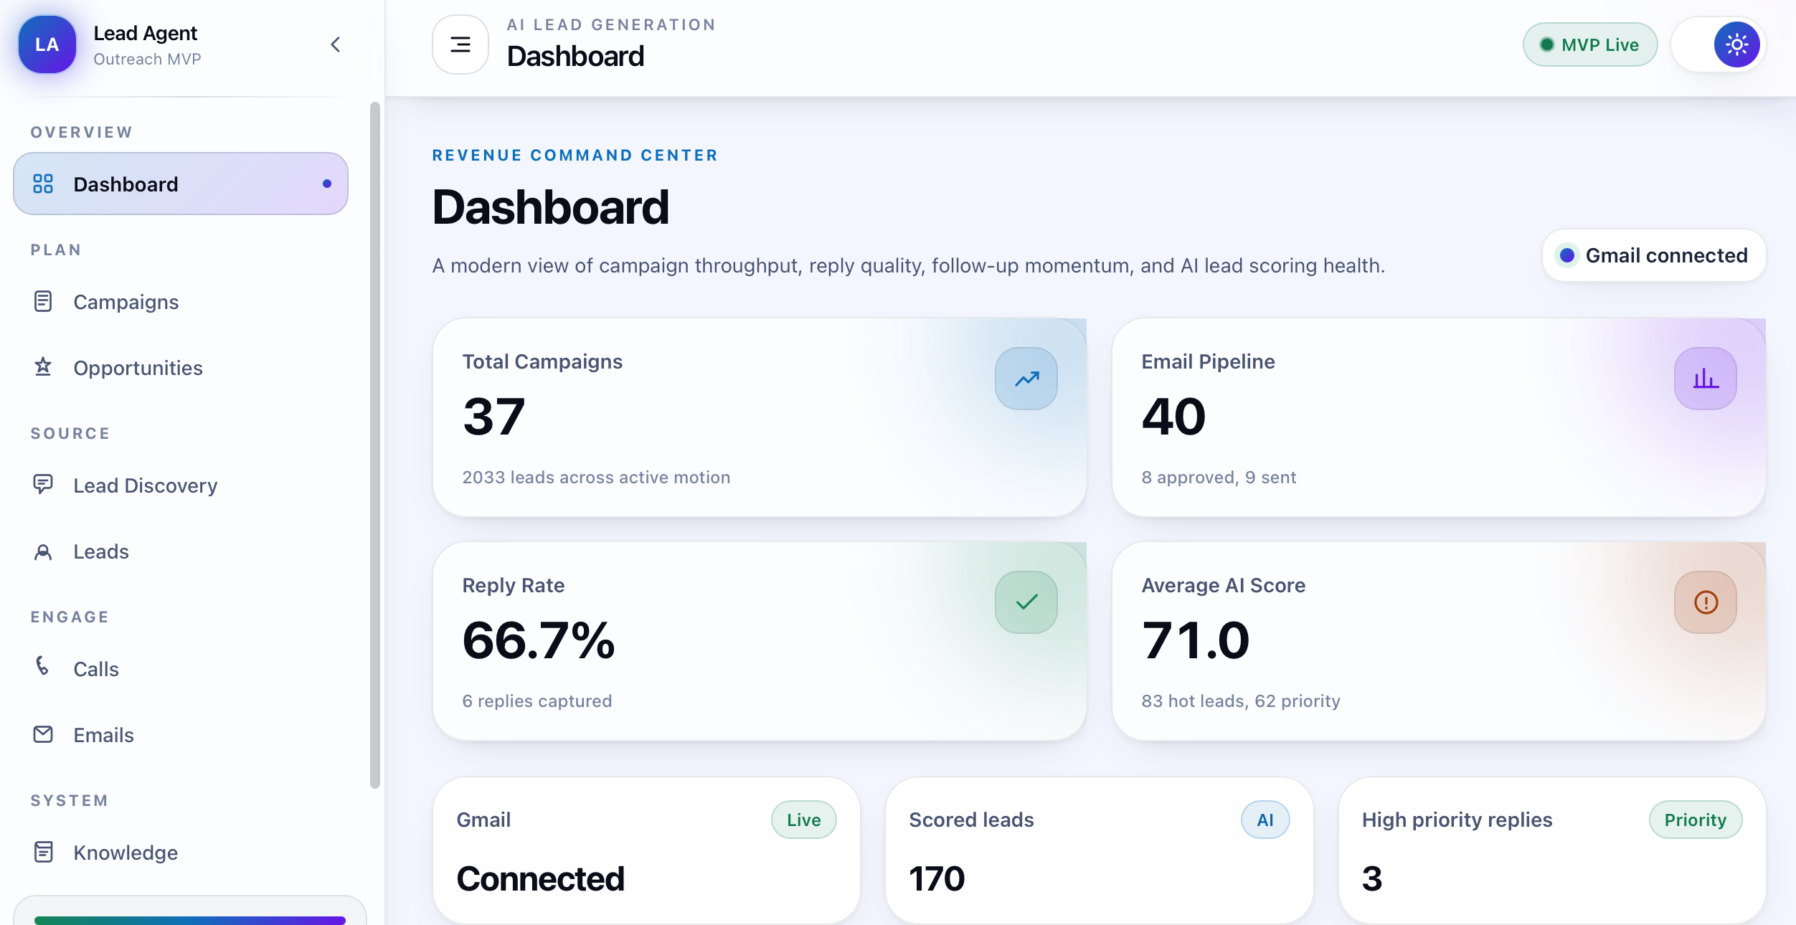
12 • PRODUCT EXPERIENCE
The dashboard is organized around decisions, not infrastructure.
The operator can move from campaign → leads → research → outreach → calls → analytics without leaving the product workflow.
UI
One-screen context
Campaigns, leads, scores, drafts and actions stay connected.
UX
Action-oriented states
The interface exposes next best actions instead of only raw data.
▶
Demo-ready
Live screenshot from the deployed app — real campaign and lead data.

Slide 14
13 • TECHNOLOGY + DEPLOYMENT
Modern stack, intentionally modular.
The documented MVP uses React/Vite/Tailwind on Vercel, FastAPI/SQLAlchemy on Render, Supabase PostgreSQL for data, and external AI/automation services.
1
Frontend
2
Backend
↗
Deployment map
React • Vite • Tailwind • Axios
FastAPI • SQLAlchemy • Python
Frontend → Vercel
Backend → Render
Data → Supabase
AI / integrations → backend-managed keys
3
Database
4
AI
Supabase PostgreSQL • pgvector
Gemini 2.5 Flash • hybrid RAG
5
Outreach
6
Automation
Gmail OAuth • public extraction
n8n • Apify / Google Maps
K
Configuration rule
7
Calling
Vapi API • webhooks • logs
Secrets are stored through deployment environment variables; real secrets are not committed to source control.

Slide 15
14 • IMPACT + EVALUATION FIT
The final build maps directly to Prasunethon’s scoring criteria.
The strongest story is not one AI feature; it is the completeness of the workflow and the control built around it.
25
Innovation • 25%
15
UX • 15%
AI discovery + enrichment + explainable scoring + RAG + AI calling in one operating loop.
Operator-first dashboard, visible states, review checkpoints and campaign analytics.
25
Technical implementation • 25%
15
Scalability + impact • 15%
React/FastAPI/Supabase architecture with Gmail, Gemini, Vapi and n8n integrations.
Modular integrations, shared lead/campaign data and automation-ready workflow.
20
Problem solving • 20%
EXPECTED BUSINESS EFFECT
Less tool switching → faster qualification → more consistent outreach → better visibility into replies and next actions.
Replaces fragmented prospecting steps with a traceable, repeatable workflow.

Slide 16
15 • NEXT STEPS
From a completed MVP to a stronger production system.
The current project is demonstrable; the next improvements focus on scale, reliability and deeper evaluation.
NOW
Live MVP
Deployed frontend • documented backend • integrated AI, email, RAG, calling
NEXT
Reliability
Automated regression tests • observability • retry strategy • stronger validation
SCALE
Operations
Multi-tenant workspaces • queues • rate controls • role-based access
GROW
Intelligence
Better lead-quality feedback loops • campaign optimization • outcome-based learning
→
Target outcome
A sales copilot that is measurable, reviewable and resilient enough for real operational use.

Slide 17
TEAM AVENGERS
Built as a complete product, not just a prototype screen.
Raj Gautam
Priyanshu Kumar
Sampath Kumar Midde
R
Team Leader
P
Member
S
Member
Product direction • coordination • final presentation
Engineering • integration • workflow execution
AI/data • documentation • deployment support
LIVE PRODUCT
SOURCE CODE
https://ai-lead-generation-mvp.vercel.app/
https://github.com/FasterThanAi/ai-lead-generation-mvp
Thank you
Live demo • architecture • Q&A

