Slide 1
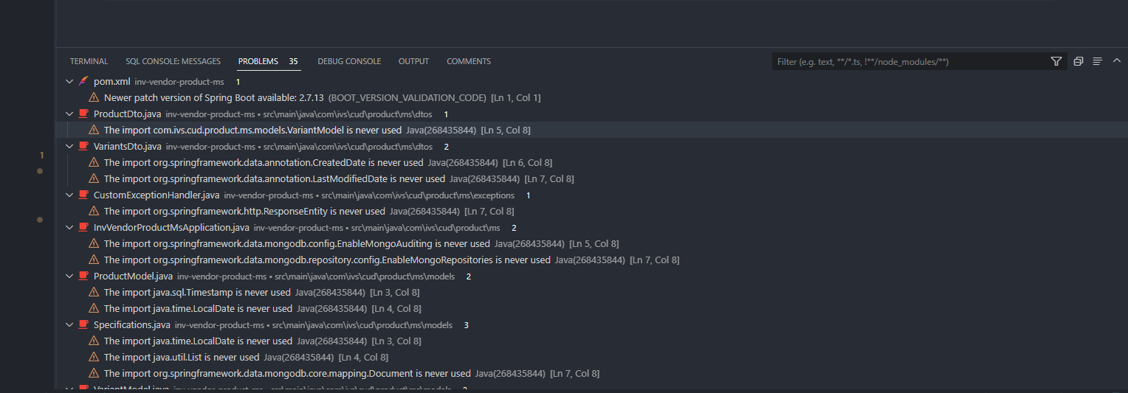

BEFORE
AFTER

Slide 2
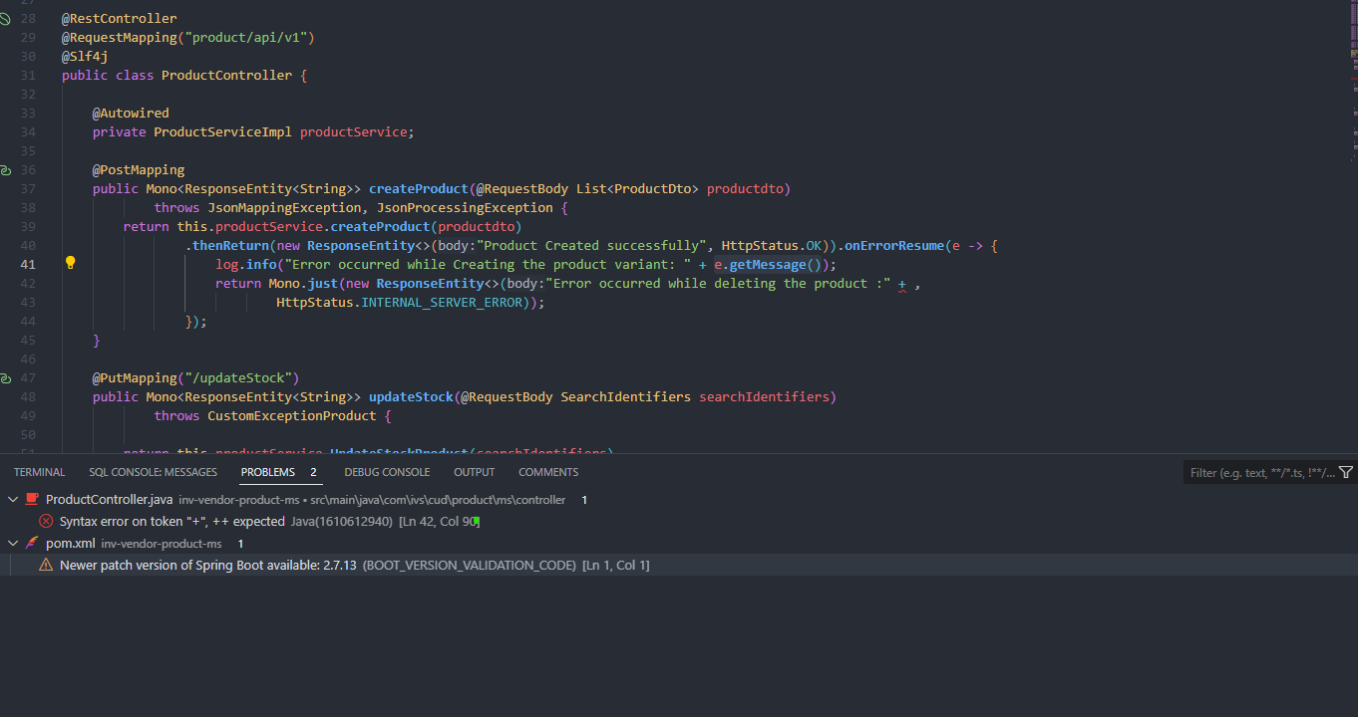
HELPING ME WITH SYNTAX ERROR

Slide 3
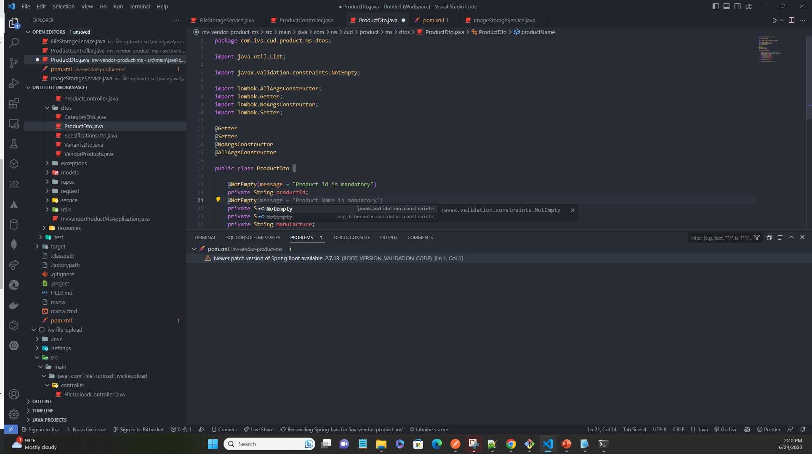
HELPING WITH MOST SENTENCES

Slide 4
