Slide 1
🛡️
Ctrl+Aid
AI-Powered Emergency Information Platform
for Pakistani Communities
AI for Civic Innovation Hackathon 2026
Team Ctrl+Aid • Code for Pakistan
Next.js 16 • TypeScript • Gemini AI • Tailwind CSS v4 • React-Leaflet

Slide 2
THE PROBLEM
Pakistan's 2022 floods displaced 33 million people
Communities lacked access to verified, timely emergency information
📡 Fragmented Information
🗺️ Inaccessible Shelter Data
No single source of verified emergency alerts — citizens relied on unverified WhatsApp forwards
People could not locate nearby shelters or hospitals during the chaos of disaster events
📞 Scattered Helplines
🤖 No AI-Assisted Guidance
Critical emergency contacts buried across dozens of different government websites
No way to ask questions and receive personalized, context-aware safety advice instantly

Slide 3
OUR SOLUTION
Ctrl+Aid — One Platform for All Emergency Needs
🔴 Live Emergency Updates
🗺️ Interactive Shelter Map
Real-time verified alerts from NDMA, PDMA, PMD, and Rescue 1122 — categorized by type and severity
12+ verified locations across Islamabad, Rawalpindi, Lahore & Karachi with capacity and status
📞 Emergency Contacts
🤖 AI Emergency Assistant
Searchable directory with one-tap calling — Rescue 1122, Edhi 115, Police, Fire, NDMA
Context-aware AI trained with verified Pakistani emergency data — streaming real-time guidance

Slide 4
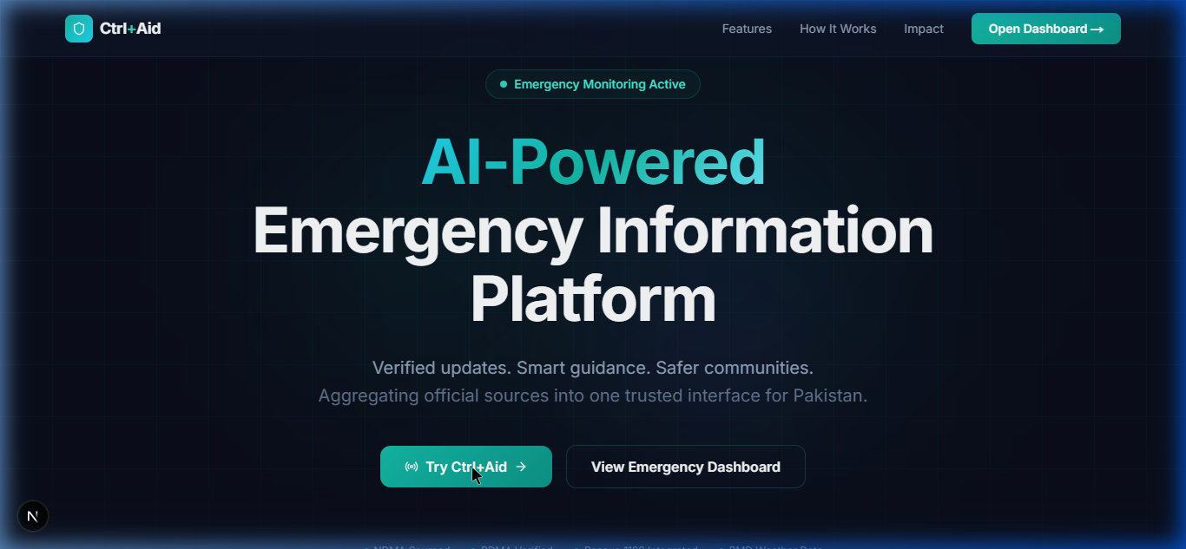
LIVE DEMO
Landing Page
Premium design with animated hero, feature showcase, and impact metrics

Slide 5
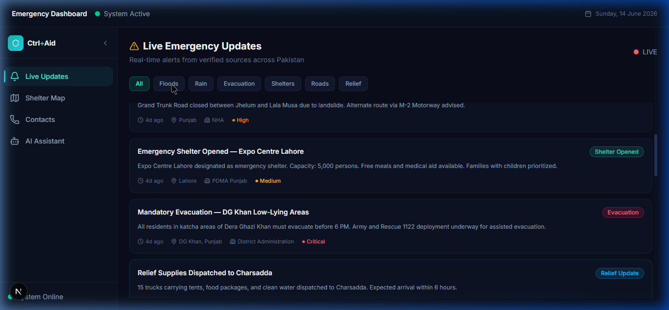
LIVE DEMO
Live Emergency Updates
Real-time alerts from verified sources with severity badges and category filtering

Slide 6
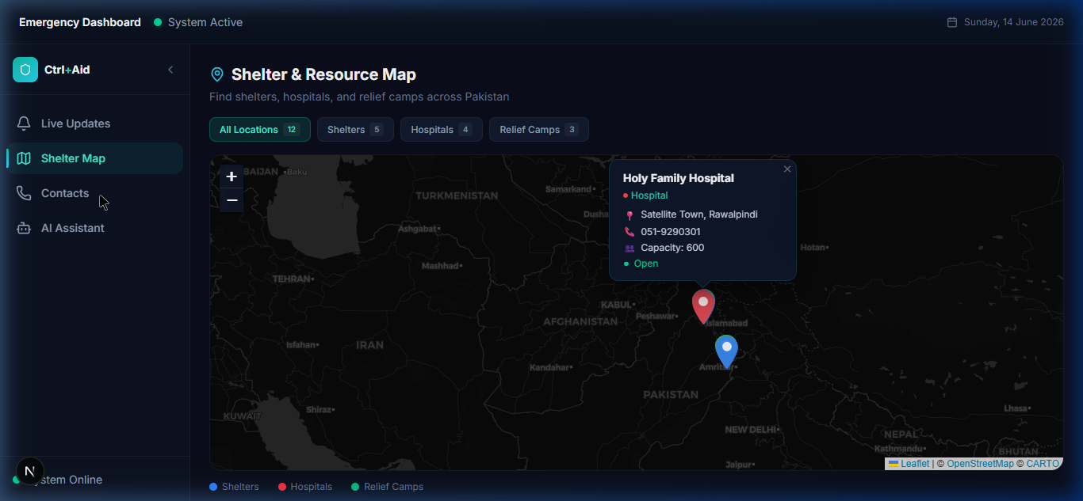
LIVE DEMO
Shelter & Resource Map
Interactive map with color-coded markers — Shelters (blue), Hospitals (red), Relief Camps (green)

Slide 7
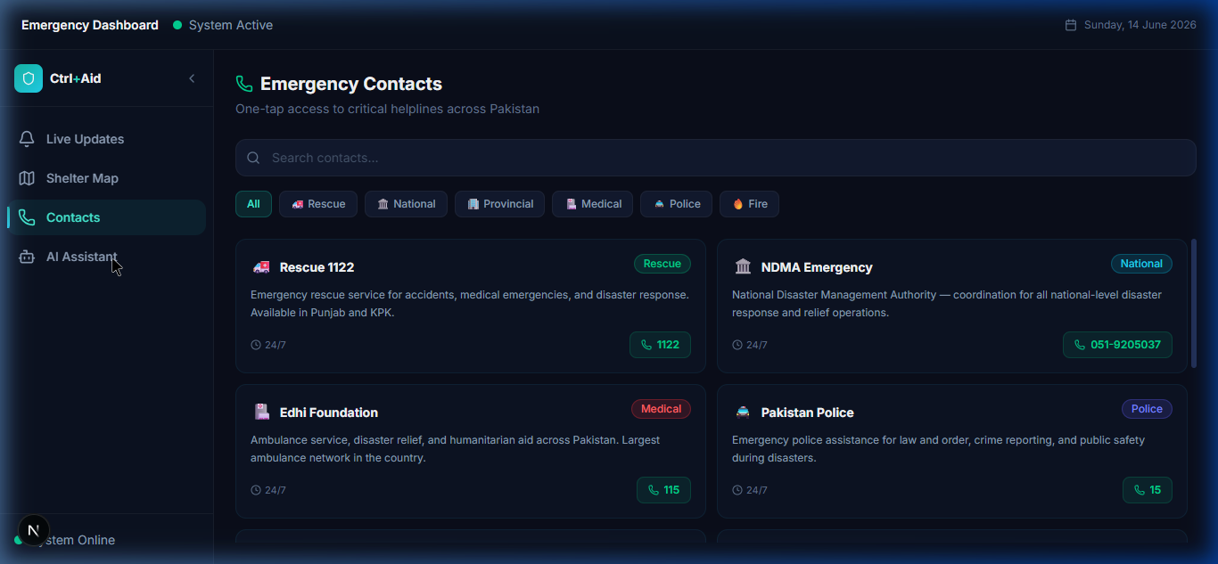
LIVE DEMO
Emergency Contacts
Searchable directory with one-tap calling and category filters

Slide 8
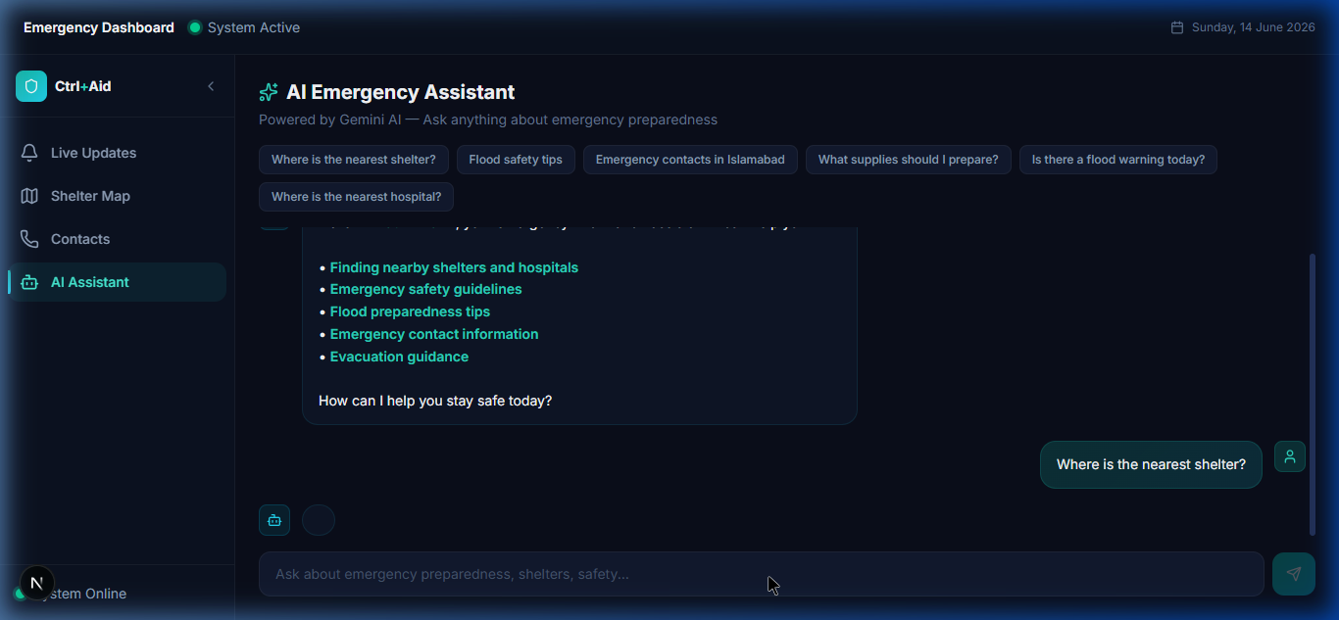
LIVE DEMO
AI Emergency Assistant
Context-aware streaming AI powered by verified Pakistani emergency data

Slide 9
HOW AI POWERS CTRL+AID
Not a generic chatbot — a context-aware emergency specialist
✦ Trained on Real Pakistani Data
Shelter addresses, hospital capacities, NDMA/PDMA contacts, evacuation protocols — all verified
✦ Streaming Architecture
Sub-second response times using Vercel AI SDK v5 transport — critical when every second counts
✦ Context-Constrained
AI only cites verified sources (NDMA, Rescue 1122, PDMA) — no hallucinated emergency info
✦ Quick-Action Prompts
Pre-built queries like "nearest shelter" and "flood safety tips" for stressed users who can't type

Slide 10
TECHNOLOGY STACK
Modern, Production-Ready Architecture
Next.js 16
TypeScript
Gemini AI
Vercel AI SDK
Full-stack React
App Router + SSR
Type-safe
Zero errors
Google Gemini
2.0 Flash
v5 Streaming
Transport
Tailwind CSS
Framer Motion
React-Leaflet
Vercel
v4 Dark Theme
Design System
Smooth
Animations
Interactive
Dark Maps
Edge-Optimized
Deployment

Slide 11
IMPACT & SCALABILITY
From Prototype to Pakistan's Emergency Portal
Now
Phase 1
Phase 2
Phase 3
Working Prototype
Real-Time Integration
Accessibility
Scale Nationwide
• 4 integrated modules
• Verified data from 5+ sources
• AI assistant with real shelter data
• Deployed on Vercel
• NDMA/PDMA live API feeds
• PMD weather warnings
• Automated alert ingestion
• Multi-language: Urdu, Sindhi, Pashto
• Offline-first PWA
• SMS fallback gateway
• Community reporting with AI verification
• Government partnership
• All 4 provinces covered

Slide 12
🛡️
Ctrl+Aid
Because access to information saves lives.
🔗 ctrl-aid.vercel.app
📂 github.com/Fastian-afk/ctrl-aid
Thank you!
AI for Civic Innovation Hackathon 2026 • Code for Pakistan

