Slide 1
AI for Civic Innovation Hackathon 2026
Ctrl+Aid
AI-Powered Emergency Information Platform
for Pakistani Communities Facing Natural Disasters
Next.js 16 • TypeScript • Google Gemini 2.0 Flash • Tailwind CSS v4 • React-Leaflet • Vercel AI SDK v5
Built by Team Ctrl+Aid • Code for Pakistan

Slide 2
THE PROBLEM
During Pakistan's 2022 floods, 33 million people were displaced
📡 Fragmented Information
🗺️ Inaccessible Shelter Data
No single source of verified emergency alerts during disaster events
People couldn't locate nearby shelters or hospitals during emergencies
📞 Scattered Contacts
🤖 No AI Guidance
Critical helplines buried across different government websites
No way to get personalized safety advice instantly

Slide 3
OUR SOLUTION
Ctrl+Aid — Everything You Need in an Emergency
🔴 Live Emergency Updates
🗺️ Interactive Shelter Map
Real-time verified alerts from NDMA, PDMA, PMD, Rescue 1122 with severity filtering
12+ locations across 4 cities with capacity, phone, and real-time status
📞 Emergency Contacts
🤖 AI Emergency Assistant
Searchable directory with one-tap calling — Rescue 1122, Edhi 115, Police 15, Fire 16
Gemini-powered streaming chat with verified shelter data and safety guidance

Slide 4
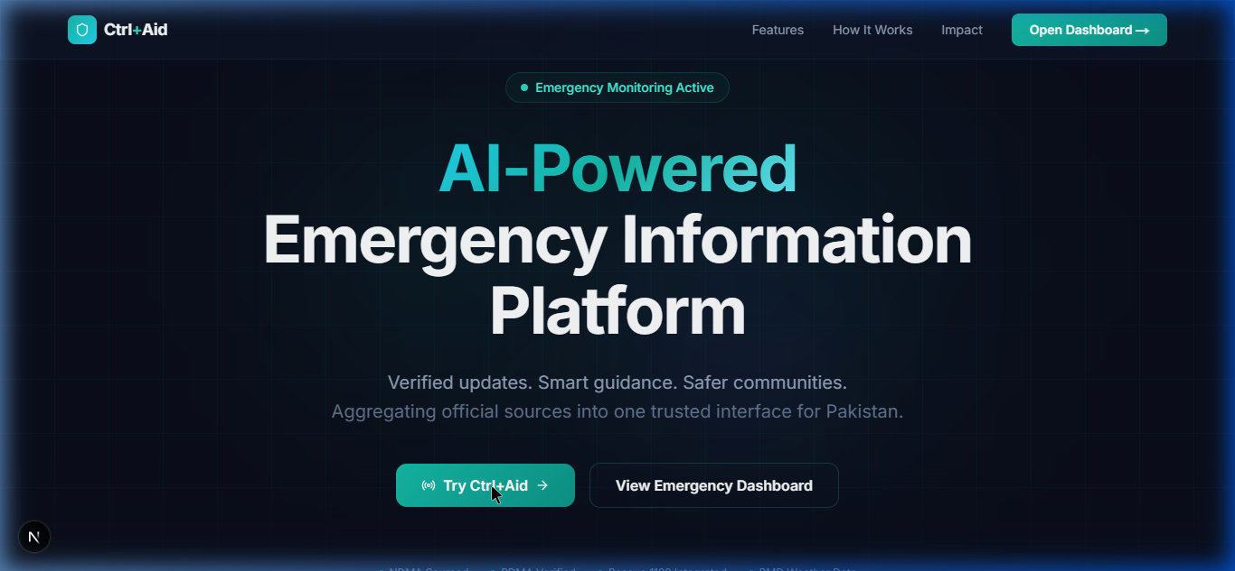
DEMO — Landing Page
Premium dark-themed hero with animated gradients and glassmorphism

Slide 5
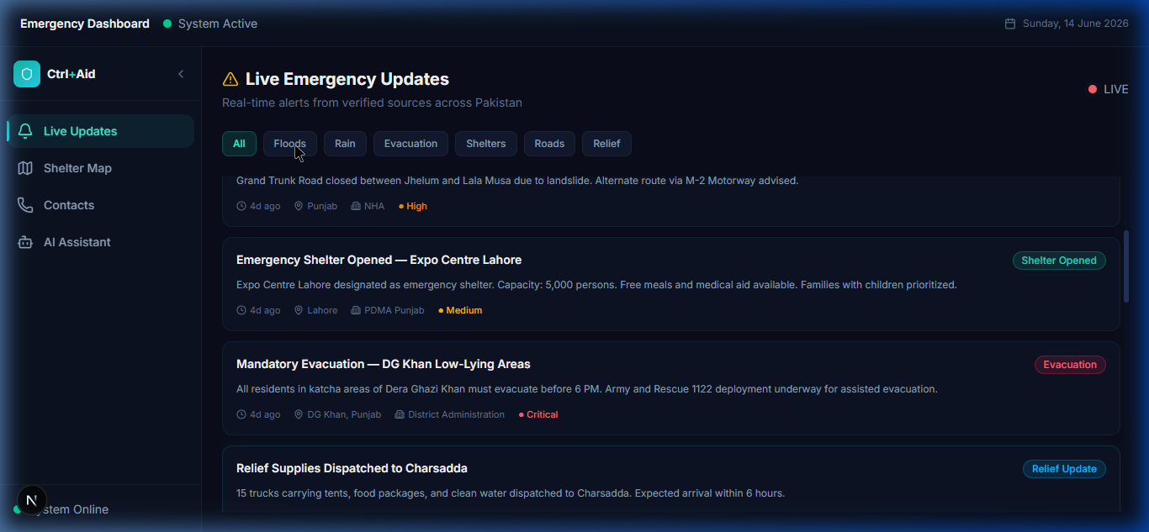
DEMO — Live Emergency Updates
Real-time alerts from NDMA, PDMA, Rescue 1122 with severity badges and category filters

Slide 6
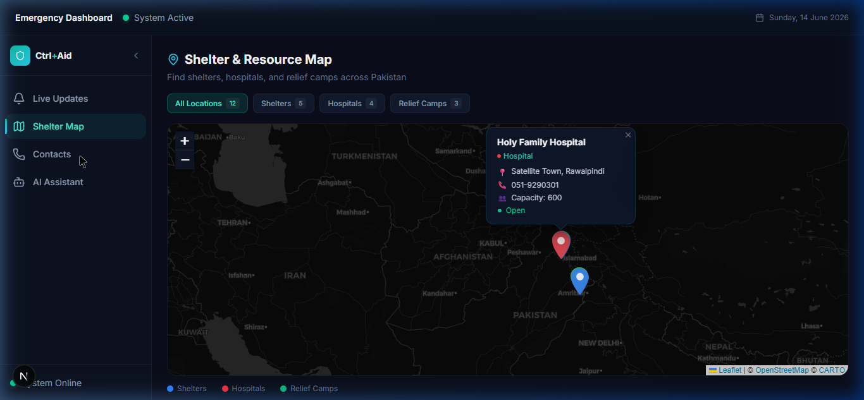
DEMO — Shelter & Resource Map
Interactive Leaflet map with color-coded markers — Shelters, Hospitals, Relief Camps

Slide 7
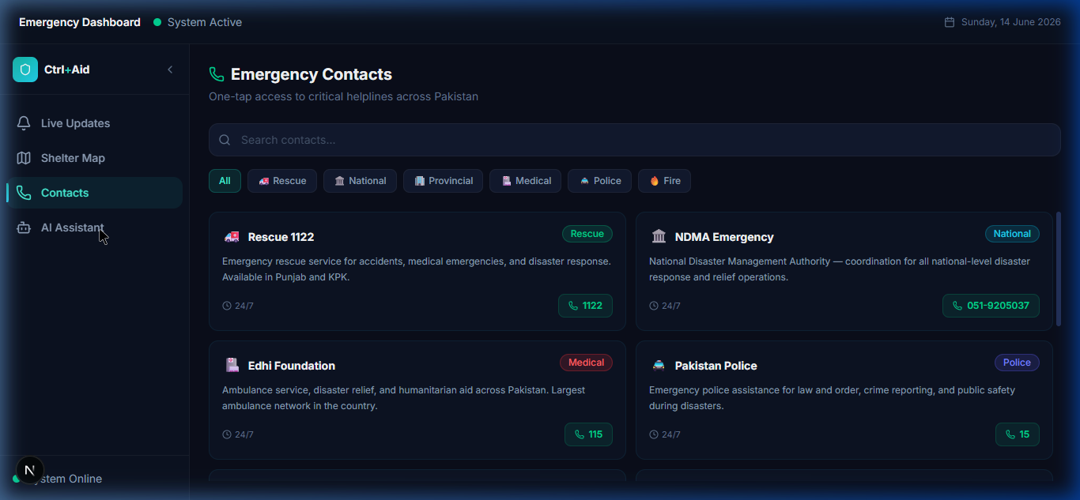
DEMO — Emergency Contacts
Searchable directory with one-tap calling and category filters

Slide 8
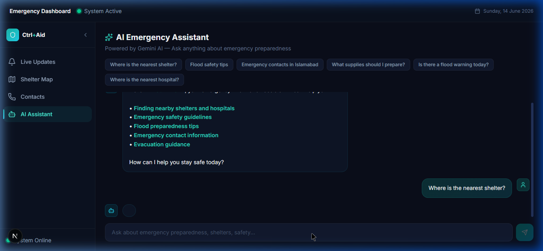
DEMO — AI Emergency Assistant
Streaming Gemini AI chat with quick-action prompts and verified emergency data

Slide 9
TECHNOLOGY STACK
Built with Modern Tools
Next.js 16
TypeScript
Gemini 2.0 Flash
Vercel AI SDK v5
App Router + SSR
Type-safe codebase
AI Assistant
Streaming Chat
Tailwind CSS v4
Framer Motion
React-Leaflet
Vercel
Dark Theme System
Micro-animations
Interactive Maps
Edge Deployment
Data sourced from NDMA · PDMA · PMD · Rescue 1122

Slide 10
IMPACT & FUTURE
Designed for Real Impact
🌐 Multi-Language Support
📱 Offline-First PWA
Urdu, Sindhi, Pashto for broader accessibility
Cached shelter data — works without internet
💬 SMS Fallback
📊 Real-time APIs
Emergency info via SMS for low-connectivity areas
Live feeds from NDMA, PDMA, PMD

Slide 11
Thank You
Ctrl+Aid
Because access to information saves lives.
🔗 Live Demo: ctrl-aid.vercel.app
📂 GitHub: github.com/Fastian-afk/ctrl-aid
AI for Civic Innovation Hackathon 2026 · Code for Pakistan

