Slide 1
CS361 Fastwatch
Riley Mahr, Philip Sauvey, Isaac Kadera, Fue Her, Andrew Krill

Slide 2
Overview of project
Requirement

Slide 3
Project Management
Git
Slack
Participation

Slide 4
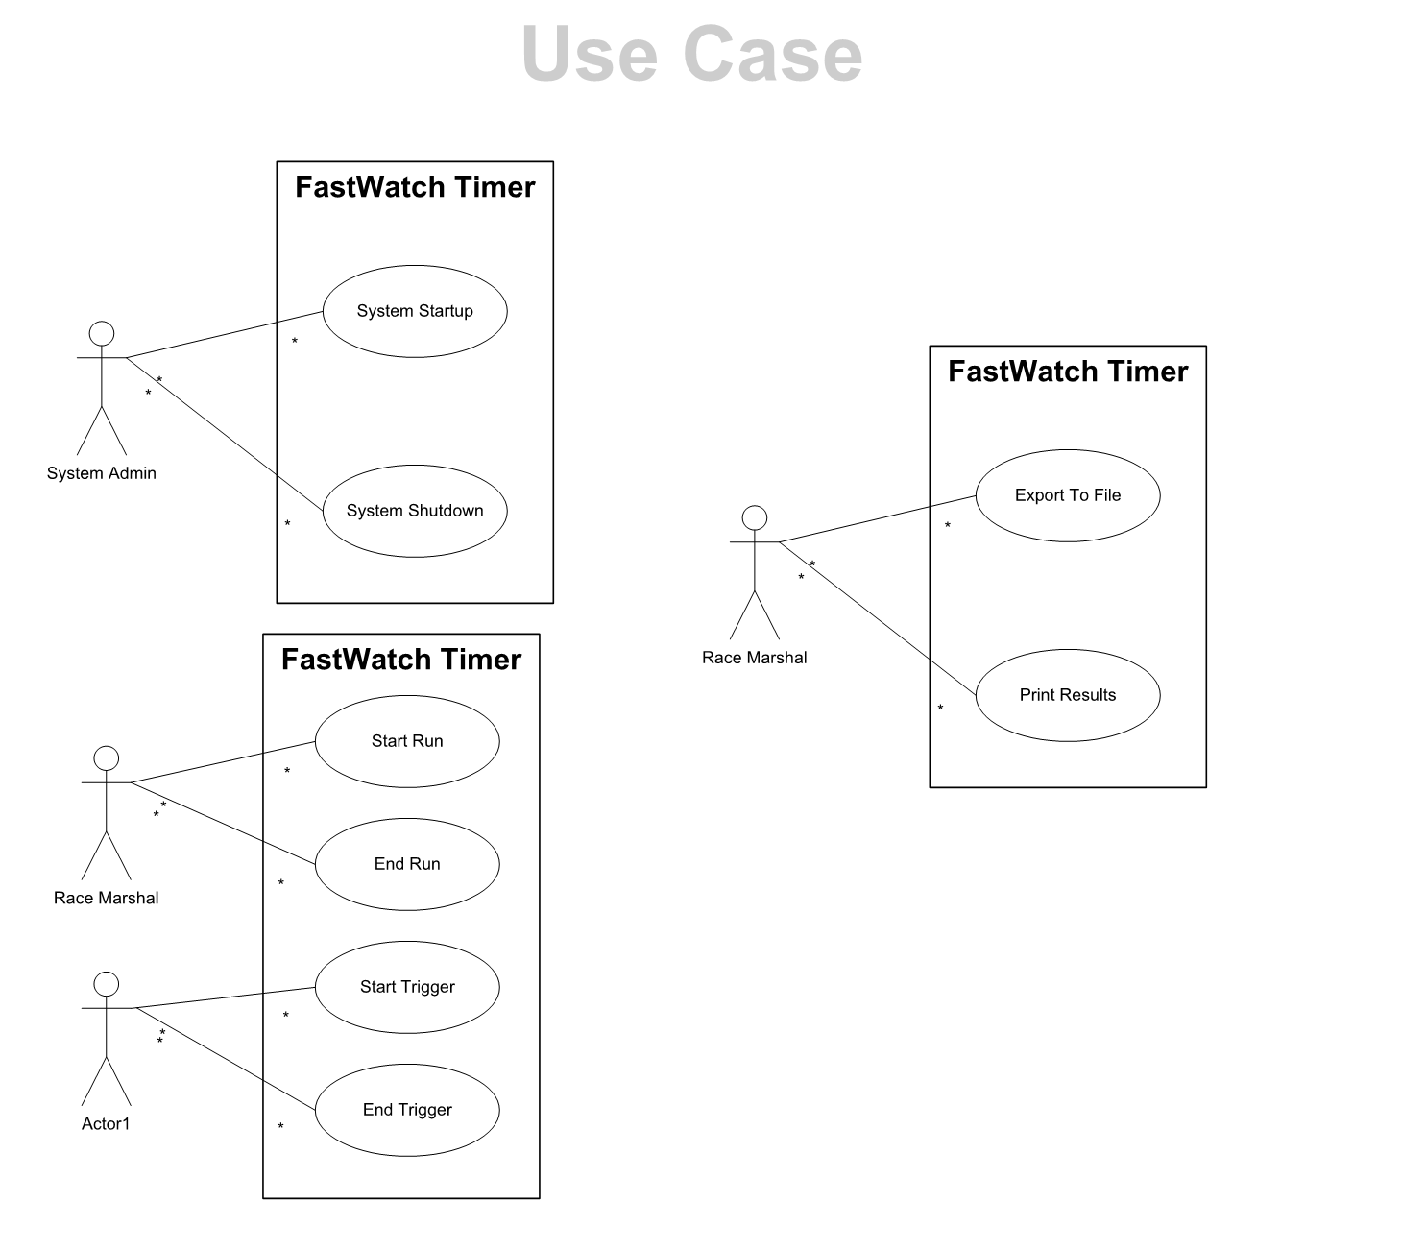
Project Requirements
Use cases
non functional requirements
precision
java

Slide 5
Domain Model
What kind of abstractions exist – partition of responsibilities
UML Model – decomposition of system from a logical perspective

Slide 6
Testing
Test Plan – Last Lab
Test Cases – show that the system works

Slide 7
Iteration Plans
Backlogs
Sprint 1 : none
Sprint 2: none
Sprint 3:

Slide 8
Participation
Riley
Philip
Andrew
Fue
Isaac

Slide 9
Design

Slide 10
Code
Demonstration

