Slide 1
CS361 Fastwatch
Riley Mahr, Philip Sauvey, Isaac Kadera, Fue Her, Andrew Krill

Slide 2
Overview of project
Requirement

Slide 3
Project Management
Source Control
Github
Communication
Slack
Slack incorporated with github
Participation
Voluntary
Organization
Charter
Retrospectives

Slide 4
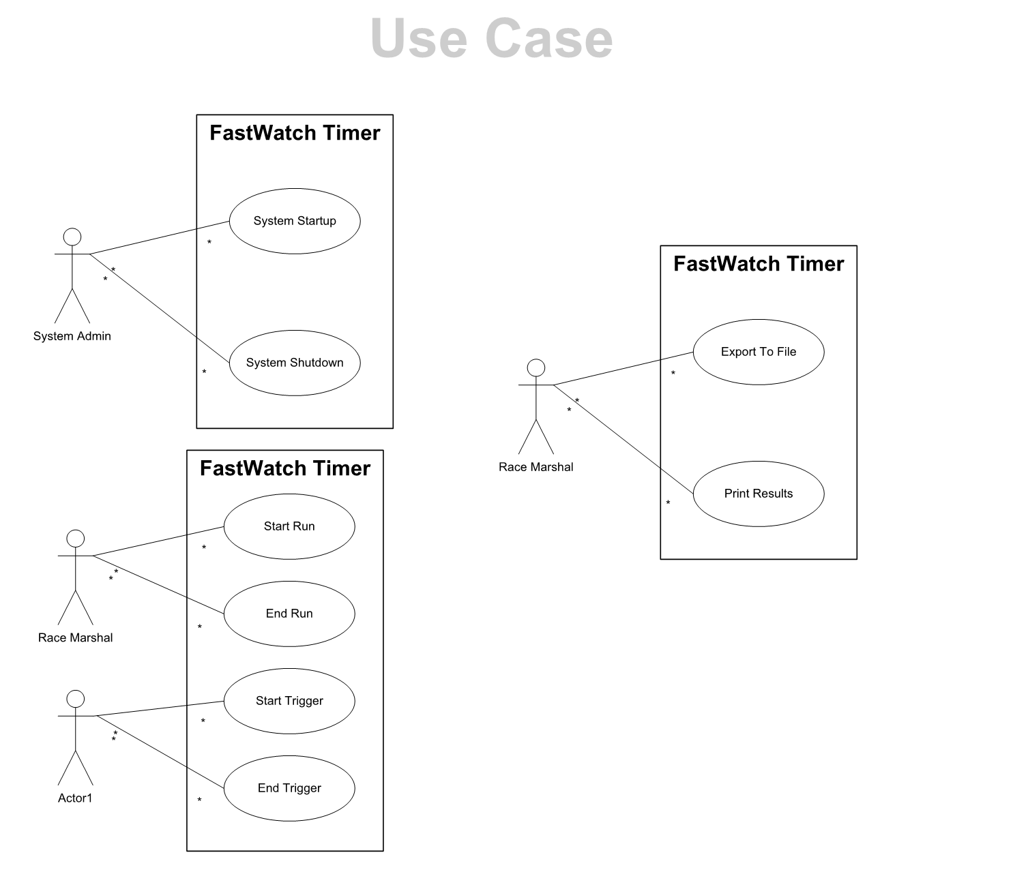
Project Requirements
Use cases
Non Functional Requirements
Number Precision
Java

Slide 5
Domain Model
What kind of abstractions exist – partition of responsibilities
UML Model – decomposition of system from a logical perspective

Slide 6
Testing
ChronoTimer
execute(String command)
Tests
Preliminary
Equivalence Classes
Full runs
Master test file

Slide 7
Iteration Plans
Backlogs
Sprint 1: none
Sprint 2: none
Sprint 3:
DNF, PRINT, EXPORT and SWAP functions with specified number (in GUI)
PRINT will either print current run or previous run and not a specified run number when using the GUI
Separate thread handling for update display
The RETURN function will return and display the updated racer’s queue
The UP/DOWN/LEFT/RIGHT Arrow Buttons will cycle through executable commands

Slide 8
Participation
Riley – GUI and Simulator
Philip – Chronotimer and GUI
Andrew – Chronotimer and Simulator
Fue – Chronotimer and GUI
Isaac – Chronotimer and Testing

Slide 9
Design

Slide 10
Code
Live Demonstration

