Slide 1
CS361 Fastwatch
Riley Mahr, Philip Sauvey, Isaac Kadera, Fue Her, Andrew Krill

Slide 2
Project Management
Source Control
Github
Communication
Slack
Slack incorporated with github
Participation
Voluntary
Organization
Charter
Retrospectives

Slide 3
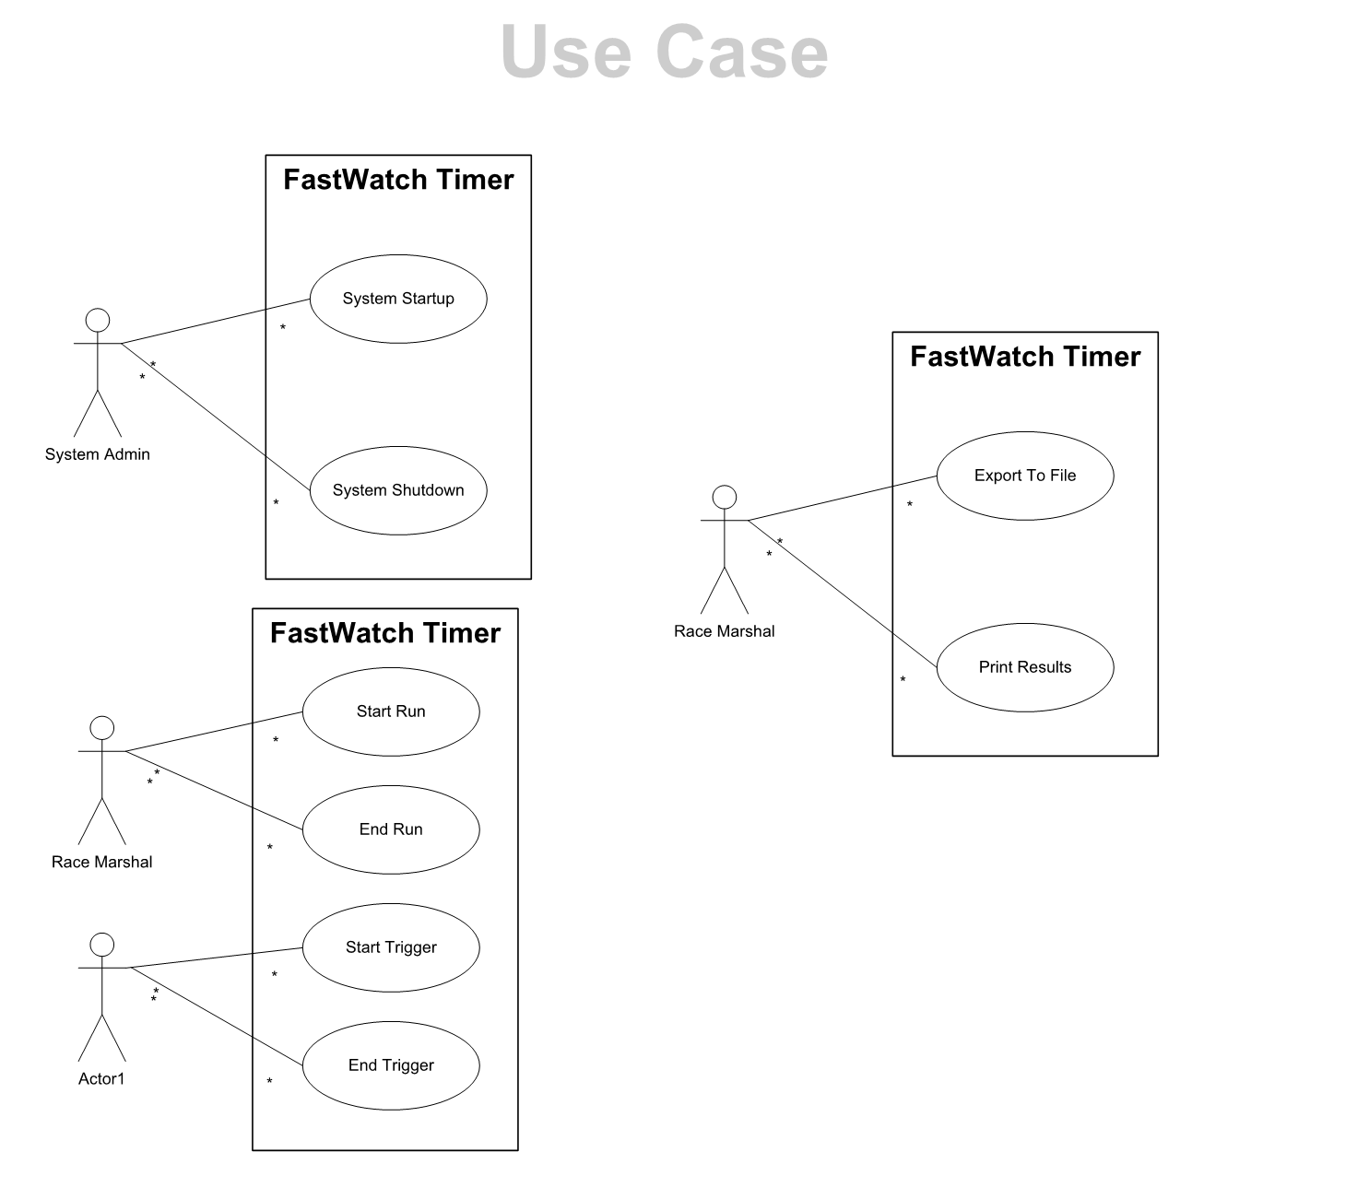
Project Requirements
Use cases
Early Diagram
Non Functional Requirements
Number Precision
Java
GUI
Server data transfer

Slide 4

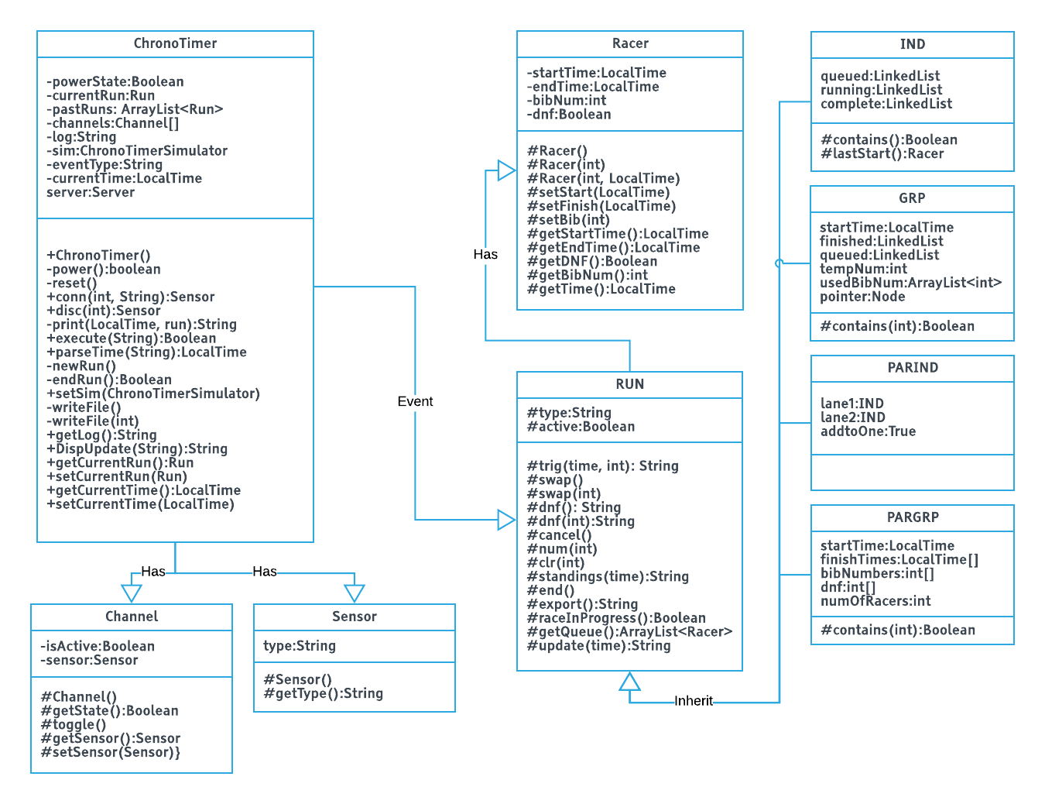
Domain

Slide 5
Testing
Feature | Test Description
EXIT | (with ct on) exit, try power
RESET | set up ct, add run(s), connect channels; reset; print runs;
TIME | set time to negative; set time past 24 hrs;
EVENT | try nonexistent event, try IND, add
ENDRUN
PRINT
EXPORT
NUM | Test #>999, #<0,
CLR | Clear a racer not in queue, clear a racer in queue (once and again with same racer),
SWAP | Swap when one competitor to finish (swap when two), check the order, swap again, check order
DNF | DNF when no racer, add three racers, DNF 4 racers,
START | Start w/o racers, add racers, start w
FINISH | Add racers, finish before start, start racers,
For All | Test when power is off,

Slide 6
Iteration Plans
Sprints:
1: Base functionality and Simulation
2: Logging, Additional Race
3: Additional Race, GUI
4: Additional Race, Server
Backlogs
Sprint 1: none
Sprint 2: none
Sprint 3:
DNF, PRINT, EXPORT and SWAP functions with specified number (in GUI)
PRINT will either print current run or previous run and not a specified run number when using the GUI
Separate thread handling for update display
The RETURN function will return and display the updated racer’s queue
The UP/DOWN/LEFT/RIGHT Arrow Buttons will cycle through executable commands
Sprint4: completed project

Slide 7
Participation
All participation was voluntary, due to the size of the group there was often a shortage of work as three to four people could manage the sprint.
Riley – GUI, Simulator, Documentation
Philip – Chronotimer, GUI, Documentation
Andrew – Chronotimer, Simulator
Fue – Chronotimer, GUI, Server
Isaac – Chronotimer, Testing, Documentation

Slide 8
Code
Live Demonstration

