Slide 1

GitHub

Slide 2
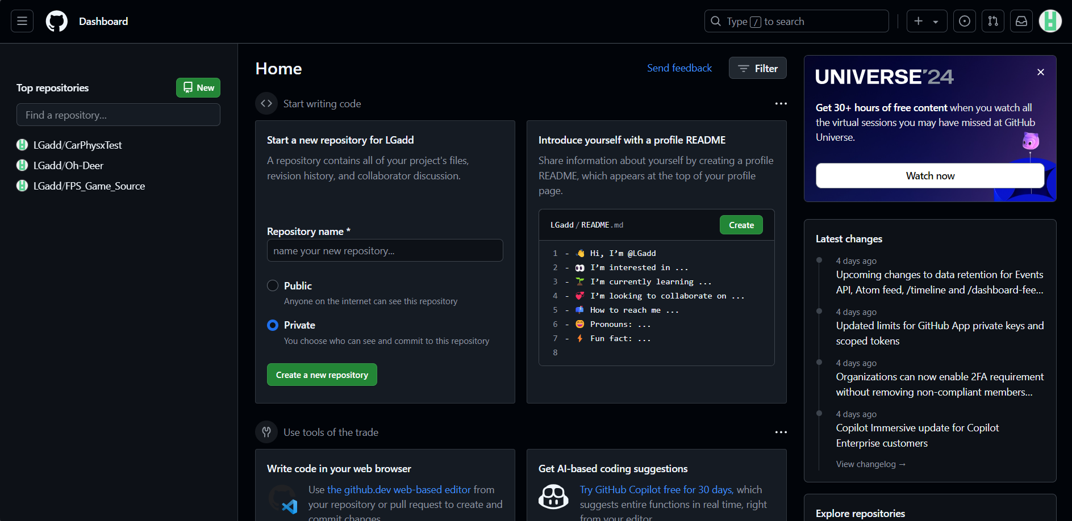
After signing up, in the dashboard you can create a new repository.

Slide 3
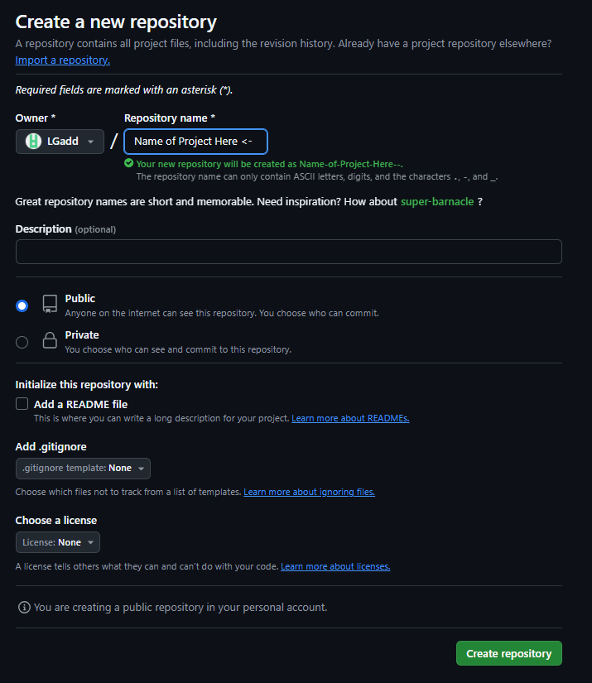
Choose a name for your project.
Set this to private if you don’t want your work to be accessible to everyone.
Finaly create your repository.

Slide 4
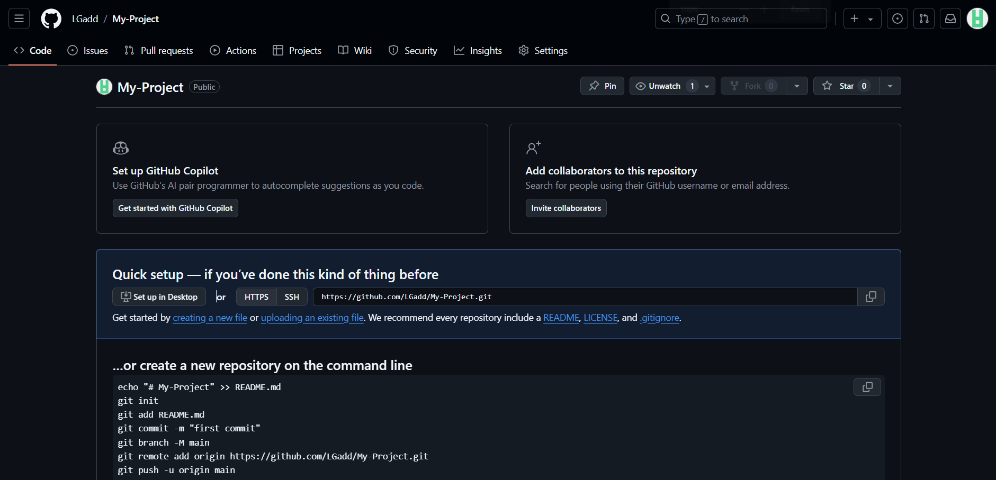
After you create your repository, Upload an existing file.

Slide 5
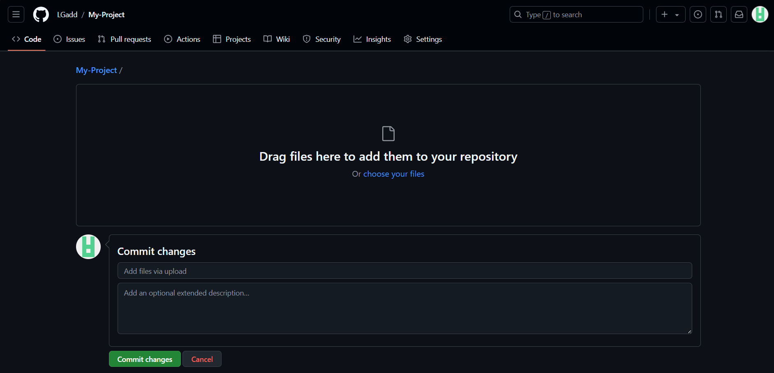
From here drag files here or click on choose your files
After adding some files, enter a note and then press commit changes

Slide 6
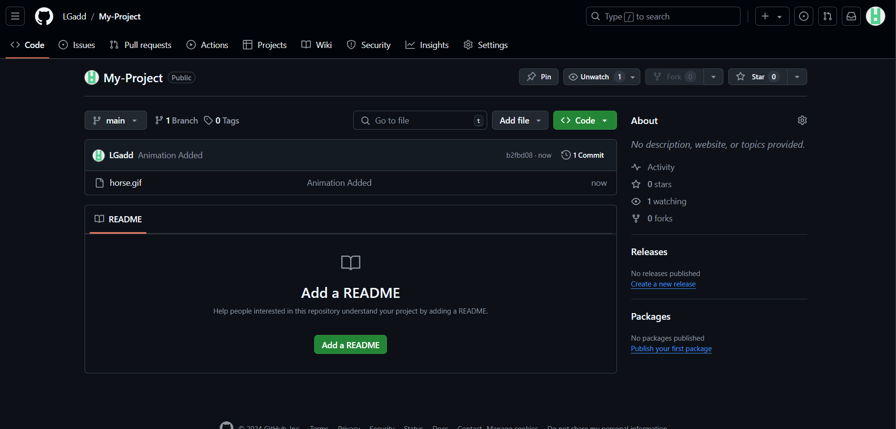
Now you can see the file has been added and you can download / add more files to your repository

