Slide 1



Supplement Store E-Commerce Frontend (React)
Created By
Fathy Mohamed Fathy
Mostafa Mohamed Kandel
Mahmoud Salah Daba
Ziad Amro Elhefnawy
Walid Nasser Elzanaty
Ahmed Fady Elsayed Dawood
Instructor
Eng/Sally Ebrahim

Slide 2

Agenda
introduction
Problem Statement
Proposed Solution
System Architecture
Tech Stack
Features
UI Preview
Code Structure
Challenges
Feature Work
Conclusion & Q&A

Slide 3
introduction
What is a supplement store?
A react-based e-commerce web application
Allows browsing supplements, viewing details, adding items to cart and book sessions with coaches
Provides a clean, fast, user-friendly shopping experience

Slide 4

Hard to find simple , organized supplement store.
Users struggle comparing products and understanding details.
Many online stores are cluttered or confusing.
Need for a clean and organized shopping experience.
Problem Statement

Slide 5

A clean and minimal E-commerce UI
Organized product browsing
Clear product details + ingredients
Add-to-cart and checkout flow
Login / Register page for user access
Responsive layout for all screens
Proposed
Solution

Slide 6
System Architecture
User (Client/Browser)
Enters the website
Interacts with the UI
Navigates between pages
React Frontend App
Components & Pages
React Router navigation
State Management
(useState, useEffect)
Rendering product data
Handling Add to Cart
Data Source (API)
Data Layer (API / JSON File)

Slide 7




Tech Stack
We used in our project
React JS
Used to build the user interface with reusable components and React Hooks
React Router
Handles navigation between pages (Home, Products, Details, Cart) without reloading.
Axios / Fetch API
Used to fetch data from the JSON / Fake API quickly and efficiently.
JavaScript (ES6+)
Responsible for application logic, state handling, functions, and events.
CSS / Bootstrap
Used for styling, responsive design, and creating a clean, organized UI.
JSON / Fake API
Main data source for products, product details, and coaches' information.

Slide 8
Features
Main Features of Our Project
Product Browsing
Users can explore a clean and organized list of supplements.
Product Details Page
Displays full information: image, description, ingredients, and price.
Add to Cart
Users can add any product to their shopping cart easily.
Cart Management
Update quantity, remove items, and view the total price instantly.
Login/Register
Basic authentication UI for user access (frontend-only).
Coach Sessions
Users can browse available coaches and book training sessions.
Responsive UI
Fully optimized layout for desktop, tablet, and mobile screens

Slide 9

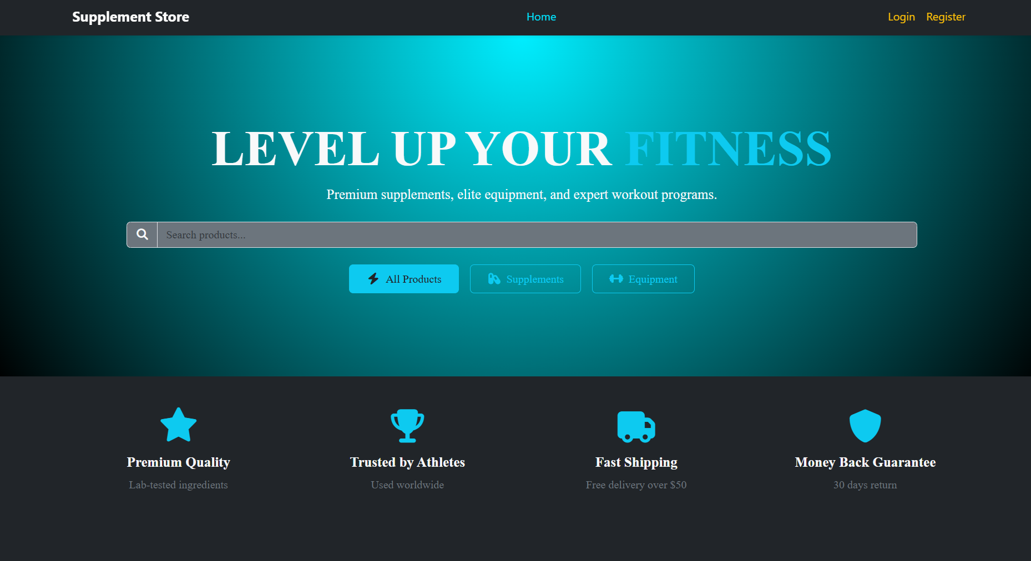
UI-Home Page
Hero Section: Clean header with a welcoming banner
Featured Products: Shows top or selected items from the store
Categories Section: Helps users to browse different types of supplements
Simple Navigation: Easy access to Products, Cart, and Coaches

Slide 10
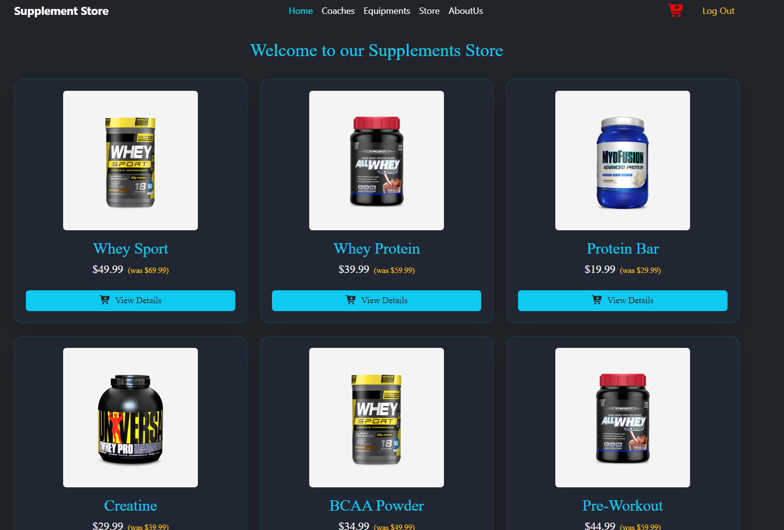
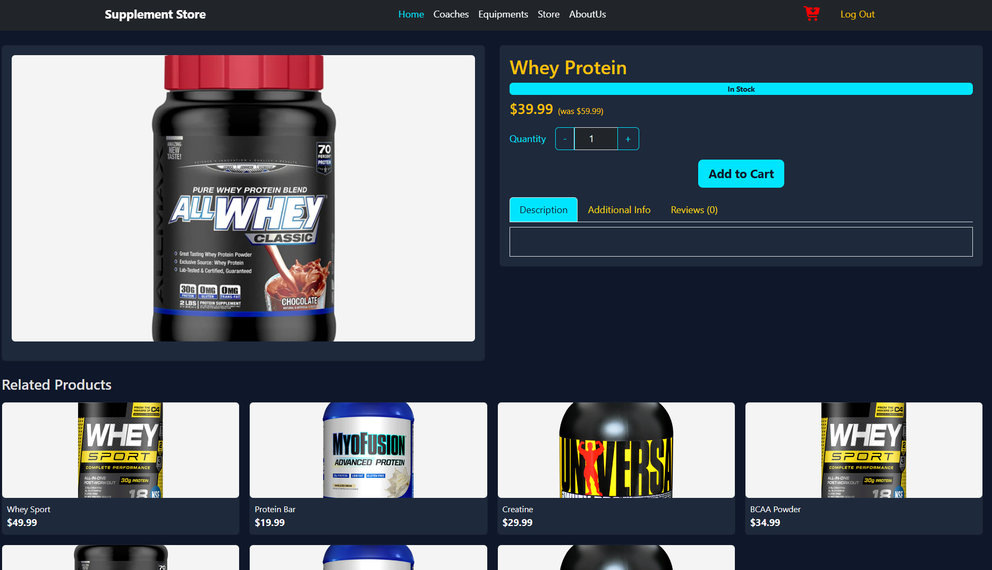
UI-Store Page
Product Cards: Display product image, name, and price clearly
Add to Cart Button: Allows users to add products to their shopping cart instantly.
Search Bar: Helps users quickly find specific products
Simple Navigation: Easy access to Products, Cart, and Coaches
Filter Options: Users can sort products by category, price, or popularity.
Responsive Layout: Page adapts to different screen sizes for smooth browsing

Slide 11
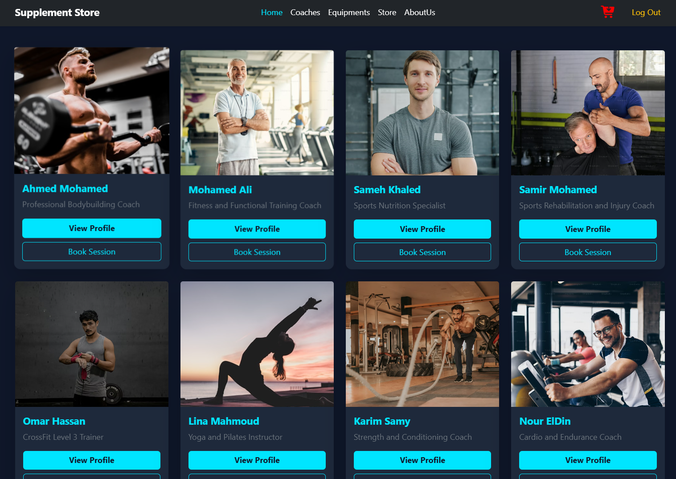
UI-Coaches Page
Coach Cards: Display coach photo, name, and specialization
View Profile Button: Allows users to see detailed coach information
Book Session Button: Lets users schedule a session directly
Responsive Design: Works smoothly on desktop and mobile
Search and Filter Options: Users can search and sort equipment by category or price.

Slide 12
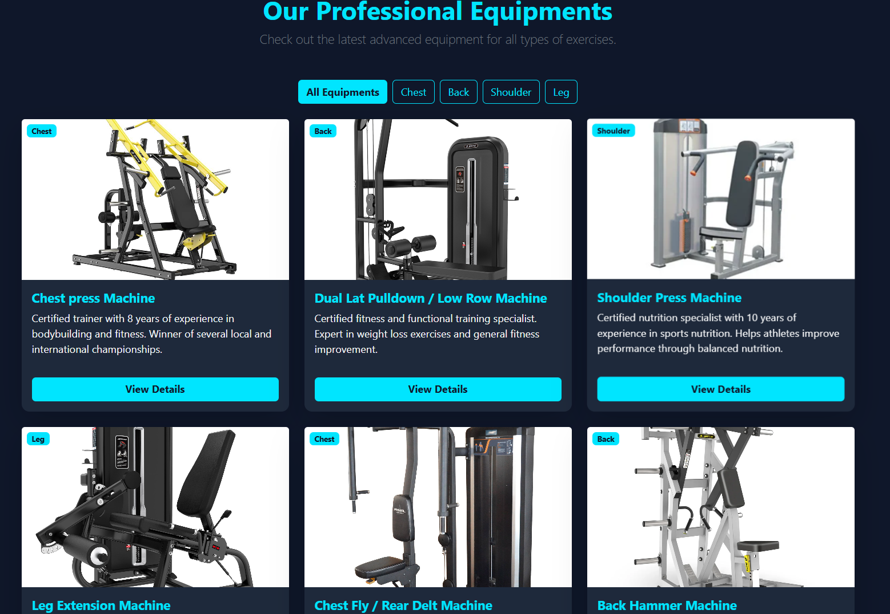
UI-Equipments Page
Equipment Cards: Show product image, name, and price clearly
Add to Cart Button: Lets users add items to their shopping cart instantly
View Details Button: Provides more information about the equipment
Responsive Layout: Page adjusts well on both desktop and mobile screens.
Search and Filter Options: Users can search and sort equipment by category or price.

Slide 13
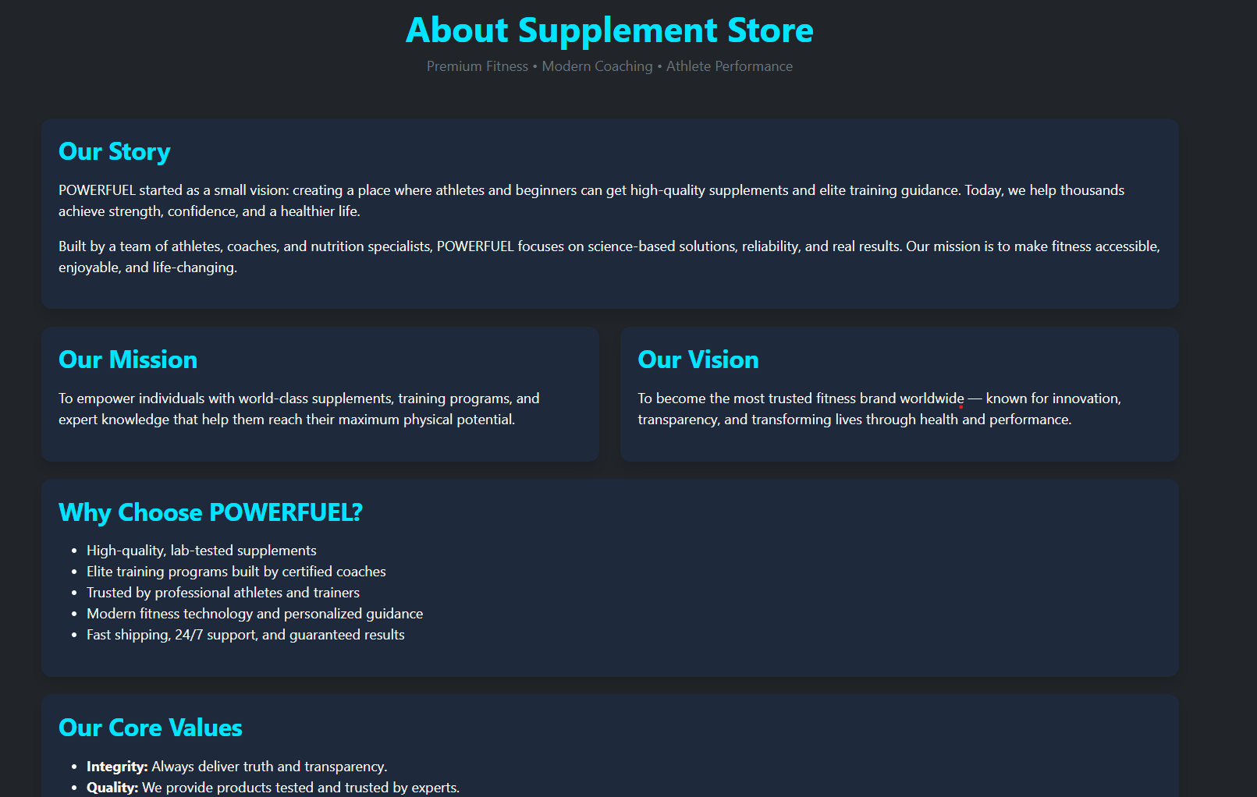
UI-AboutUs Page
Our Story: Briefly explain the idea behind the project and why we created it
Our Team: Introduce the team members and their roles.
Mission & Vision: State the main goal and vision of the project.
User Focus: Explain how the project helps the users.

Slide 14
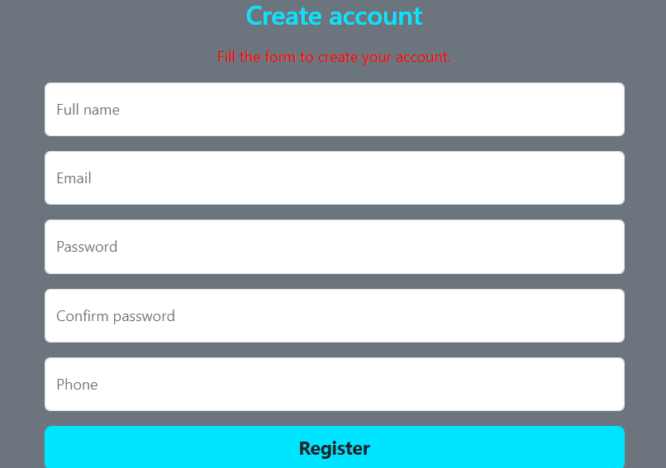
UI-Register Page
Input Fields: Users enter Name, Email, Password, and Confirm Password.
Register Button: Creates a new account for the user.
Validation: Ensures correct email format and matching passwords.
Responsive Layout: Page adjusts well for all screen sizes.

Slide 15
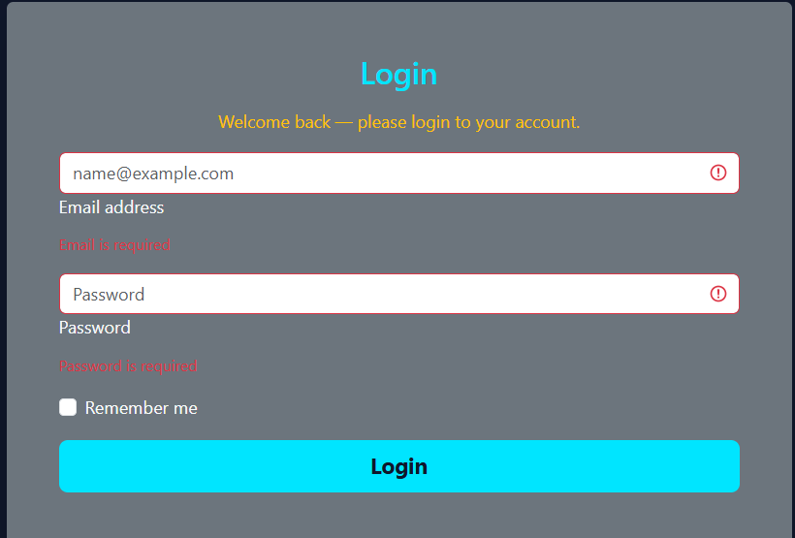
UI-Login Page
Email & Password Fields: Users enter their credentials to access the account.
Login Button: Submits the form and logs the user in.
Validation: Ensures correct email and matching password.
Responsive Design: Works well on both desktop and mobile screens.

Slide 16
Summary
Built a complete and functional React e-commerce project.
Included pages: Home, Store, Coaches, Equipments, Login, Register, About Us
Implemented clean and user-friendly UI with responsive design

Slide 17
Learnings
Gained practical experience in React components and state management.
Learned routing with React Router and handling forms with validation.
Improved skills in styling, layout, and responsive design.

Slide 18
Future Work
Integrate a backend for dynamic data and user management.
Add payment gateway for online transactions.
Enhance user profiles and implement advanced search & filter options.

Slide 19

“
Any
Questions?

