Slide 1
Genetic Algorithm Traveling Salesman
Team 527: Abdusamed Shamsuddin, Yanfei Peng

Slide 2
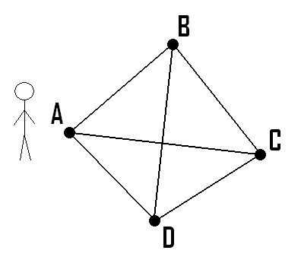
Problem Description
The Travelling Salesman Problem (often called TSP) is a classic algorithmic problem in the field of computer science and operations research^{[1]}. It is focused on optimization. In this context better solution often means a solution that is cheaper. TSP is a mathematical problem. It is most easily expressed as a graph describing the locations of a set of nodes.
Our goal in this problem is to find the shortest path to visit all cities(points) exactly once

Slide 3
Methodology
Initial Population Size(50) : Randomly generated individuals , filled with different Route.
Population: { [MA,CA,NY,MI],[CA,MA,NY,MI],[NY,CA,MA,MI].......}
Genotype: Each Route consists with City objects(Array of Cities).
Single Route: [MA,CA,NY,MI]
Gene Expression: Cities are randomly distributed within the array.
The index of city is random. [MA,CA,NY,MI] and [CA,NY,MI,MA] are in different gene expression

Slide 4
Methodology
Selection Process → Tournament Selection: Randomly pick 5 individuals from entire population as tournament array and individual/chromosome with highest fitness is chosen for breeding
Fitness Score is the Sum of the distance of all city in a route/array in consecutive order. Hence, the total distance is the fitness score instead of 1/distance typically used. It was done this way, solely on better illustration during run time as the system evolved.
Best fitness score = the least distance, worst fitness score = the greatest distance, the lower the score, the shorter the path, the better fit.
Distance: Calculated as the Euclidean distance on 2D space between two cities’ x and y coordinate

Slide 5


Methodology
Parents: Select two best fitness score individuals as parents using tournament selection
CrossOver: Randomly generate a START and END point. Pick START and END point element from Parent A. Pick rest of element from Parent B keeping in check there is no duplicate gene

Slide 6

Methodology
Mutation (0.015 Possibility – 1.5%): after crossover, child is produced. The child will have certain possibility to mutate. Swap city by index to mutate.
Eliminate: if new child fitness score is better than the worst fitness score individual in the original population, replace the lowest fitness score individual with this child.
Repeat

Slide 7
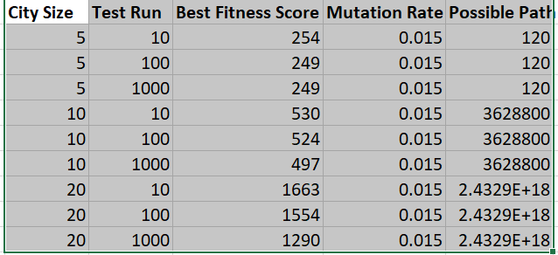
Experiment & Result
Kept City Size at 5
All possible path solution is 120 (5!)
10 Evolution : 254m
100 Evolution : 249
1000 Evolution: 249m
Kept City Size at 20
All possible path solution is 2.4329E + 18 (20!)
10 Evolution: 1663m
100 Evolution: 1554m
1000 Evolution: 1290m

Slide 8
Conclusion
GA found useful to find ideal solution when there are many possible solution. The larger the number of element (n) is the individual, the more possible combination of solution (n!)
When mutation is set to high frequency, it was observed the population array to be more chaotic and the chromosome diversity to be high
For a 5 city sized array, the number of possible route is 120. For a 10 city sized array, the number of possible route is 3628800. For a 20 city sized array, the number of possible route is 2.4329E +18. With an increase number of test run, the system to had more trials to evolve the solution space into a better solutions keeping all other parameters constants

Slide 9
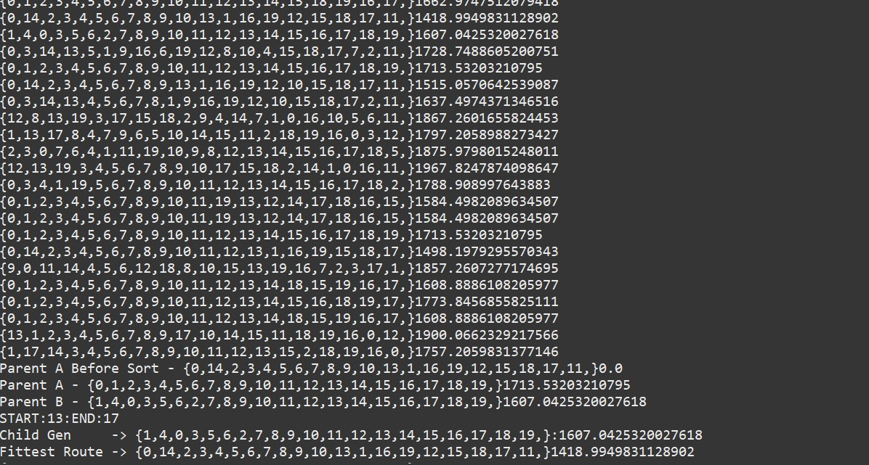
Main Console Run Screenshot

Slide 10
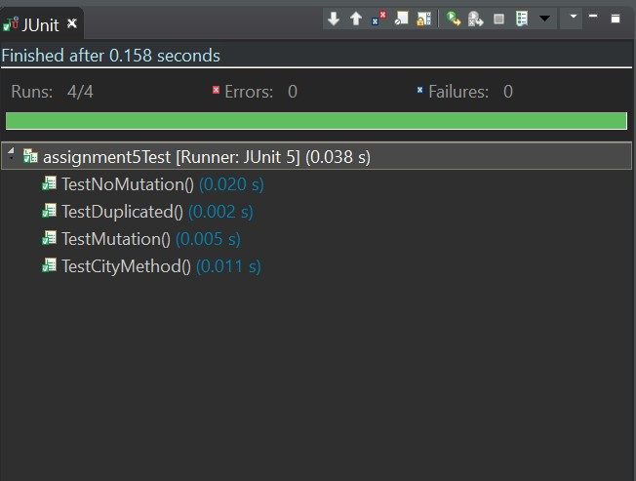
Unit Test Carried Out & Passed

