Slide 1
An Approach to Sustainable Agriculture Ecosystem
Abdusamed Ahmed
MS Information System
12-14-17

Slide 2
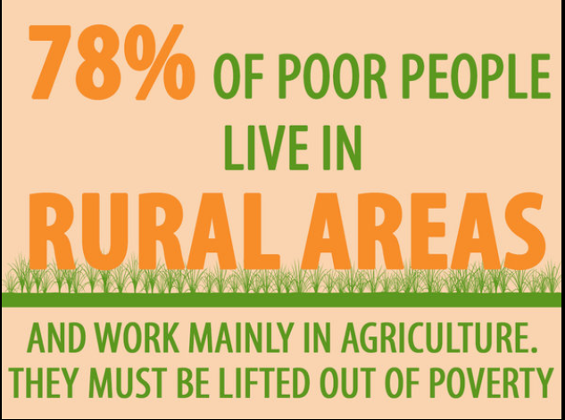
Problem Statement
Conceptualize a Sustainable Agriculture Ecosystem
Developing a bridge between the farmer and 21th century Technological innovation
WHY
Close to 800 million people live in rural areas and rely on agriculture to make a living
Agriculture is one of the most powerful tools for raising poor peoples’ incomes. It is also critical to feeding the world, creating jobs and fighting climate change

Slide 3
Approach
Finance
Farmer At the Center of all
Adherence to Ecosystem Model
Services
Financial
Healthcare
Transport
Market
Chemical
Market
Chemical
Farmer
Healthcare
Transport

Slide 4
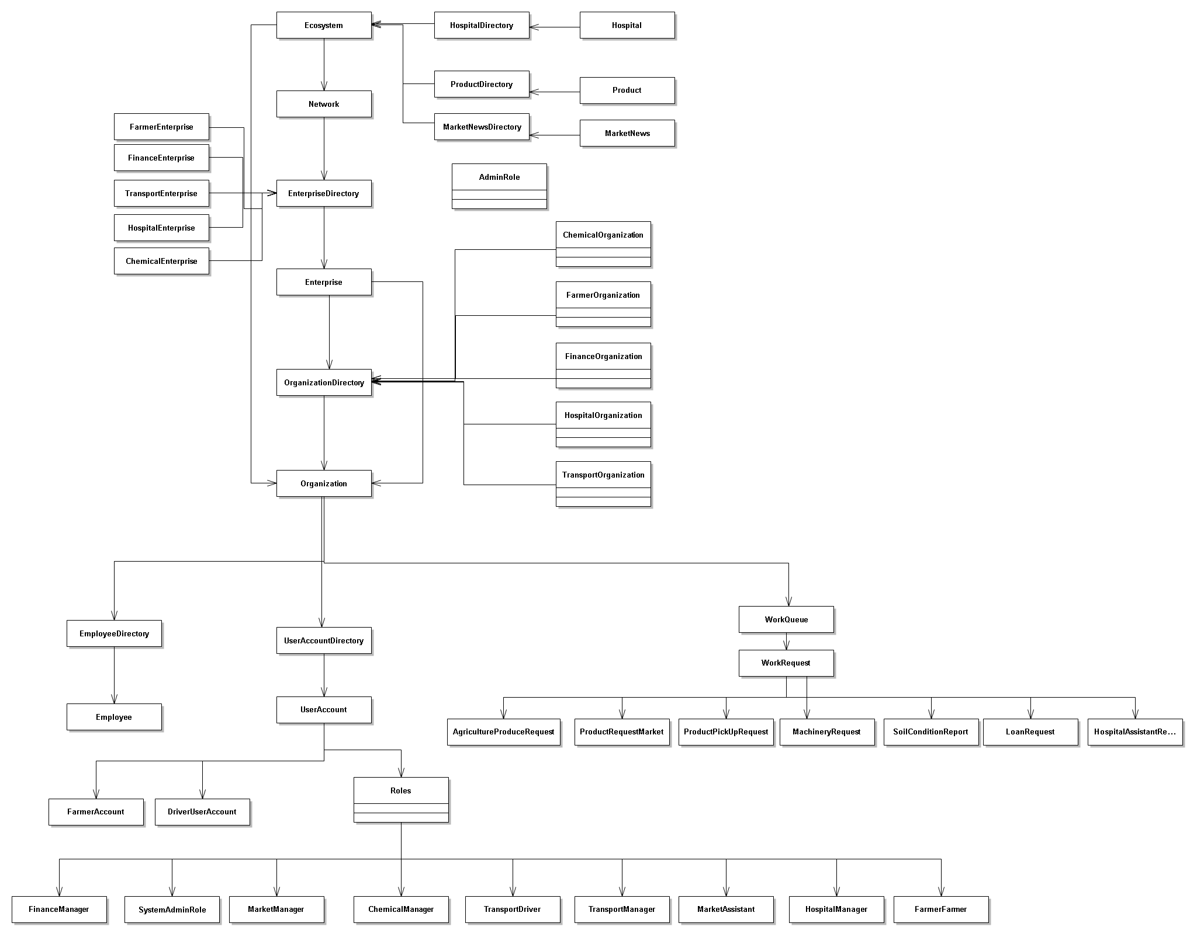
Object Model

Slide 5
Usecases
Farmer
Enterprises connected with Farmer
Finance
Ask for microloan
Healthcare
Find nearest Hospital
Request Immediate Assistance
Transport
Send Product Market
Request agricultural machinery
Transport Enterprise ships goods -> Cold Storage or to the Market Enterprises
Market
Receives farmers good and tries to sell it at best rate – using computerized bidding system
Chemical
Request unique types agriculture product
Request analysis of farm soil

Slide 6
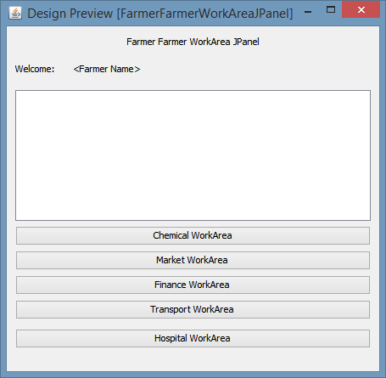
Farmer WorkArea

Slide 7
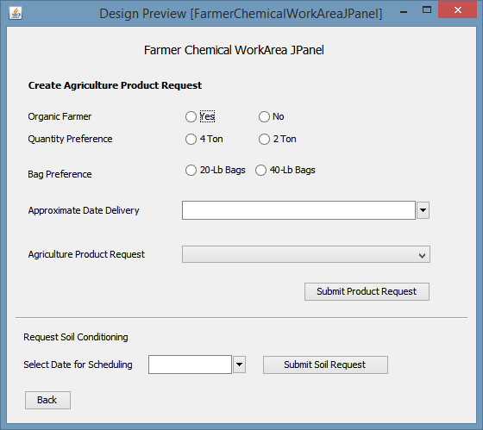
Farmer Chemical

Slide 8
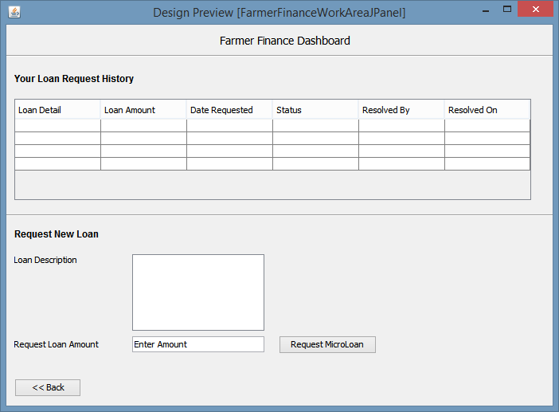
Farmer - Finance

Slide 9
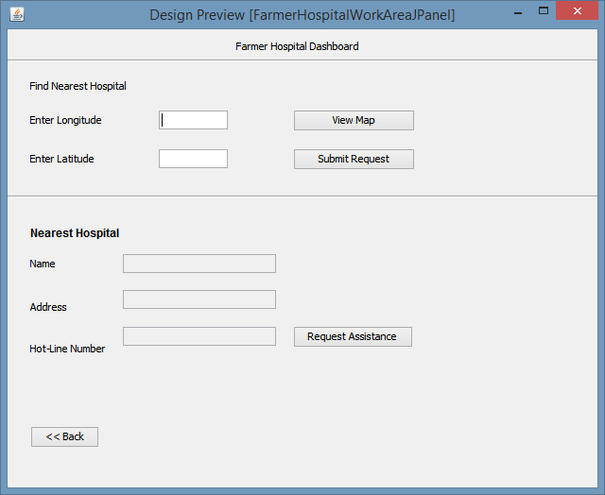
Farmer - Hospital

Slide 10
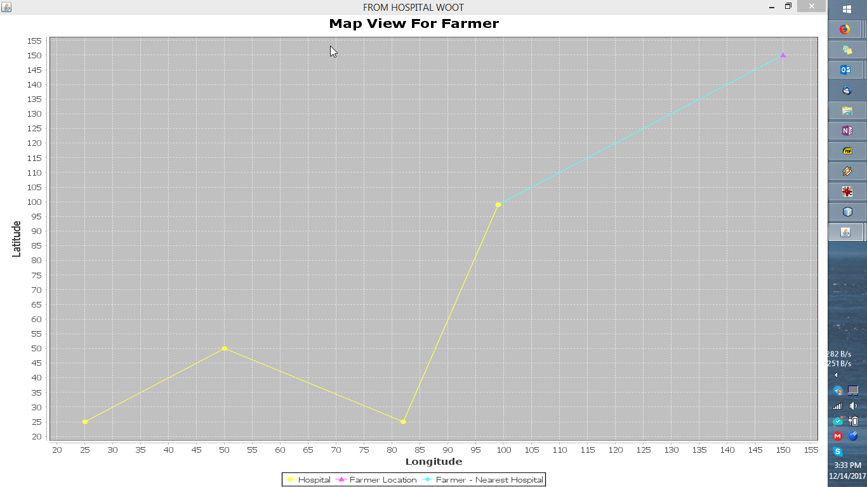
Farmer – Hospital -> Map View

Slide 11
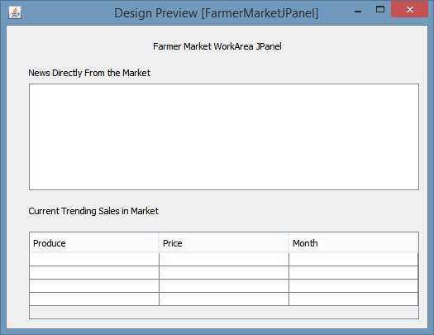
Farmer - Market

Slide 12
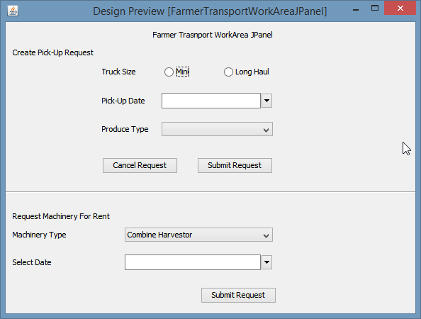
Farmer Transport

Slide 13
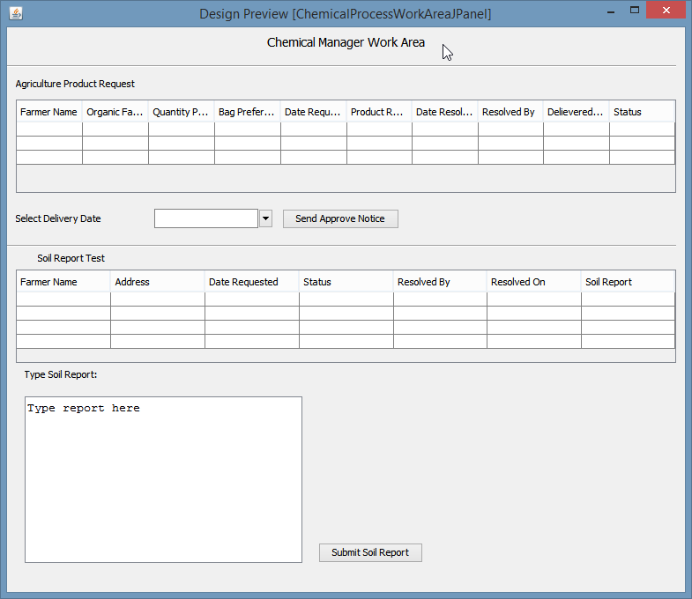
Chemical

Slide 14
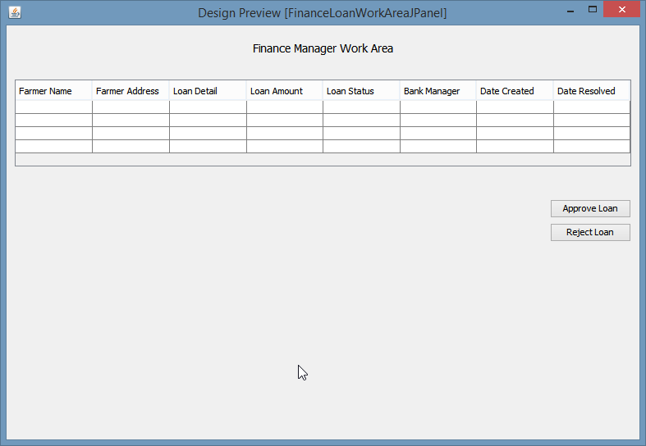
Finance

Slide 15
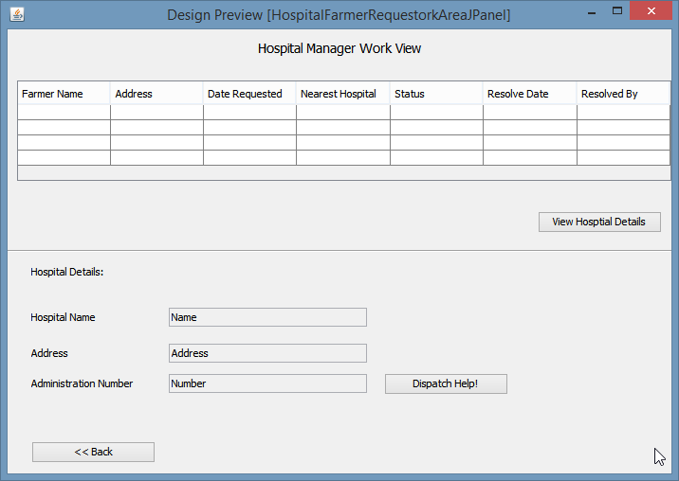
Hospital

Slide 16
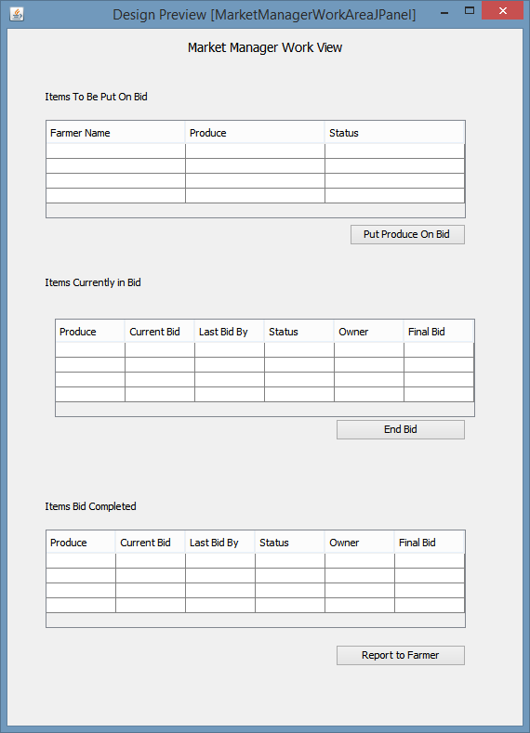
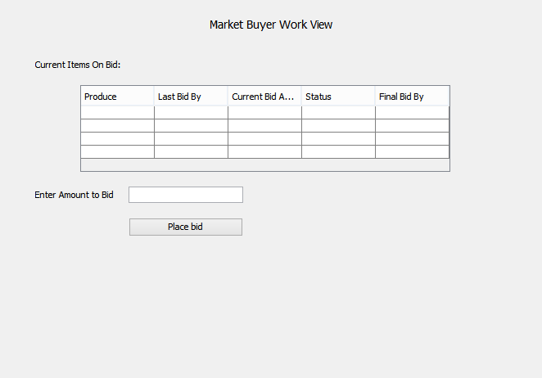
Market

Slide 17
Market Buyer

Slide 18
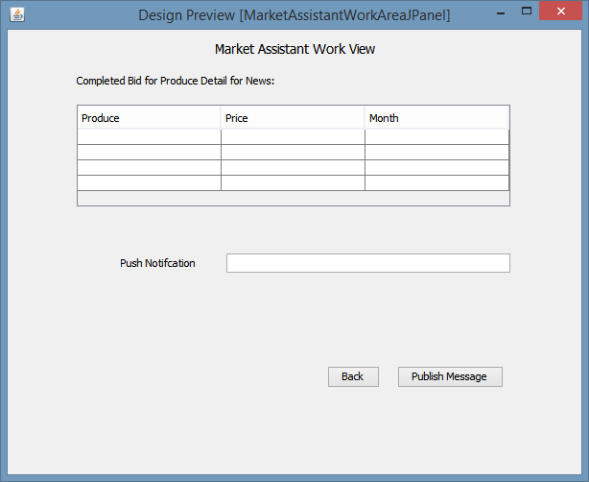
Market Assistant

Slide 19
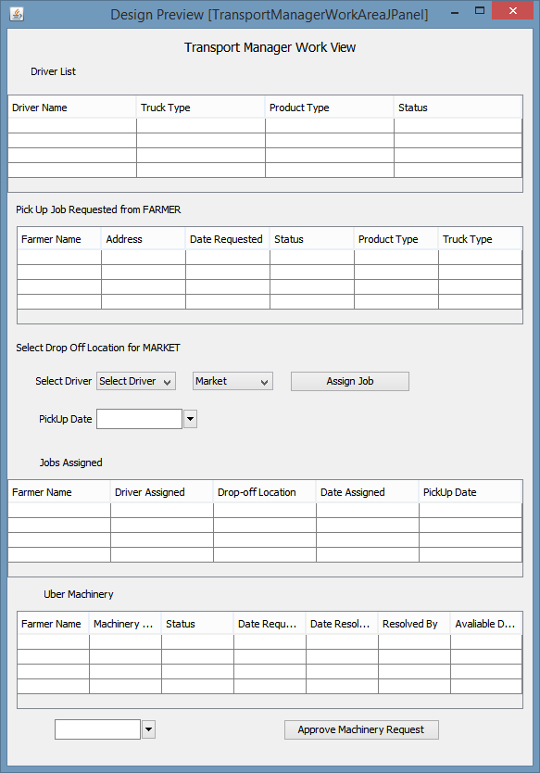
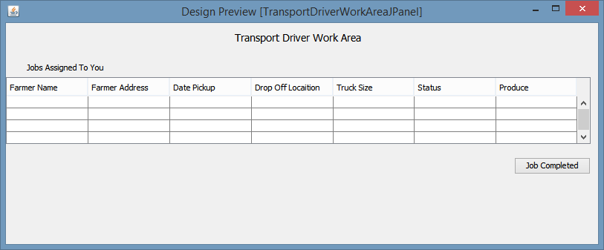
Transport

