Slide 1
Real Time Text Editor
Abdusamed
Shubham
Akshay

Slide 2

Features
Collaborative Text Editor → TextArea
Collaborative Code Editor → Ace Editor
Users can share a link to enable chat & video call while using the collaborative code & text editor
Server running and listening for calls using Express.js & Socket.io

Slide 3
Collaborative Text Editor
New documents can be created on the fly
Each new document created will have its stated stored
On visit, a list of existing documents is retrieved and displayed
Name is generated on random to keep unique and avoid conflict on the database

Slide 4
Collaborative Code Editor
  View multiple user changing code in real time
  On resume, the state of the code is restored from the database call
  Ace Editor Framework used text editor
  Socket.io for communication between nodes
  Experimental: Ability to ‘travel back in time’ by using to restore previous state of the code editor

Slide 5
Back-end Structure
Three Components
  Editor Components → to cycle between editors
  Text Editor Component → real-time textarea
  Code Editor Components → Ace Editor
Two Service Layer
  Document Service → calls the server on invok by the Text Editor Component
  Code Editor Service → calls the server on invoke by the Code Editor Component

Slide 6
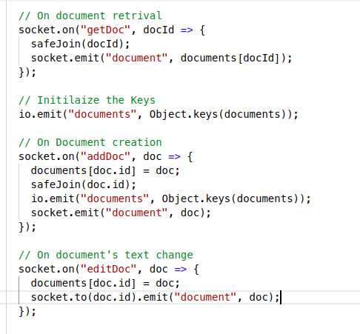
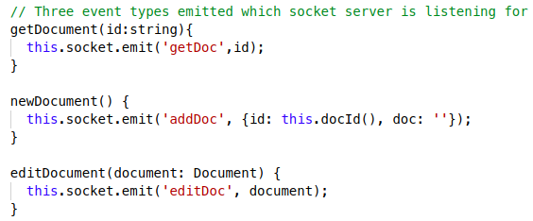
Text Editor ↔ Document Service
On start of Editor, place with text area subscribed to observable on service player
Service Server

Slide 7
Code Editor ↔ Code Service
Publishing changes to the server
Listening for changes from the server
On call, retrieving a list of changes & updating

Slide 8
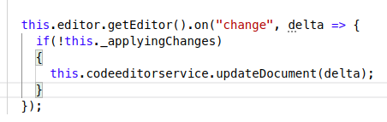

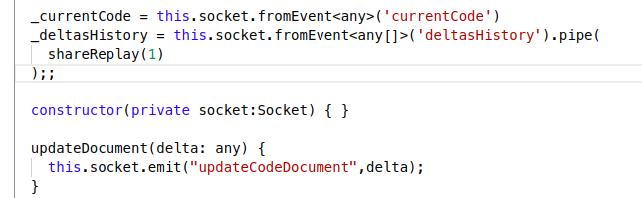
Publishing changes to the server
Editor Server
Service

Slide 9
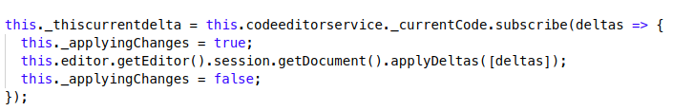
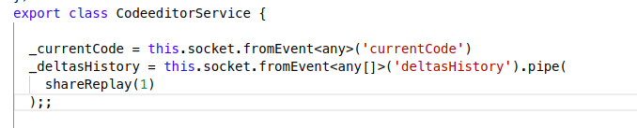
Listening for changes from the server
Editor updates with lock
Listener

Slide 10
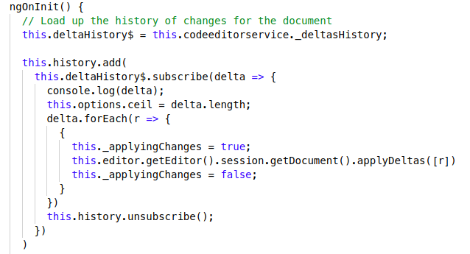
On call, retrieving a list of changes & updating
Retrieves onInit() ...

Slide 11

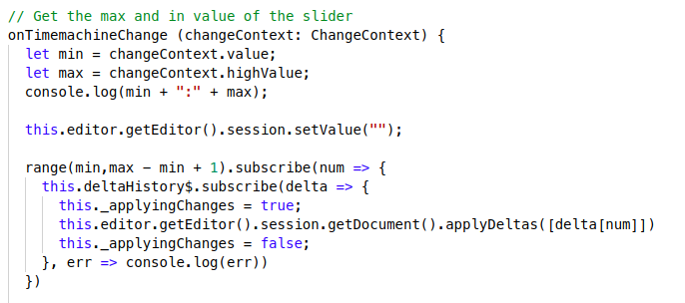
Time Slider

