Slide 1
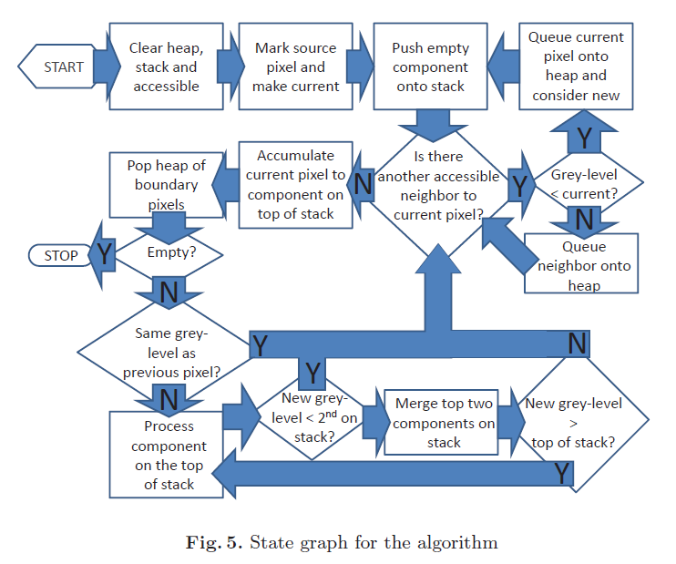
A
B
C
D
I
H
E
F
Z
J
G
K
M
N
O
L

Slide 2
253
254
252
254
254
252
252
252
253
c0
Q1
cmp[0].val = 253 (0,0) 253
cmp[-1].val = 256
254<256 Yes!
update top cmp val
hist[0].val = 253
hist[0].size = 1
Q2
Q3
Q1
cmp[0].val = 254 (0,0) 253
cmp[-1].val = 256
Q2
Q3
Q1
cmp[1].val = 252 (0,2) 252
cmp[0].val = 254 (0,0) 253
cmp[-1].val = 256
Q2
c1
Q1
Q3
Q1
cmp[1].val = 252 (0,2) 252 (1,2) 252
cmp[0].val = 254 (0,0) 253
cmp[-1].val = 256
Q2
253<254 Yes!
update top cmp val
hist[1].val = 252
hist[1].size = 2
Q1
Q1
Q3
Q1
cmp[1].val = 253 (0,2) 252 (1,2) 252
cmp[0].val = 254 (0,0) 253
cmp[-1].val = 256
Q2
Q1
Q3
Q1
Q1
cmp[2].val = 252 (2,1) 252
cmp[1].val = 253 (0,2) 252 (1,2) 252
cmp[0].val = 254 (0,0) 253
cmp[-1].val = 256
Q2
c2
Q1
cmp[2].val = 252 (2,1) 252 (2,0) 252
cmp[1].val = 253 (0,2) 252 (1,2) 252
cmp[0].val = 254 (0,0) 253
cmp[-1].val = 256
Q3
Q1
Q1
253<253 No!
merge c2 c1 as c1
hist[2].val = 252
hist[2].size = 2
Q2
Q1
Q3
Q1
cmp[1].val = 253 (2,1) 252 (2,0) 252 (0,2) 252 (1,2) 252 (2,2) 253
cmp[0].val = 254 (0,0) 253
cmp[-1].val = 256
254<254 No!
merge c1 c0 as c0
hist[3].val = 253
hist[3].size = 5
Q2
Q1
Q3
Q1
cmp[0].val = 254 (2,1) 252 (2,0) 252 (0,2) 252 (1,2) 252 (2,2) 253 (0,0) 253 (0,1) 254
cmp[-1].val = 256
Q2
Q1
cmp[0].val = 254 (2,1) 252 (2,0) 252 (0,2) 252 (1,2) 252 (2,2) 253 (0,0) 253 (0,1) 254 (1,1) 254
cmp[-1].val = 256
Q2
Q1
cmp[0].val = 254 (2,1) 252 (2,0) 252 (0,2) 252 (1,2) 252 (2,2) 253 (0,0) 253 (0,1) 254 (1,1) 254 (1,0) 254
cmp[-1].val = 256
cmp[0].val = 254 (2,1) 252 (2,0) 252 (0,2) 252 (1,2) 252 (2,2) 253 (0,0) 253 (0,1) 254 (1,1) 254 (1,0) 254
cmp[-1].val = 256

Slide 3
253
254
253
254
253
254
253
254
253
c0
Q1
cmp[0].val = 253 (0,0) 253
cmp[-1].val = 256
254<256 Yes!
update top cmp val
hist[0].val = 253
hist[0].size = 1
Q2
Q2
Q1
cmp[0].val = 254 (0,0) 253
cmp[-1].val = 256
Q2
Q1
Q3
cmp[1].val = 253 (1,1) 253
cmp[0].val = 254 (0,0) 253
cmp[-1].val = 256
254<254 No!
merge c1 c0 as c0
hist[1].val = 253
hist[1].size = 1
c1
Q4
Q2
Q1
Q3
cmp[0].val = 254 (1,1) 253 (0,0) 253
cmp[-1].val = 256
Q4
Q2
Q1
Q3
cmp[1].val = 253 (2,2) 253
cmp[0].val = 254 (1,1) 253 (0,0) 253
cmp[-1].val = 256
254<254 No!
merge c1 c0 as c0
hist[2].val = 254
hist[2].size = 2
Q4
c1
Q2
Q1
Q3
cmp[0].val = 254 (1,1) 253 (0,0) 253 (2,2) 253
cmp[-1].val = 256
Q4
254<254 No!
merge c1 c0 as c0
hist[3].val = 254
hist[3].size = 3
Q2
Q1
Q3
cmp[1].val = 253 (0,2) 253
cmp[0].val = 254 (1,1) 253 (0,0) 253 (2,2) 253
cmp[-1].val = 256
c1
Q4
Q2
Q1
Q3
cmp[0].val = 254 (1,1) 253 (0,0) 253 (2,2) 253 (0,2) 253 (1,2) 254
cmp[-1].val = 256
Q4
Q2
Q1
Q3
cmp[0].val = 254 (1,1) 253 (0,0) 253 (2,2) 253 (0,2) 253 (1,2) 254
cmp[-1].val = 256
Q2
Q1
c1
cmp[1].val = 253 (2,0) 253
cmp[0].val = 254 (1,1) 253 (0,0) 253 (2,2) 253 (0,2) 253 (1,2) 254
cmp[-1].val = 256
254<254 No!
merge c1 c0 as c0
hist[4].val = 254
hist[4].size = 5
Q3
Q2
Q1
Q3
cmp[0].val = 254 (1,1) 253 (0,0) 253 (2,2) 253 (0,2) 253 (1,2) 254 (2,0) 253 (2,1) 254
cmp[-1].val = 256
Q2
Q1
cmp[0].val = 254 (1,1) 253 (0,0) 253 (2,2) 253 (0,2) 253 (1,2) 254 (2,0) 253 (2,1) 254 (0,1) 254
cmp[-1].val = 256
Q1
cmp[0].val = 254 (1,1) 253 (0,0) 253 (2,2) 253 (0,2) 253 (1,2) 254 (2,0) 253 (2,1) 254 (0,1) 254 (1,0) 254
cmp[-1].val = 256
cmp[0].val = 254 (1,1) 253 (0,0) 253 (2,2) 253 (0,2) 253 (1,2) 254 (2,0) 253 (2,1) 254 (0,1) 254 (1,0) 254
cmp[-1].val = 256

Slide 4
253
254
253
254
254
253
253
253
253
c0
Q1
cmp[0].val = 253 (0,0) 253
cmp[-1].val = 256
254<256 Yes!
update top cmp val
hist[0].val = 253
hist[0].size = 1
Q2
Q3
Q1
cmp[0].val = 254 (0,0) 253
cmp[-1].val = 256
Q2
Q3
Q1
cmp[1].val = 253 (0,2) 253
cmp[0].val = 254 (0,0) 253
cmp[-1].val = 256
Q2
c1
Q1
Q3
Q1
cmp[1].val = 253 (0,2) 253 (1,2) 253
cmp[0].val = 254 (0,0) 253
cmp[-1].val = 256
Q2
Q1
Q1
Q3
Q1
Q1
cmp[1].val = 253 (0,2) 253 (1,2) 253 (2,2) 253
cmp[0].val = 254 (0,0) 253
cmp[-1].val = 256
Q2
Q1
Q3
Q1
Q1
cmp[1].val = 253 (0,2) 253 (1,2) 253 (2,2) 253 (2,1) 253
cmp[0].val = 254 (0,0) 253
cmp[-1].val = 256
Q2
Q1
Q3
Q1
Q1
cmp[1].val = 253 (0,2) 253 (1,2) 253 (2,2) 253 (2,1) 253 (2,0) 253
cmp[0].val = 254 (0,0) 253
cmp[-1].val = 256
254<254 No!
merge c1 c0 as c0
hist[1].val = 253
hist[1].size = 5
Q2
Q3
Q1
cmp[0].val = 254 (0,2) 253 (1,2) 253 (2,2) 253 (2,1) 253 (2,0) 253 (0,0) 253 (0,1) 254
cmp[-1].val = 256
Q2
Q1
cmp[0].val = 254 (0,2) 253 (1,2) 253 (2,2) 253 (2,1) 253 (2,0) 253 (0,0) 253 (0,1) 254 (1,1) 254
cmp[-1].val = 256
Q2
Q1
cmp[0].val = 254 (0,2) 253 (1,2) 253 (2,2) 253 (2,1) 253 (2,0) 253 (0,0) 253 (0,1) 254 (1,1) 254 (1,0) 254
cmp[-1].val = 256
cmp[0].val = 254 (0,2) 253 (1,2) 253 (2,2) 253 (2,1) 253 (2,0) 253 (0,0) 253 (0,1) 254 (1,1) 254 (1,0) 254
cmp[-1].val = 256

Slide 5
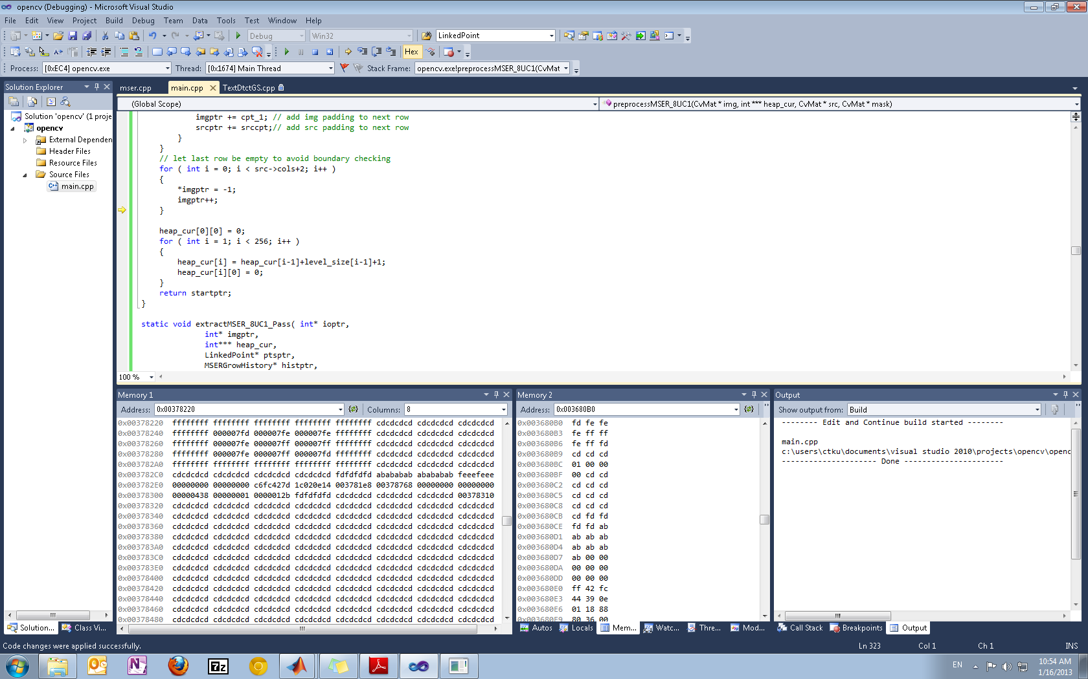

Slide 6
