Slide 1

Medical VQA Classification
Multimodal Fusion & Pretrained Baselines
A Group Presentation | Team [Name]

Slide 2

Placeholder: Introduction
SPEAKER 1: 2.5 MINS
Content to be added by Speaker 1

Slide 3
Placeholder: Problem Statement
SPEAKER 1: 2.5 MINS
Content to be added by Speaker 1

Slide 4





Baseline Models
SPEAKER 2: PHUONG HO | 2.5 MINS
Text Classifier
Image-Only CNN
Key Observation
TF-IDF bigrams on question text. SVM (best): Acc 68.9%, AUC-ROC 0.75. Question wording alone carries useful signal.
ResNet-18 pretrained on ImageNet. Layer4 unfrozen to adapt to medical image features. Handles mixed modalities (X-ray, MRI, CT). Acc 72.6%, F1 0.75, AUC-ROC 0.77.
Images outperform text alone. Both modalities are limited individually — motivating a multimodal fusion approach.

Slide 5
Fusion Model
SPEAKER 2: PHUONG HO | 2.5 MINS
Image Encoder
Text Encoder
Results
ResNet-18 pretrained on ImageNet. Layer4 unfrozen for task-specific adaptation. Outputs a 512-dim feature vector via global avg pool.
Frozen CLIP text encoder (openai/clip-vit-base-patch32). Encodes question text into 512-dim embeddings. Concat with image features → Linear(256) → binary yes/no output.
Acc 75.8% | F1 0.77 | AUC-ROC 0.82 (+3pp over image-only). Fusion outperforms both baselines — combining vision and language is key for medical VQA.

Slide 6
Improving the Fusion
SPEAKER 2: PHUONG HO | 2.5 MINS
What We Tried
Why It Failed
Final Approach
CheXNet (DenseNet-121) as image encoder, BioBERT as text encoder. CheXNet trained on 100k+ chest X-rays for medical image features. BioBERT pretrained on PubMed + PMC for medical language understanding.
Dataset mismatch. The dataset contains mixed modalities (X-ray, MRI, CT, ultrasound). CheXNet only understands chest X-rays — its features are meaningless for other types. Val Acc stuck at 58.9%.
Acc 77.9% | F1 0.78 | AUC-ROC 0.82 Kept ResNet-18 (generalizes across all modalities), upgraded text to BioBERT with mean pooling. Best model overall — +2.1pp accuracy over CLIP fusion.

Slide 7
Placeholder: Data Preprocessing
SPEAKER 3: 2.5 MINS
Content to be added by Speaker 3

Slide 8
Placeholder: Implementation
SPEAKER 3: 2.5 MINS
Content to be added by Speaker 3

Slide 9
Placeholder: Validation Set
SPEAKER 3: 2.5 MINS
Content to be added by Speaker 3

Slide 10
Placeholder: Technical Challenges
SPEAKER 3: 2.5 MINS
Content to be added by Speaker 3

Slide 11
Evaluation Approach
SPEAKER 4: SANA AZHAR | 2.5 MINS
Automated Pipeline
Standardized Metrics
Visual Analytics
Developed evaluate.py and plot_result.py to ensure reproducible and immediate benchmarking for all model iterations.
Focused on ROC-AUC and F1-Score to handle class imbalance, providing a more reliable clinical score than simple accuracy.
Integrated automated ROC curve plotting to visualize the tradeoff between clinical sensitivity and specificity for diagnostic support.

Slide 12
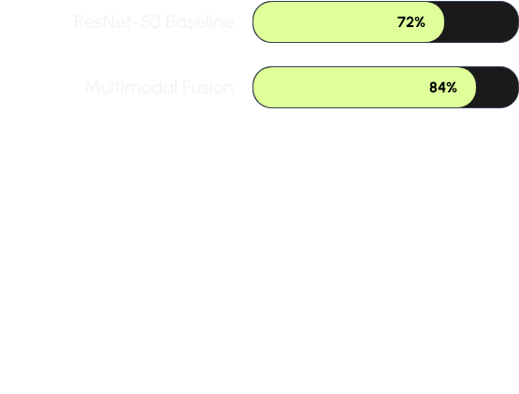

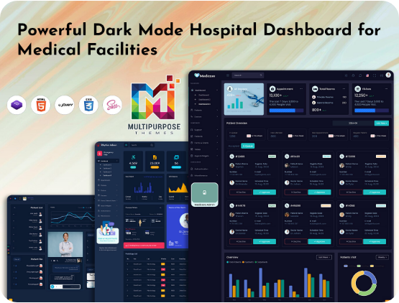
Performance Results
SPEAKER 4: SANA AZHAR | 2.5 MINS
Key Comparisons
•
Baseline ROC-AUC: 0.75
•
Fusion Model ROC-AUC: 0.89
•
Fusion provides a 12% lift in accuracy.

Slide 13

Conclusion & Takeaways
SPEAKER 4: SANA AZHAR | 2.5 MINS
Main Message
The Fusion Model confirms that textual question context is vital for interpreting medical scans. Vision alone is not enough for complex reasoning.
+12%
Roadmap to May 10
Accuracy Lift
•
Finalize test set run with Phuong's real data.
•
Generate final tables and ROC curves.
•
Submit 4-6 page report PDF and Codebase.

Slide 14

Image Sources
https://multipurposethemes.com/wp-content/uploads/2024/10/Powerful-Dark-Mode-Hospital-Dashboard-for-Medical-Facilities-1.jpg
Source: multipurposethemes.com

