Slide 1
Raising the Roof
DataThon Dec-2016
Stefan
Joe
Amir
Ingrid
Shabs

Slide 2
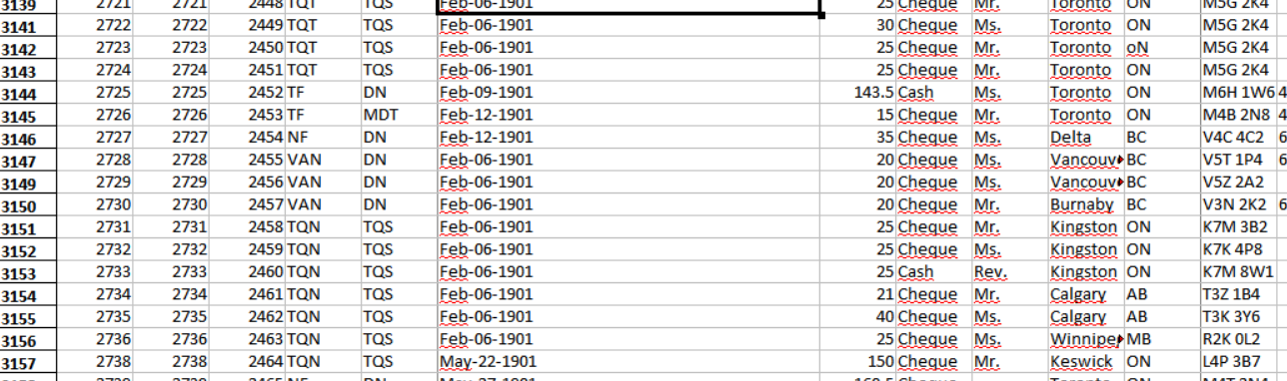
Y2K BUG!!!!

Slide 3
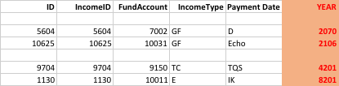
TIME TRAVEL

Slide 4
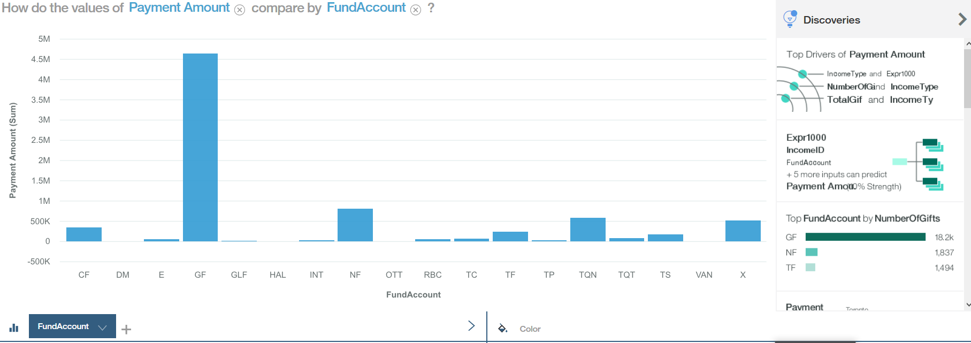

Slide 5
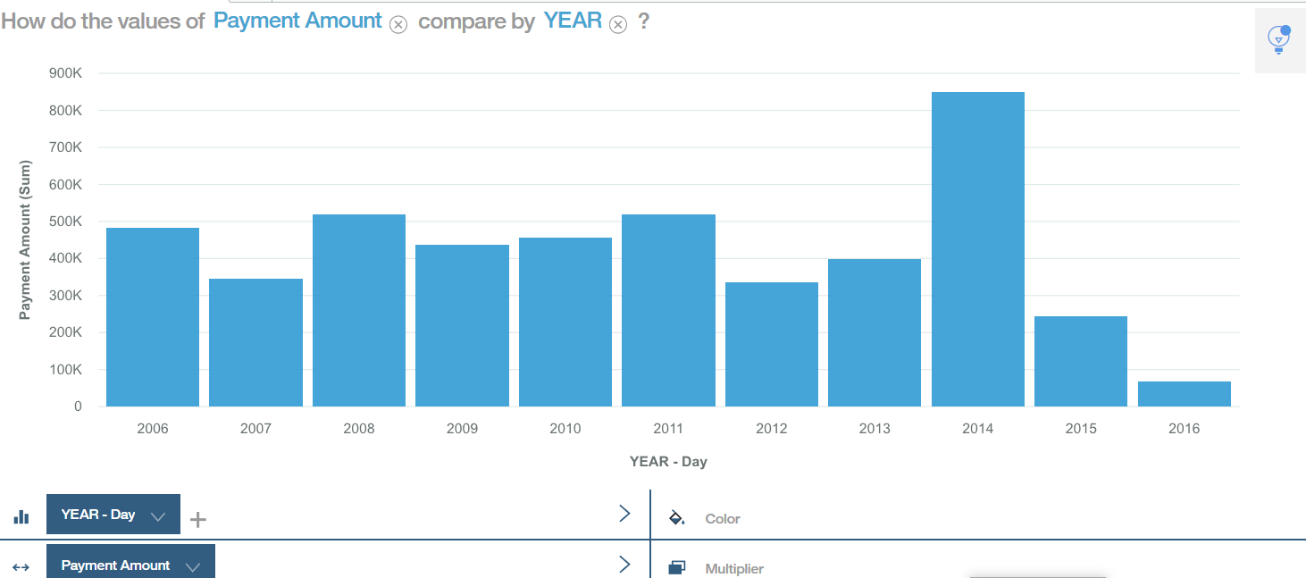

Slide 6
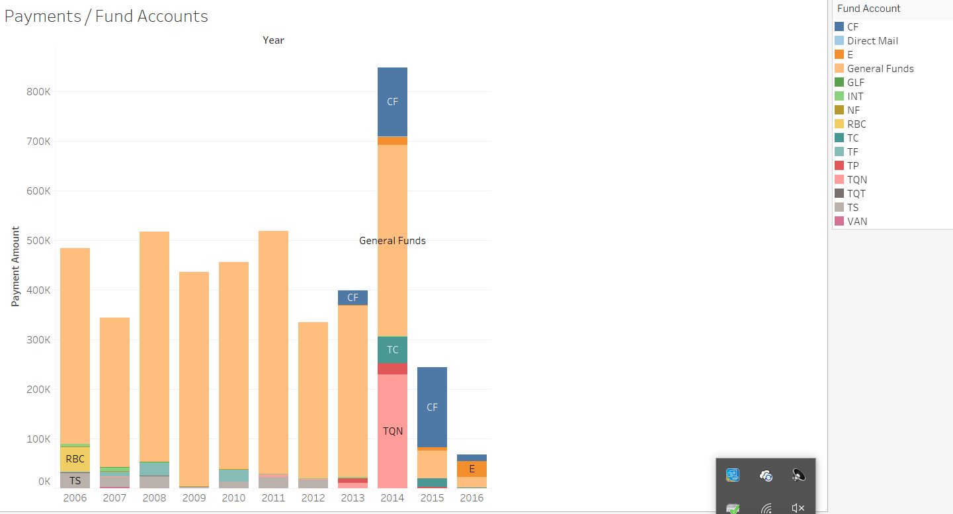

Slide 7
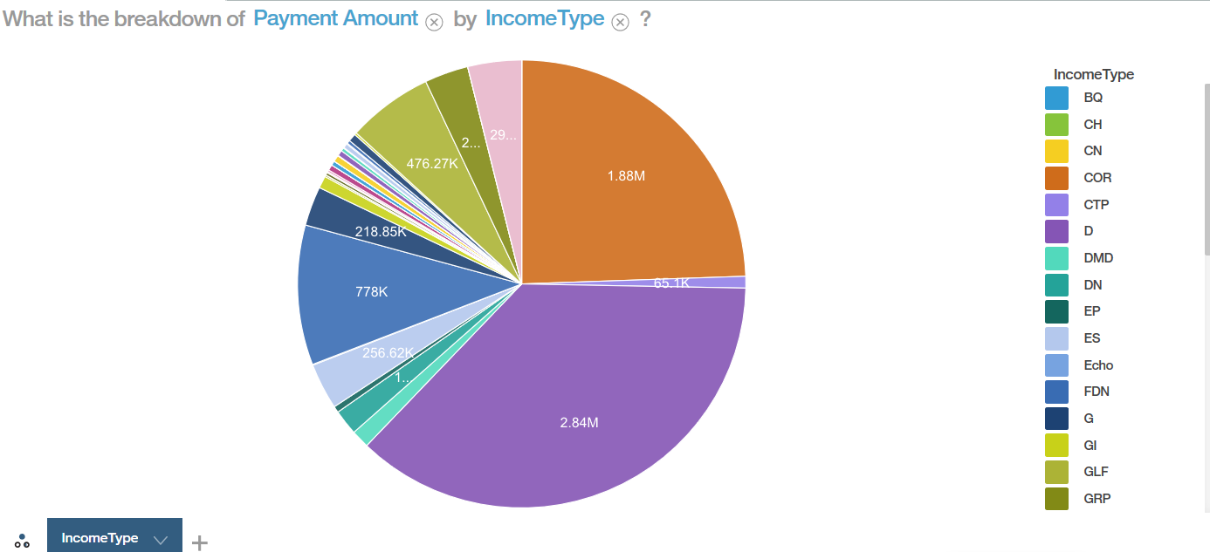

Slide 8
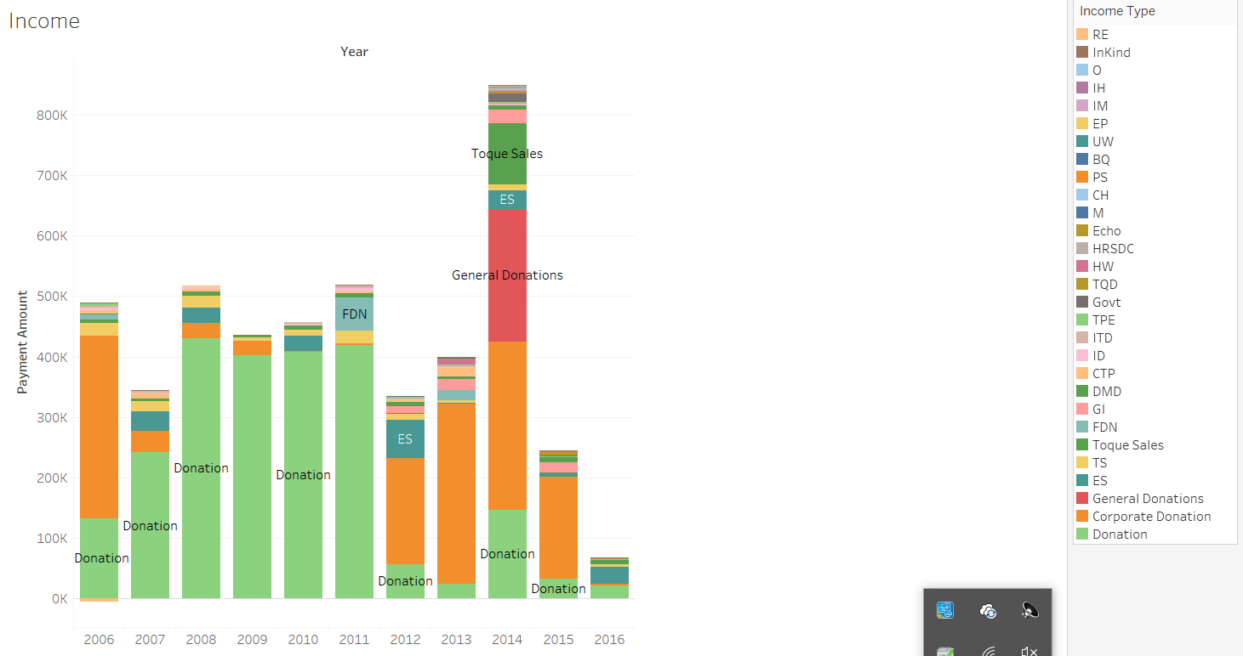

Slide 9
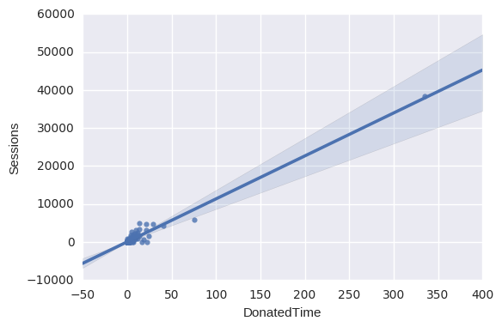
Analyzing data with Google Analytics

Slide 10
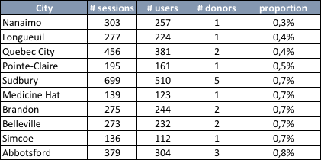
Analyzing data with Google Analytics
Increase the number of campaigns/donations:
Increase the number of in person campaigns in cities which people are visiting the website but not donating:
Top 10:
Assuming we have a linear relationship between the population and number of homeless
The volunteers should receive a complete list

Slide 11
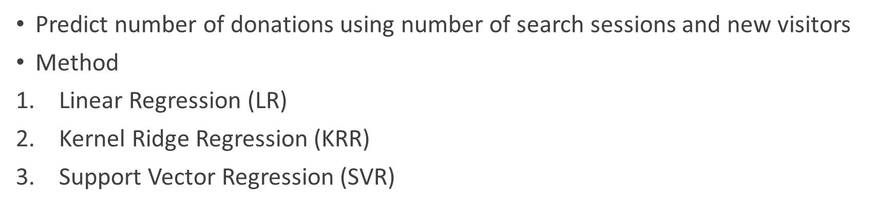
Prediction Performance: Regression

Slide 12
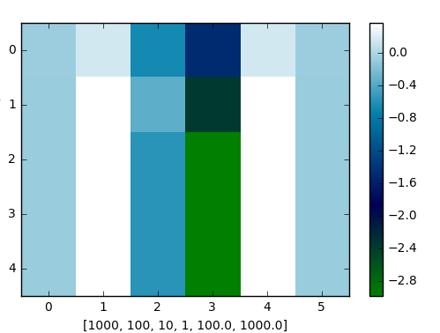
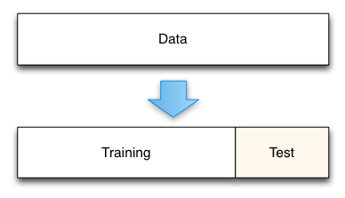
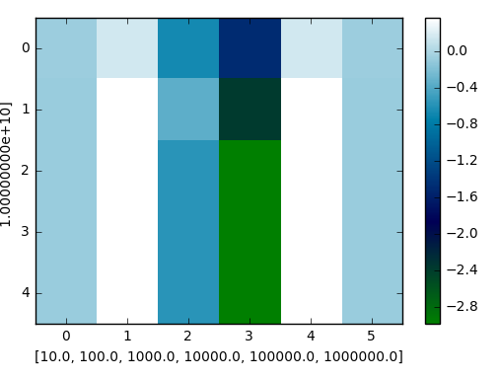
Prediction Performance: Regression
SVR
Grid Search d
Train Test split
RRG
Normalize

Slide 13
Prediction Performance: Regression Leve out Coefficient of determination
LR | KRR | SVR
52% | 37% | 56%
Features | Coefficient of determination (SVR)
Number of Search’s | 42 %
New Visitors | 55 %

Slide 14
Suggestions
Create variables to follow the effect of campaigns (examples: campaign_id, date of the campaign start, date campaign finish)
Create patterns to feed the data sets (less cleaning and data misunderstood)
Create an on-going MIS report to track the main triggers (top 10 cities, by province,....)
Expand sales beyond Toques
Cover sales in Summer months
Appeal to younger millennial generation

Slide 15

Suggestions

