Slide 1
Problem. A program is needed to print the properties of a number of shapes (e.g., Polygon, Circle, etc.) from an input file. The information includes
-- descriptive information (name of the shape, vertices in polygon, center and radius in circle)
-- area, and
-- perimeter.

Slide 2
P10: Read shapes from file
vP11: Add descriptive information
vP12: add circle, point, etc.
P13: add a print function

Slide 3
P11: Add descriptive information
convex polygon
3 (0,0), (3,0), (3,4)
Area 6
Perimeter 12
{convex polygon, 3, [(0,0), (3,0), (3,4)], 6, 12}

Slide 4
{Circle, (0,0), 1}

Slide 5
Exercise: Sort a number of shapes by their perimeter in the increasing order (shapes with smaller perimeter in front)
Do this with an unit test.

Slide 6
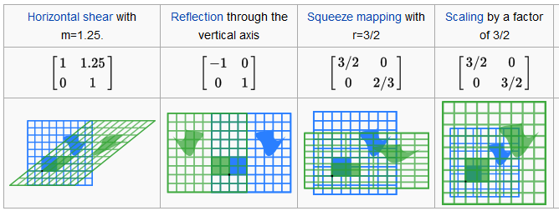
Given a unit square P={(0,0),(1,0),(1,1),(01)} apply linear transformation M to it
https://en.wikipedia.org/wiki/Matrix_%28mathematics%29#Linear_transformations

Slide 7
Goodbye code::blocks!
Why
Platform Compatibility: you want your project to compile across multiple platforms without modification, e.g., windows, Ubuntu, OSX, …
gcc is available on all of them but not code::blocks (and many other IDEs)
So you need a platform independent way of developing your C++ program

Slide 8
Software stack for platform independence
Compiler: gcc
Builder: make
Editor: atom
Version control: git
Hello mingw-64 (gcc, make) , atom, and git (git and bash)!

Slide 9
Windows
Mingw-w64
atom
git
Windows

Slide 10
Ubuntu/OSX/other Linux-based
atom
git
gcc
Ubuntu/OSX/…(Linux-based)

Slide 11
makefile
CXXFLAGS = -O3 -o hello.exe -L./libCppUnitLite
LIBS = ./cppunitlite/libCppUnitLite.a
hello.exe: hello.cpp
g++ hello.cpp $(LIBS) $(CXXFLAGS)
clean:
rm hello.exe

Slide 12
Version control with git
Open git bash on your working directory
git init
vi .gitignore
git add <files>
git status
git commit
editor is vim
git log --oneline
git checkout version
git checkout master -f

