Slide 1



Auto Surveillance For Security
Supervisor:
Dr. Hasan Mujtaba
Group Members:
Fateh Muhammad 19I-1750
Fahad Baig 19I-1883
Adeel Subhan 19I-1869

Slide 2

Project Idea
A customizable security application for homes and private properties [Scope reduced due to time constraints].
Suspicious Activity Detection.
Threat Detection.
Notifying User and Authorities accordingly.

Slide 3
Progress
Development of FYP-I
Domain Research
Data Collection
Suspicious Activity [1/2]
Mid Evaluation
Web Interface [Iter 1]
Suspicious Activity [2/2]
Web Interface [Iter 2]
Integration
IP Camera Integration
Final Evaluation
Threat Detection [2/2]
Reporting Authorities
Web Application Dashboard
Mid Evaluation (FYP-2)

Slide 4
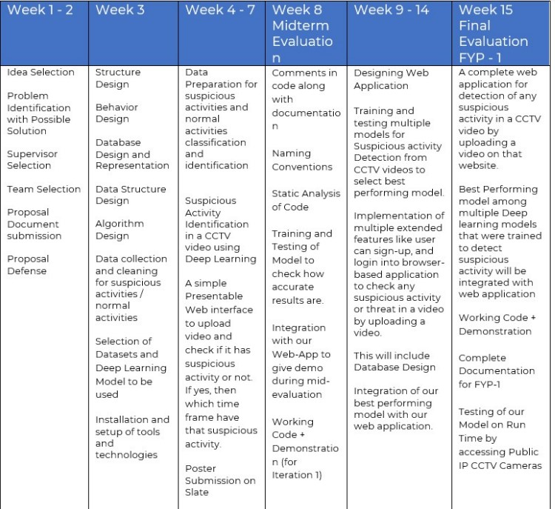
Progress w.r.t. Commitment
Commitment

Slide 5
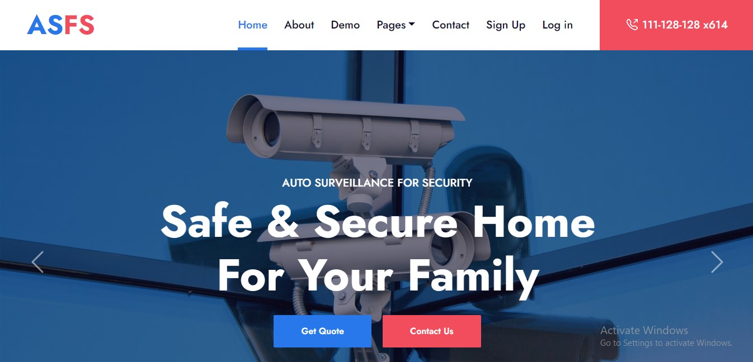
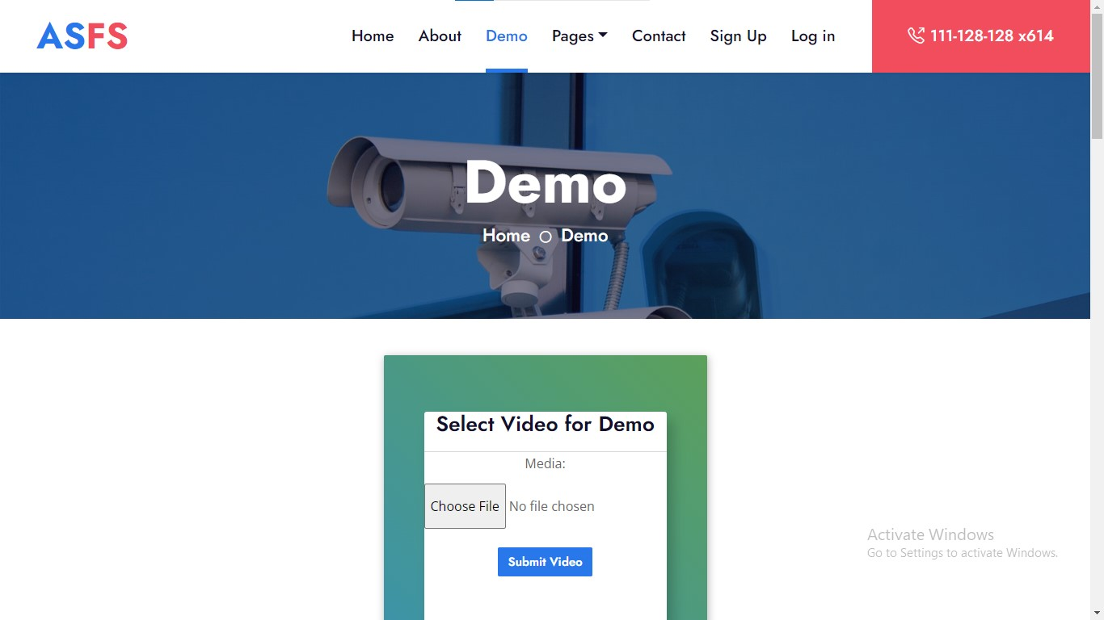
Web Application

Slide 6
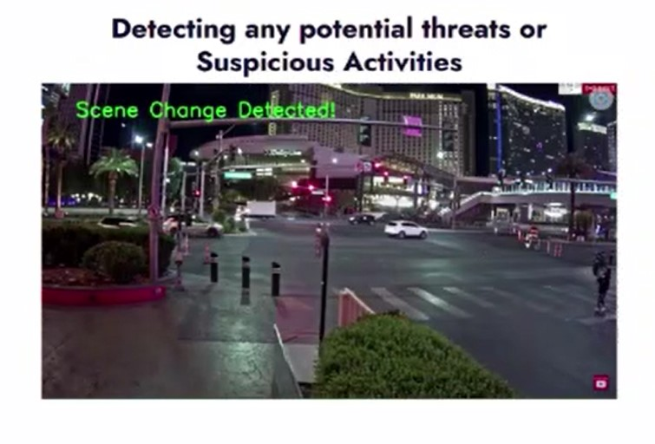
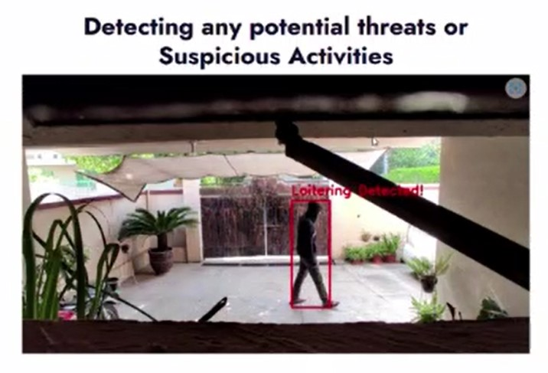
Results

Slide 7
Suspicious Activity Detection
Loitering Detection
Unattended Luggage
Scene Change Detection
CCTV Camera Lens Covered

Slide 8
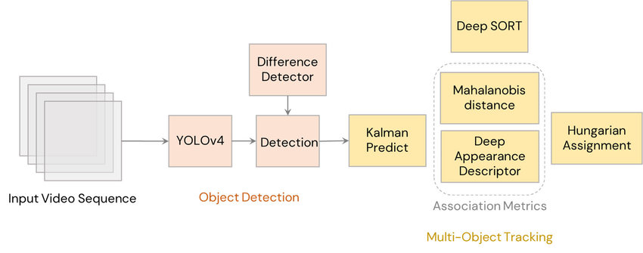
Implementation Details (1)
Loitering Detection
YOLO for Person Detection
Deep Sort for Tracking of that Person
Custom State Dictionary for Loitering Detection of multiple Persons

Slide 9
Implementation Details (2)
Unattended Luggage Detection
YOLO for Luggage Detection (Hand bags, Backpacks, Suitcases)
Trained on thousands of pictures from coco dataset
A tracker which keeps track of Bag with associated person

Slide 10
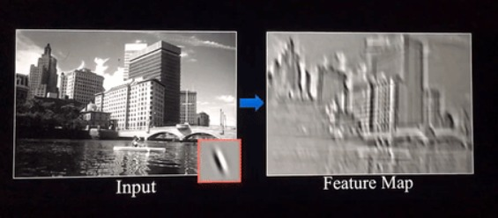
Implementation Details (3)
Scene Change Detection in CCTV Video (by using convolutions and then comparing the feature maps)
Camera Lens Covered Detection

Slide 11
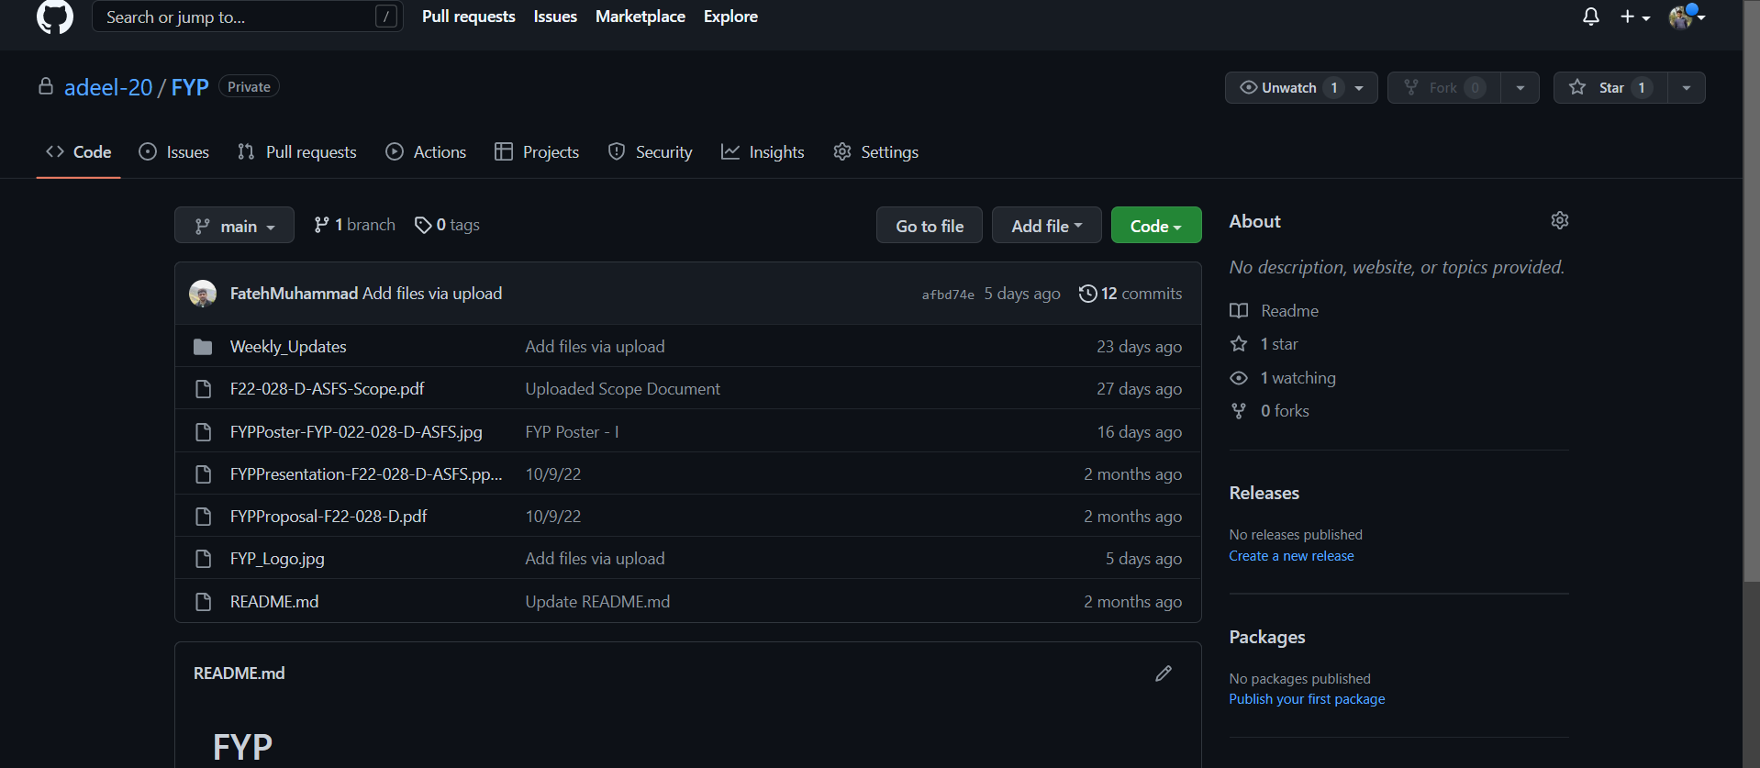
Maintenance

Slide 12
Thank you

