Slide 1

Machine learning is the science of getting computers to act without being explicitly programmed – Andrew NG

Slide 2
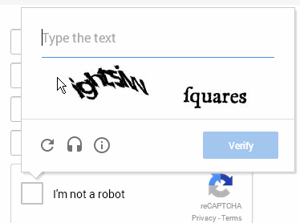

People are lazy - Machines are not
Data == Money

Slide 3
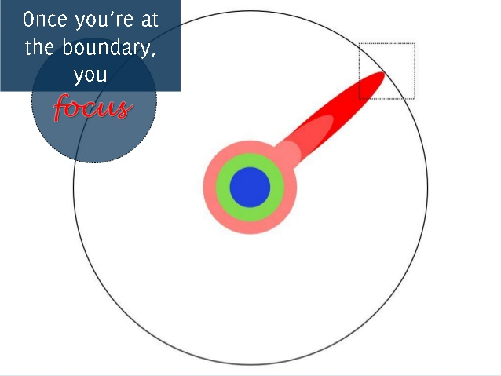
Machine learning is a very Open Source Community
Research
Software
AI knowledge

Slide 4
Environment setup
Python
Scipy
Numpy
SpeechRecognition
Scikit-learn
Textblob
Script – Linux ubuntu
https://github.com/tanmoy12/data_models/blob/master/env.txt
Repository
https://github.com/tanmoy12/data_models

Slide 5
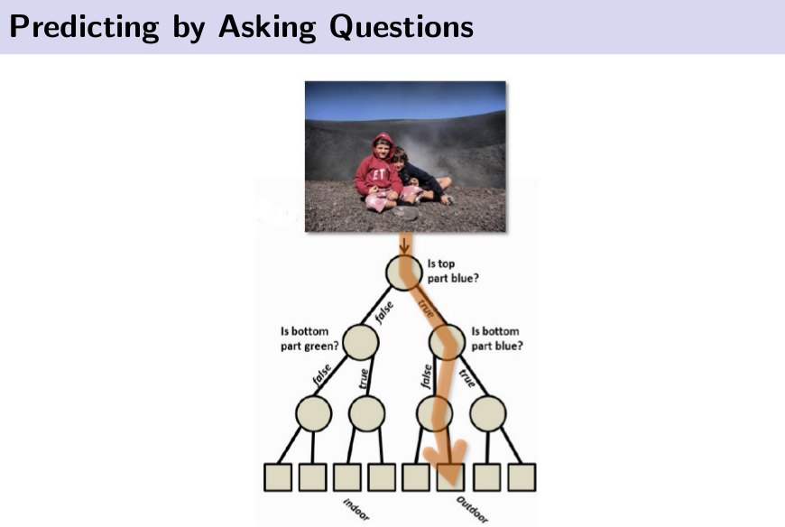
Decision Tree

Slide 6
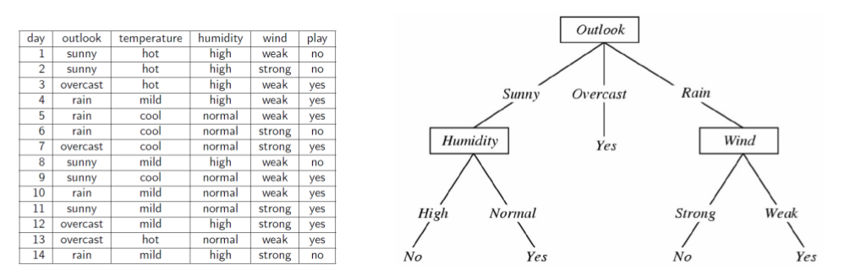
Feature wise - building trees -
Entropy/information gain
DT is a NP-complete problem-- Brute force is used.

Slide 7
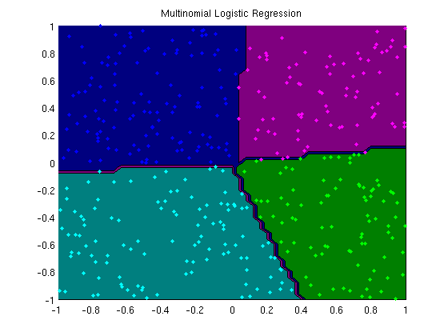
Multinomial Logistic Regression

Slide 8
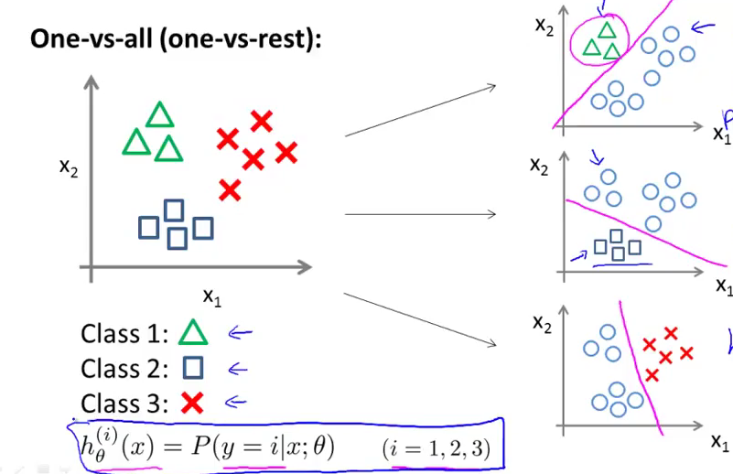
Multinomial Logistic Regression

Slide 9
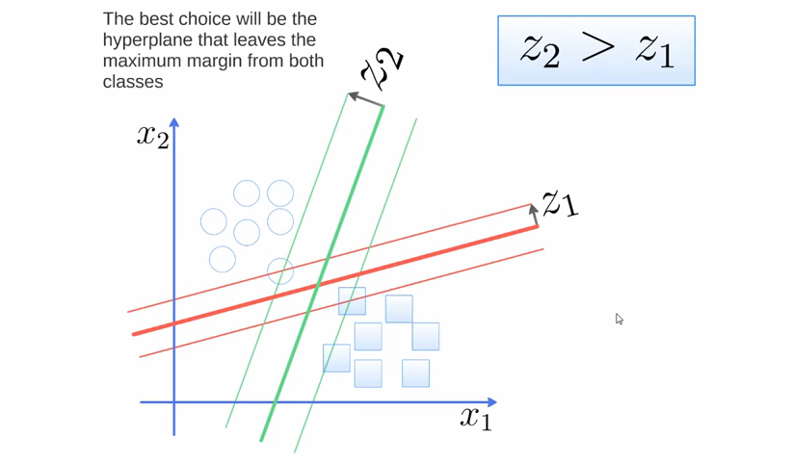
Support Vector Machines

Slide 10
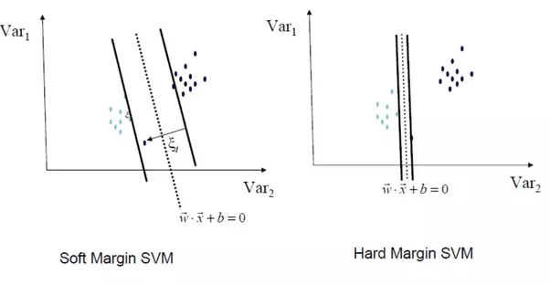
SVM – Soft margin, hard margin

Slide 11
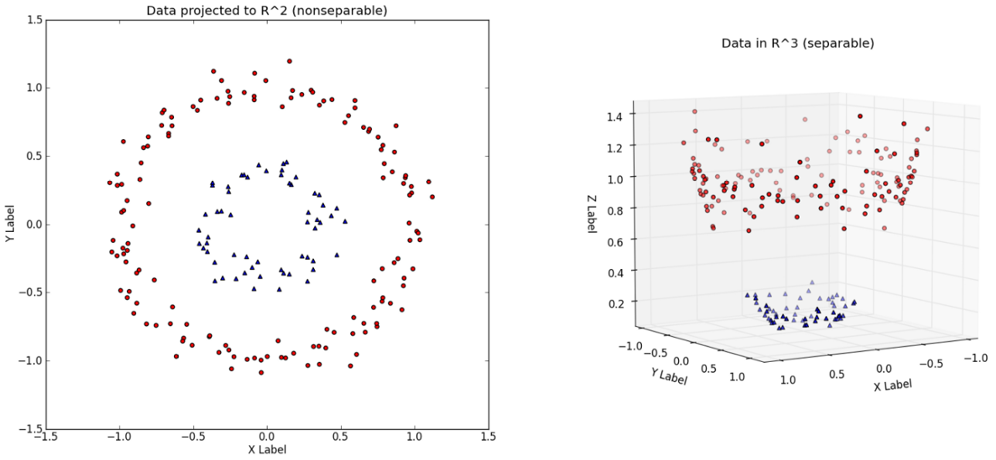
Kernel trick

Slide 12
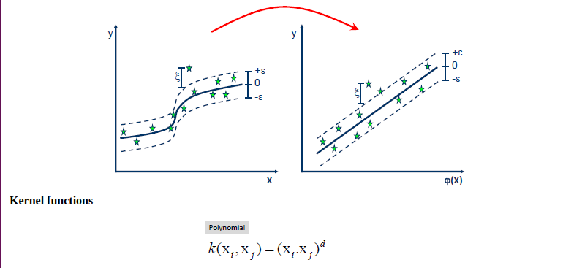
Support Vector Regression

Slide 13
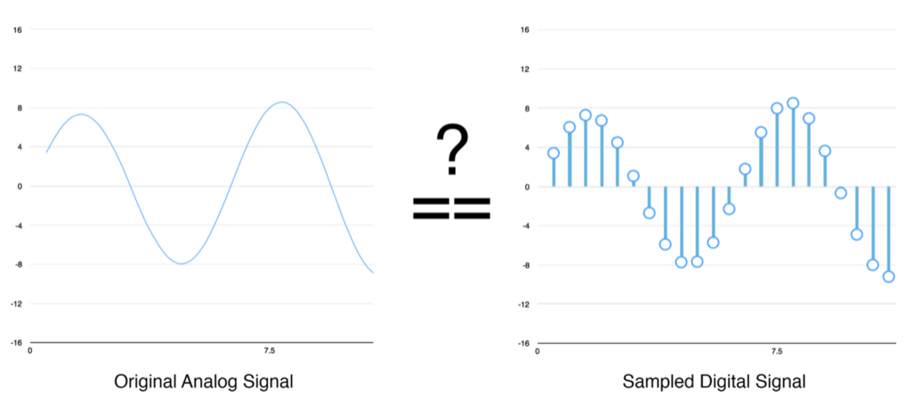
Speech Recognition

Slide 14
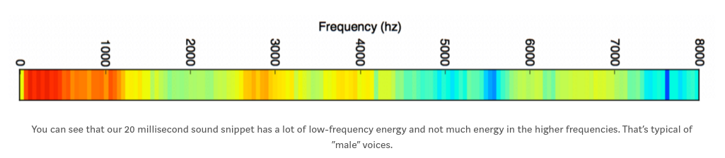
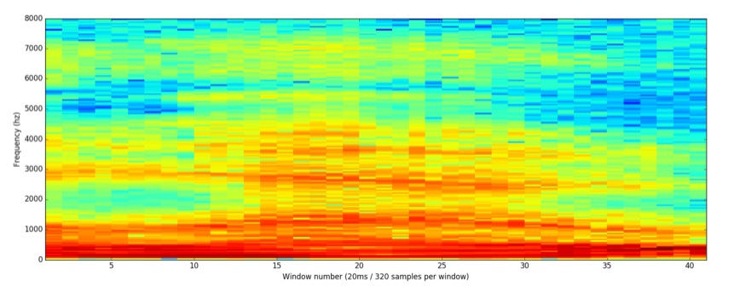
Speech Recognition

Slide 15
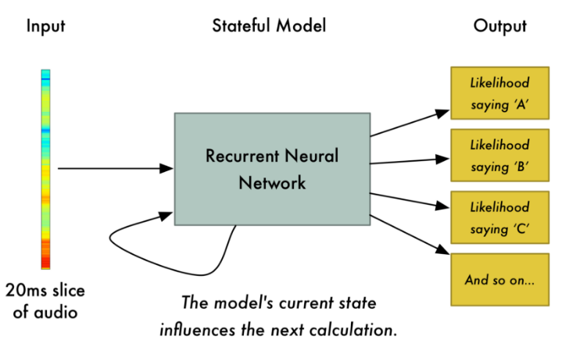
Speech Recognition

Slide 16
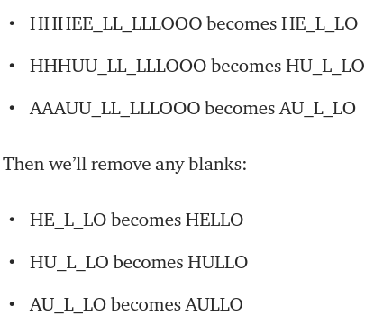
Speech Recognition

Slide 17
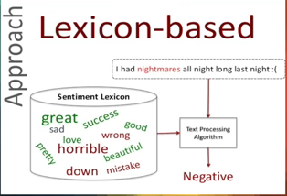
Sentiment Analysis - Textblob
Sentiment Analysis- understanding and extracting feelings from data
Textblob - NLP
Tokenization
lexicon-based sentiment
polarity- how positive or negative?
subjectivity- opinion or fact?
https://textblob.readthedocs.io/en/dev/quickstart.html#sentiment-analysis

Slide 18
Time to Build this Robot

