Slide 1
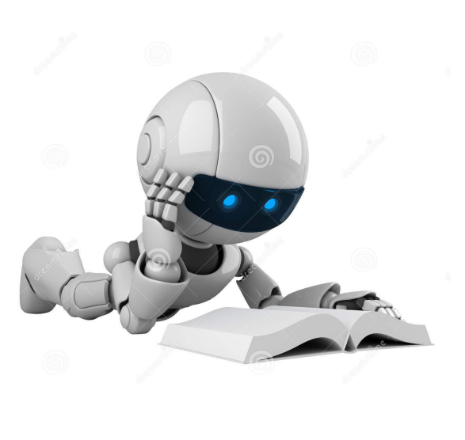
Machine learning is the science of getting computers to act without being explicitly programmed – Andrew NG

Slide 2
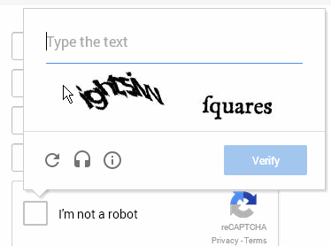
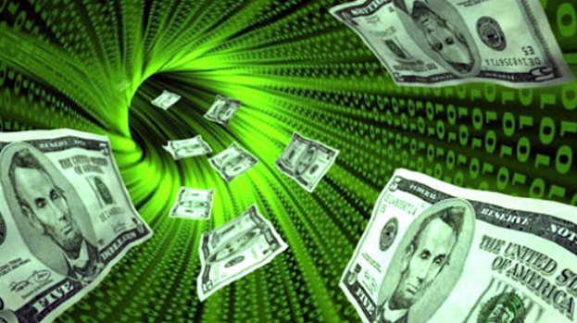
People are lazy - Machines are not
Data == Money

Slide 3
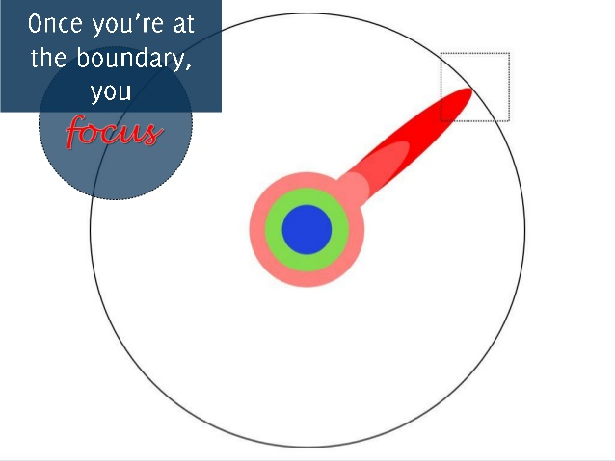
Machine learning is a very Open Source Community
Research
Software
AI knowledge

Slide 4
environment setup
Python
Pip
Scipy
Numpy
SpeechRecognition
Scikit-learn
Textblob

