Slide 1


Sinhgad Academy of Engineering
Department of Information Technology
Project Based Seminar (Oral) Presentation
On
“Crime Analysis and prediction”
By
71825850K
Fatehraj J Suthar
Guide
“Mrs. P .Y. Pawar ”
Day and Date of Exam : 25/04/2020

Slide 2
Contents
Project Group
Project Motivation
Problem Statement
Aim and Objectives
Literature Survey
Introduction to Fuzzy Logic
Applications
Conclusions
References
1

Slide 3
Project Details
Project Title : Crime Analysis and Prediction
Project Domain: Machine Learning
Project Group Members:
  1] 71825850K , Fatehraj J Suthar.
  2] 71825419J , Kunal M Salunke.
  3] 71825084C , Lokesh P Chatur.
  4] 718258503H, Smit A Mune.

Slide 4
Motivation
NEWS is a source of a large collection of data in the form of texts, which can be analysed to make this project fruitful.
Crime analysis is a key step in the sequence of activities aimed at conceiving, implementing, and evaluating measures to prevent crime.
My Personal Interest to work with Crime based data source.

Slide 5
Problem statement
To develop a system which will examine newspaper articles and generate an analysis on crime by comparison of different samples of newspaper articles using machine learning algorithm SVM.

Slide 6
Aim and Objectives
Aim :
  To select enlightening features related to crime.
  To train and test the SVM classifier model using the selected features .
Objectives :
  To provide aid to the law enforcement bodies in analyzing crime.
  To Develop and seek Knowledge on how to deal with Online Data Source.

Slide 7
Project and Seminar Topics
Project Title : Crime Management
Fatehraj J Suthar :crime analysis from newspaper articles.
Lokesh P Chatur :Crime Analysis and Prediction
Kunal M Salunke:Crime Hotspot detection
Smit A Mune : Predictive Policing

Slide 8
Introduction
The newspaper is a vast information source but the information is not organized or specific to take decisions based on them.
Crime analysis from the newspaper article is an area of processing and refining to extract unknown information.
Detecting crime news, crime location, grouping similar crime news are few of them which can be used as basic methodologies for extracting information to detect crime pattern and criminal behaviour.
2

Slide 9
Introduction
The analysis will provide the definite information about a news whether it is a crime related news or not, crime location, similarity and grouping crime news as stories based on a crime news.
SVM classification algorithm can used to perform a two-class classification when collecting data from online newspapers.
2

Slide 10
Steps for Document Classification
Data collection
Data preprocessing
Term-document matrix is constructed
Feature selection
Feature transformation
Classification.

Slide 11
Literature Survey/Related work
Sr. No. | Reference Name (Write Paper Title) | Seed Idea/ Work description | Problems found
1 | 2017 IEEE | Crime News Analysis: Location and Story Detection | Training data set is collected manually for document classification and named entities (location, human) are removed manually.
2 | 2015 IEEE | Crime Analytics: Analysis of Crimes Through Newspaper Articles | Less accuracy
3 | International Journal of Engineering Research and Applications (IJERA) | News document analysis by using a proficient algorithm. | Dataset
4 | 2017 IEEE | Crime Analysis against Women from Online Newspaper Reports | Always eight clusters are being formed but it should not be the case
SAE, Information Technology (2018-19)

Slide 12
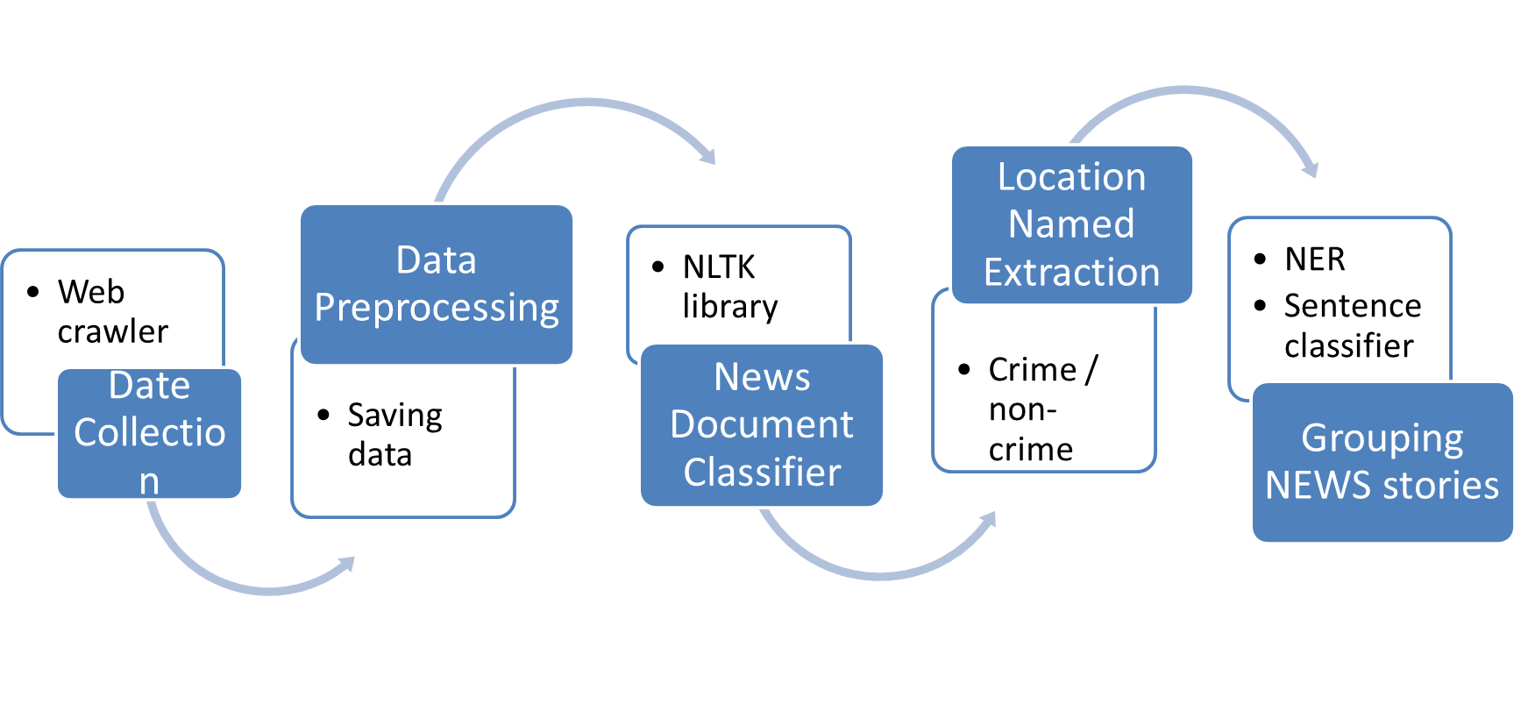
Fuzzy Model:Document Classification

Slide 13
Working
DATA COLLECTION:
    a) collect news from newspaper’s online version using web crawler.
    b) Save data in the database
    c) Data preprocessing:
    -clears the structure of text data.
    -word tokenization, lemmatization processing purpose(NLTK library).
    -Feature selection techniques TF-IDF selects the features that are highly discriminative.
NEWS DOCUMENT CLASSIFIER:
    a) The proposed document based SVM classification system takes the documents and generates a model that classifies the new documents as crime or non-crime.

Slide 14
Working
  b) Both linear and rbf kernel are used to compare the performance. SVM can give better performance when hyper-parameter is tuned properly.
  c) I have used grid search with 5-fold cross-validation.
  C. LOCATION NAMED EXTRACTION:
a) Crime location extraction using named entity recognition (NER) and sentence classification.
b) 1st sentence tokenization and then NER is performed over each sentence to get the sentences having location names.
c) Sentence with a location in crime news is used as training data.

Slide 15
Working
D. GROUPING NEWS STORIES:
a) Searching Similarity: implemented based on cosine similarity.
c) Clustering News Story: To group same type of story based on a query news document.
E. OUTPUT: a) NEWS document classification
b) Crime location extraction from news document.
c) Ranking location names by the occurrence of number of crime.
d) Ranking of crime news by similarity.
e) Searched news story (cluster).

Slide 16
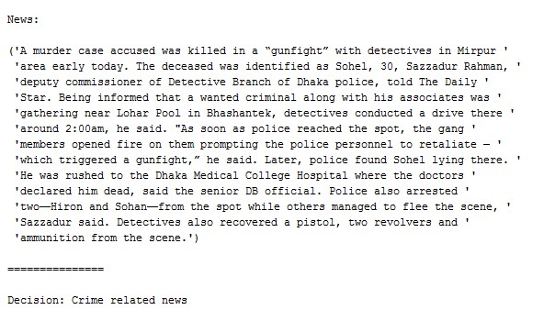
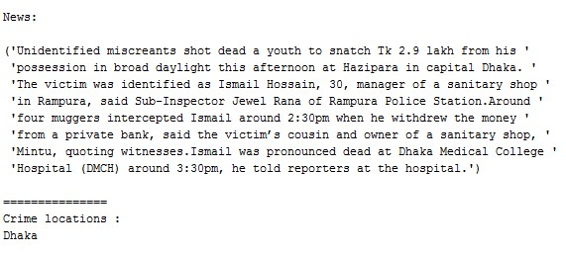
Features
1] News document classification:crime / non-crime
2] Crime location extraction from news document.

Slide 17
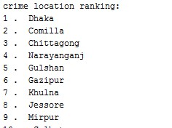
Features
3] Ranking location names by the occurrence of number of crime
4] Ranking by similarity to the searched document string from database.
5] List of similar documents from the same crime story clustered by the system and ordered by the published date: helps to understand the density of a single type of crime.

Slide 18
Applications
To show regional crime trends.
We can port these subsystems to any crime analysis system to perform a basic analysis.
Crime news detection, crime location extraction and story detection can help to understand crime pattern in a single location.
To understand the density of a single type of crime.

Slide 19
Conclusion
SVM classifier correctly classifies the news as crime / non-crime
Our model can be used for the following:
  Preventing future occurrences by deflecting offenders.
  Protecting likely victims.
  Making crime locations less conducive to problem behaviors.

Slide 20
References
[1] Journal article –
Base paper: Crime News Analysis:Location and Story Detection , 2017 IEEE.
News document analysis by using a proficient algorithm , International Journal of Engineering Research and Applications (IJERA) ISSN : 2248-9622, Vol. 7, Issue 6, (Part -2) June 2017.
Crime Analytics: Analysis of Crimes Through Newspaper Articles,2015 IEEE.
Crime Analysis against Women from OnlineNewspaper Reports,2017 IEEE.

Slide 21
References
[2] Website :
https://ieeexplore.ieee.org/document/8281798
http://www.ijera.com/papers/Vol7_issue6/
https://ieeexplore.ieee.org/document/7112359
https://ieeexplore.ieee.org/document/8070855

