Slide 1

Personal Expense Tracker
Team_NOOB (Group-8)

Slide 2
Presented To
Yasin Sazid Lecturer Department of Computer Science and Engineering East West University
Presented by:
Budrun Nahar Bristy | 2022-1-60-144
Fatema Tuz Zannat | 2022-1-60-153
Abu Kahhar Mohammad Sakib | 2021-1-60-040
Prioti Kar Tithy | 2022-1-60-082

Slide 3

Introduction
Many people struggle to track spending and overspend without realizing it.
Personal Expense Tracker is a web app that helps users manage income, expenses, and budgets easily with summaries and alerts.

Slide 4

Objectives
Financial awareness and discipline
Effective budgeting
Data-driven decision making
Security and accessibility
Collaborative financial management

Slide 5

Requirement Engineering
Methods: Interviews + Google Form (82 responses)

Slide 6
From Interview:
Fix a budget
Daily,weekly and monthly summary in graph.
Category wise tracking
Give alert after 70% amount exceed

Slide 7
Survey:
Users want monthly budgets, alerts, and visual reports
Preferred reports: weekly/monthly summaries by category

Slide 8
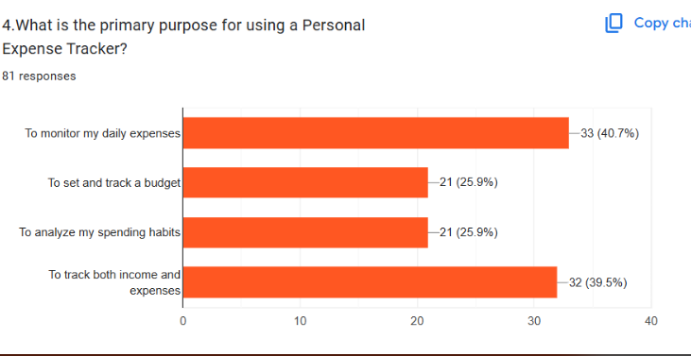
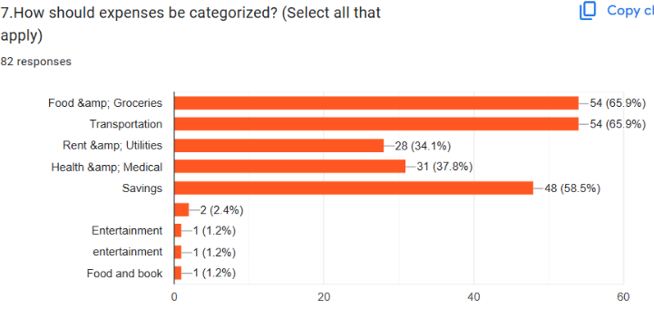
Survey Graph:

Slide 9

Wow Factor:
Use multiple devices at the same time
Provide smart recommendations based on spending habits using AI.
support shared budgeting for families and groups.
Give reward users with badges for achieving savings goals.

Slide 10

Technology Stack
Frontend: React.js , CSS , tailwind CSS
Database: Firebase Firestore
Authentication: Firebase
Hosting: Firebase Hosting
Version Control: Git + GitHub

Slide 11
System Design

Slide 12
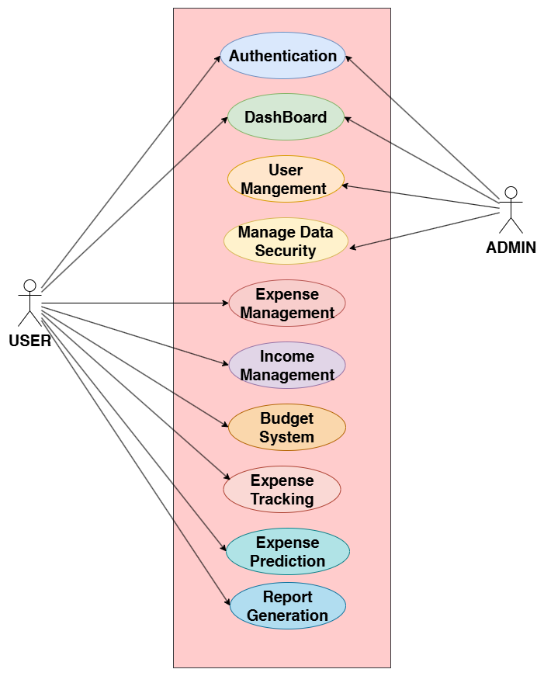

Use Case Diagram

Slide 13
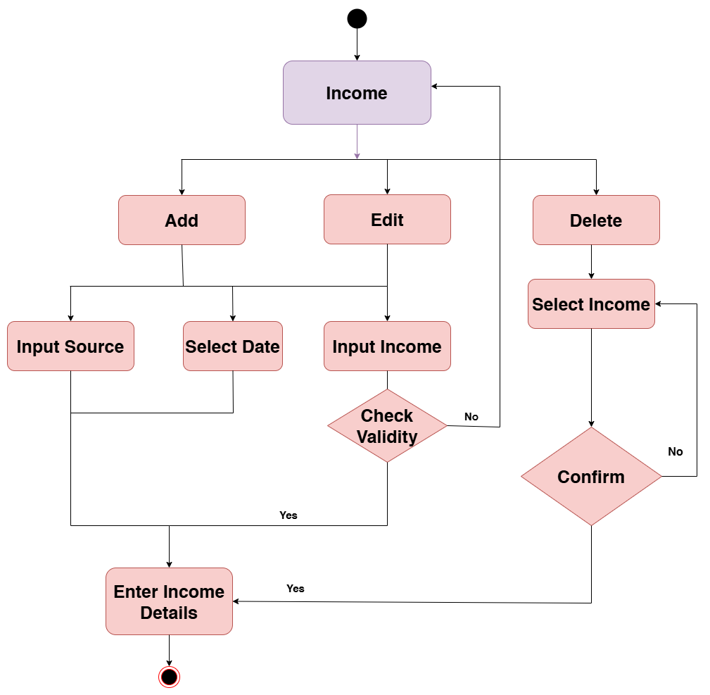

Activity Diagram:
Income Management

Slide 14
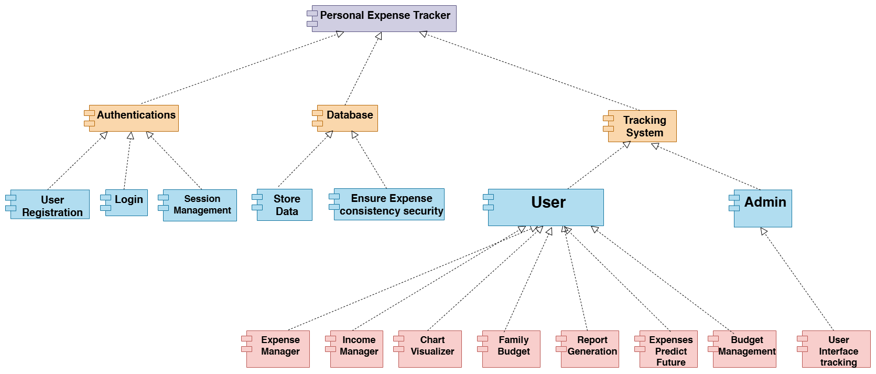
Component Diagram:
Elaborated Component diagram

Slide 15
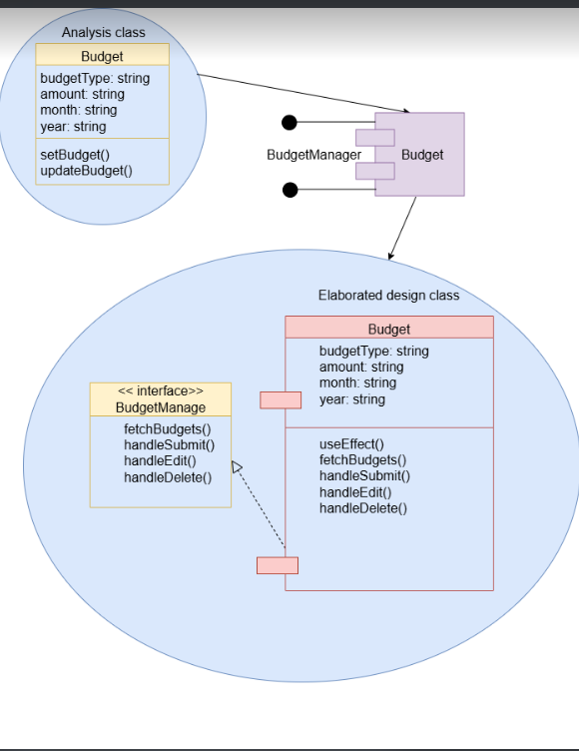
Component Level Design for budget:

Slide 16
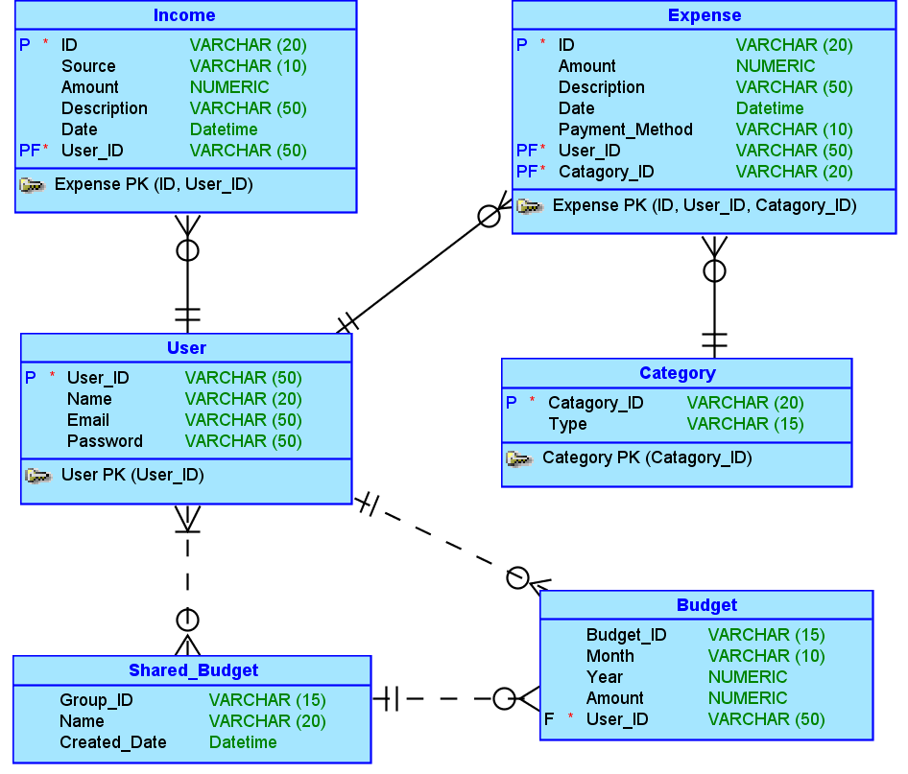
ER Diagram:

Slide 17
System Testing

Slide 18
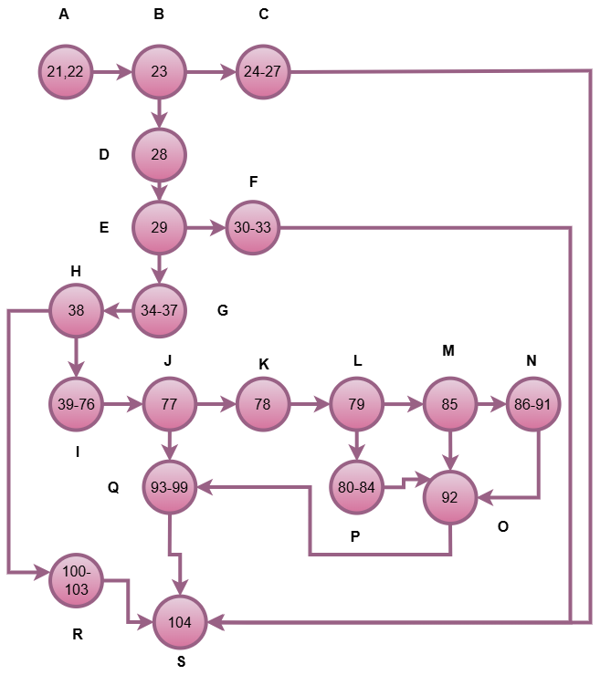

White Box Testing
Decision-to-Decision Graph

Slide 19
Independent Paths:
We got 7 independent path from our DD graph. They are:
A → B → C → S
A → B → D → E → F → S
A → B → D → E → G → H → R → S
A → B → D → E → G → H → I → J → Q → S
A → B → D → E → G → H → I → J → K → L → M → N → O → Q → S
A → B → D → E → G → H → I → J → K → L → M → O → Q → S
A → B → D → E → G → H → I → J → K → L → P → O → Q → S

Slide 20
Test Case
Test Case ID | Component | Class | Input | Expected Output' | Actual Output | Pass/Fail
WTC1 | ExpenseManager | Expense | category = "", amount = "", date = "" | Please fill out this Form | Please fill out this Form | Pass
WTC2 | ExpenseManager | Expense | category = "Food", amount = "-100", date = "2025-05-01" | Alert: "Please enter a valid positive amount." | Alert: "Please enter a valid positive amount." | Pass
WTC3 | ExpenseManager | Expense | Valid input, no budget in DB | Expense added successfully, no warning | Expense added successfully, no warning | Pass
WTC4 | ExpenseManager | Expense | Valid input, budget exists, >=70% used | Expense added successfully, warning shown | Expense added successfully, warning shown | Pass

Slide 21
Test Case ID | Component | Class | Input | Expected Output' | Actual Output | Pass/Fail
WTC5 | ExpenseManager | Expense | Valid input, budget exceeded | Expense added successfully, exceed warning | Expense added successfully, exceed warning | Pass
WTC6 | ExpenseManager | Expense | Valid input, budget < 70% used | Expense added successfully, no warning | Expense added successfully, no warning | Pass
WTC7 | ExpenseManager | Expense | DB write fails (mock error) | Alert: "Failed to add expense." | Alert: "Failed to add expense." | Pass

Slide 22
Black Box Testing
Test Cases:
Test Case ID | Component | Class | Input | Expected Output' | Actual Output | Pass/Fail
BTC1 | ExpenseManager | Expense | 0.01 | Expense added successfully, no warning | Expense added successfully, no warning | Pass
BTC2 | ExpenseManager | Expense | 1 | Expense added successfully, no warning | Expense added successfully, no warning | Pass
BTC3 | ExpenseManager | Expense | 1000000 | Expense added successfully, no warning | Expense added successfully, no warning | Pass
BTC4 | ExpenseManager | Expense | 999999999 | Expense added successfully, no warning | Expense added successfully, no warning | Pass

Slide 23
Implementation
and
Deployment
Website link - https://personal-expense-tracker-1c190.web.app/login

Slide 24
Limitations:
Some advanced features like receipt scanning.
No integration with external apps or bank accounts.
We cannot provide smart recommendations based on spending habits using AI.

Slide 25

Conclusion:
Personal Expense Tracker enhances financial literacy and planning.
Offers secure, collaborative, and insightful management of personal finances.

Slide 26

Thank You

