Slide 1
A Survey on IoT Security: Application Areas, Security Threats, and Solution Architectures
Paper Review By : Fatema Tuj Jahura
Course Code: CSE707
ID:23366007

Slide 2
Summary
1.1 Hypothesis
.Significance of Inter of Things (IoT)
.The Security Challenges and Sources of Threats in IoT
.Introduced Blockchain, Fog Computing, Edge Computing and Machine Learning
in IoT

Slide 3
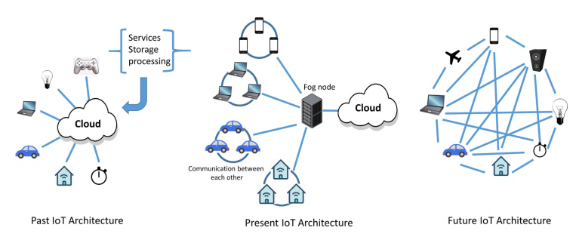
Figure: Present and Future Architecture Of IoT

Slide 4
Summary
1.2. Contribution
.Found open issues, Challenges, Outlined Future Researches in the realm of
Developed and secured IoT Applications
.A detailed explanation is offered for various threat sources present in IoT
Ecosystem

Slide 5
Summary
1.3. Methodology
1.Analyzing the common vulnerabilities in sensing, networking, middleware and
application layers.
2.Detecting Blockchain as preventing data loss, spoofing attacks, and unauthorized access.
3.Identifying fog computing to ensure data integrity locally.
4.Identifying protection against spoofing attacks involves ML techniques such as Q-learning, Dyna-Q, Support Vector Machines (SVM), Deep Neural Network (DNN) model, incremental aggregated gradient (IAG), and distributed FrankWolfe (dFW)

Slide 6
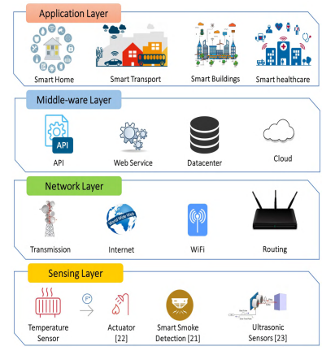
Figure: Layers in IoT Architecture

Slide 7
Conclusion
Present the insights into the state-of-the-art in IoT security.
It is a valuable resource for improving security in upcoming IoT applications.

Slide 8
Limitation
2.1. First Limitation
.Redundant data in Blockchain
2.2. Second limitation
. Lack of Security in Edge computing

Slide 9
Synthesis
Enhanced Security by incorporating Blockchain
Low Latency Applications by using fog computing
Autonomous devices by implementing edge computing

