Slide 1
Reinforcement Learning, Looking for New Backgammon Strategies
Student Name: Fatema Alkhanaizi
Supervisor Name: Rob Powell

Slide 2
Project Aim
Is to find a new strategy for backgammon using reinforcement learning techniques; a hybrid of known strategies will be used as the basis for the new strategy.

Slide 3
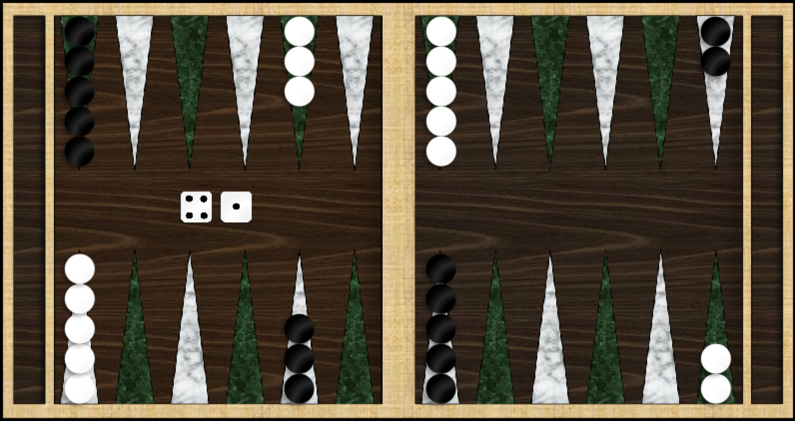
Backgammon
Fields
Bar
White Home
White movement
Checkers
Black movement
Black Home
Notes:
Backgammon is a game played with dice and checkers on a board consisting of 24 fields, in which each player tries to move his checkers home and bear them off while preventing the
1 opponent from doing the same thing (Keith 1995). Figure 1 illustrates the basic setup that will be used for this project.

Slide 4
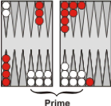
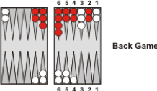
Backgammon Strategies
Red movement
Notes:
This project will focus on using modular neural network architecture to incorporate a hybrid of backgammon strategies to find a new game strategy. In addition, the performance of the new strategy will be evaluated by comparing it to another network that includes the strategies separately.

Slide 5
Concepts
Reinforcement learning
Temporal difference (TD) learning
TD(λ) algorithms
Notes:
A reinforcement learning algorithm allows an agent to learn from its experience generated by its interactions with an environment (Sutton & Barto 1998).
Temporal difference (TD) learning is a class of reinforcement learning which uses the difference between two successive positions for backpropagating the evaluations of the successive positions to the current position (Sutton & Barto 1998).
There is a whole family of temporal difference algorithms known as TD(λ)-algorithms which are parametrised by the value λ which makes the agent looks further in the future for updating its value function (Sutton & Barto 1998).

Slide 6
Early Works
TD-Gammon of Tesauro
Boyan’s modular neural network
GNU-Backgammon

Slide 7
Deliverables
3 Trained neural networks
AI agent
User interface and human agent
Testing suit
Project Report

Slide 8
Monolithic Neural Network
wih
bh
who
bo
O
H
I

Slide 9
Modular Neural Network

Slide 10
Network Output
Input Layer
Gating
Program
Designer Domain Decomposition Network (DDD)

Slide 11
Trainable
Gating
Network
Network Output
Meta-pi Network
Input Layer

Slide 12
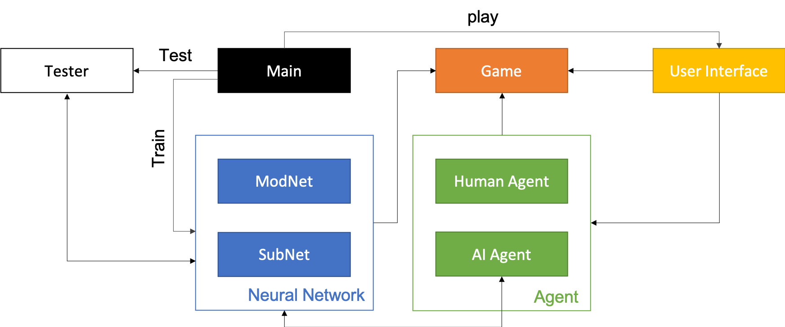
System Components

Slide 13
Training

Slide 14
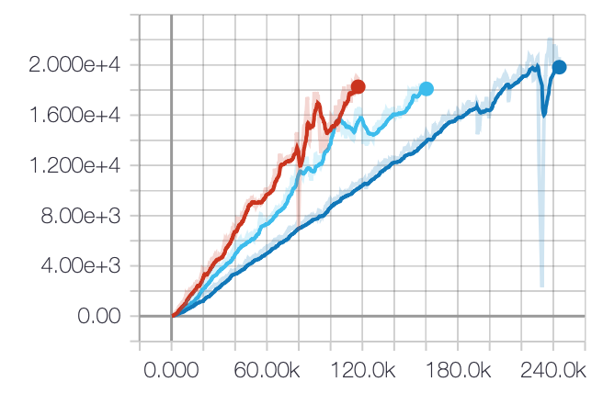
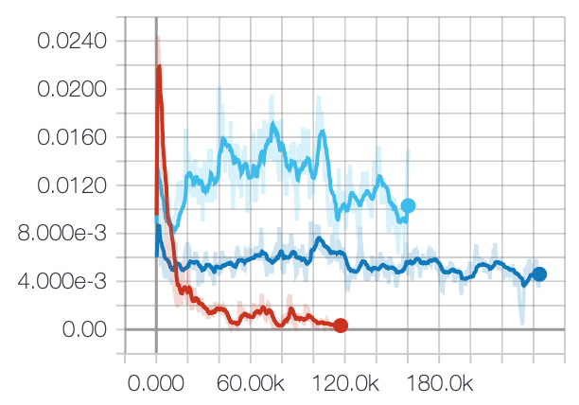
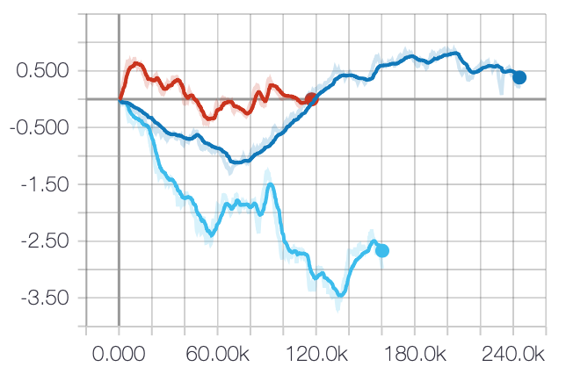
Average Accuracy
Average Loss
Monolithic Network
Racing Game – Modular Network
Default – Modular Network
Average Delta
Notes:
Loss # mean squared error of the difference between the next state and the current state
Accuracy # check if the model predicts the correct state
Delta # delta = V_next - V

Slide 15
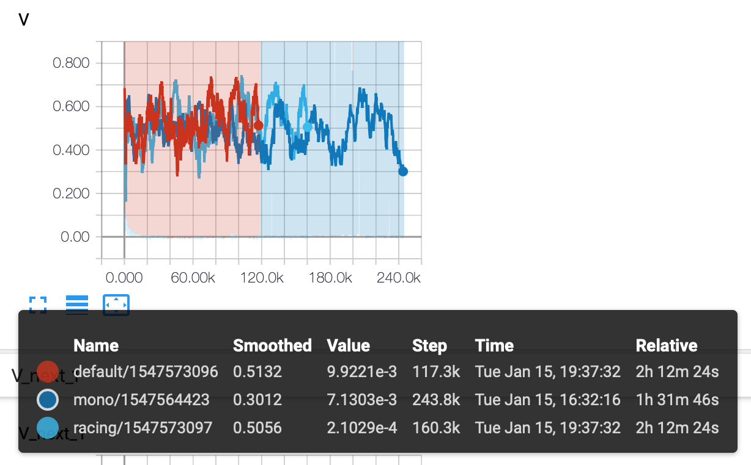

Slide 16
Questions

