Slide 1
play
play
Tester
Test
Main
Game
User Interface
Train
ModNet
Human Agent
SubNet
AI Agent
Neural Network
Agent

Slide 2
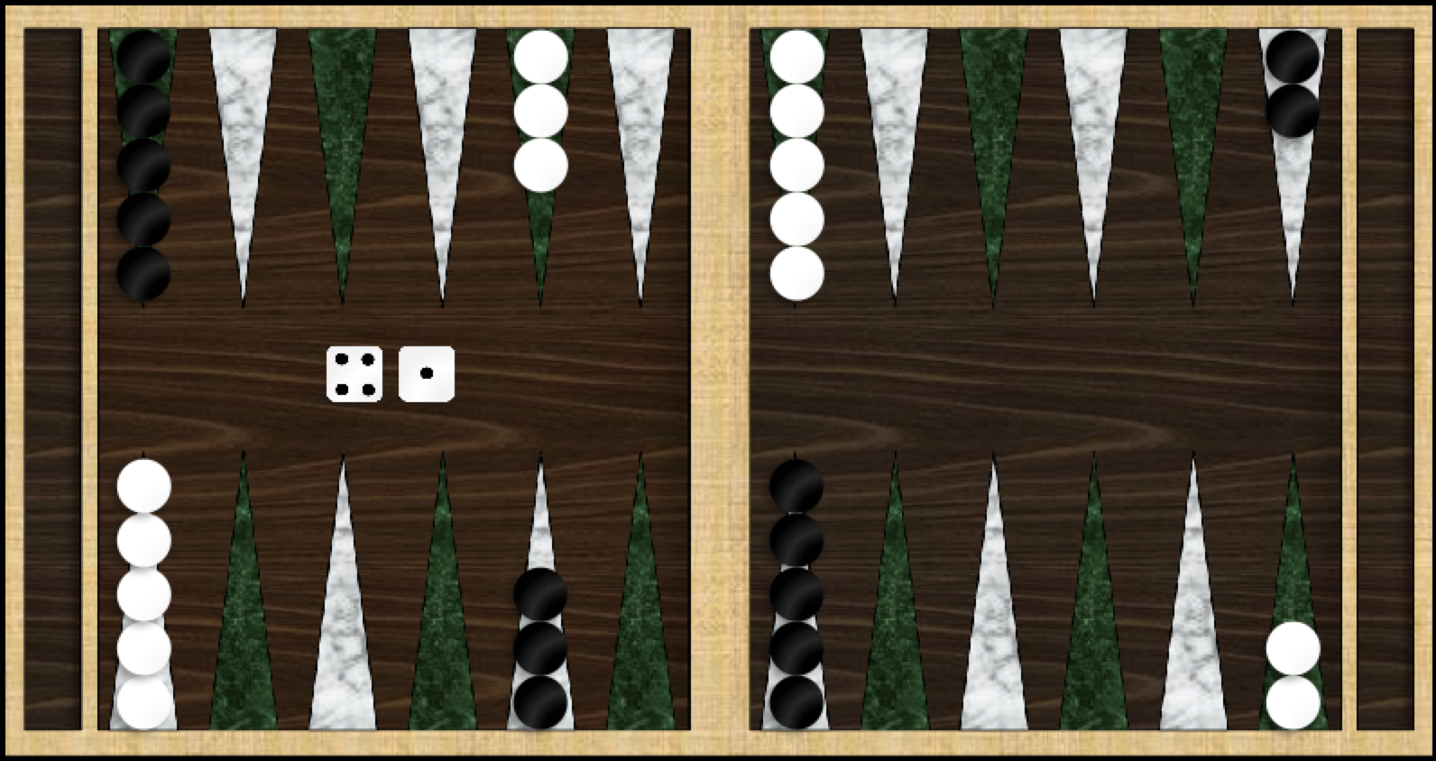
White Home
White movement
Black movement
Black Home

Slide 3
wih
bh
who
bo
O
H
I

Slide 4
Network Output
Input Layer
Gating
Program

Slide 5
Network Output
Trainable
Gating
Network
Input Layer

