Slide 1


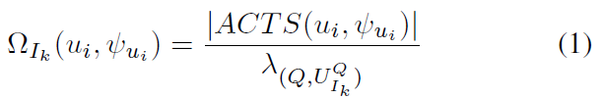
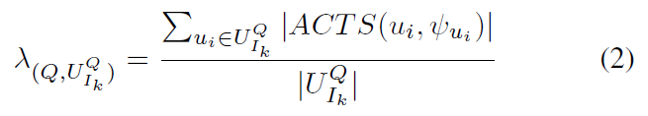
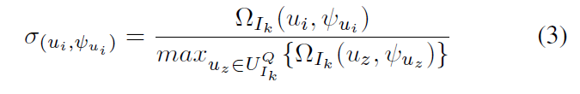
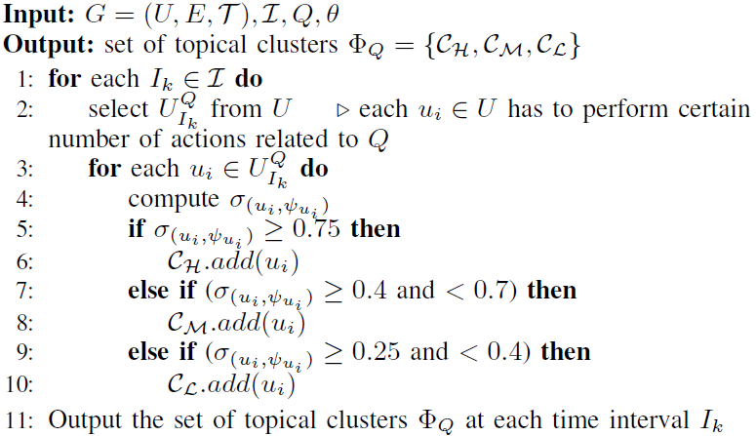
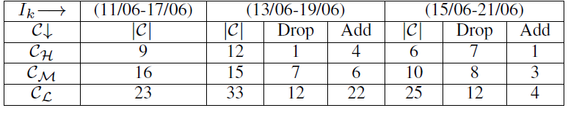
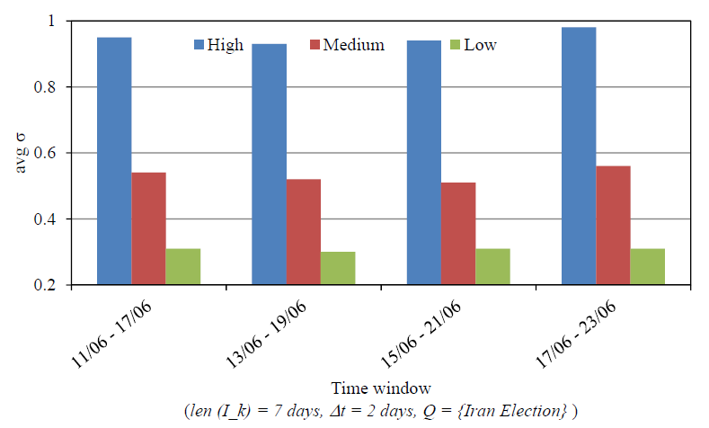

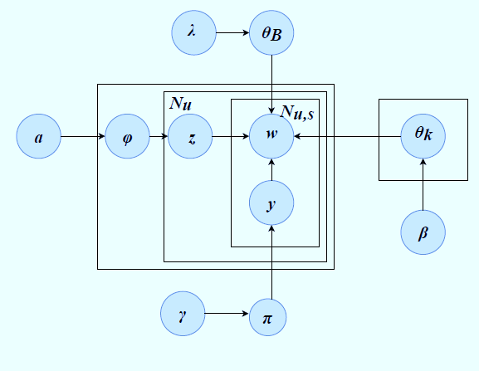
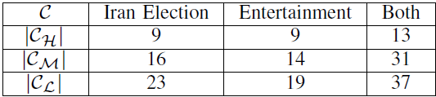





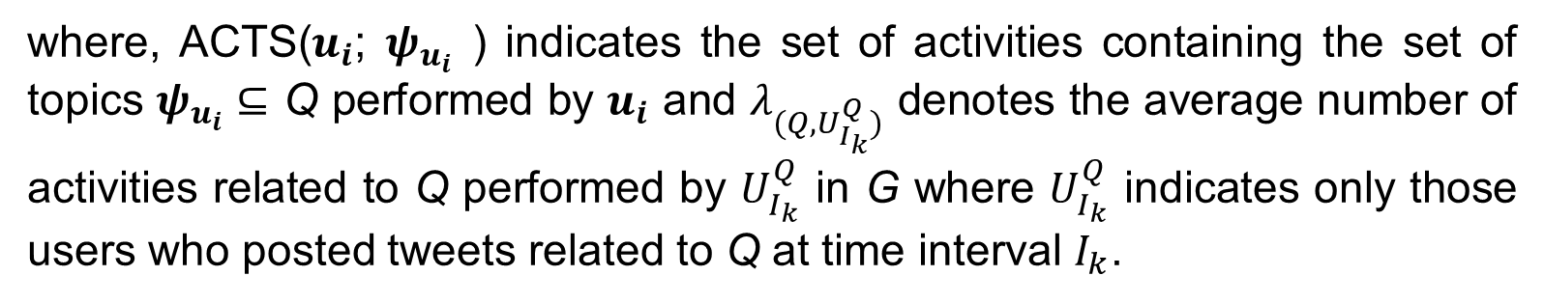
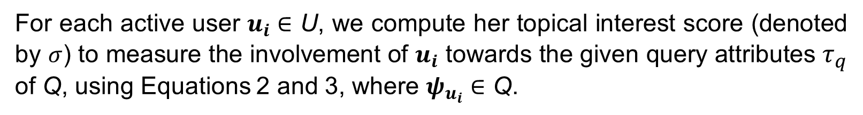

Discovering and Tracking Query Oriented Topical Clusters in Online Social Networks
Fatema Khan, Tanjim Taharat Aurpa and Md Musfique Anwar Jahangirnagar University
fatemakhankgsc@gmail.com ,taurpa22@gmail.com, manwar@juniv.edu
Background
Experimentation and Finding
Attributed Graph
Rich attributed nodes with properties.
Users | Topic 1 | Topic 2 | Topic 3
u₁ | 0. 45 | 0.25 | 0.30
u₂ | 0.52 | 0.35 | 0.13
u₃ | 0.38 | 0.45 | 0.17
…….. | ……. | …….. | ………..
For each active user $u_{i}∈$ U, we compute her topical interest score (denoted by $σ$) to measure the involvement of $u_{i}$ towards the given query attributes $τ_{q}$ of Q, using Equations 2 and 3, where $ψ_{u_{i}}∈$ Q.
Topical Interest Score
To measure the involvement of user
Consider temporal activeness based
on the number of their posts
Sliding Time Window
A window of a predefined length is moved over the activity stream.
Specifies the intervals to analyze.
where, ACTS($u_{i}$; $ψ_{u_{i}}$ ) indicates the set of activities containing the set of topics $ψ_{u_{i}}⊆$ Q performed by $u_{i}$ and $λ_{(Q,U_{I_{k}}^{Q})}$ denotes the average number of activities related to Q performed by $U_{I_{k}}^{Q}$ in G where $U_{I_{k}}^{Q}$ indicates only those users who posted tweets related to Q at time interval $I_{k}$.
Motivation and Problem Formulation
Motivation
Previous approaches
Paid less attention to the user interests and activities on different attributes.
ii. Didn’t detect cluster of activeness based on user interest
Our approach
i. Determine the users’ temporal topical interest scores
ii. Clustered active users based on topical interest score.
Date Sets
Dataset | # of Nodes | # of Nodes | # of activities
SNAP | 400,000 | 5,357,560 | 573,832
Co-Author | 327 | 1,180 | 807
Problem Formulation
Given an attributed graph G = (U, E, $τ$) where U, E and $τ$ denote user, connections and topic, an input query Q ={$τ_{q}$}, Topical interest score will cluster {$C_{H}$, $C_{M}$ & $C_{L}$} the users
Results
Measure users’ topical Interest score $σ_{(\text{(}u_{i}\text{; }ψ_{u_{i}})}$
Discovering topical clusters {$C_{H}$, $C_{M}$ & $C_{L}$} based on $σ_{(\text{(}u_{i}\text{; }ψ_{u_{i}})}$ for $τ_{q}$
Observations
Changes in clusters {$C_{H}$, $C_{M}$ & $C_{L}$} at different time interval $I_{k}$
Changes in clusters {$C_{H}$, $C_{M}$ & $C_{L}$} for different $τ$
TRACKING CLUSTERS AT DIFFERENT $I_{k}$ FOR TOPIC Q={Iran Election} ($I_{k}$ = 7 days, $Δt$ = 2 days).
Topical Clusters Detection Algorithm
Proposed Methodology
Stage 1
Social Stream
Data
Pre-processing
Normalization
Lexicon
Stage 2
Q={Iran Election} ($I_{k}$ = 7 days, Δ𝑡 = 2 days)
T-lda
Cleaned Social
Stream
Stage 3
TRACKING CLUSTERS FOR DIFFERENT VALUES OF Q={Iran Election, Entertainment}
Conclusion and Future Work
Topical
Clusters
Detection
Algorithm
Apply
$$C_{H}$$
$$C_{M}$$
$$C_{L}$$
This Work
-Propose an approach to detect and track topical clusters based on topical interest score.
-Track the changes by sliding time window and changing topics.
Changes in clusters by Sliding Time Window and by changing topics
Future Work
-Determine the characteristics of bursty topics by tracking the changes in clusters.
References
Zhao, W. X., Jiang, J. , Weng, J., He, J., Lim, E., Yan, H., Li, X.:Comparing twitter and traditional media using topic models, In: ECIR, pp. 338–349 (2011)
Huang, X., Lakshmanan, L. VS.: Attribute-driven community search. In: VLDB, pp. 949–960 (2017)
Leskovec, J., Krevl, A.: SNAP Datasets: Stanford large network dataset collection. (2014)
Blei, D. M., Ng, A. Y., Jordan, M. I.: Latent dirichlet allocation. In: Journal of Machine Learning Research, 3:993–1022 (2003)
NSysS 2019, Dec 18-20, 2019, Dhaka, Bangladesh

