Slide 1




Data Analytics Course
DAB-14
Decoding the Flow
Ensuring Safe Drinking Water Quality
Fatema Alalawi
Fatema Hilal
Mohamed

Slide 2
Introduction
Safe drinking water is a priority
26% of the world have unsafe water

Slide 3
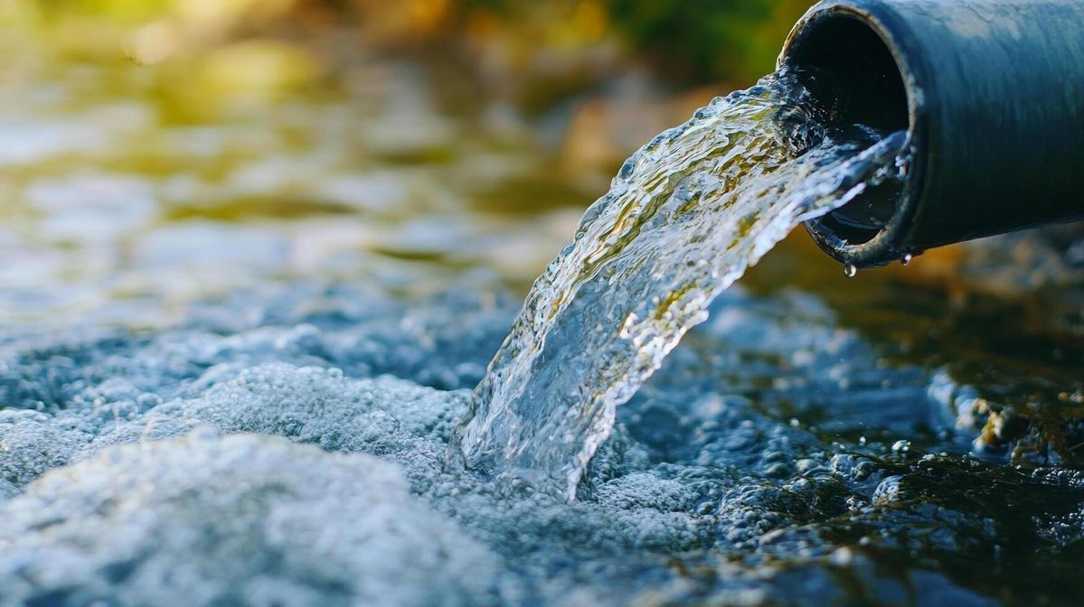
Problem Statement
Chlorine dioxide
Inaction-able Data
Turbidity
Challenges
Redox potential
Conductivity
pH

Slide 4

Aim and Objectives
Validating Safety of Drinking Water
Validating anomalies
Parameter relationships
Trends over time

Slide 5
Data and Parameters
Data Parameters
Fm: water flow rate
Tp: water flow rate temperature
Redox Potential: water ability to break down waste.
pH: Hydrogen number
Cl: Chlorine dioxide
Leit: Electrical conductivity
Trueb: water turbidity (water cloudness )

Slide 6
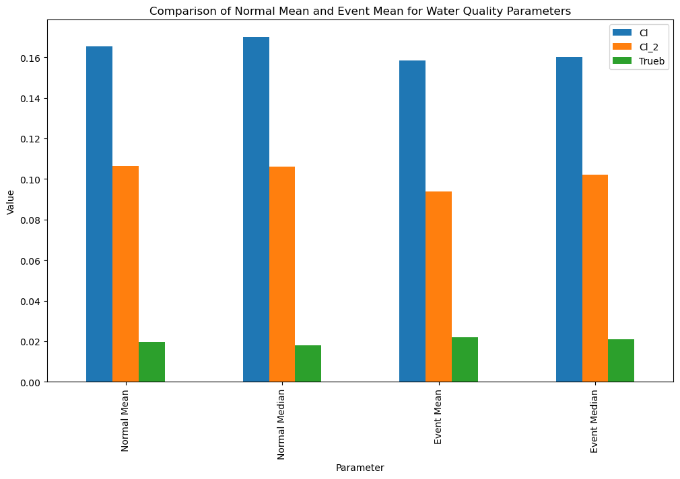
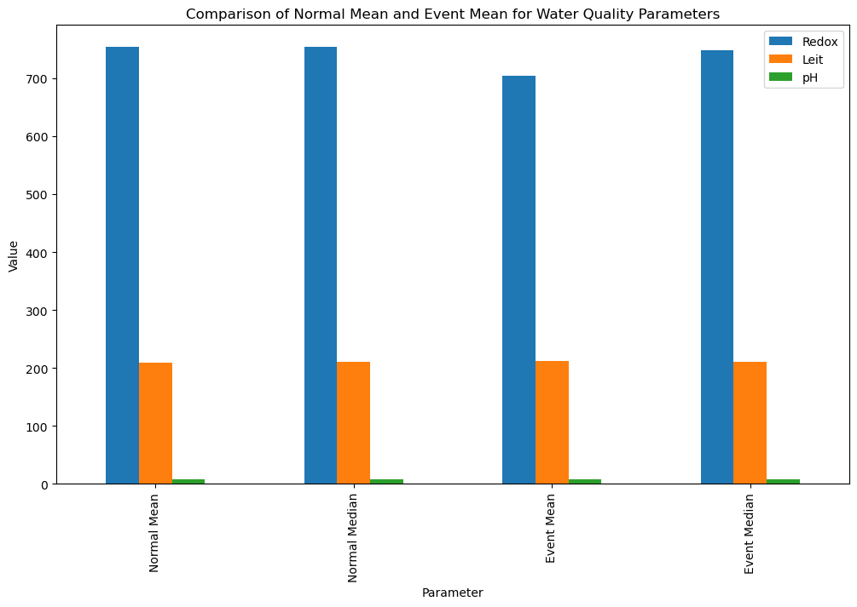
Potential Anomalies
Event: a dataset for change detection only

Slide 7
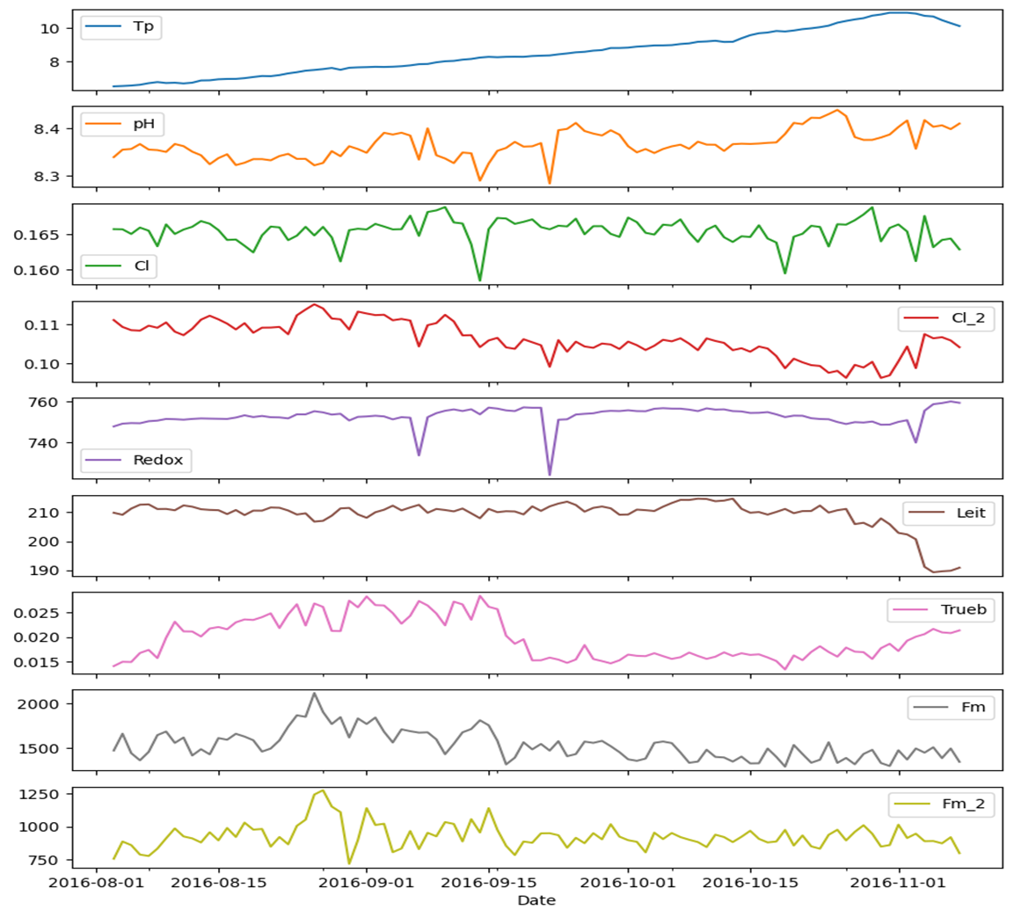
Trends Over Time
Safety Standards: | Safety Standards:
pH | 6.5 - 8.5
Turbidity | < 5 NTU
Chlorine | 0.2 - 0.5 mg/L
Redox | >650 mV
Conductivity | <500 µS/cm (0.0005 S/cm)
The safety standards for parameters affecting water quality, according to WHO (World Health Organization)

Slide 8
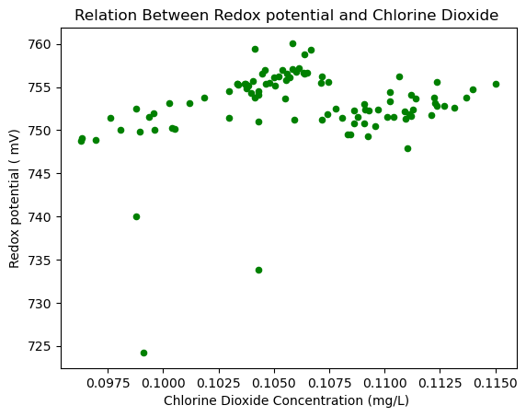
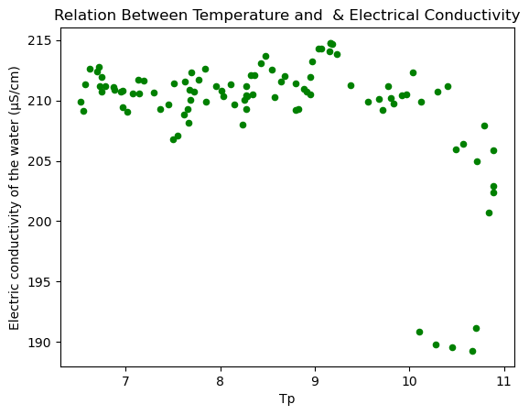
Parameter Correlations
A clear positive correlation.
No consistent relationship.

Slide 9
Conclusion
The water is safe for drinking
Despite the presence of some anomalous changes

Slide 10
Q & A

Slide 11
Thank You!

