Slide 1
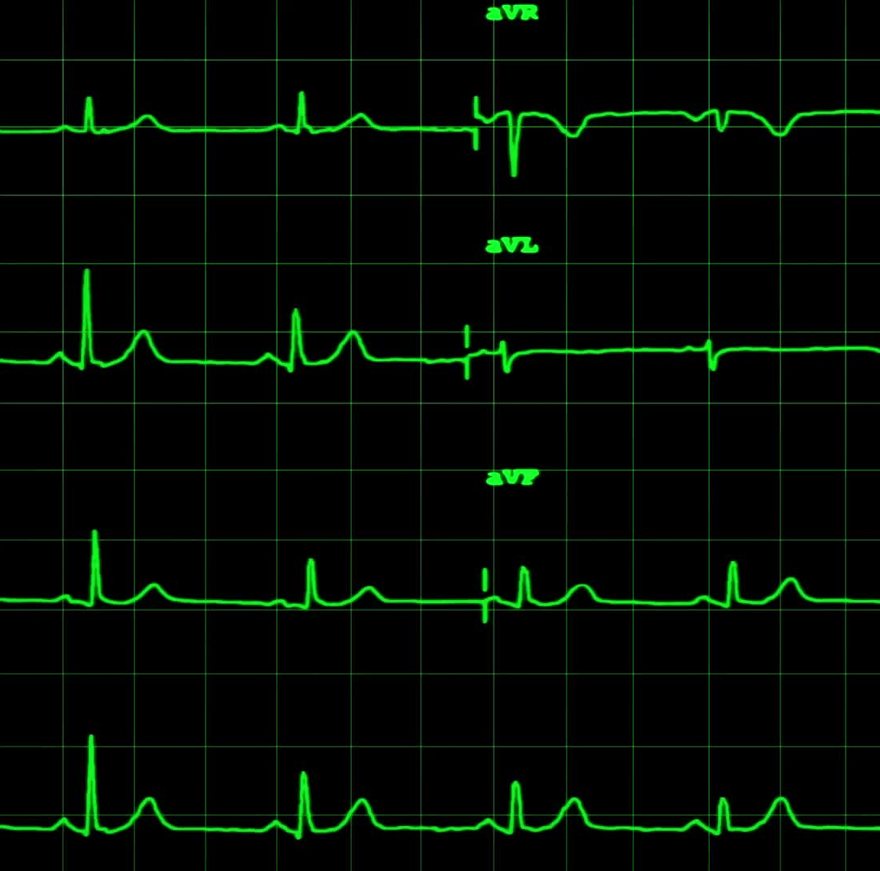
Heart Failure Prediction
Christina
David Adeline rock
Fatema G
Frank

Slide 2
Fatema

Slide 3
Kristina

Slide 4
Frank

Slide 5
David

