Slide 1
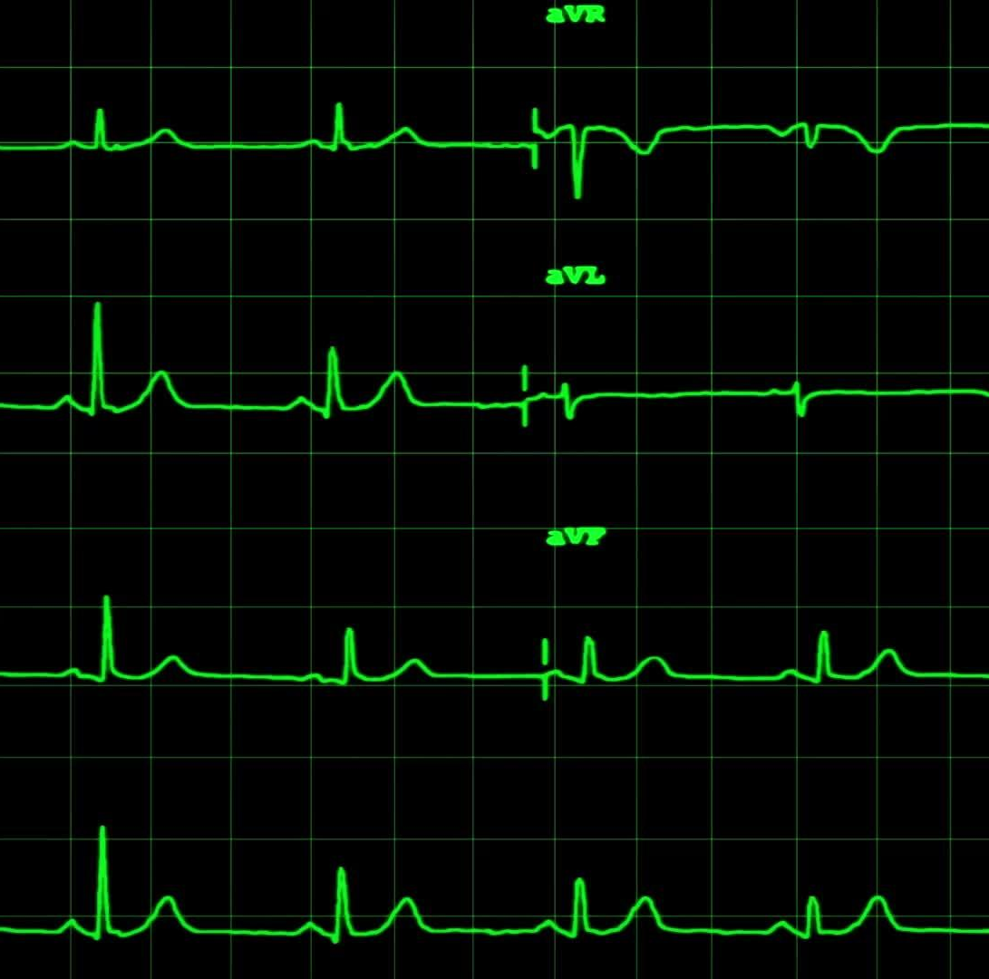
Heart Failure Prediction
Kristina Abramoff
David Adeline rock
Fatema G
Hao Nguyen (Frank)

Slide 2

Introduction
Leveraging machine learning to predict heart failure using clinical data.
Importance:
Heart disease is a leading cause of mortality globally.
Early prediction is crucial for prevention and treatment.
Notes:
Today, we will be presenting our project on "Heart Failure Prediction," where our goal is to leverage machine learning techniques to predict whether a patient is likely to experience heart failure based on various clinical features.
Heart disease remains one of the leading causes of mortality worldwide, making early prediction and prevention crucial. In our study, we analyze a dataset containing 918 observations and 11 clinical features, ranging from patient demographics like age and sex to critical health indicators such as blood pressure, cholesterol levels, and ECG results.
NEXT SLIDE

Slide 3

Process
PySpark - data handling
Matplotlib - Visualisations
Scikit-learn - model evaluation
Pandas - data manipulation
Google Colab - hosted Jupyter Notebook service
Streamlit - deployment and web access
Notes:
Our approach includes data preprocessing, visualization, and applying machine learning models to create a robust prediction system. We utilized a combination of tools, including Python libraries like Pandas for data manipulation, Matplotlib for visualization, Scikit-learn for implementing and evaluating our models, and PySpark to efficiently handle data processing tasks, ensuring scalability and performance. We also leveraged Google Colab, to streamline our development process.
For deployment and easy web access, we used Streamlit, allowing us to present our results in an interactive and user-friendly manner.
NEXT SLIDE

Slide 4
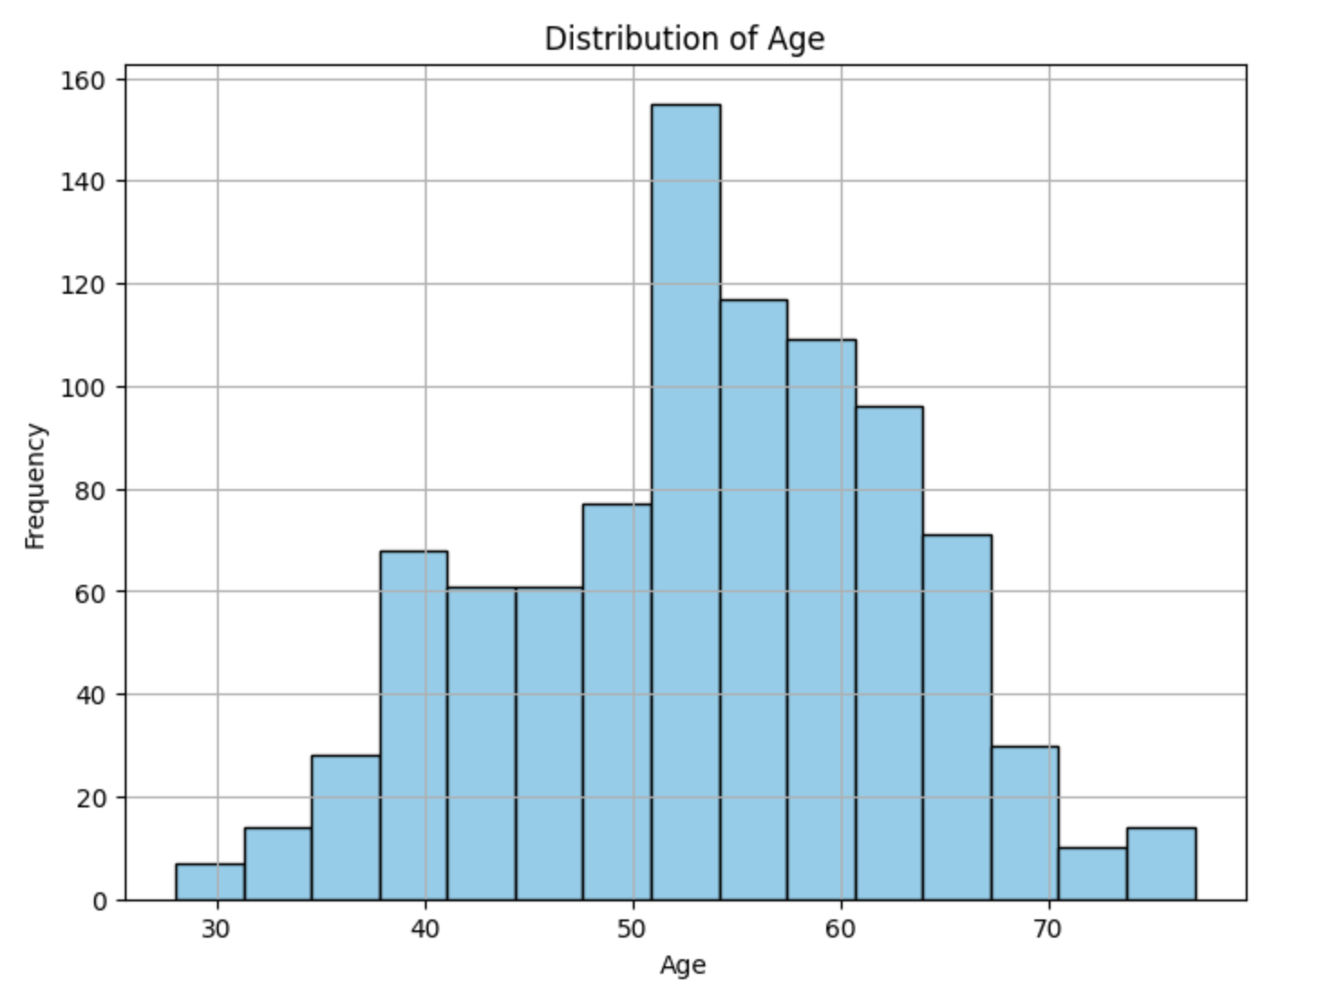
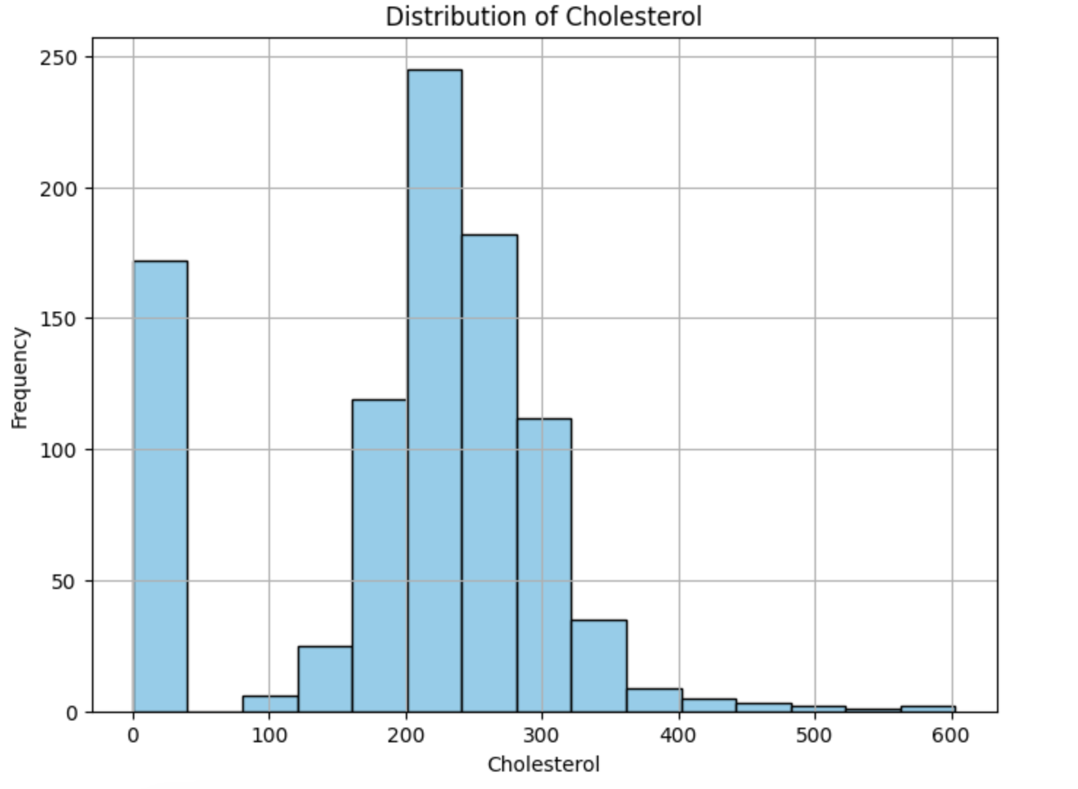
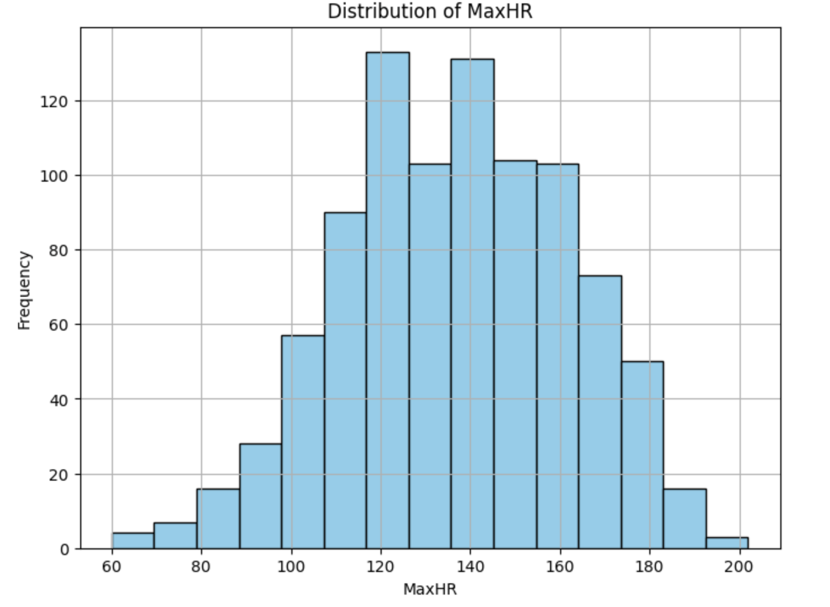
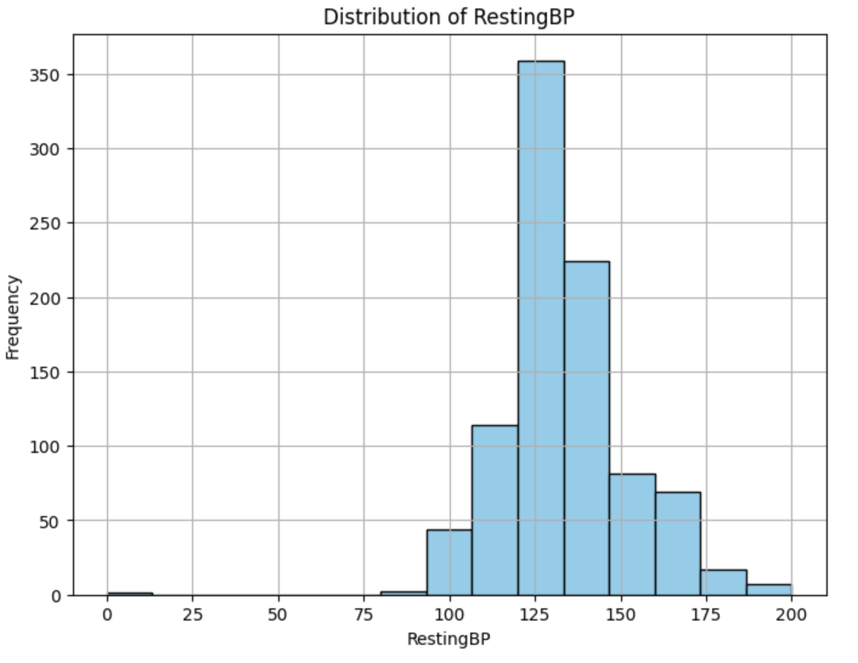
Visualisations
Notes:
We explored key clinical features that play a crucial role in assessing the risk of heart failure.
We looked at cholesterol level, fasting blood sugar, maximum heart rate, old peak, resting blood pressure and patient’s age
These visualizations provide a foundation for the predictive analysis that follows, helping us better understand and predict heart failure risks
NEXT SLIDE

Slide 5

Logistic Regression
Binary Classification Focus - Ideal for predicting binary outcomes (Heart Failure: Yes/No).
Simplicity & Efficiency - Low computational complexity; quick to train.
Multi-feature Handling - Integrates diverse patient data for comprehensive prediction.
Proven in Medical Research - Widely trusted and used in epidemiology for disease prediction.
Notes:
"Thanks Fatema. We examined Logistic Regression as it's great for tasks that involve binary classification.
It's simple to implement and doesn't need much computational power, allowing us to train models quickly, even with large datasets.
Its reliability and ease of understanding make it a strong choice for predicting heart failure, where every moment counts & accuracy is critical."
(Next Slide_)

Slide 6
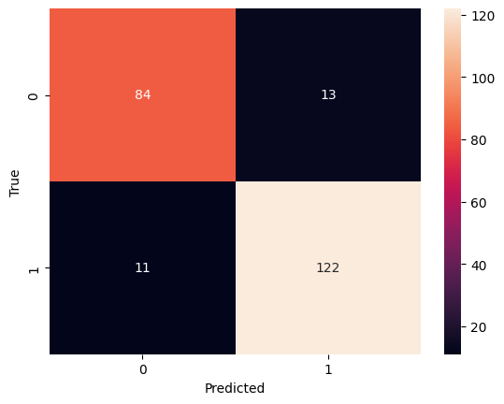
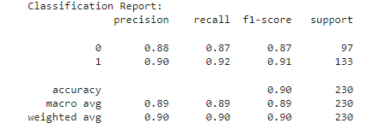
Logistic Regression (Cont.)
Trained on labeled data using ‘liblinear’ solver with a set random_state for reproducibility.
Predictions evaluated on the test set using a confusion matrix and classification report.
Confusion matrix: 122 true positives, 84 true negatives, 13 false positives, 11 false negatives.
High precision (0.88-0.90), recall (0.87-0.92), and F1-scores (0.87-0.91) across both classes.
Final accuracy: 90%—strong performance with minor misclassifications noted.
Notes:
"We then trained the model on labeled data using the 'liblinear' solver, making sure it’s reproducible by setting a fixed random state."
"After training, we tested the model using a confusion matrix, which showed a good balance between true positives and true negatives, with only a few misclassifications."
"Overall, the model reached a solid 90% accuracy, which shows reliable performance, though there’s still some room to reduce those misclassifications."
(Next Slide_)

Slide 7

Neural Networks
Complex Pattern Recognition - Capable of identifying intricate relationships between multiple health factors.
High Accuracy Potential - Often achieves high predictive accuracy by learning from large amounts of data.
Feature Importance - Can automatically learn which features are most important for predicting heart failure.
Adaptability - Flexible architecture allows for customization to improve model performance for specific datasets.
Notes:
"We also examined the Neural Networks model because it’s great at spotting complex patterns in health data, making it ideal for predicting heart failure
It also improves accuracy by learning from large datasets and can automatically determine which features are most critical, reducing the need for manual input.
Additionally, its flexible architecture allows us to customise to better fit specific datasets, enhancing overall performance."
(Next Slide_)

Slide 8
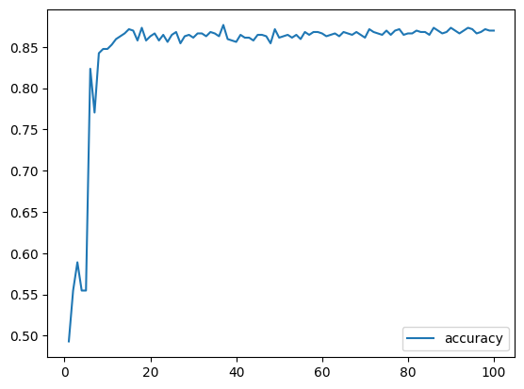
Neural Networks (Cont.)
Five hidden layers with decreasing nodes (128 to 16) and sigmoid activation functions.
Trained for 100 epochs with a 15% validation split.
Training accuracy improved, but validation accuracy stagnated at 49%.
Achieved approx. 89% accuracy on the test set, indicating strong performance on test data.
Notes:
"So with this model, it used five hidden layers, starting with 128 nodes and gradually decreasing to 16, all using sigmoid activation functions.
The model was trained for 100 epochs with 15% of the data reserved for validation.
It performed well on the test data, achieving an 89% accuracy, which indicates its potential effectiveness in predicting outcomes."
Now over to Kristina who will now speak on the other models we examined, Thank You.
(End of Frank’s Part.)

Slide 9
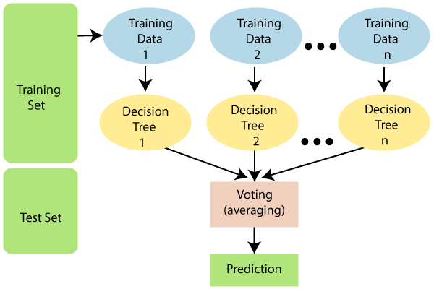
Random Forest Model
Notes:
The next model we used was Random Forest, a machine learning model involving trees using different subsets of the data and features, to make predictions it then combines their predictions to improve accuracy and reduce overfitting.

Slide 10
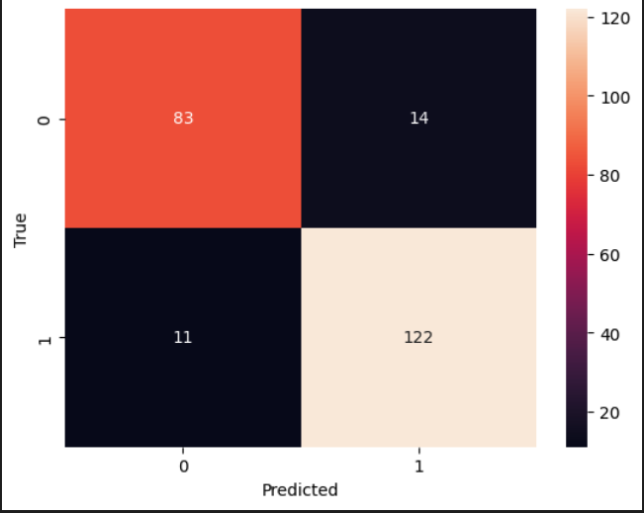
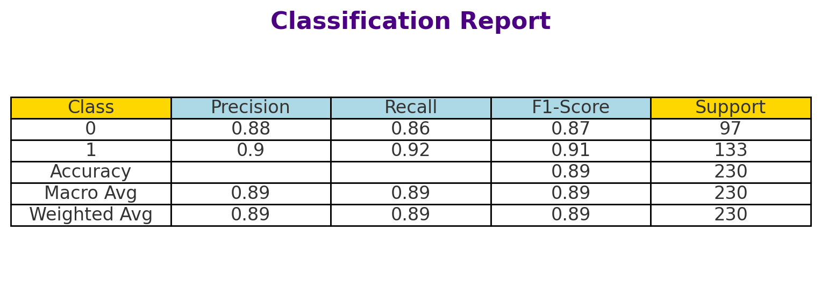
Random Forest Model
Notes:
To evaluate the performance of this model we did a confusion matric and classification table.
Overall this mode had an accuracy of 89%, indicating the model is reliable in predicting heart disease risk.

Slide 11
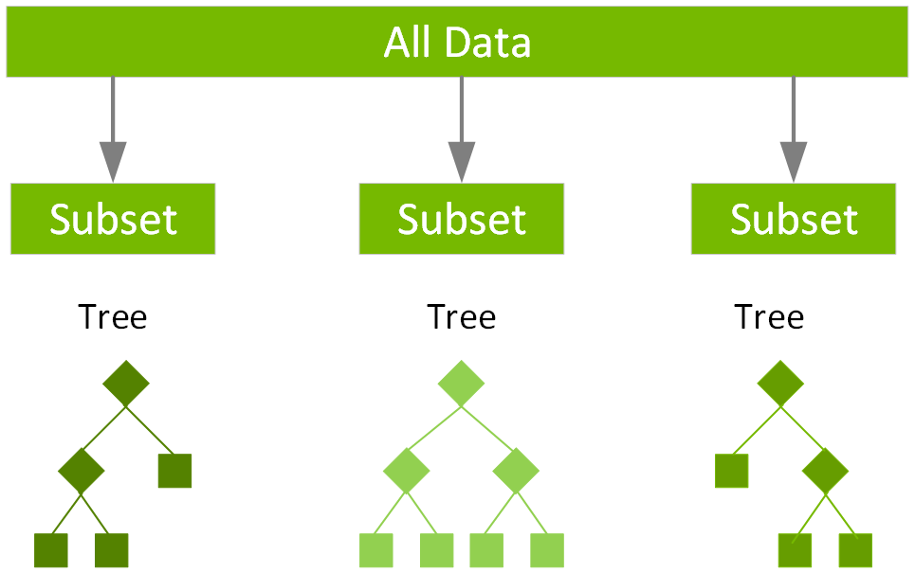
XGBoost model
Notes:
While Random Forest builds trees in parallel to reduce variance and improve stability, XGBoost builds them sequentially, correcting previous errors. XGBoost also uses regularization to prevent overfitting, making it more accurate in complex datasets

Slide 12
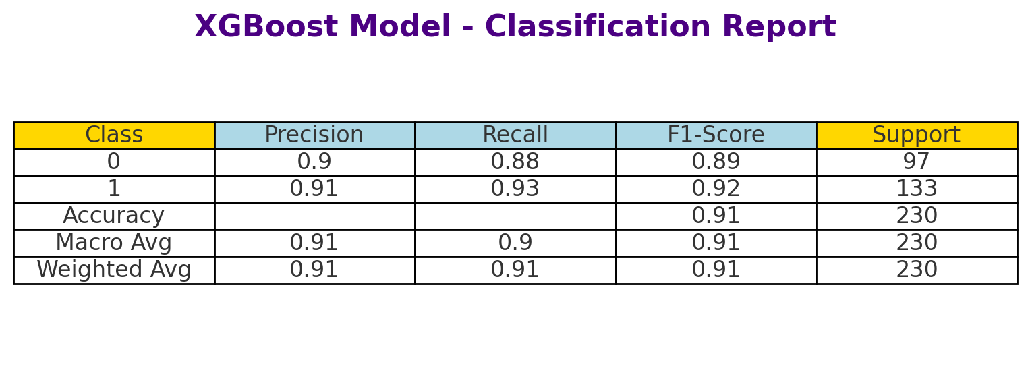
XGBoost model
Notes:
When evaluate the perform of our XG model using the confusion matric and classification report as before we found that the XG boost model was our most accurate model with an overall accuracy of 91%. We then wanted to see if we should strengthen this model

Slide 13
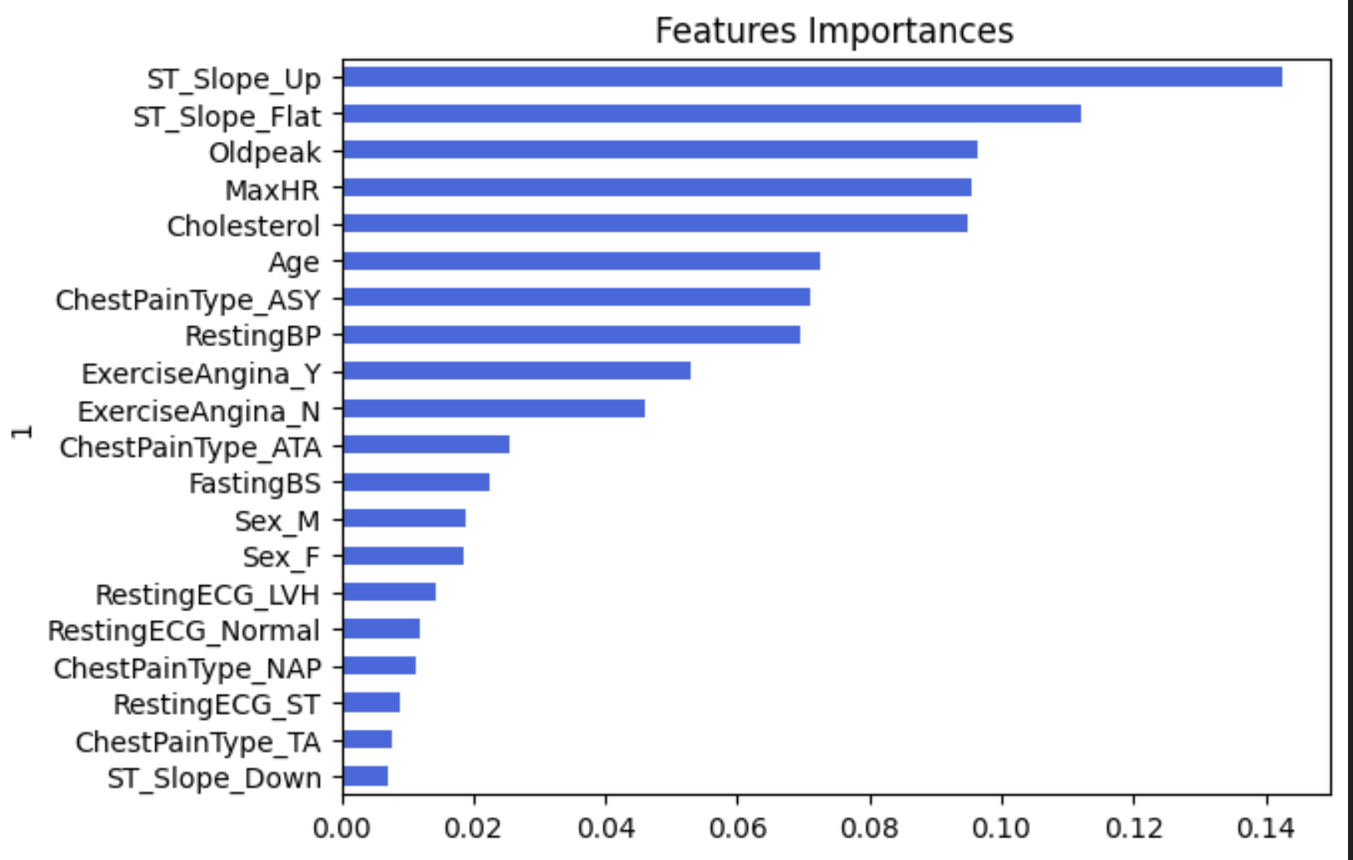
XGBoost model- Features Importance
Notes:
We then evaluated the feature importance in the XGBoost model, as shown here. We then wanted to see if we could streghten our model by dropping the three lowest ranking features.

Slide 14
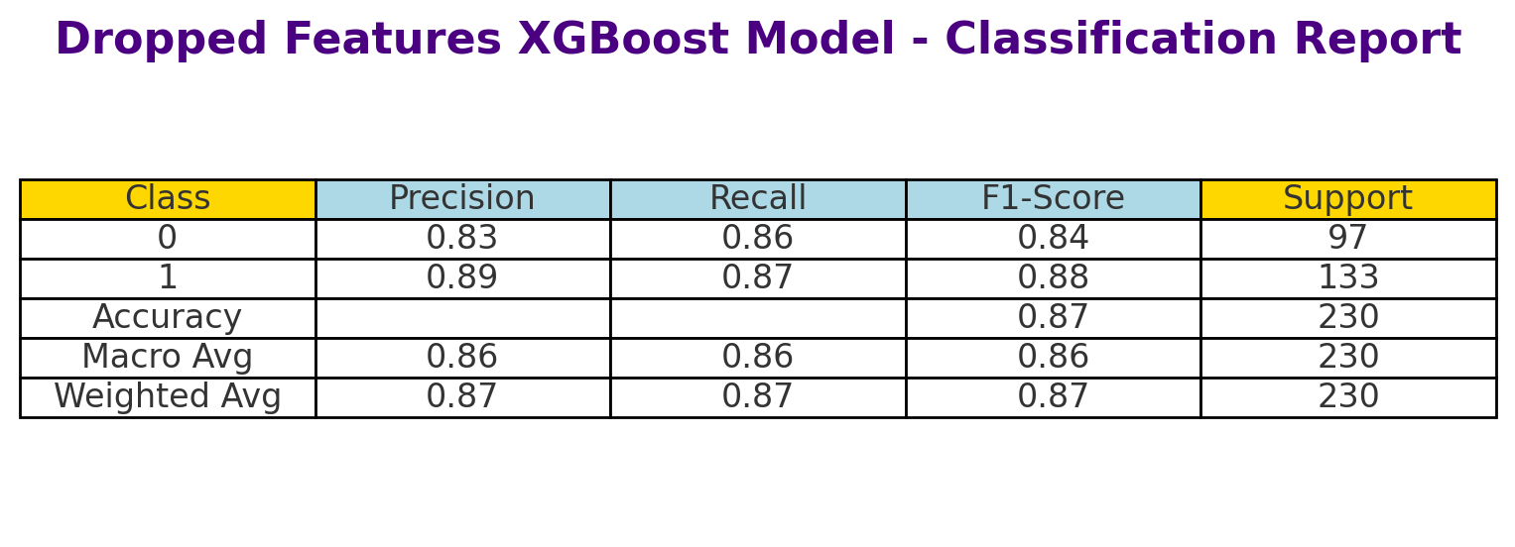
XGBoost Model- Dropped features
Notes:
After dropping these features, the model’s performance slightly decreased across key metrics (accuracy, precision, recall, and F1-score). This reduction suggests that although these features were ranked lower, they contributed meaningfully to the model’s ability to classify both healthy and at-risk hearts.

Slide 15
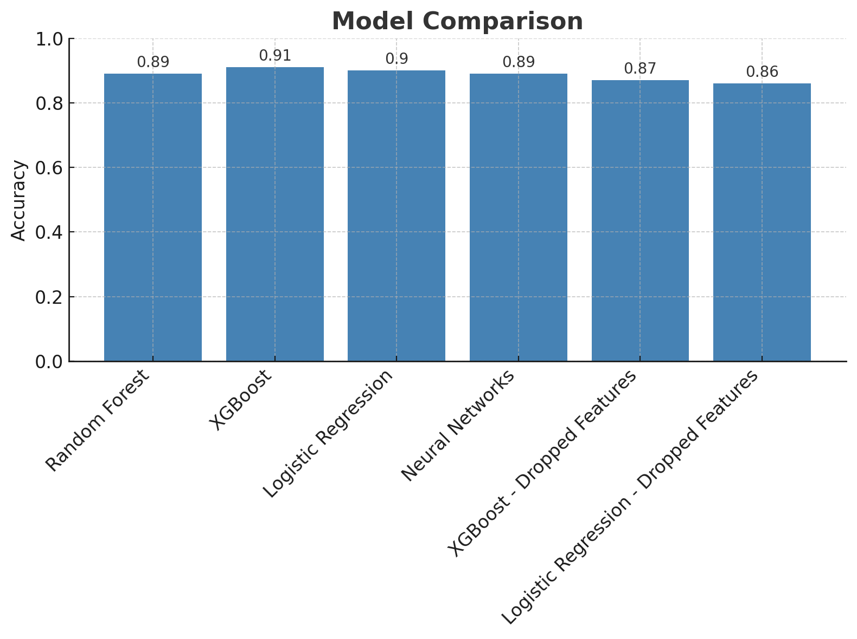
XGBoost our highest performing model
Notes:
. With our XG boost model using the full dataset having the highest accuracy compared to our other models.

Slide 16


Deployment
Google Colab
Local Computer
Train, Fit, Test and Validate Models
Download necessary libraries & Create Streamlit App
Save Trained Models onto Google Drive
Download models onto local drive
Run the Streamlit App
Access Streamlit App in Browser
Notes:
Google Colab was used to train, fit, test and validate the models. The trained models were then saved onto a google drive for access.
On the local computer, a Streamlit app was created using python. This required a number of libraries to be installed locally including streamlit, scikit-learn, keras, and tensorflow
The models were downloaded onto the local drive and stored in a subfolder relative to where the streamlit app was.
The Streamlit App is run at a terminal on the local computer and the Streamlit App is accessed in the browser.

Slide 17
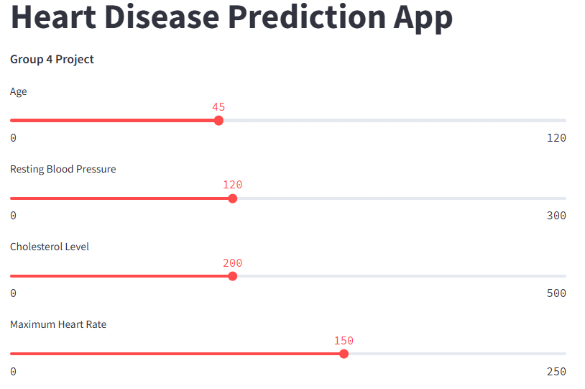
Live Demo
Notes:
I am now going to do a live demo of the Streamlit prediction app. I have already started the app using streamlit as it can take a long time to startup, this is because of the many libraries i had to install, like tensorflow.
** Move to the app and run and example**

Slide 18

Clinical relevance
Healthcare Applications of Predictive Models:
Models like Random Forest and XGBoost are valuable tools for early detection and risk assessment in heart disease.
These models assist in identifying high-risk patients earlier, allowing for timely interventions and personalized care plans.
Importance of Reducing Invasive Procedures:
Further screening methods, such as angiograms and stress tests, are invasive, costly, and carry risks.
By leveraging machine learning models like those discussed, we can reduce unnecessary invasive procedures by focusing on patients most likely to benefit from further evaluation.
Optimizing Healthcare Outcomes:
These predictive models enable more efficient resource allocation.
They contribute to better patient outcomes through data-driven insights and improved diagnostic accuracy.
Notes:
in healthcare, predictive models like Random Forest and XGBoost are valuable for early detection and risk assessment, especially for conditions like heart disease. These models help identify high-risk patients earlier, enabling timely interventions and tailored care plans, reducing the need for invasive and costly procedures. By focusing on those most likely to benefit from further evaluation, we can use resources more efficiently and improve patient outcomes. However, these models still have limitations, including a small degree of false positives and negatives, which can be detrimental, so caution is needed when applying them in practice

